Slide 1

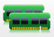




Virtual Machine #1
Virtual Machine #2
Virtual Machine #3
Hypervisor
Physical Server

Slide 2
Virtual Machine #1
Virtual Machine #2
Virtual Machine #3
Hypervisor

Slide 3
Virtual Machine #1
Virtual Machine #2
Virtual Machine #3
Hypervisor
Physical Server

Slide 4


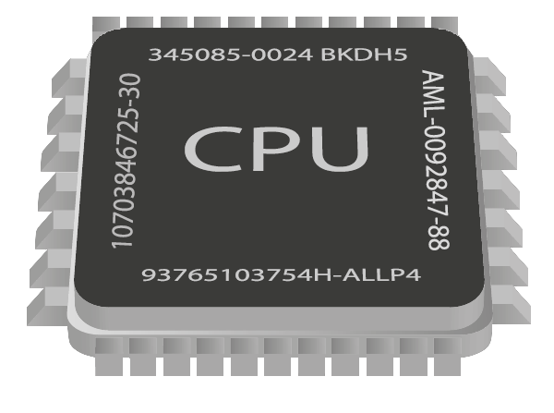

Slide 5
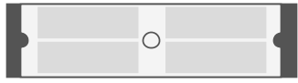

Application
Application
Unmodified guest kernel
Unmodified guest kernel
Virtual Hardware
Virtual Hardware
………
User-space Applications
QEMU
QEMU
KVM
Linux Kernel
Server with Virtualization capable CPU
(Intel VT-X or AMD – SVM)

Slide 6

Virtual Machine #1
Virtual Machine #2
Linux Process
Linux Process
Host Linux Kernel

Slide 7

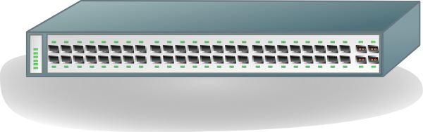
Emulated Devices
Virtual Machine #1
Virtual Machine #2
QEMU
QEMU
Tap
Tap
Host Linux Kernel
Bridge
Br0
Eth0
- - - - - - - - - - - - - - - - - - - - - - - -

Slide 8
Para-Virtualized Networking
Virtual Machine #1
Virtual Machine #2
QEMU
QEMU
Tap
Tap
Host Linux Kernel
Bridge
Br0
Eth0
- - - - - - - - - - - - - - - - - - - - - - - -

Slide 9
Para-Virtualized Internal Networking
Virtual Machine #1
Virtual Machine #2
QEMU
QEMU
Tap
Tap
Host Linux Kernel
Bridge
Br0
Eth0
- - - - - - - - - - - - - - - - - - - - - - - -

Slide 10
Device Direct Assignment
Virtual Machine #1
Virtual Machine #2
QEMU
QEMU
Host Linux Kernel
Eth0
Eth1
- - - - - - - - - - - - - - - - - - - - - - - -

Slide 11
Device Direct Assignment with SR-IOV
Virtual Machine #1
Virtual Machine #2
QEMU
QEMU
Host Linux Kernel
Eth0
Intel VT-X, VT-D
- - - - - - - - - - - - - - - - - - - - - - - -

Slide 12
Container #1
Container #2
Application
Application
User-space Applications
………
Namespace
Namespace
LXC
(or) LibVirt
CGroups
Linux Kernel
Commodity Server Hardware capable
of running GNU/Linux

