Slide 1
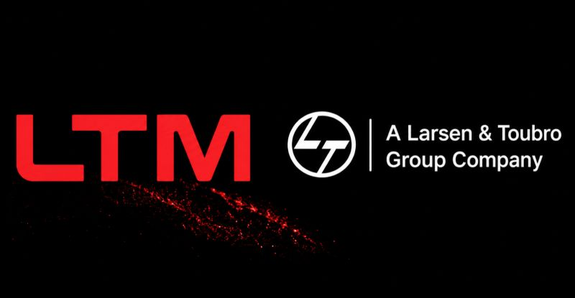

M.Tech Program
Advanced Industry Integrated Programs
Jointly offered by University and LTIMindTree
Project Title
Troubleshooting Assistance Through Expert knowledge Retrieval Techniques Using Bounded Agentic AI
Aravindkumaran R
SE-T9977
REC – 2025 - 2027
Knowledge partner | Implementation partner

Slide 2
Troubleshooting Assistance Through Expert knowledge Retrieval Techniques Using Bounded Agentic AI
i
Introduction
The project develops an AI-based industrial troubleshooting assistance system to support technicians and machine operators in identifying and resolving equipment issues and their Queries.
It retrieves relevant technical knowledge from stored industrial documents and provides evidence-supported troubleshooting guidance
A Bounded Agentic AI framework manages the troubleshooting workflow by understanding the problem, identifying missing information, selecting the appropriate tool, and verifying the retrieved evidence before responding.
The system is designed to make troubleshooting faster, safer, more reliable, and easier to use, while preventing unsupported diagnosis and uncontrolled machine actions.

Slide 3
Troubleshooting Assistance Through Expert knowledge Retrieval Techniques Using Bounded Agentic AI
Objective
Preprocess industrial manuals into structured troubleshooting knowledge
Retrieve relevant technical evidence using vector embeddings
Generate grounded responses through a RAG pipeline
Control troubleshooting workflows using Bounded Agentic AI
Verify responses with evidence and safety controls

Slide 4
Troubleshooting Assistance Through Expert knowledge Retrieval Techniques Using Bounded Agentic AI
Scope….
Industrial Query Assistance – Supports technicians, machine operators, junior engineers, and apprentices in analysing equipment faults, alarms, and operating issues.
Knowledge-Based Troubleshooting – Retrieves relevant troubleshooting information from structured industrial documents to support accurate decision-making.
Guided Technical Support – Provides step-by-step clarification, required checks, and evidence-supported guidance for less-experienced industrial personnel.
Safe AI Assistance – Delivers bounded troubleshooting recommendations while excluding unsupported diagnosis, repair execution, and direct machine control.

Slide 5
Troubleshooting Assistance Through Expert knowledge Retrieval Techniques Using Bounded Agentic AI
Literature Review
Reference | Technical Contribution | Limitation
Guided Operations and Maintenance with RAG – Machine Manufacturer (2026) | Uses manufacturer documentation with RAG to support fault diagnosis, repair, and maintenance guidance. | Focuses mainly on RAG-based assistance; stronger bounded agent control and explicit safety verification are not the central focus.
Ontology-Based RAG Maintenance Assistant (2025) | Combines semantic retrieval, ontology knowledge, and LLMs for maintenance-oriented question answering. | Requires ontology construction and does not primarily address bounded troubleshooting tool execution.
LLM-TSFD: Human-in-the-Loop Fault Diagnosis (2025) | Uses LLM-based reasoning with human interaction for industrial fault diagnosis and decision support. | Focuses mainly on time-series fault diagnosis rather than document-based evidence retrieval.
Agentic AI for Maintenance Management (2026) | Explores multi-step reasoning, tool orchestration, governance, and controlled AI adoption in maintenance workflows. | Highlights the need for safer autonomy, validation, and governance in real industrial deployment.

Slide 6
Troubleshooting Assistance Through Expert knowledge Retrieval Techniques Using Bounded Agentic AI
Summary of Literature
Recent studies show that RAG and semantic retrieval can effectively use technical documents to support industrial maintenance and troubleshooting activities.
LLMs and Human-in-the-Loop approaches improve fault interpretation and decision support, especially when user clarification is required.
Agentic AI enables multi-step reasoning and tool orchestration, but industrial applications require controlled autonomy and validation.
A common limitation is the lack of evidence verification, bounded reasoning, and safe tool execution in existing maintenance-assistance systems.
our project focuses on evidence-grounded retrieval combined with Bounded Agentic AI and safety controls for reliable industrial troubleshooting assistance.

Slide 7
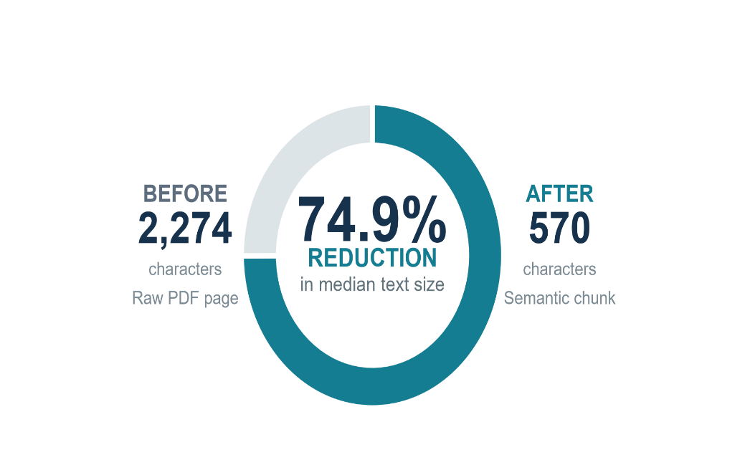
Troubleshooting Assistance Through Expert knowledge Retrieval Techniques Using Bounded Agentic AI
Additional Information
74.9% Reduction in Median Retrieval-Unit Size Raw technical content was transformed into compact semantic chunks while maintaining 100% chunk-to-vector alignment.
Industrial Knowledge Corpus: Technical manuals were transformed into a structured knowledge base containing 2,888 semantic chunks and 54 structured troubleshooting records for evidence-based retrieval.
Semantic Embedding & Retrieval: The pretrained BAAI/bge-small-en-v1.5 Sentence Transformer converts processed text into 384-dimensional dense embeddings, enabling meaning-based vector similarity search for the RAG pipeline.
Bounded Agentic Intelligence: A custom Bounded Agentic AI framework controls clarification, tool selection, evidence retrieval, and verification while preventing unsupported diagnosis and automatic machine actions.

Slide 8
Troubleshooting Assistance Through Expert knowledge Retrieval Techniques Using Bounded Agentic AI
Modules to cover
Module 1 – Knowledge Acquisition & Preprocessing
Module 2 – Semantic Embedding & Vector Retrieval
Module 3 – RAG-Based Troubleshooting Engine
Module 4 – Bounded Agentic AI Orchestration
Module 5 – Verification & Safety Control
Module 6 – System Integration & Technician Interface
Module 7 – Evaluation & Reliability Analysis
Module 8 - Logging, Audit & Traceability :

Slide 9
Troubleshooting Assistance Through Expert knowledge Retrieval Techniques Using Bounded Agentic AI
Module name
Knowledge Acquisition & Preprocessing : Industrial Document Collection, PDF Text Extraction, Data Cleaning and Structuring, Section Parsing, Semantic Chunking, Metadata Preservation
RAG-Based Troubleshooting Engine : Query Processing, Context Retrieval, Evidence Selection, Context Construction, Grounded Response Generation
Bounded Agentic AI Orchestration : Intent Understanding, Missing-Information Detection, Clarification Handling, Tool Selection, Controlled Reasoning, Workflow Orchestration
Verification & Safety Control : Evidence Verification, Grounding Validation, Known-Information Checking, Duplicate Tool-Call Prevention, Unsupported Diagnosis Prevention, Automatic Action Restriction
System Integration & Technician Interface : Fast API Integration, Agent-Tool Integration, RAG-Agent Integration, Backend-Frontend Communication, Technician Interface, End-to-End Integration
Evaluation & Reliability Analysis : Retrieval Evaluation, Agent Behaviour Testing, Safety Validation, Response Reliability, Latency Analysis, Industrial Troubleshooting Reliability Score (ITRS)

