Slide 1
Dashboard Design - Sales Call Analysis
Objective: Design an interactive dashboard for business stakeholders
Dataset: Product_Sales.csv
Deliverables: Interactive Dashboard + PPT summary

Slide 2
Key KPIs
Total Calls: 9939
Total Products Sold: 2089
Conversion Rate: 21.02%
Average Call Duration: 125.16 units
Pickup Rate: 69.62%

Slide 3
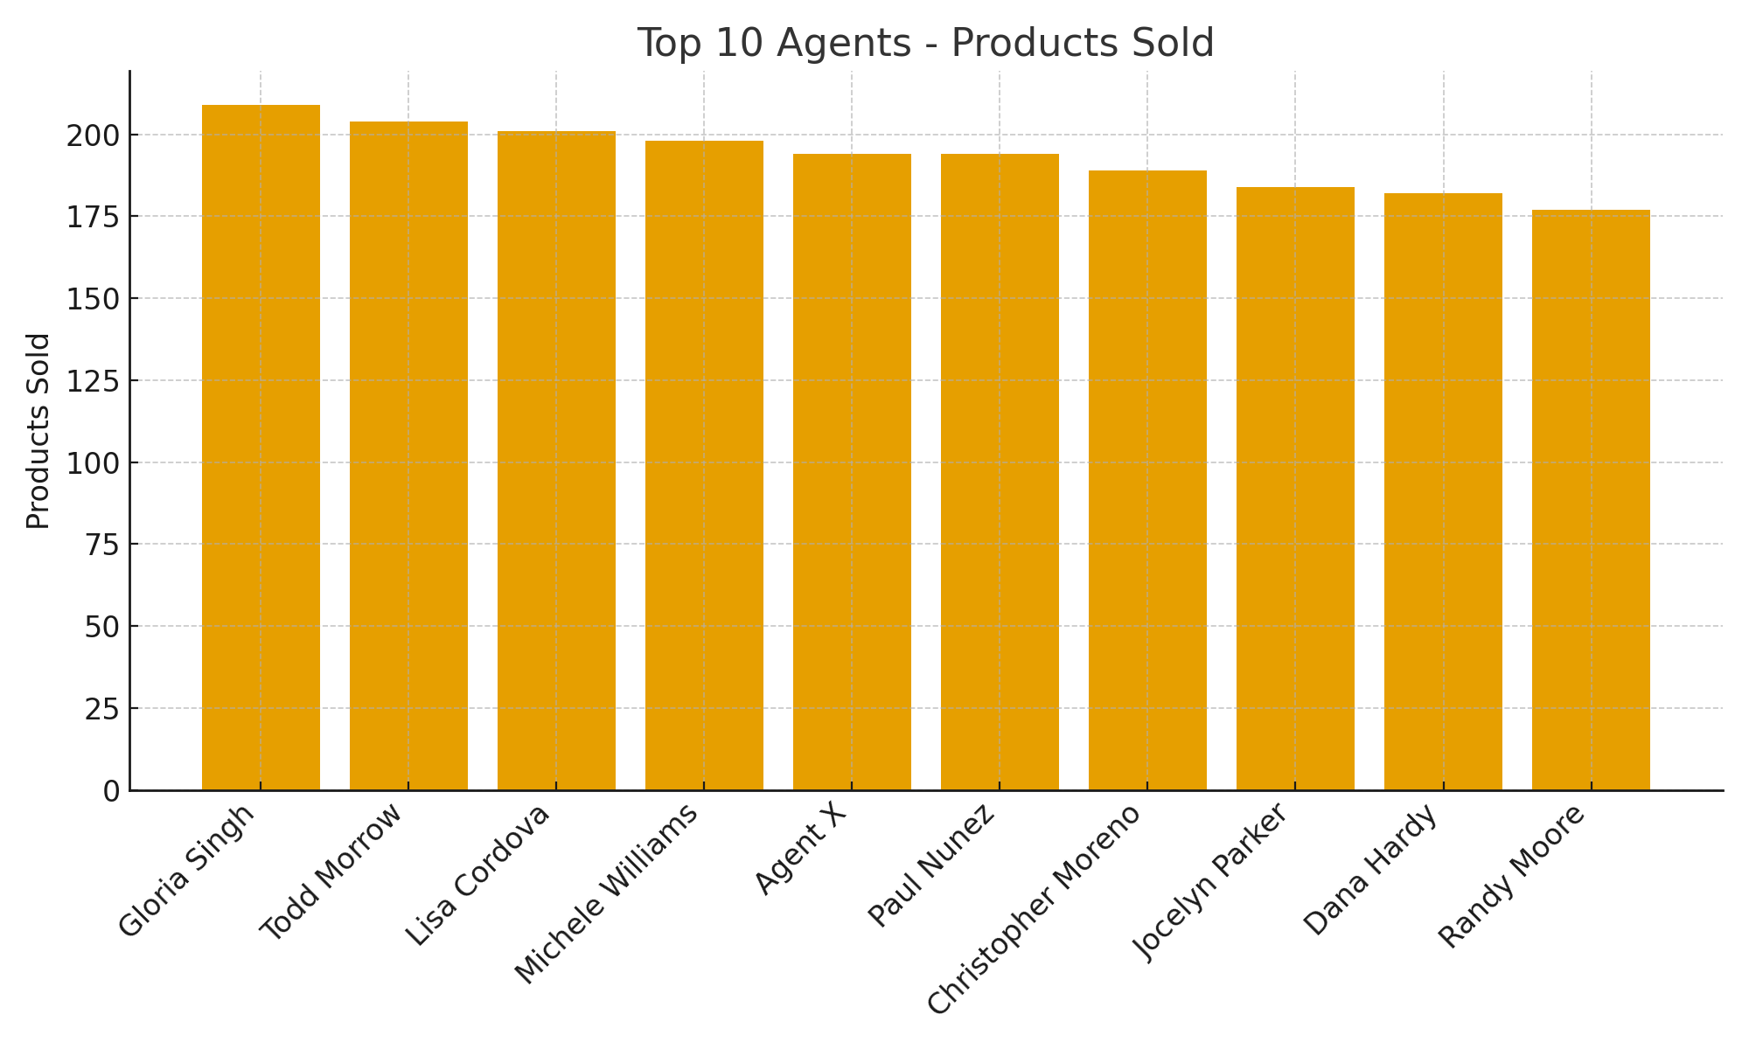
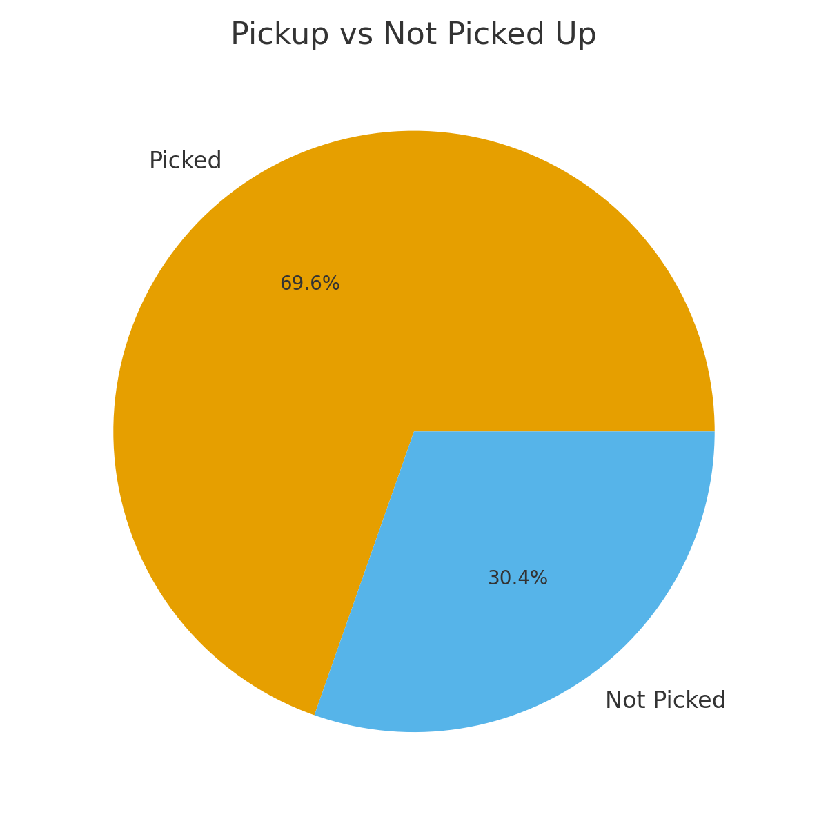
Top Agents & Pickup Rate

Slide 4
Recommendations
- Train low-performing agents to improve conversion.
- Investigate calls with high duration but low conversion.
- Focus outreach on customers with higher pickup rates.
- Create monthly targets per agent and monitor trends.

