Slide 1

EE5003: Electrical Engineering Project, Presentation-2 on 27 June.2018
Multi-agent Assisted Indoor Environmental Quality (IEQ) for Smart Buildings
Guided by
Assoc. Prof. S.K. Panda
Electrical and Computer Engineering Department
Presented by
Aravind Madan Mohan
e0154145@u.nus.edu

Slide 2
Contents
Previous Update
Energy Simulation Tools
IESEV
ResCheck
Open Studio
Thermal Model and its electrical equivalent

Slide 3
1. Previous Update:
Literature survey of IEQ and its components viz., IAQ, Comfort Quality, Accoustic Quality and Lighting Quality.
Major Standards Used
IEQ Goals and guidelines
Multi-agent System
List of Measurands and their standard reference values.

Slide 4
2.Energy Simulation tools
Important for reducing the cost of energy in buildings
Thermal simulation software tools for buildings allow to:
• Determine the appropriate size of HVAC systems
• Analyze the energy consumption
• Calculate the cost of the energy used

Slide 5
2.Energy Simulation tools (cont...)
Simulation software tools can be used calculate to the following variables:
• Indoor temperatures
• Needs for heating and cooling
• Consumption needs of HVAC systems
• Natural lighting needs of the occupants
• Interior comfort of the inhabitants
• Levels of ventilation

Slide 6
2.Energy Simulation tools (cont...)
Steps invloved in Energy Simulation:
Building a geometrical model of the building.
Simulation of factors involved in environment of the building.
Analysis of Results.

Slide 7
3.IESVE
Integrated environment solutions Virtual Environment.
Features:
Individual addition of buildings, HVAC systems, Floor, Office Equipment, Predefined model rooms.
Several precise models available in the library.
Weather data available from the website iesve.com for 2 locations in Singapore Changi Airport and Paya Lebar based on the ASHRAE standard. New weather data can be imported to the model built.
Graphical Representation

Slide 8
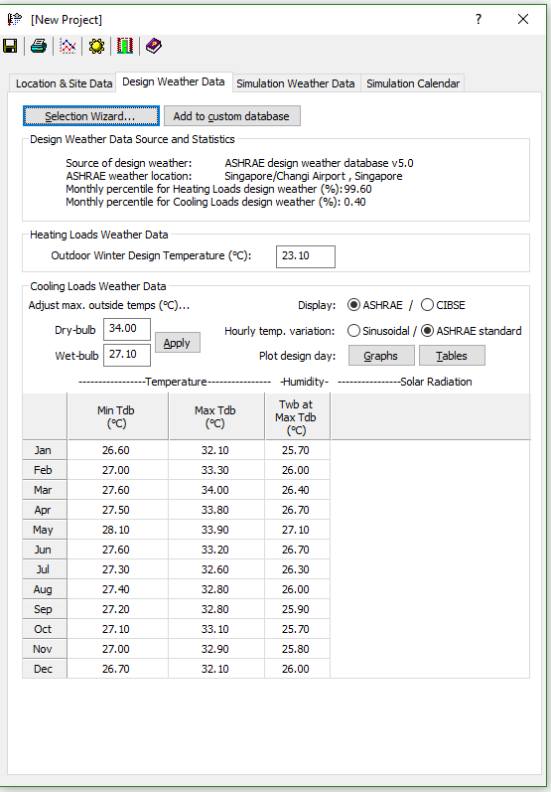
Weather Data for IESEV
Figure 1: IESEV weather data input
Notes:
CO2 concentration is an indicator of the effectiveness of the ventilation rate of the building, and is associated with sick building syndrome (SBS) symptoms such as eye irritation, headache, throat irritation, mental fatigue, nausea and dizziness .
SO2 irritates the nose, throat, and airways to cause coughing, wheezing, shortness of breath, or a tight feeling around the chest. The effects of sulfur dioxide are felt very quickly and most people would feel the worst symptoms in 10 or 15 minutes after breathing it in.

Slide 9
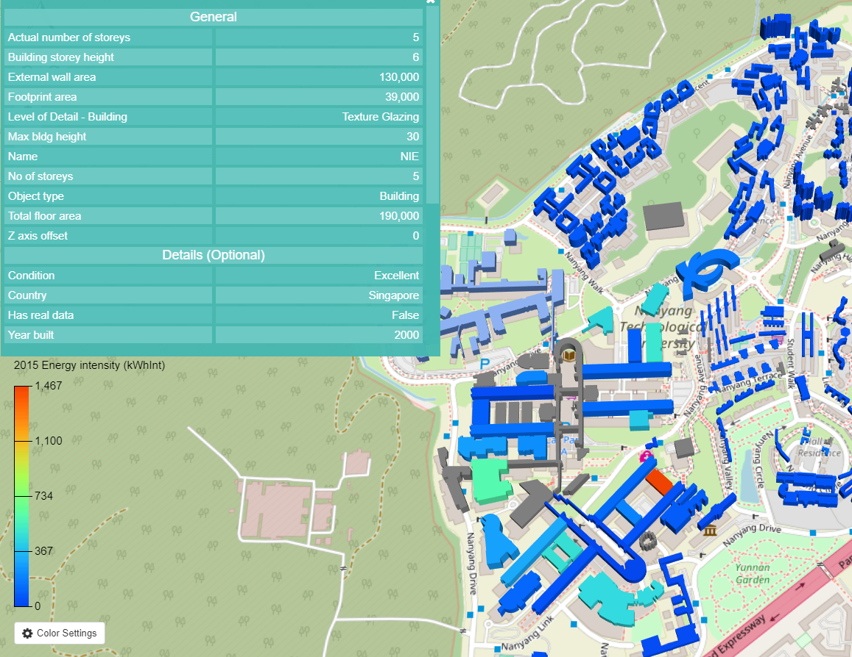
3.IESVE
Figure 2: Sample Presentation of Various details using IESEV

Slide 10
4.ResCheck
Residential Energy Compliance Check (U.S. Dept. Of Energy)
Features:
Individual addition of building components and mechanical systems based on a tabular format.
Gives the requirement of insulation, lighting, mechanical components and water heating and systems involved like HVAC system.
Standard of evaluation of data is based on Department of Energy, USA.
More of Text oriented.
Just gives the requirements for the specified components based on the standard.

Slide 11
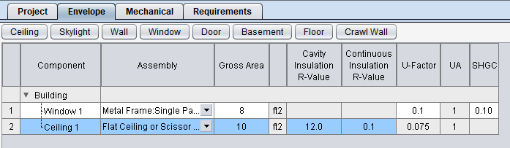
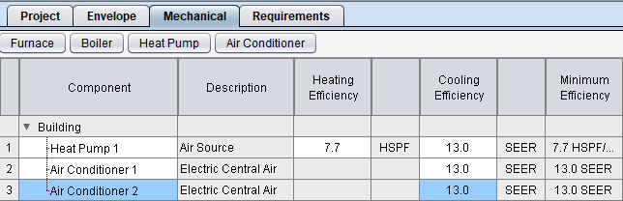
4.ResCheck (cont...)
Figure 3: ResCheck room components input
Figure 4: ResCheck Mechanical components input

Slide 12
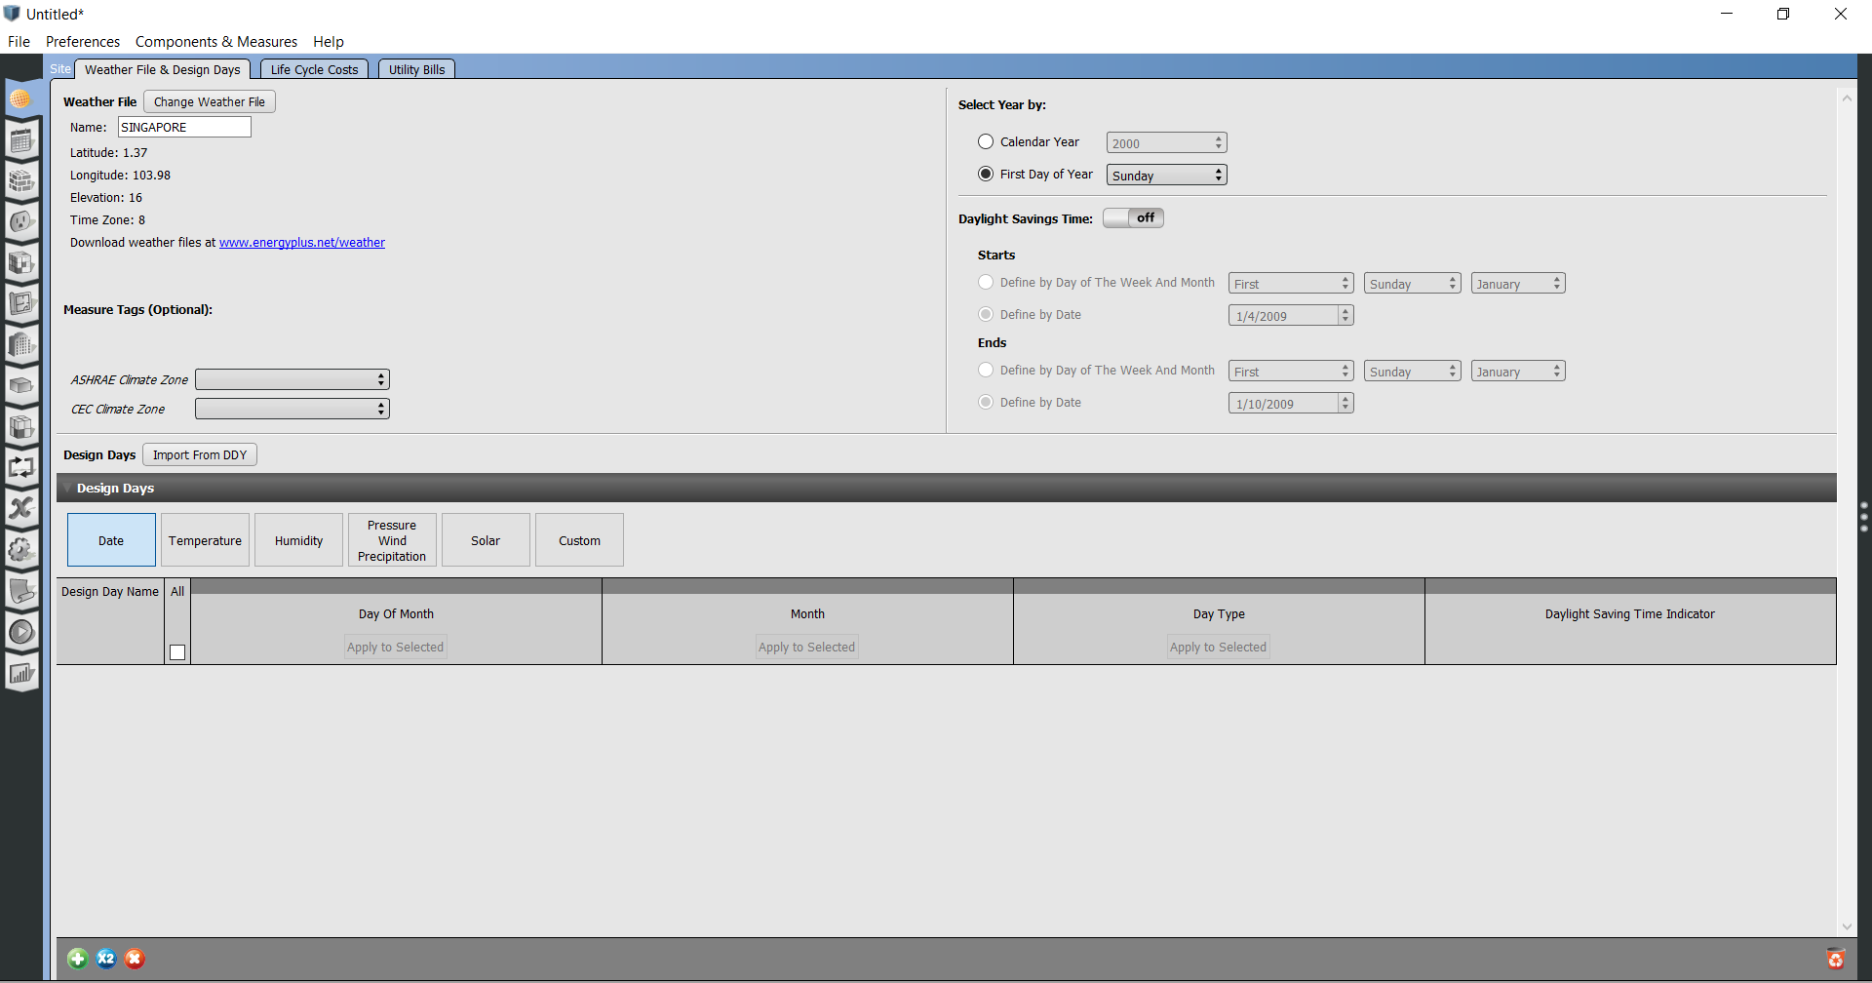
5. OpenStudio
Figure 5: Open Studio with readily available Singapore weather data files

Slide 13
Software Components:
Components that can be used:
The geometrical drawing of the buildings can be taken, as it is more user-friendly. The tabular format of data can be used to build several models.
New standards of parameters should be editable so that current standards can be implemented.
The overlay should contain real time data of the index and the standard reference limit that is utilised.
Addon may include individuals option to change a few parameters like temperature and humidity.
The simulation tools did not include individual component energy consumption, if energy calculation is feasible for individual components it can be added and also control of those individual components.
The geometrical drawing can be presented on Maps api instead of building geometrical models.
Drawbacks of Energy Simulation tools:
The energy simulation tools does not include real time sensing of data which might be drawback for monitoring. They take in data that is already recorded.

Slide 14
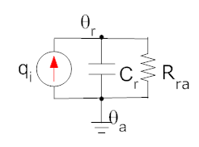
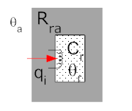
6.Thermal Model and its Electrical equivalent
Heating a building with one room:
Resistance to thermal conductance between the room and the ambient R_{ra} . Thermal Capcaitance of the room C_{r}. Heat supplied to the room from external sources q_{i}. External temperature a constant Ѳ_{a}
Figure 6: Thermal Model of a room
Figure 7: Electrical Equivalent of a room
Heat in = Heat Out + Heat Stored
$q_{i}=\frac{θ_{r}−θ_{a}}{R_{a}}+C\frac{dθ_{r}}{dt}$

Slide 15
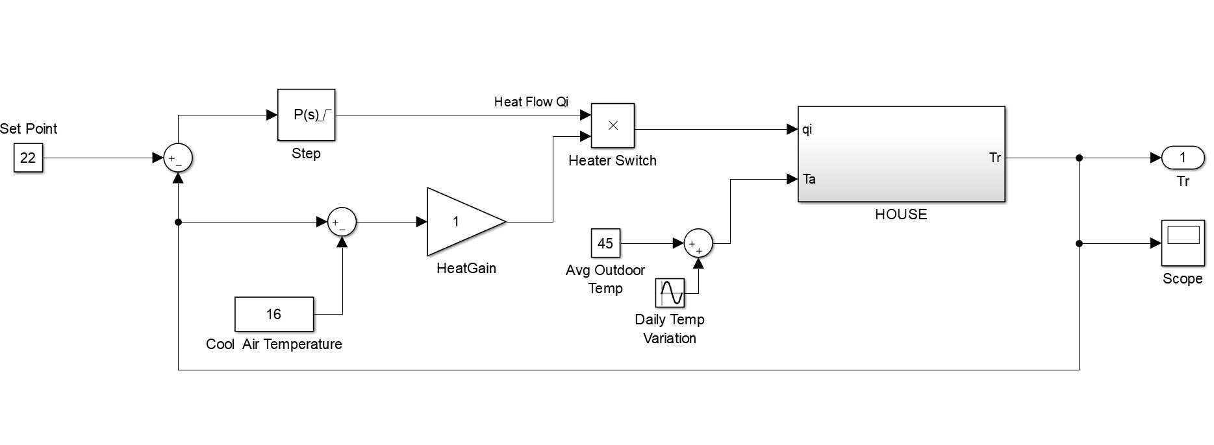
6.Thermal Model and its Electrical equivalent
Heating a building with one room:
Figure 8: Simulink Model of a room

Slide 16
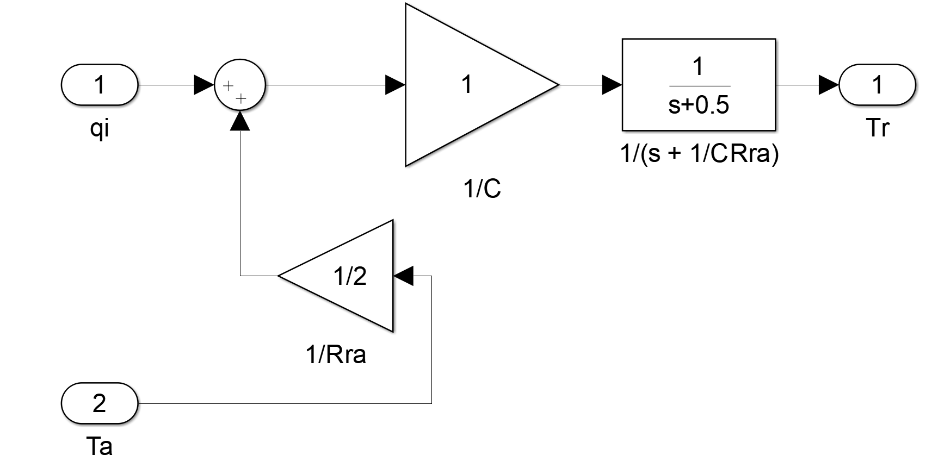
6.Thermal Model and its Electrical equivalent
Heating a building with one room:
Heat in = Heat Out + Heat Stored
$q_{i}=\frac{θ_{r}−θ_{a}}{R_{a}}+C\frac{dθ_{r}}{dt}$

Slide 17
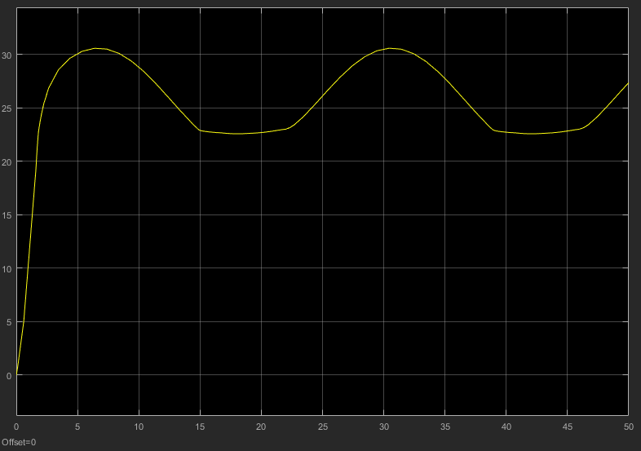
6.Thermal Model and its Electrical equivalent
Heating a building with one room:
Simulated for a On-Off control of Air-COnditioner
Figure 9: Variation of Temperature in the Room

Slide 18
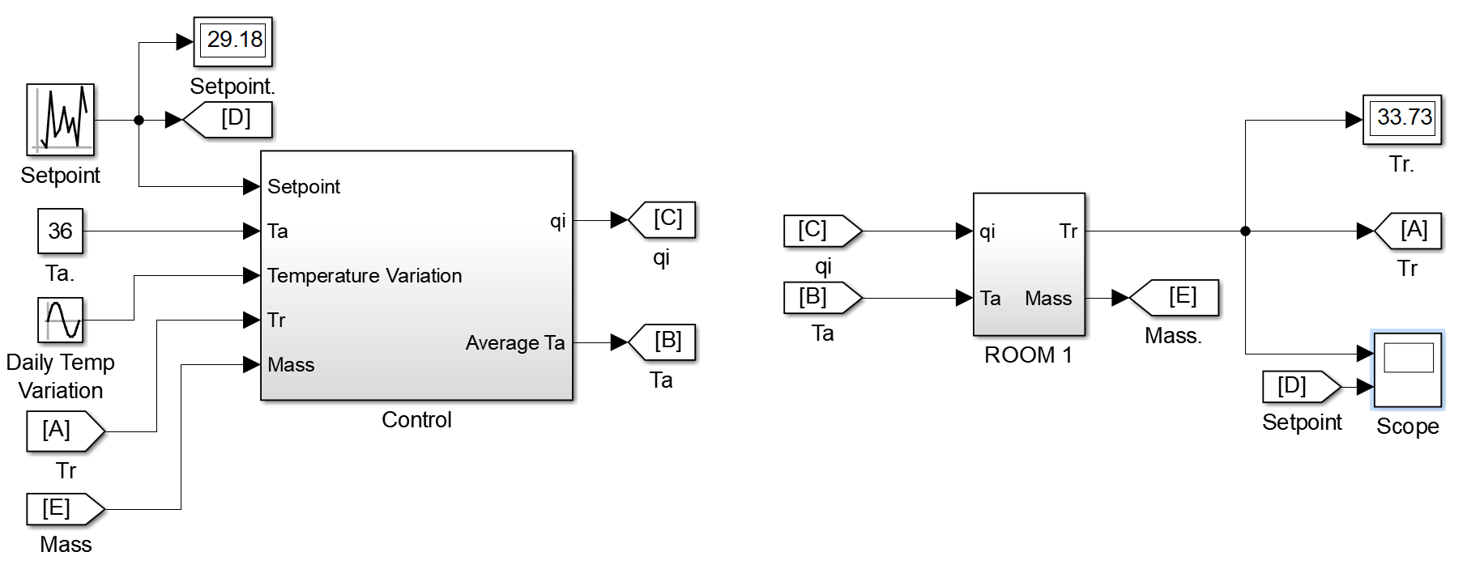
6.Thermal Model and its Electrical equivalent
Heating a building with one room:
Figure 10: Simulink Model of one room HVAC

Slide 19
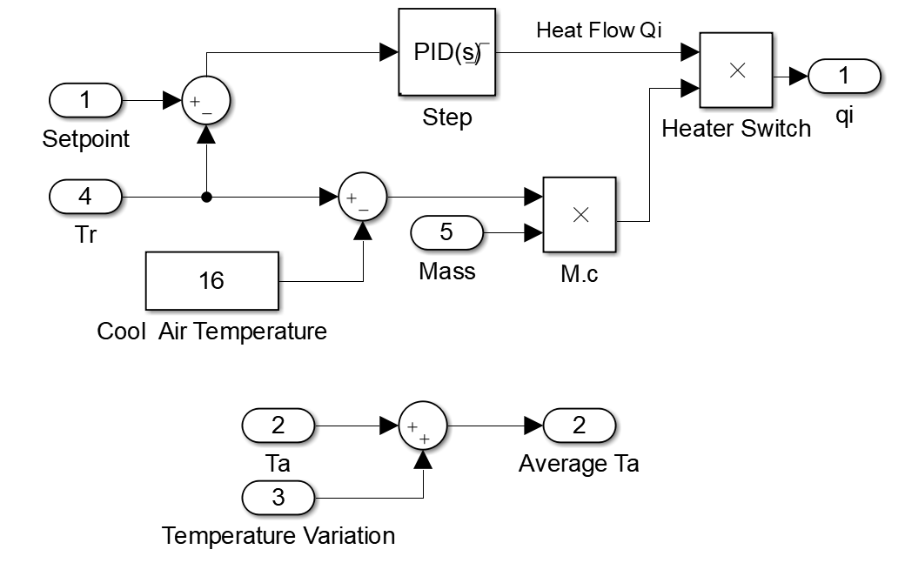
6.Thermal Model and its Electrical equivalent
Heating a building with one room: Control Block
Figure 11: Simulink Model of one room HVAC

Slide 20
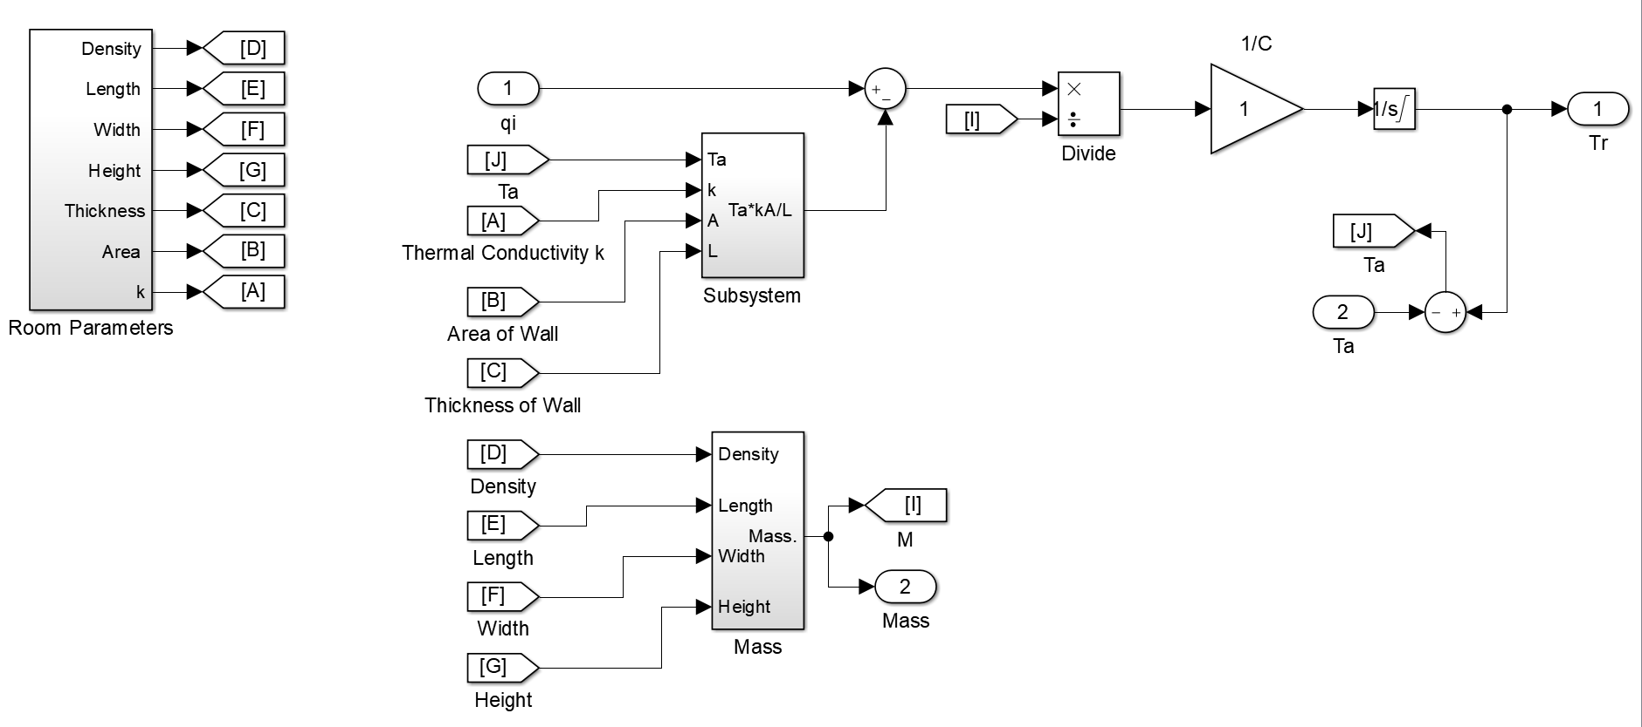
6.Thermal Model and its Electrical equivalent
Heating a building with one room: Room Model Block
Figure 12: Simulink Model of one room HVAC

Slide 21
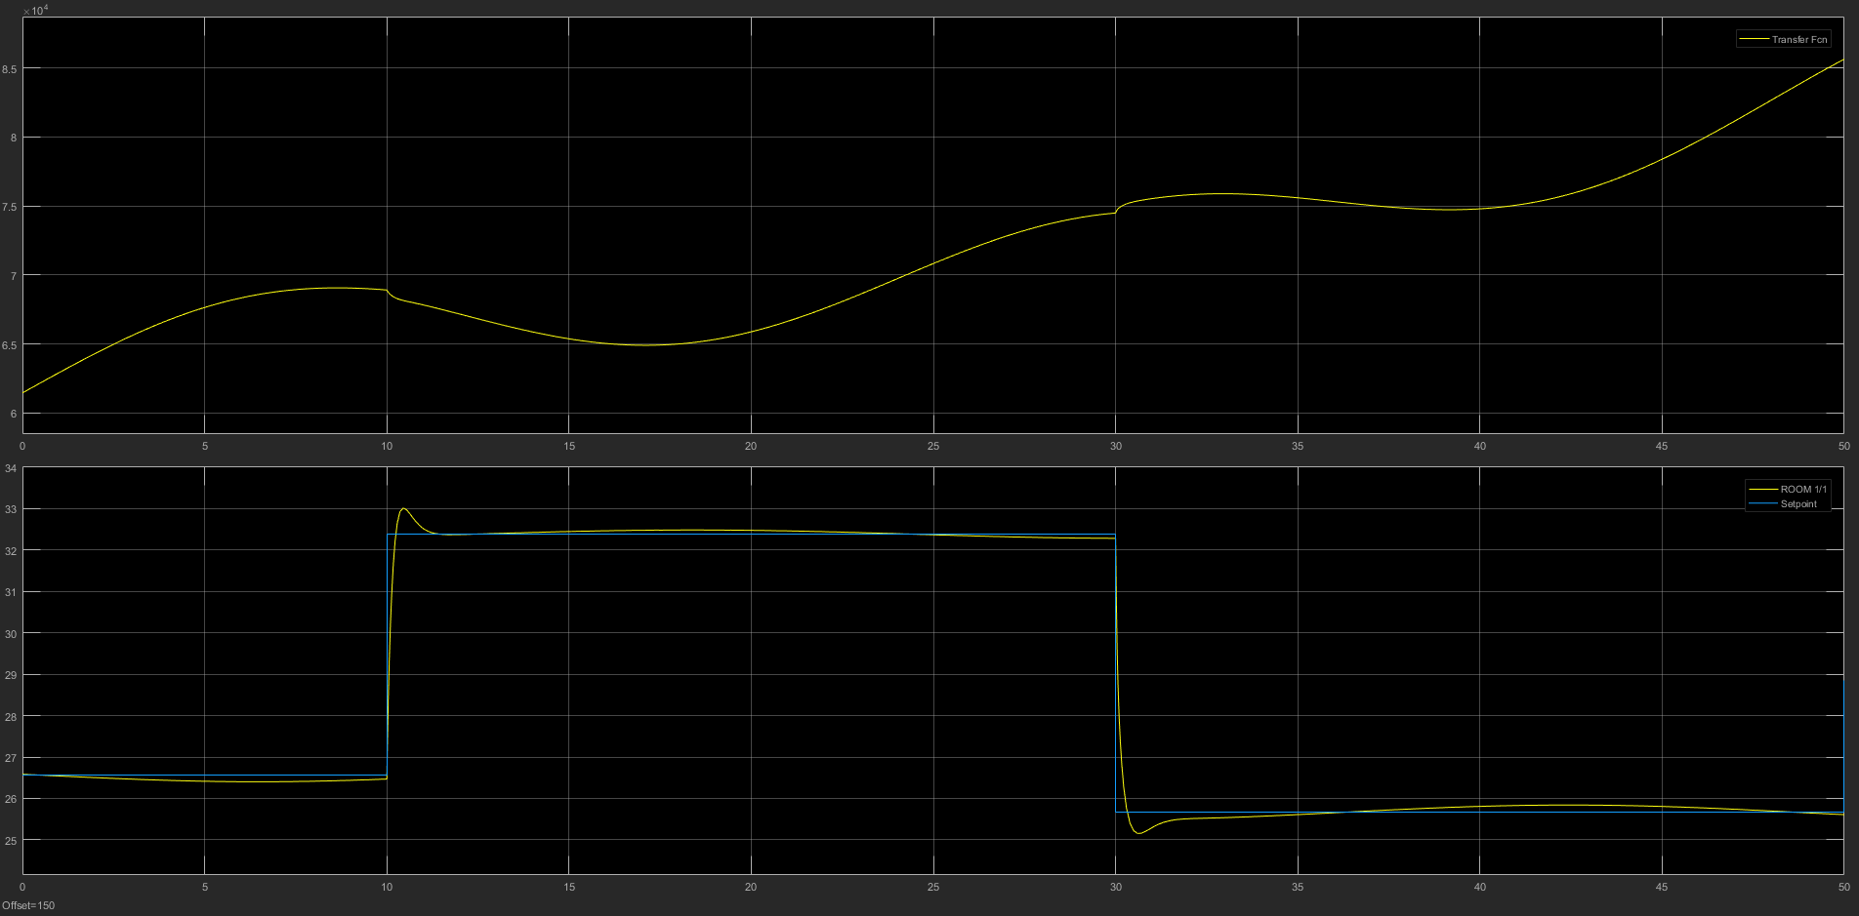
6.Thermal Model and its Electrical equivalent
Heating a building with one room:
Simulated for a PID control for HVAC system of a room.
Graph 1:Cost of Heat removed and
Graph 2:Setpoint vs Temperature of Room

Slide 22
6.Thermal Model and its Electrical equivalent
Heating a building with one room:
Simulated for a PID control for HVAC system of a room:
Initial Condition and paramters:
Length of Room = 20m, Width = 20m, Height = 2m
Thickness of Wall = 0.1m, Area of Exposed Wall = 60m²
Thermal Conductivity of Brick Wall (k)= 0.1 W/mº C
Initial Temperature = 30º C
Random setpoint with a sample time of 10 sec.

Slide 23
7.Present work
Work on CO₂ sensor its calibration and data collection.
Buildup of GUI in MATLAB to create a model of the room.
Work Remaining:
Work on sensors for remaining measurands and their data collection.
Building a Mathematical model and monitoring of data for the different measurands.
Work on a presentable format for the data for the user.

Slide 24
THANK-YOU

