Slide 1
IWONTMISS
ARAVIND VENKATESAN M (921315621310)
Guided by
Mathankumar

Slide 2
Problem Statement
This IWONTMISS is an online shopping website.
In real time there is no communication between farmer and buyer.
The purpose of this site is to provide easy way of shopping facility to get healthy food products on online for consumers.
For vendors it provides an easy way to sell the Food products using online.

Slide 3
Existing System
In existing system sellers and buyers are used to go the market to sell and buy food products.
in existing system there is middle person between the farmer and buyer. the farmer produce the food products and handover it to the middle person, the middle person who bring food products to the market, consumer able to get food product only from the market
there is no opportunity to get different kinds of food products from a single place.

Slide 4
Proposed System
To solving the issues of the existing system I proposed a system that will allow the buyer and seller to buy and sell food product online.
in that system there is no intermediate process between farmer and buyer. Buyer can get a healthy and good product from the farmer it self.
We also get different types of product from one place.
It also reduce the cost for buyers and encourage the farmers.

Slide 5
Requirements
Hardware Requirements
Processor Intel i3
Ram 2GB
Memory Space 50GB

Slide 6
Requirements
Software Requirements
Operating System Windows and Android
Language AMP,PWA
Editor Notepad++
Server XAMPP, Web Server for Chrome
Browsers Google Chrome

Slide 7
Modules
Buyer Module
Seller Module
Admin Module

Slide 8
Module Description
Buyer Module:
Buyer Module is the place where users can Search and order their needed food items. and the buyers also able to pay the amount when they place the order.
Seller Module:
Seller Module allows the sellers to create their own login. Also update the quantity of food items and track the order. Seller is also notification about their orders from the page itself.

Slide 9
Module Description
Admin Module:
Admin Module is the process of verify the sellers, buyers and also track the orders.

Slide 10
UML Diagrams

Slide 11
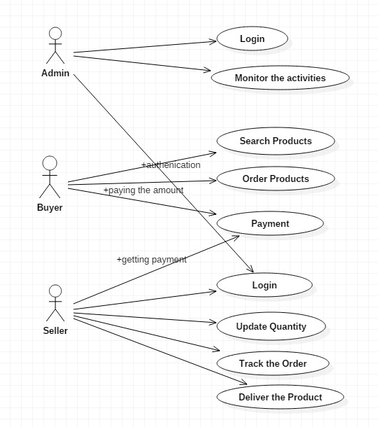
Use case Diagram

Slide 12
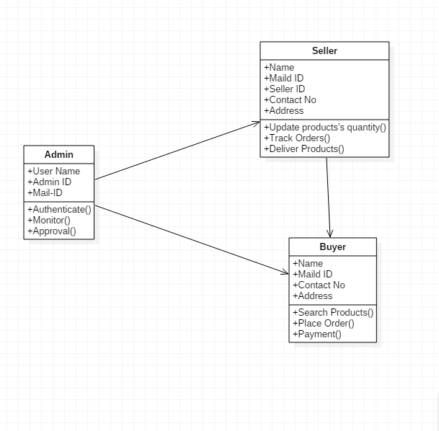
Class Diagram

Slide 13
Sample Screen Shots

Slide 14
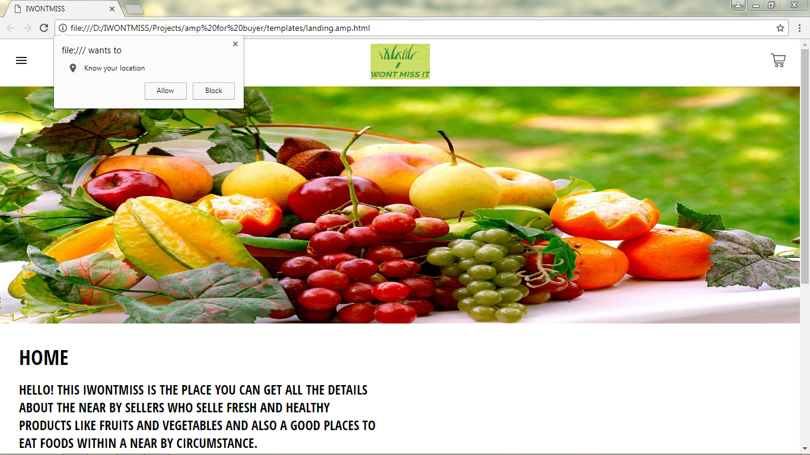

Slide 15
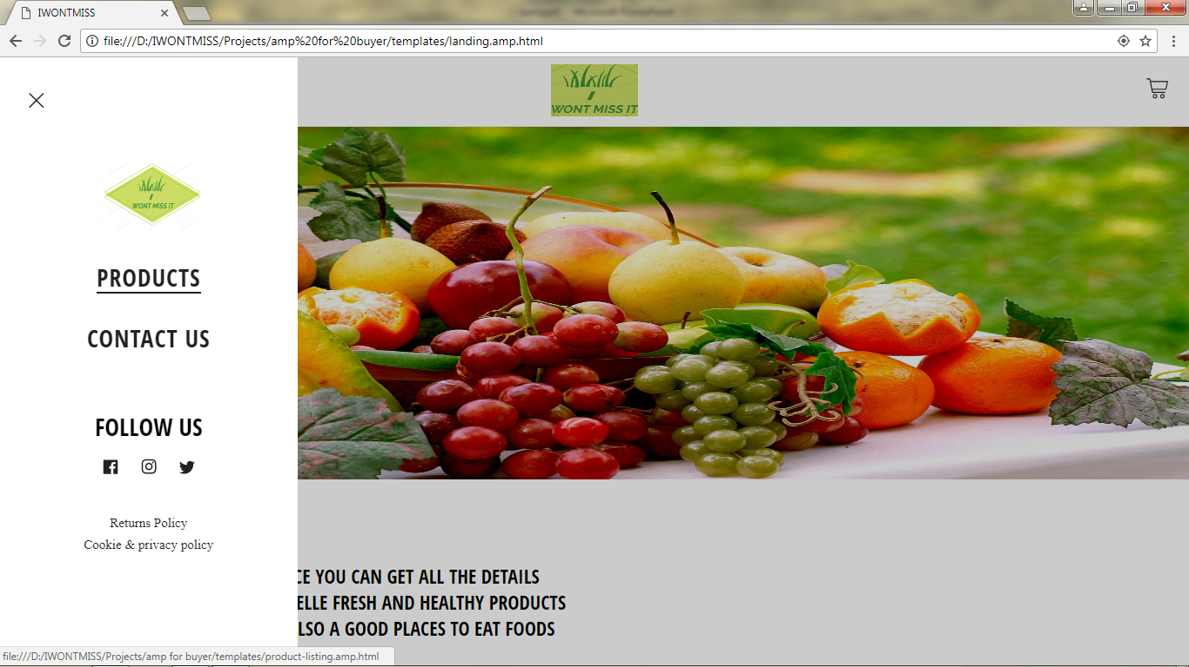

Slide 16
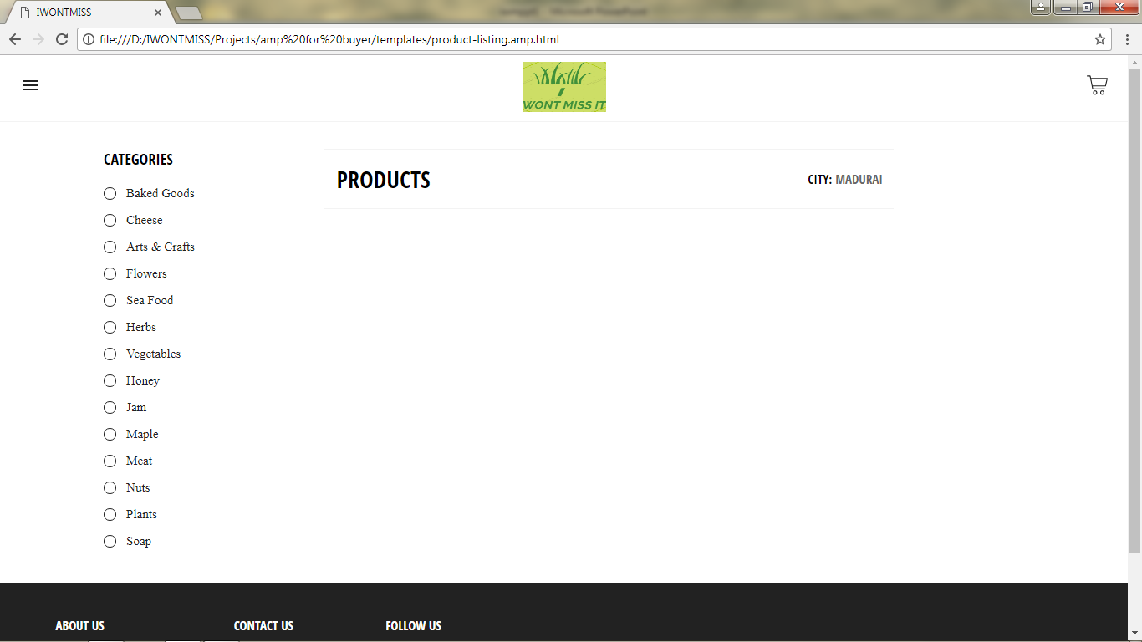

Slide 17
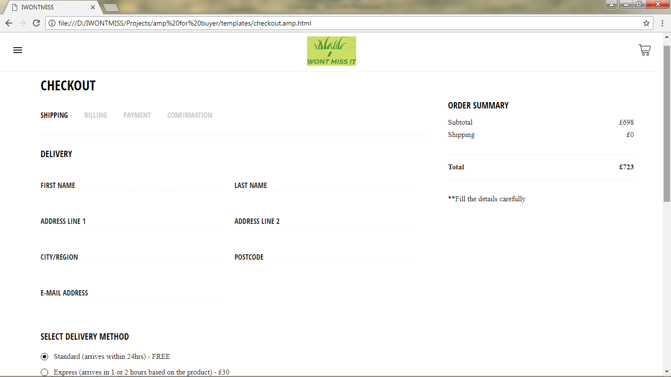

Slide 18
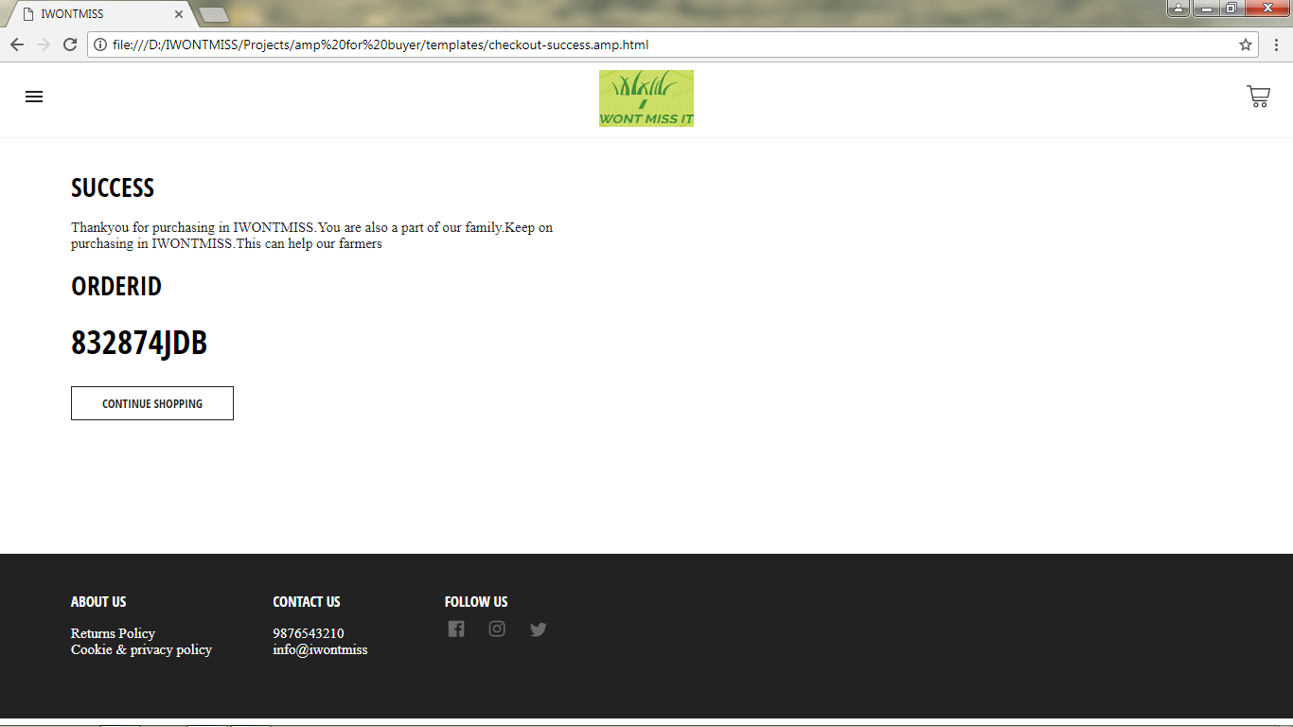

Slide 19
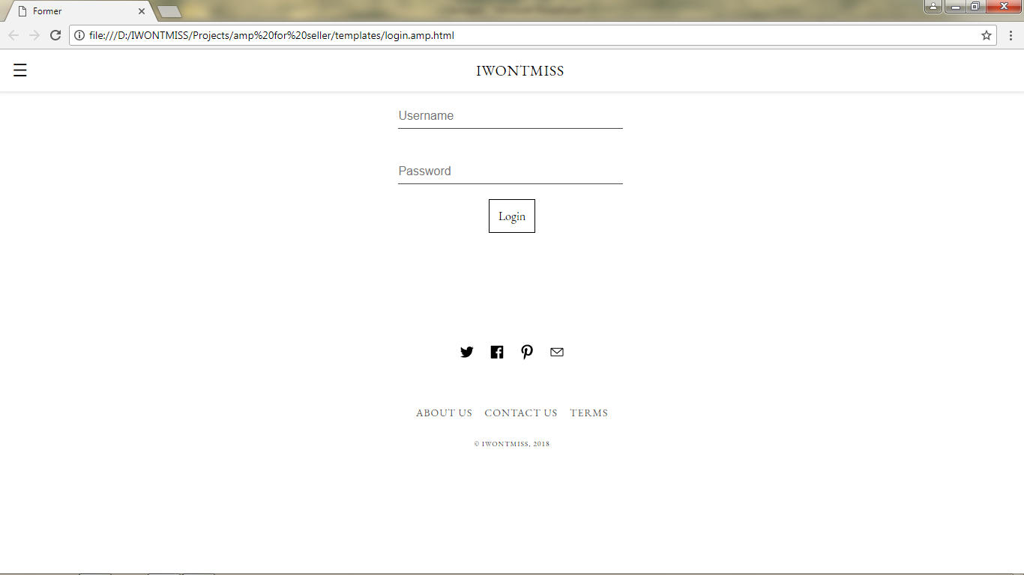

Slide 20
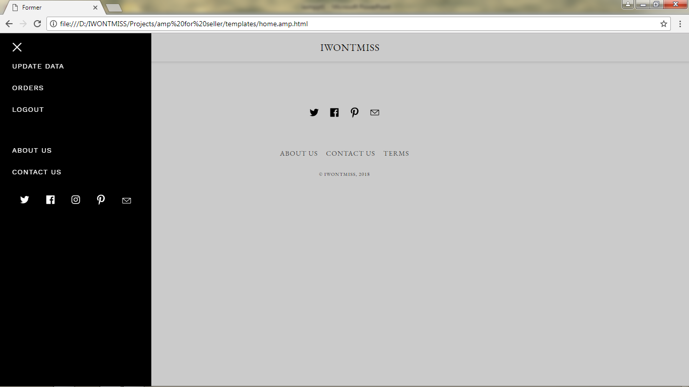

Slide 21
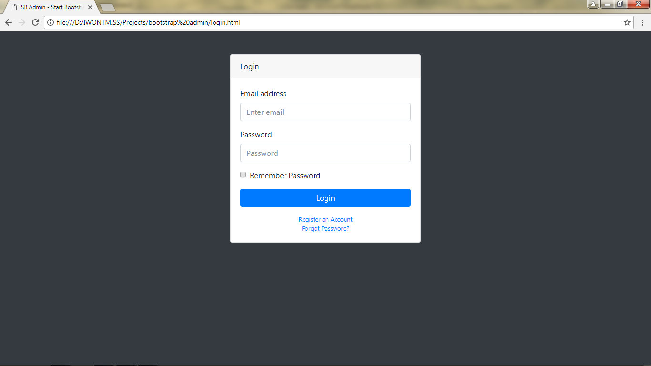

Slide 22
