Slide 1

Automated Vocabulary Building for Characterizing and Forecasting Elections using Social Media Analytics
Aravindan Mahendiran
Master’s Thesis Presentation

Slide 2
Introduction
Twitter mining
Established correlations and forecasting future trends for
Flu case counts
Box office sales
Stock Markets
Can Twitter model the social, political landscape of a country?
Notes:
Twitter used by politicians to mobilize support.
2008 Obama campaign

Slide 3
Election Modeling using Twitter
Volume Based approaches
Compute the aggregated sentiment of mass by counting mentions of candidate
Profile Modeling
Model the contesting candidates
Model the ‘voter’
Notes:
Profile modeling
NRC EmoLex
Profile of Mood States POMS

Slide 4
Drawbacks
Reproducibility
Models tailored for specific elections
Self-selection bias
Twitter is not a representative sample
‘Vote’ modeling
Algorithms do not define what a ‘vote’ is
Sentiment classifiers
Detecting humor and sarcasm
Notes:
Other biases like
bot generated tweets vs human generated tweets.

Slide 5
Motivation
Key ingredient to forecasting : Vocabulary to track tweets
Usually handcrafted by SMEs
Not exhaustive
Twitter language radically different from other corpora
Sub-optimal vocabulary leads to poor recall which leads to inaccurate predictions
Notes:
Hashtags
multiple words are compressed into one
capture the essence of the tweet.
more important than rest of the tweet itself.

Slide 6
Motivation
Vocabulary must be dynamic
Should capture the evolving trends
#elmundoconChavez, #hayuncaminoo vs #chavez, #capriles
Solution:
Dynamic Query Expansion
Notes:
Explain hashtag growth

Slide 7
Query Expansion
IR solution to synonymy
Iterative process
Initialize query with seed vocabulary
Retrieve documents
Rank words according to term frequency
Use top words to refine query
Repeat until no new words are added to vocabulary.
Notes:
Explain what is synonymy

Slide 8
Our Approach
Build a dynamic query expansion algorithm using Probabilistic Soft Logic to model language preferences of ‘potential voters’ and grow a vocabulary for elections
Show the DQE vocabulary improves the accuracy of prediction algorithms

Slide 9
Probabilistic Soft Logic

Slide 10
Probabilistic Soft Logic
Declarative language to specify graphical models
Logical predicates with soft truth values in [0,1] to capture facts/ beliefs
Weighted first order logic rules to encode interactions and relationships
Linear (in)equality constraints

Slide 11
Applications of PSL
Collective classification
Ontology alignment
Entity resolution
Link prediction
Trust in social networks
Social group modeling
Personalized medicine
Notes:
Entity Resolution
similar names → same person

Slide 12
Typical PSL Program
Atoms
Predicates
Constraints
Rules
Groundings
MPE inference mechanism
Weight Learning mechanism
Notes:
Atoms capture the entites
Predicates >> relationsips/interactions
Groundings >> substitution of variables
Mpe >> given partial evidence reasons the ot

Slide 13
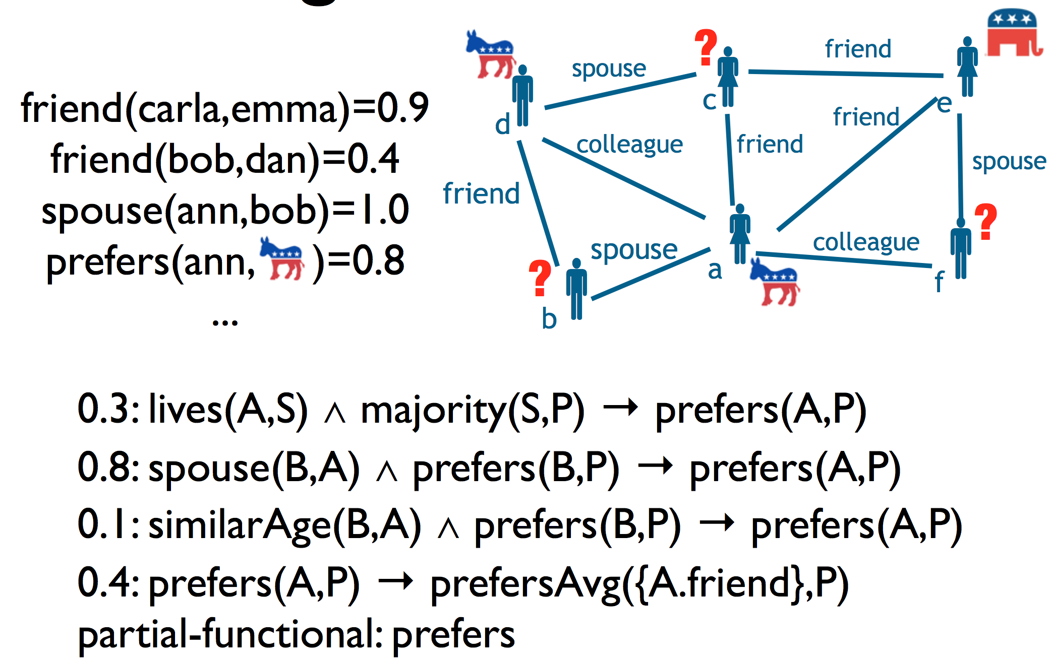
Social Group Modeling
Notes:
F

Slide 14
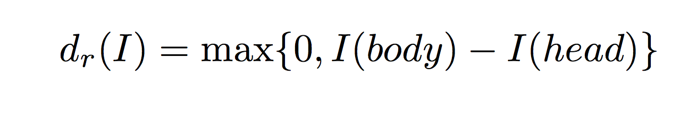
Distance to Satisfaction
body → head satisfied
iff
truth value of body <= truth value of head
Notes:
This is consistent with the boolean implication operatior.

Slide 15
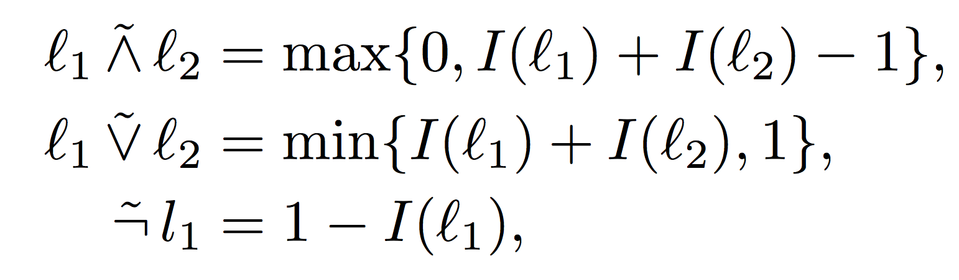
Lukasiewicz t-norm
Notes:
Adaptations of the first order logic relaxed for the soft truth values.

Slide 16
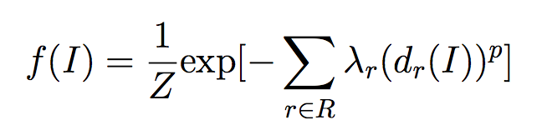
Probabilistic Model
Notes:
Z is continous version of the normalization constant used in discrete Markov Random Fields
If a constraint is violated, f(I) = 0

Slide 17
Probabilistic Model
Interpretation
Notes:
Z is continous version of the normalization constant used in discrete Markov Random Fields
If a constraint is violated, f(I) = 0

Slide 18
Probabilistic Model
Interpretation
Set of rule groundings
Notes:
Z is continous version of the normalization constant used in discrete Markov Random Fields
If a constraint is violated, f(I) = 0

Slide 19
Probabilistic Model
Interpretation
Set of rule groundings
Rule’s Weights
Notes:
Z is continous version of the normalization constant used in discrete Markov Random Fields
If a constraint is violated, f(I) = 0

Slide 20
Probabilistic Model
Ground rule distance to satisfaction for a given I
Interpretation
Set of rule groundings
Rule’s Weights
Notes:
Z is continous version of the normalization constant used in discrete Markov Random Fields
If a constraint is violated, f(I) = 0

Slide 21
Probabilistic Model
Ground rule distance to satisfaction for a given I
{1,2}
Interpretation
Set of rule groundings
Rule’s Weights
Notes:
Z is continous version of the normalization constant used in discrete Markov Random Fields
If a constraint is violated, f(I) = 0

Slide 22
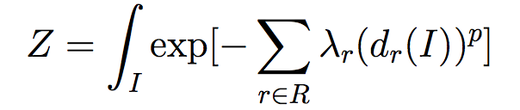
Probabilistic Model
Ground rule distance to satisfaction for a given I
{1,2}
Interpretation
Set of rule groundings
Rule’s Weights
Normalization Constant
Notes:
Z is continous version of the normalization constant used in discrete Markov Random Fields
If a constraint is violated, f(I) = 0

Slide 23
MPE Inference
Computes
prefers(bob, Rep.) >= prefers(bob, Dem.)?
Constrained convex optimization problem
Time Complexity : O(n^{3.5})
where n is the number of relevant rule groundings with non-zero distance to satisfaction.
Notes:
Given an evidence it finds the most probable explanation extending the given partial interpretation(evidence).
Because of solft truth values and form of PSL
the optimization problem becomes convex. And this is exploited for the efficiency.
Means maximizing density function f(I) thereby minimimizing the summation of the exponent
subject to the partial evidence supplied and the equality and inequality constraints.
This constrained optimiztion is cast as Second Order Cone Program SOCP.
Iteratively solves the optimizations. Starts with non evidence as truth value 0. then does MPE. Now uses these new values for non-evidence and does MPE again and again until no new rules are activated.

Slide 24
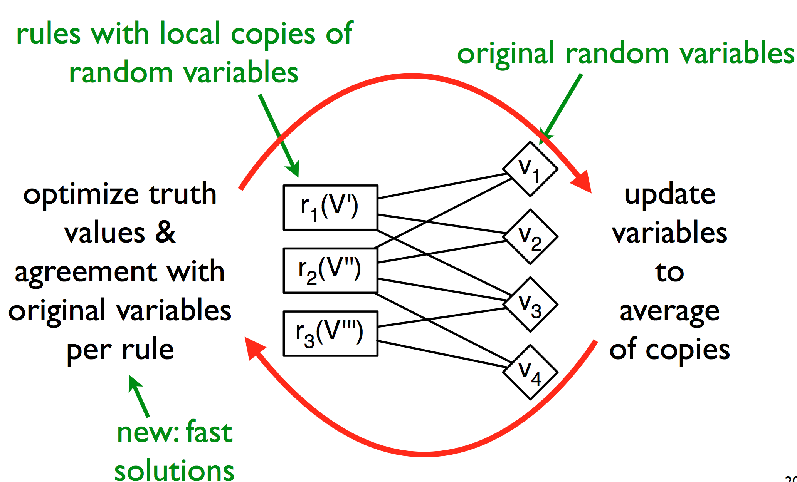
Consensus Optimization
Notes:
Consensus optimization splits the optimization problem into independent, small problems tied together by additional constraints.
Each rule is a sub problem
Sub-problems have their own copies of the variables and introduces constraints to equate truth values to the original variable
Consensus optimization then iterates between
a) optimizing local copies as a trade off between contribution to the original objective function and agreement with original values
b) updating the original values to average of local copies.
Linear Time complexity

Slide 25
Dynamic Query Expansion Using PSL

Slide 26
Design
Geo-Location and Date Filter
Keyword and Author Filter
Predicate Generation
Tweets
Pre-Processing
Seed Vocabulary
PSL Program
Keyword And Author List For Next Iteration
Threshold Filter
Inferred Vocabulary And Group Membership
Post-Processing
Notes:
Date filter = window size
Seed words loaded every time to keep a check on the expansion.

Slide 27
Geo-Location
GPS
Location in tweet Content
Landmark in tweet Content
Location in user Profile
Location in tweet Content
Tweet
(Country, State, City)
Label Propagation
Notes:
Each stage appends info to the previous stage’s information.

Slide 28
PSL Predicates
Tweeted(U,T)
Contains(T,W)
Is_Member(U,G)
Belongs(W,G)
ReTweet(T,U)
Mention(T,U)
Seed_Word(W,G)
Was_Member(U,G)
Belonged(W,G)
Positive(T)
Negative(T)

Slide 29
PSL Predicates
Tweeted(U,T)
Contains(T,W)
Is_Member(U,G)
Belongs(W,G)
ReTweet(T,U)
Mention(T,U)
Seed_Word(W,G)
Was_Member(U,G)
Belonged(W,G)
Positive(T)
Negative(T)

Slide 30
Initialization Rules
Seed_Word(W,G) → Belongs(W,G) : 0.5
Belonged(W,G) → Belongs(W,G) : 0.5
Was_Member(W,G) → Is_Member(W,G) : 0.5
Notes:
Weights are weighted at 0.5 as they are priors and have to over come the bias from previous learnings in light of newer evidence.

Slide 31
Recursive rules for growth of vocabulary
Tweeted(A,T) ^ Contains(T,W) ^ Belongs(W,G) ^ Positive(T) → Is_Member(A,G) :1.0
Tweeted(A,T) ^ Contains(T,W) ^ Belongs(W,G) ^ Negative(T) → ~Is_Member(A,G) :1.0
Is_Member(A,G) ^ Tweeted(A,T) ^ Contains(T,W) ^ Positve(T) →
Belongs(W,G) :1.0
Is_Member(A,G) ^ Tweeted(A,T) ^ Contains(T,W) ^ Negative(T) →
~Belongs(W,G) :1.0
Contains(T,W1) ^ Contains(T,W2) ^ Seed_Word(W1,G) ^ Positive(T) →
Belongs(W2,G) :1.0
Notes:
All these rules are weighted at 1.0

Slide 32
Social Interactions
Tweeted(A,T) ^ Re_Tweet(T,B) ^ Member(B,G) → Is_Member(A,G) :1.0
Tweeted(A,T) ^ Mentions(T,B) ^ Member(B,G) ^ Positive(T) → ~Is_Member(A,G) :1.0
Tweeted(A,T) ^ Mentions(T,B) ^ Member(B,G) ^ Negative(T) → ~Is_Member(A,G) :1.0
Tweeted(A,T) ^ Mentions(T,B) ^ Member(A,G) ^ Positive(T) → ~Is_Member(B,G) :1.0
Tweeted(A,T) ^ Mentions(T,B) ^ Member(A,G) ^ Negative(T) → ~Is_Member(B,G) :1.0
Notes:
All these rules are weighted at 1.0

Slide 33
Window size
Optimal window size : 3
Smaller window size lead to sub-optimal inferences.
Larger window size causes memory issues.

Slide 34
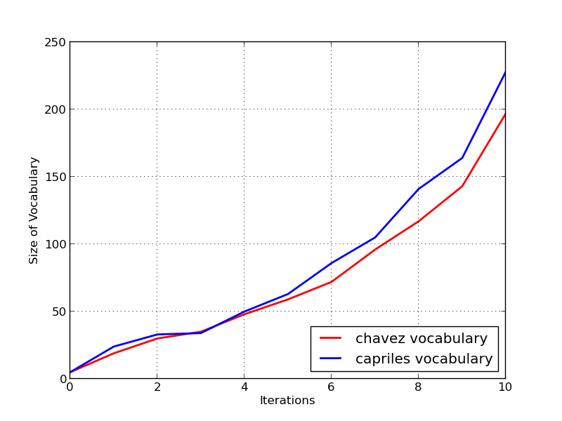
Vocabulary Growth
Notes:
No correlation just coincidence.

Slide 35

Capriles Day 0

Slide 36
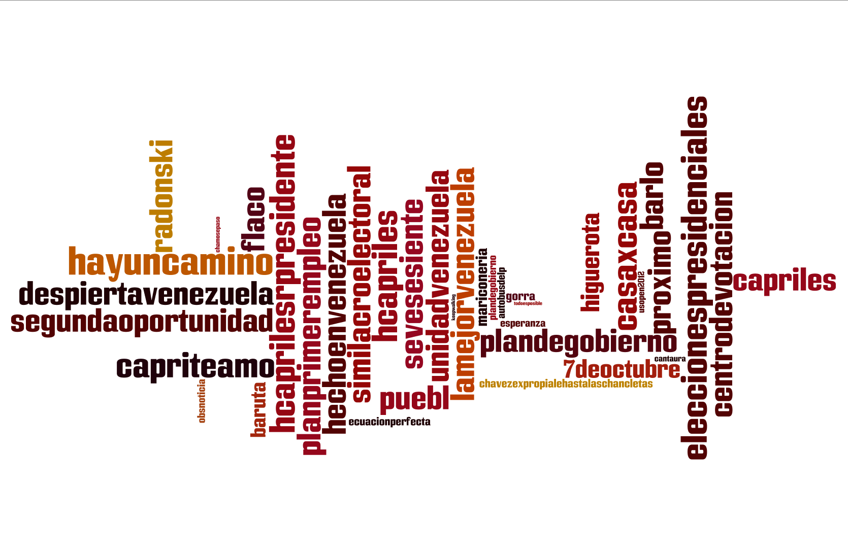
Capriles Day 6

Slide 37
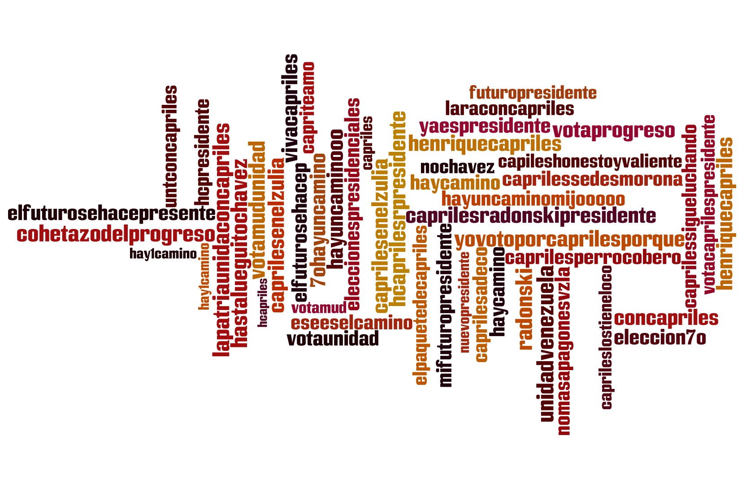
Capriles- Day 15

Slide 38
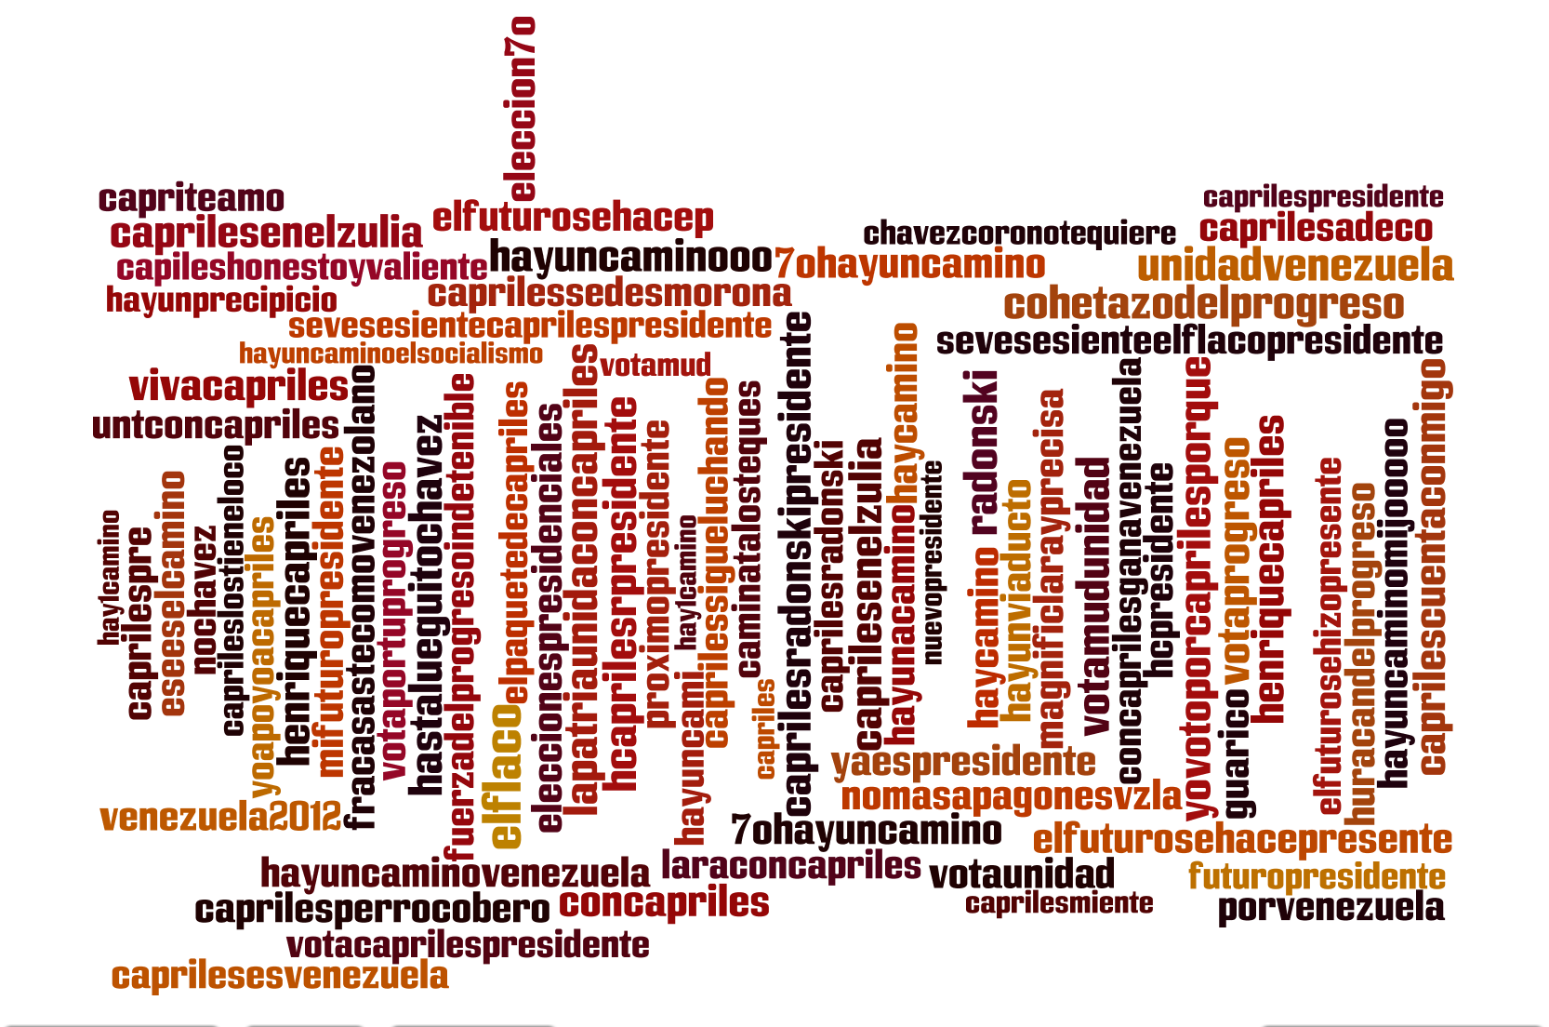
Capriles Day 30

Slide 39
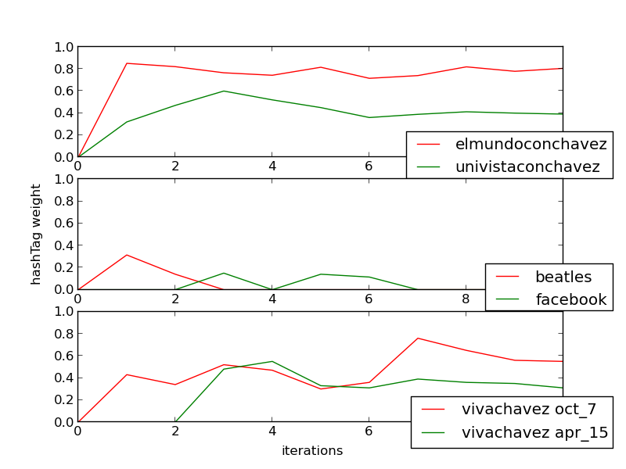
Threshold filtering
Notes:
1st plot : over all average greater than threshold 0.3
2nd plot : un informative words..
3rd plot : venezueala story.
chavez death re election maduro using chavez death as campaign strategy

Slide 40
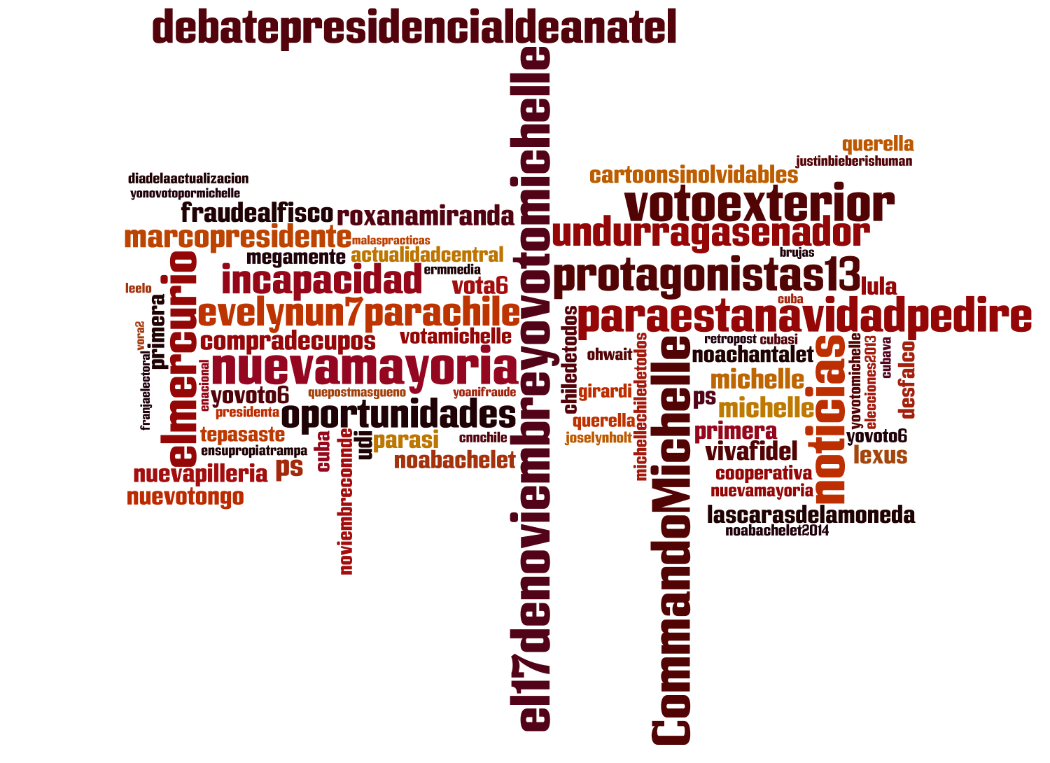
Chile Nov 17

Slide 41
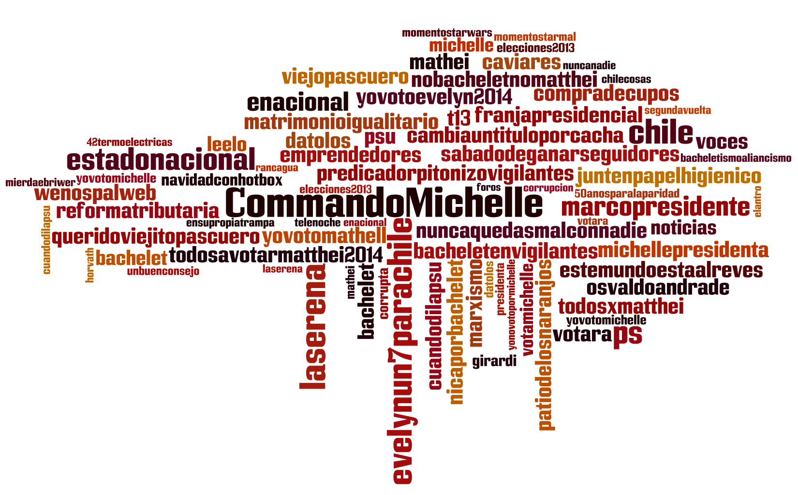
Chile Dec 15

Slide 42
Prediction Models

Slide 43
Tracking Mentions
Tweets from the month leading upto the elections are tracked and geo coded
Tracked for mentions of candidate/ party names and symbols
Time series of Sentiment, mentions and Klout scores are created
Klout score quantifies the influence a user has on social media. Range: [0,100]
Sentiment is typically in [-15,15].

Slide 44
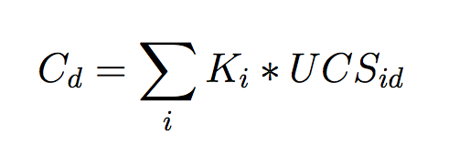
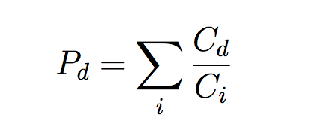
Unique Visitor Model
where
C_{d} : Candidate Score
K_{i} : Klout Score of User
UCS_{id} : User Candidate Score
P_{d} : Probability of Candidate winning
Notes:
Talk about how UVM came about from Total Mentions model.

Slide 45
Regression Model
Independent variable : Twitter Features
Dependent variable : Opinion Polls
Assumption : By regressing from twitter features to opinion polls the self-selection bias can be minimized
Total of 6 twitter features
Features calculated from 10 day window leading to the opinion poll date

Slide 46
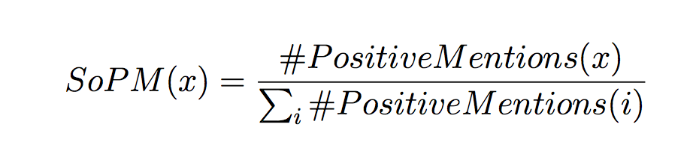
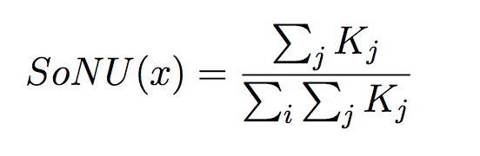
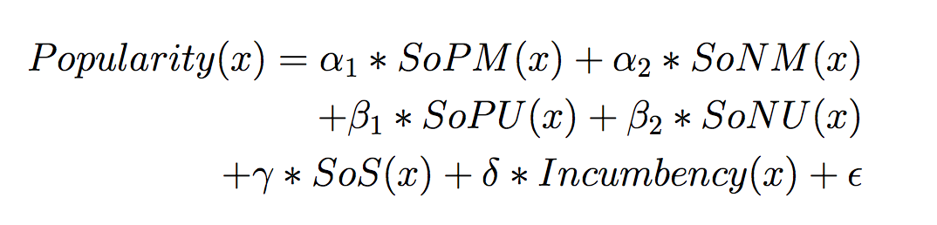
Regression Model

Slide 47
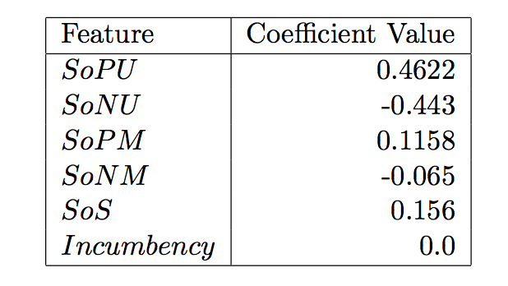
Feature Weights
Number of unique users and sentiment have greater predictive power
Incumbency surprisingly is a weak predictor
Notes:
Talk about the negative weights.
This is averaged across all candidates from all elections.

Slide 48
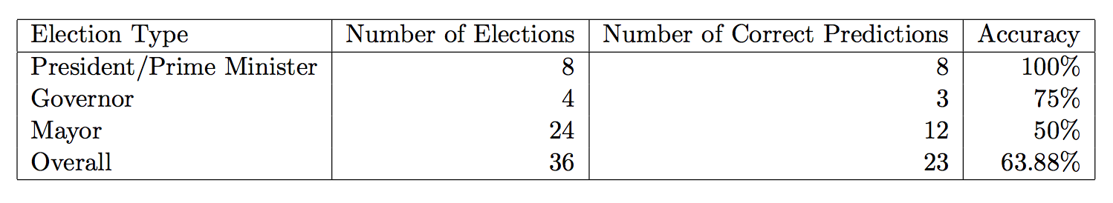
Performance
Regression Model used only for Presidential Elections
Accuracy 91.5% if mayoral elections are ignored
All elections predicted ahead of time

Slide 49
Evaluation of Dynamic Query Expansion

Slide 50
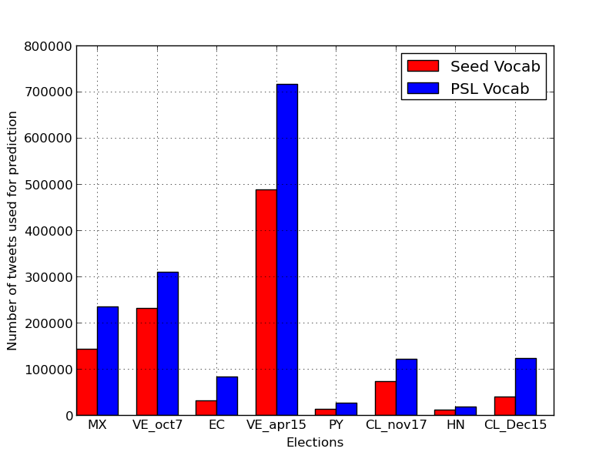
Improvement in tracking tweets

Slide 51
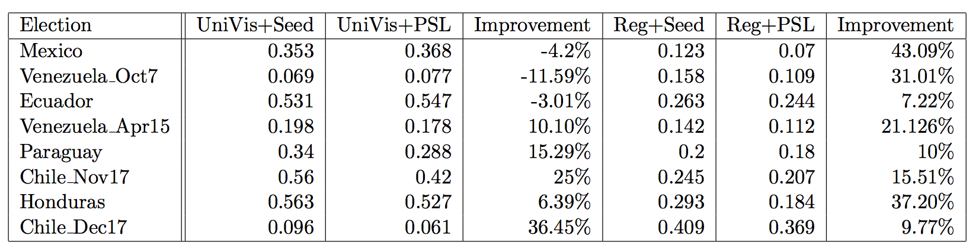
Improvement in Accuracy
Notes:
Explain the UniVis discrepency.
We see greater and more consistent improvement with the regression model as the model weighs each window of tweets differently depending upon the opinion poll time series whereas the unique visitor model values them equally. Therefore, when the algorithm uses the ‘not-so-informative’ hashtags identified during the earlier iterations, the sentiment value and the counts of these mentions bring down the accuracy of the model even though at a later stage hash-tags that are strongly indicative of a user’s preference is picked up. So words such as ”facebook” which occur commonly dominate the counts and therefore skew the results even though they are dropped from the vocabulary at a later point.

Slide 52
Future Work
Group Level modeling vs User level modeling.
Age, gender, location
Learn demographics of electorate
Improving the mention tracking by using Named Entity Recognition
With labeled ground truth we can study various social theories
Eg: Structure Balance in Triads

Slide 53
Acknowledgements
This work is part of the EMBERS project for the IARPA supported Open Source Indicators (OSI)via Department of Interior National Business Center (DoI/NBC) contract number D12PC00337.
I would like to thank Dr.Naren Ramakrishnan, Dr.Cal Ribbens, Dr. Aditya Prakash, Dr.Bert Huang and Dr. Lise Getoor.
Thank you!

