Slide 1
DATA ANALYTICS INTERNSHIP · JUNE 2026
Bluestock Mutual Fund Analytics Platform
An end-to-end analytics platform for mutual fund performance analysis, investor behaviour, portfolio diversification, and investment risk — built through data engineering, financial analytics, and business intelligence techniques.
Prepared by: Repalle Aravind Pavan Kumar

Slide 2
BUSINESS CONTEXT
Business Problem & Project Objectives
The Challenge
Project Objectives
Asset Management Companies generate large volumes of financial and investor data. Traditional reporting struggles to provide a unified view across multiple datasets, making it difficult to derive actionable insights for fund performance monitoring, risk evaluation, and investment decision-making.
Build a comprehensive mutual fund analytics platform
Develop a robust ETL pipeline for data processing
Analyze industry growth and investor behavior
Evaluate fund performance using financial metrics
Measure portfolio concentration and downside risk
Create interactive Power BI dashboards
Generate actionable business recommendations

Slide 3

DATA ENGINEERING
Data Sources & Technology Stack
Data Sources
Technology Stack
Mutual Fund NAV History
Fund Master Data
Investor Transaction Data
Assets Under Management (AUM)
Portfolio Holdings
Benchmark Index Data
Scheme Performance Data
SIP Data
Python — core programming language for data processing and analytics
Pandas — data manipulation, transformation, and analysis
SQLite — lightweight relational database for structured storage
SQL — querying and aggregating analytical datasets
Power BI — interactive dashboard and visualization layer
GitHub — version control and collaboration
Jupyter Notebook — exploratory analysis and documentation
Outcome: Integration of multiple datasets into a unified analytical framework for mutual fund analysis.

Slide 4
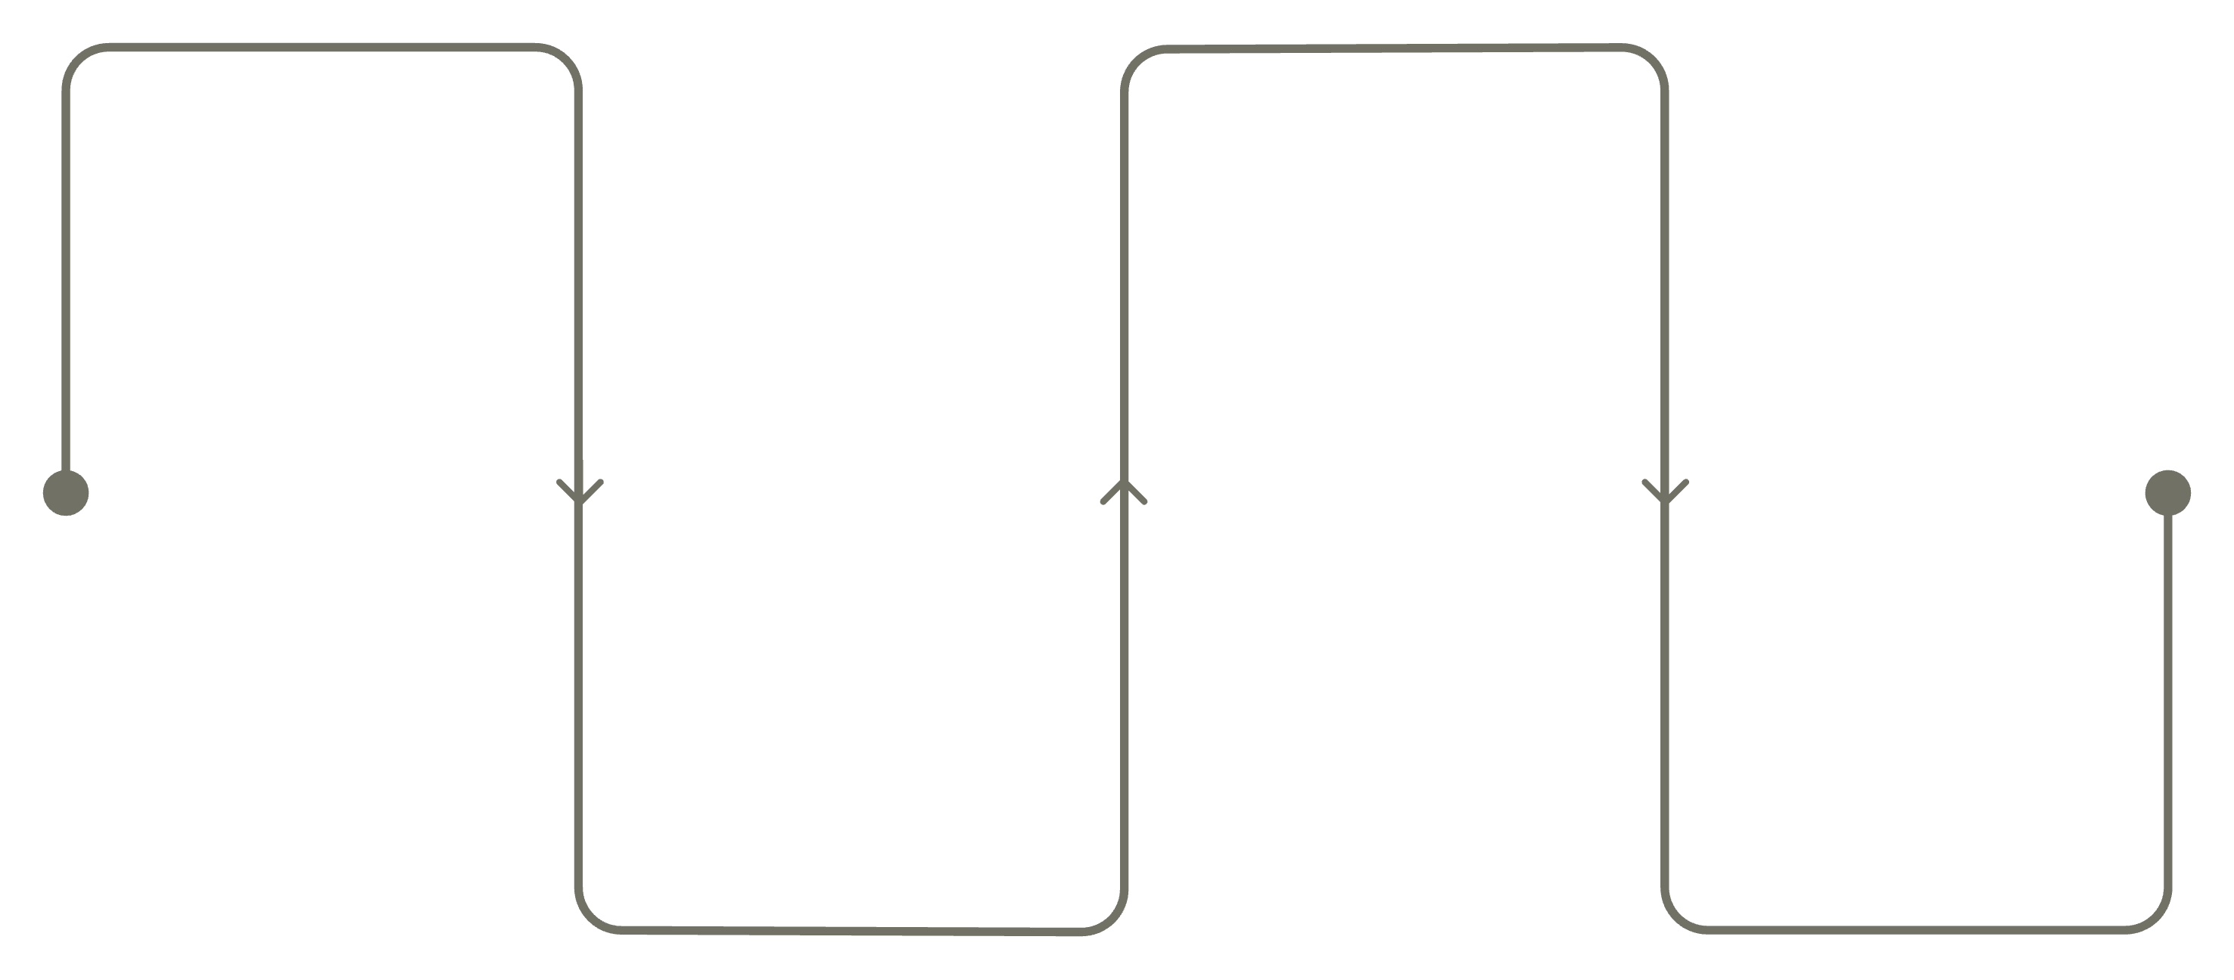
DATA ENGINEERING
System Architecture & ETL Design
Extract
Load
Ingest raw CSV files
Populate SQLite database
Analyze
Transform
Power BI dashboards & insights
Clean, validate and standardize
The ETL pipeline ensures high-quality, consistent data flows from raw sources to analytical outputs. Key activities include missing value handling, duplicate removal, data type standardization, rigorous validation checks, and structured database integration — creating a reliable foundation for all downstream analytics.
Data Quality
Validation
Integration
Missing value handling, duplicate removal, and type standardization ensure clean, consistent inputs.
Automated checks confirm data integrity before loading into the SQLite database.
Unified analytical datasets support seamless Power BI connectivity and reporting.

Slide 5
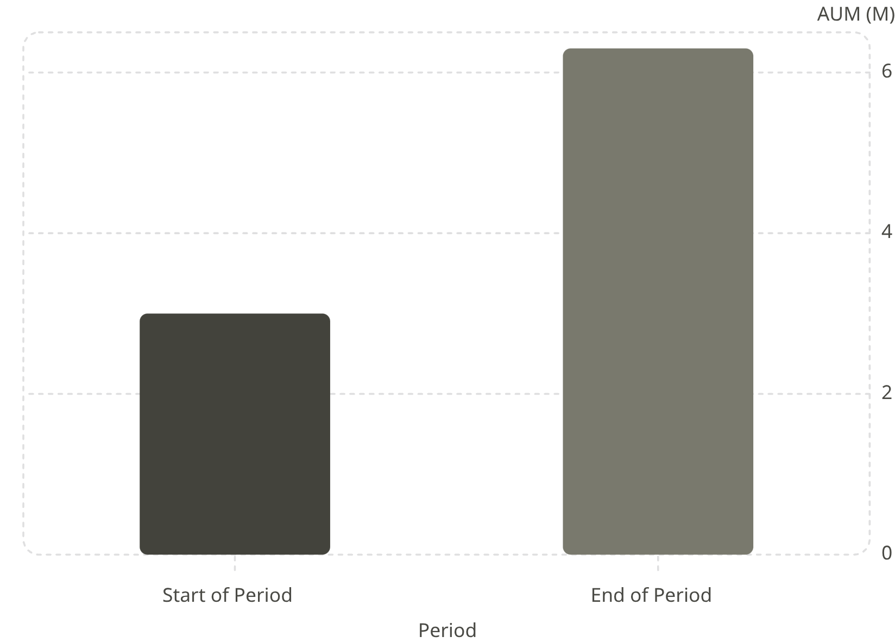

EXPLORATORY ANALYSIS
Industry Overview & Growth Trends
Key Findings
Industry AUM increased from approximately 3.0M to 6.3M — more than doubling over the analysis period
Total SIP inflows exceeded 940K, reflecting growing systematic investment participation
Investor folios crossed 26.12 crore, demonstrating broad market penetration
SBI Mutual Fund emerged as the leading AMC by AUM
ICICI Prudential and HDFC remained major competitors in the space
Business Insight: The mutual fund industry demonstrated strong and sustained growth, supported by increasing investor participation and systematic investment adoption across demographics.

Slide 6
EXPLORATORY ANALYSIS
Investor Behavior Analysis
Geographic Participation
Age Demographics
Punjab and Tamil Nadu recorded significant investment activity, highlighting regional hotspots for targeted investor engagement and marketing initiatives.
Investors aged 26–35 contributed the highest SIP volume, underscoring young professionals as the primary driver of systematic investment growth.
Transaction Patterns
SIP Growth Driver
Lump sum investments represented the largest transaction category by value, while monthly transaction activity remained stable throughout the analysis period.
Young investors continue to drive SIP adoption, signaling long-term market expansion potential and the importance of digital-first onboarding strategies.

Slide 7

FINANCIAL ANALYTICS
Financial Performance & Risk-Return Analysis
Performance Metrics Evaluated
Risk vs. Return Observations
A scatter plot analysis compared fund performance across risk and return dimensions:
CAGR
Sharpe Ratio
Annualized investment growth rate over the analysis period.
Risk-adjusted return — excess return per unit of volatility.
Higher returns were generally associated with higher volatility
Large-cap and flexi-cap funds demonstrated balanced risk-return characteristics
Lower-risk funds produced more stable but comparatively lower returns
Different schemes showed varying levels of benchmark outperformance
Alpha & Beta
Max Drawdown
Excess return relative to benchmark and market sensitivity.
Largest peak-to-trough decline in portfolio value.
Key Insight: Investors must balance expected return against acceptable risk exposure when selecting investment products. Multi-dimensional fund evaluation is essential.

Slide 8

ADVANCED ANALYTICS
Risk Modelling: VaR & CVaR Analysis
Value at Risk (VaR)
Key Findings
Measures the maximum expected loss at a 95% confidence level over a defined time horizon. Provides a single-number summary of downside exposure for portfolio risk assessment.
Significant variation in downside risk observed across funds in the portfolio
Fund 101207 exhibited one of the highest downside-risk levels in the dataset
CVaR analysis revealed meaningful tail-risk exposure not captured by VaR alone
Risk profiles varied considerably by fund category and investment strategy
Conditional VaR (CVaR)
Measures the average loss beyond the VaR threshold, offering deeper insight into tail-risk exposure and extreme downside scenarios that VaR alone may understate.
Business Value: VaR and CVaR metrics support proactive risk management, regulatory reporting, and informed investment decision-making for fund managers and investors alike.

Slide 9
ADVANCED ANALYTICS
Investor Cohort, SIP Continuity & Portfolio Concentration
4,803
₹349Cr
35
2024 Investor Cohort
Cohort Investment Value
SIP Gap Threshold (Days)
New investors onboarded in the 2024 cohort period.
Total investment value generated by the 2024 cohort.
Investors with gaps exceeding this threshold classified as AT_RISK.
SIP Continuity Analysis
Portfolio Concentration (HHI)
Investors with payment gaps exceeding 35 days were flagged as AT_RISK, enabling proactive retention outreach. This analysis supports targeted engagement initiatives to reduce churn and sustain SIP inflows.
The Herfindahl-Hirschman Index (HHI) measured portfolio diversification across funds. Most funds demonstrated strong diversification with relatively low concentration risk, indicating healthy asset allocation practices across the portfolio.

Slide 10

CONCLUSION
Dashboard Solution, Key Insights & Recommendations
Power BI Dashboard Modules
Key Insights & Recommendations
01
Industry AUM more than doubled — sustained growth trajectory confirmed
SBI Mutual Fund maintained market leadership throughout the period
The 2024 investor cohort generated the highest investment contribution
Most portfolios exhibited strong diversification with low concentration risk
Rolling Sharpe analysis highlighted evolving risk-adjusted performance over time
Industry Overview
AUM trends, SIP inflows, and AMC market share.
02
Fund Performance
Strategic Recommendations
CAGR, Sharpe ratio, alpha, and benchmark comparisons.
Strengthen SIP retention initiatives targeting AT_RISK investors
Monitor high-risk funds using VaR and CVaR frameworks
Promote diversified portfolio construction across fund categories
Expand recommendation models using machine learning techniques
03
Investor Analytics
Demographics, geographic distribution, and cohort analysis.
04
SIP & Market Trends
Continuity tracking, risk metrics, and market dynamics.
Project Conclusion: The Bluestock Mutual Fund Analytics Platform successfully combined data engineering, financial analytics, business intelligence, and risk modelling into a unified analytical framework — transforming raw financial datasets into actionable business intelligence and providing a scalable foundation for data-driven decision-making.

Slide 11
THANKYOU

