Slide 1
Pylon
Monsters

Slide 2
Intorduction
1990 technology and biology tied up together
To revel the genetic code of humam and to manupulate these codes in other species and plants and animals.
A mouse with human hear is said as monster here.
Artist srated to discriminate between the made and the born.
cyborgs

Slide 3
Living in systems
With the emergence of cybernetics artist turned to the figure of the systems
1968 theorist
Jack Burnham declared that "we are now in transition from an object-oriented to a systems-oriented culture.
Artists strated defining the structure and boundaries

Slide 4
Environmental art
Hans Haacke's Condensation Cube
A system with no moving parts , a sealed perpex box with water
The boundary of the cube creates the dynamic of air ,heat,water and gratvity .
Creating droplet pattern ,this is used to give feedback to the machine which monitors the humidity in a museus

Slide 5
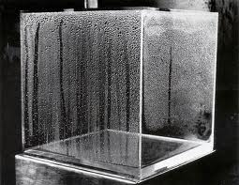

Slide 6
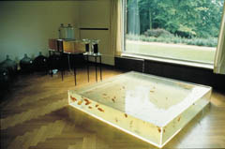
Another work of Haackes is to turn the filthy river water not as drinking water but for goldfish

Slide 7
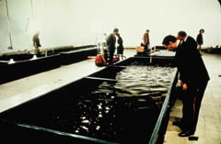
Mayer Harrison and Newton Harrison
Showcased the ecosystem with dunliella algae and brine shrimp
The interaction between them changes the salinity of the water
Producing patterns with the change in colors of the algae

Slide 8
symbiosis and the lifeworld
Symbiosis means mutually beneficial relation ship between living things
Mutualism
Comensalism
Parasitism
amensalsism, where one organism is harmed and the other unaffected

Slide 9
Hybrids circuits
Fish plant rack(2004)
The elephant fish instructs the actions of the robot
The robot monitors the developmetns of the plant in hrydrophonic system
The robot in turn relays the image of the plant to the fish
A real connection occurs
http://www.youtube.com/watch?v=1fRpTMHjcRA
Bio artificial ecosystem is influenced by others

