Slide 1
ResumeIQ
PARSE
AI Resume Intelligence Platform
ANALYZE
Analyze • Improve • Get Hired
IMPROVE
Presented by:
Aravind
B.Tech — Artificial Intelligence & Machine Learning
Centurion University
PREPARE
DETERMINISTIC • RULE-BASED • EVIDENCE-AWARE
Notes:
ResumeIQ is a resume intelligence workflow: Analyze, Understand, Improve, Prepare, and Get Hired. It combines parsing, ATS-oriented analysis, evidence, recommendations, rewriting, interview preparation, and PDF reporting.

Slide 2
Introduction
Resumes contain useful evidence, but it is difficult to review quickly.
Candidates need role-specific feedback—not only a generic score.
ResumeIQ connects analysis, job matching, improvement guidance, and preparation.
ANALYZE
UNDERSTAND
IMPROVE
PREPARE
Explainable results from extracted text, known rules, and resume evidence.
ResumeIQ
02
Notes:
A resume contains useful facts, but candidates need to know which facts matter for a particular job. ResumeIQ gives one guided, explainable report based on deterministic rules and extracted evidence.

Slide 3
Problem Statement
Manual resume review is time-consuming.
Candidates may miss important job-description requirements.
Generic advice may not connect to actual resume facts.
Unsafe rewriting can accidentally invent skills or experience.
Resume
Job Description
? Supported skills
? Missing requirements
? Safe improvements
ResumeIQ
03
Notes:
Manual review takes time, and generic keyword matching does not show which requirements are supported or missing. The system also protects against rewriting that invents experience or skills.

Slide 4
Existing System
Fragmented candidate journey
ATS Checker
Advice Tool
Interview Prep
limited context
generic feedback
separate inputs
Challenge: outputs may not share the same evidence or factual boundaries.
ResumeIQ
04
Notes:
Candidates often use separate ATS, advice, and interview tools whose outputs do not share evidence. ResumeIQ brings these activities into one transparent and testable report.

Slide 5
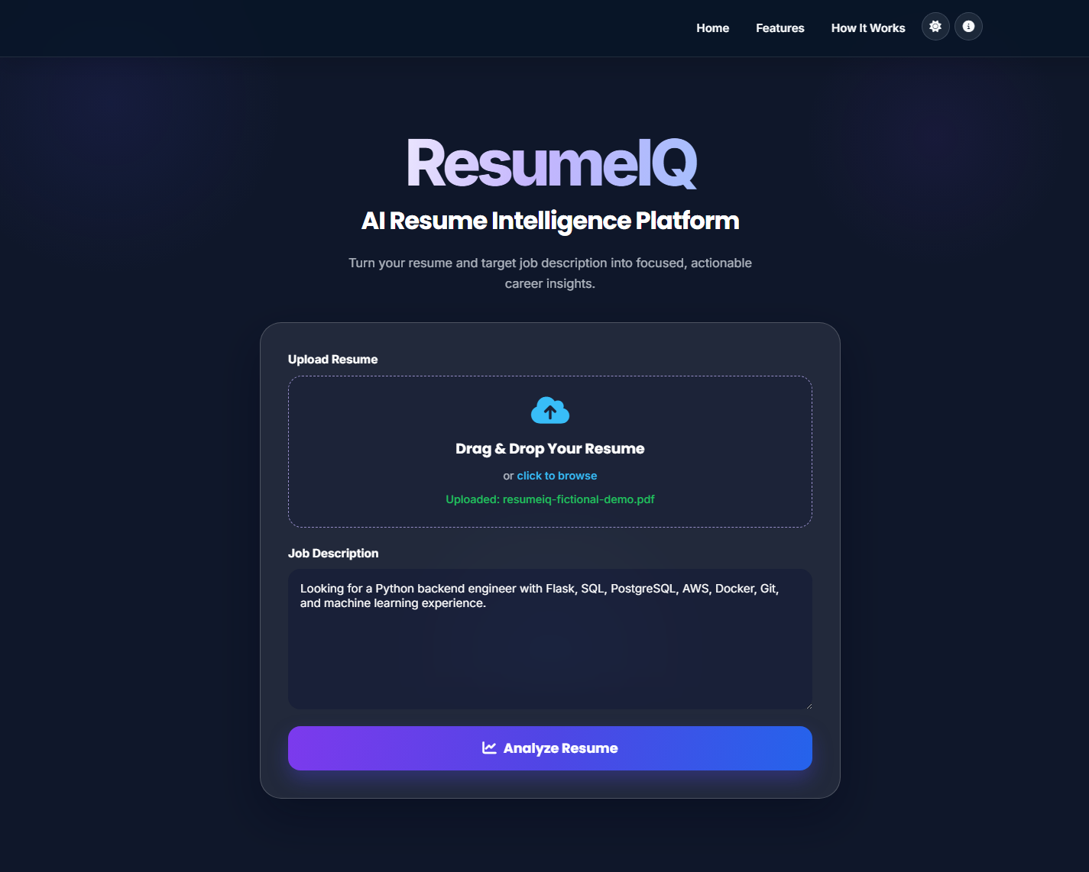
Proposed System
One upload for resume and target JD.
Modular analysis, ATS matching, and structured evidence.
Evidence-backed advice, factual rewrite preview, and interview questions.
Continuous dashboard and PDF report.
ONE GUIDED WORKFLOW
ResumeIQ
05
Notes:
The proposed system accepts a resume and job description, extracts text, analyzes sections, calculates ATS results, and builds an evidence-aware report with improvement and preparation features.

Slide 6
Objectives
01
Extract PDF/DOCX resume data
02
Compare supported skills with JD
03
Preserve traceable evidence
04
Prioritize actionable improvements
05
Generate safe rewrites & questions
06
Deliver dashboard + PDF report
ResumeIQ
06
Notes:
The objectives are extraction, JD comparison, traceable evidence, practical priorities, safe rewrites, grounded questions, and delivery through a dashboard and report.

Slide 7
Technology Stack
Backend
Extraction
Reports
Python • Flask
PyPDF2 • ZIP/XML
ReportLab
Frontend
Testing
HTML • CSS • JavaScript
pytest
Lightweight, deterministic application stack
ResumeIQ
07
Notes:
The backend uses Python and Flask; PyPDF2 extracts PDF text; ZIP/XML handles DOCX; ReportLab creates reports. The stack is lightweight and deterministic.

Slide 8
System Architecture
USER
RESUME UPLOAD
RESUME PARSER
SECTION DETECTION
ATS + JD ANALYSIS
ANALYZERS
RESUME EVIDENCE
ADVISOR + SKILLS INTELLIGENCE
REWRITER
INTERVIEW GENERATOR
DASHBOARD
PDF REPORT
Deterministic analysis pipeline
ResumeIQ
08
Notes:
The architecture separates validation, extraction, analysis, scoring, evidence, recommendations, and presentation. This modularity keeps the pipeline clear and independently testable.

Slide 9
Application Workflow
Upload
Resume
Add JD
Analyze
Understand
Improve
Prepare
Export
A guided path from input to action
ResumeIQ
09
Notes:
A user uploads a PDF or DOCX resume and supplies a JD, then follows the dashboard from analysis and understanding to improvements, preparation, and export.

Slide 10
Core Modules
Extract
Analyze
Ground
Improve
Present
resume_parser.py
section_detector.py
independent analyzers
ats_engine.py • score_engine.py
resume_evidence.py
resume_advisor.py
resume_rewriter.py
interview_generator.py
Flask dashboard
PDF generator
Focused responsibilities—not one opaque component.
ResumeIQ
10
Notes:
Focused modules cover parsing, sections, analyzers, matching, scoring, evidence, advisor, rewriting, interview preparation, dashboard, and PDF generation.

Slide 11
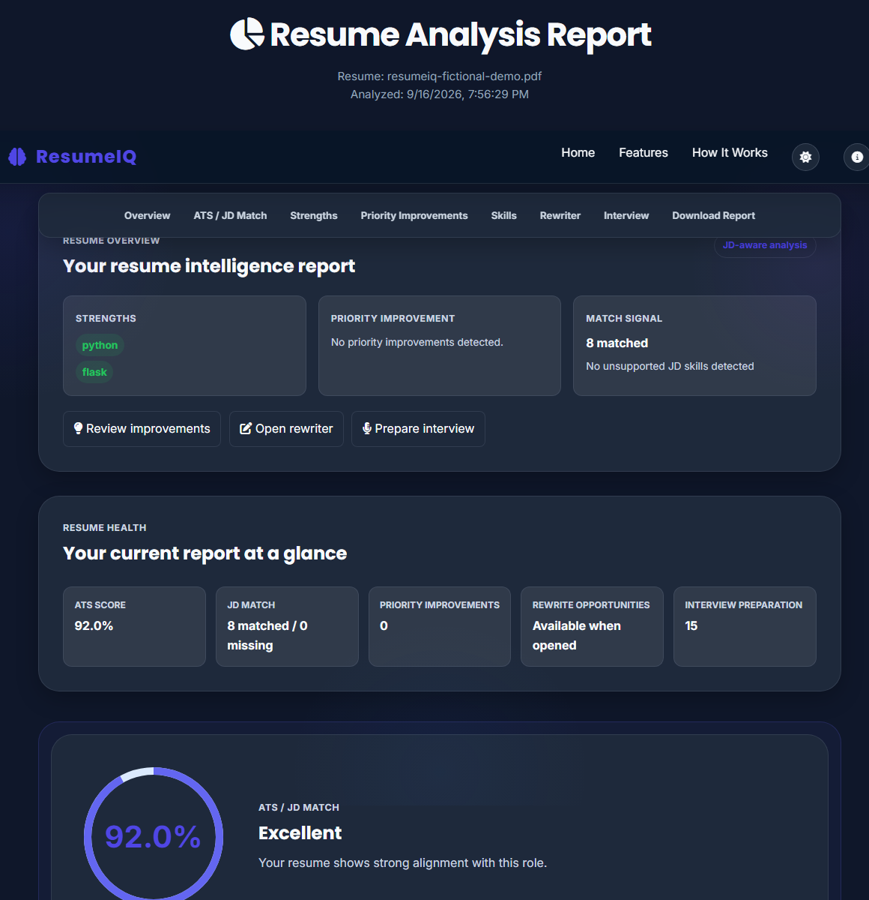
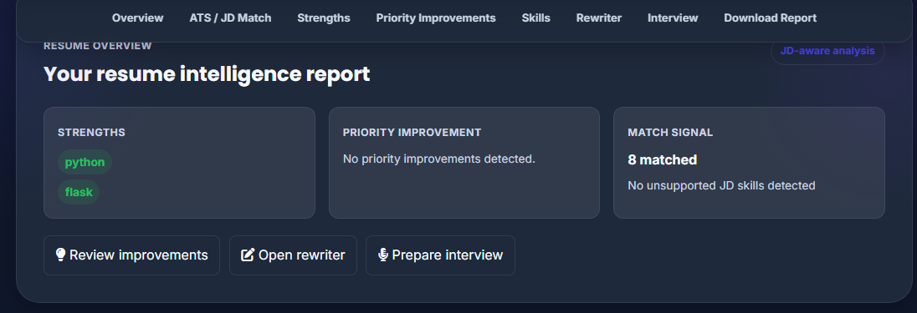
ATS & Job Description Analysis
WEIGHTED ATS SCORE
JD MATCHING
100
MATCHED: supported by both sources
MISSING: not supported by resume
Skills 40 • Projects 15
Experience 15 • Education 10
Sections 10 • Formatting 10
Related technologies remain related—not exact matches.
ResumeIQ
11
Notes:
The weighted ATS result and JD matching are distinct. Skills supported by both resume and JD are matched; a JD-only requirement remains missing and unsupported.

Slide 12
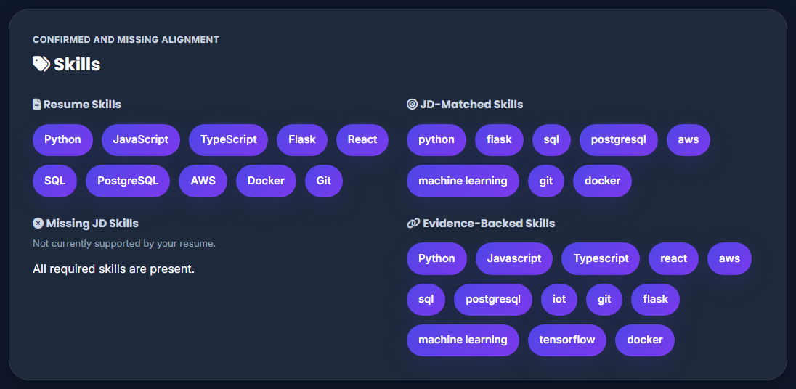
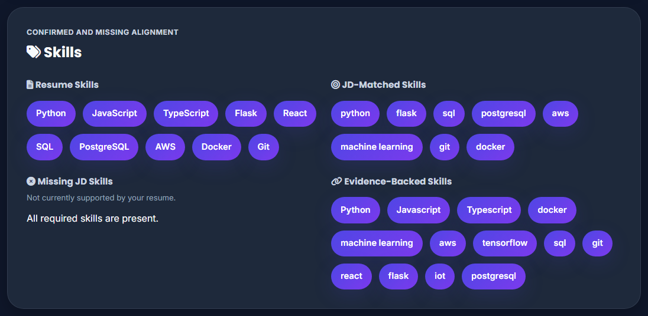
Resume Evidence & Skills Intelligence
Evidence preserves value, type, section, source text, and metadata where supported.
Skills Intelligence distinguishes four evidence-aware groups.
Resume Skills
JD-Matched Skills
Missing JD Skills
Evidence-Backed Skills
JD-only technologies are never presented as confirmed candidate skills.
ResumeIQ
12
Notes:
Evidence preserves the value, type, section, source text, and metadata where supported. The dashboard separates resume skills, matched skills, missing JD skills, and evidence-backed technologies.

Slide 13
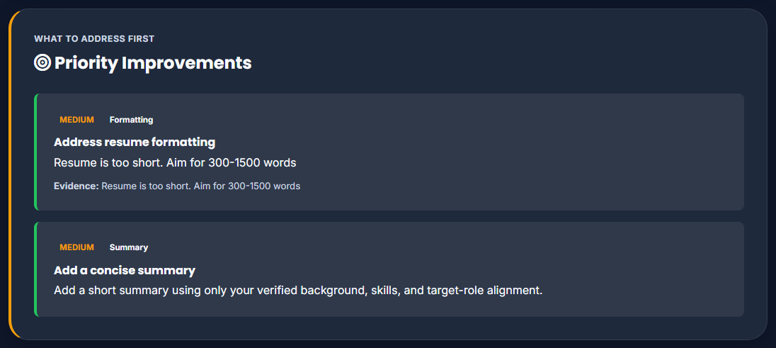
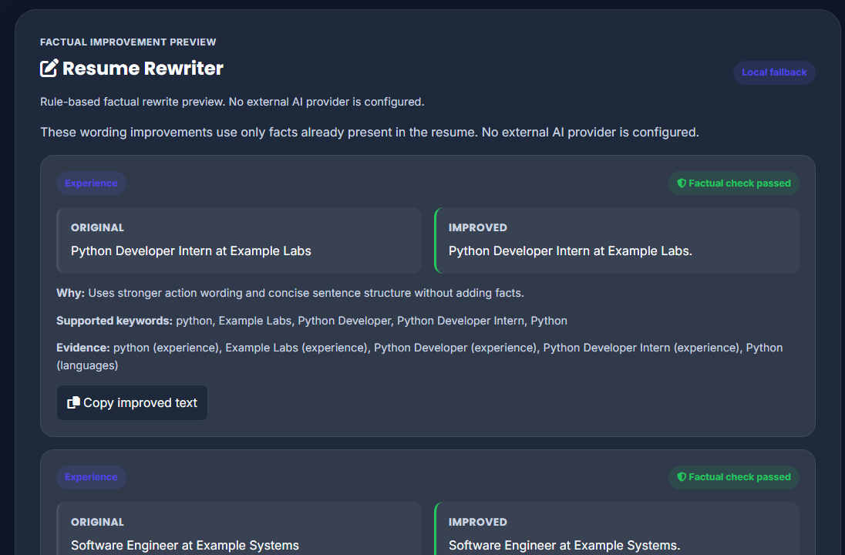
Resume Advisor & Rewriter
RESUME ADVISOR
RULE-BASED REWRITER
HIGH
priority • section • source • evidence
Original text remains exact
Improve wording and clarity
Reject or revert unsupported facts
MEDIUM
priority • section • source • evidence
LOW
priority • section • source • evidence
Evidence-backed, actionable recommendations
FACTUAL-SAFETY CHECK
ResumeIQ
13
Notes:
The advisor provides prioritized recommendations with evidence. The deterministic rewriter improves wording and formatting while preserving factual boundaries and exact original text.

Slide 14
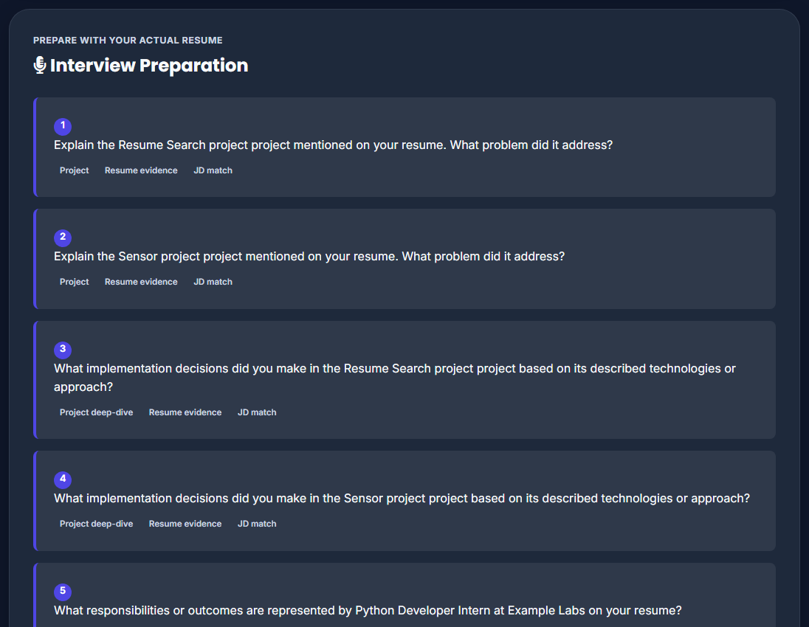
Interview Preparation
Projects
Technology
Experience
Education
Certifications
Achievements
JD Gap
Behavioral
Grounded prompts use supported resume evidence.
JD-gap prompts ask for clarification; they do not assume unsupported experience.
ResumeIQ
14
Notes:
Interview questions come from supported projects, experience, technologies, education, certifications, achievements, JD gaps, and generic behavioral prompts. A JD gap is framed as a clarification question.

Slide 15
Dashboard & PDF Report
Continuous dashboard
Portable static analysis report
ResumeIQ
15
Notes:
The continuous dashboard summarizes the analysis and retains detailed sections. The backend-generated PDF is a portable static report with clear analysis headings.

Slide 16
Testing, Security & Results
✓
Security testing
134
✓
Edge-case testing
TESTS PASSED
✓
Browser end-to-end testing
✓
PDF validation
0 TESTS FAILED
✓
Invalid input handling
ResumeIQ
16
Notes:
The verified checkpoint is 134 tests passed and zero failed. Tests cover normal and hostile inputs, security controls, browser flow, and PDF output.

Slide 17
Conclusion & Future Scope
A complete, explainable path from resume upload to job preparation.
Analyze
Understand
Improve
Prepare
Get Hired
Future scope
User history and authentication
Stronger document layout extraction
Optional integrations with privacy controls
Thank you
ResumeIQ
17
Notes:
ResumeIQ offers an explainable route from resume upload to job preparation. Future work can add history, authentication, stronger layout extraction, and privacy-controlled optional integrations.

