Slide 1
Detection and replacement of obscene literature in a video by implementing a profanity filter
Guide :
Dr. Monica R Mundada
Professor
Department of Computer Science and Engineeering
Ramaiah Institute of Technology
Submitted by :
Punith S – 1MS17CS085
Rashad Mohamed Khan-1MS17CS093
Ravva Venkata Subba Aravind-1MS17CS095
Shashank Prakash Patil-1MS17CS111

Slide 2
Agenda
Detection, removal and replacement of obscene, foul and cuss words in a video to facilitate complete obliteration of profanity and modelling of a new video free from abusiveness

Slide 3
Introduction
The 21st century is an era of rapid technological progress and development. Technology influences the way children socialize and their way of interaction with others. Social media content easily available on the Internet is full of obscene literature. This has led to a negative impact on the society especially the youth.
Web series on various streaming platforms are immensely popular among the youth of today. These web series and many other videos house cuss words which are deplorable in a civilized society. This increased usage of vulgarity has to be curbed to prevent further harm.

Slide 4
Problem definition
Identification of abusive language in a video and subsequent removal of the noted obscene literature by replacing it with a beep sound.
Current methodology: The existing system to cater this problem involves manual filtering by looking at each and every cuss word that appears in the video and then replacing it with an appropriate sound (usually the beep sound)
Proposed methodology: The proposed system is an automatic profanity filter which identifies the hate word and automatically replaces it with an appropriate sound.

Slide 5
System requirements
Operating environment for the profanity filter system is as listed below :
1. Operating system – Windows
2. Client/server system
3. Python programming in Vscode, Flask
4. A browser which supports HTML5 and JavaScript
5. Google cloud
6. Materialize CSS
7.Ffmpeg

Slide 6
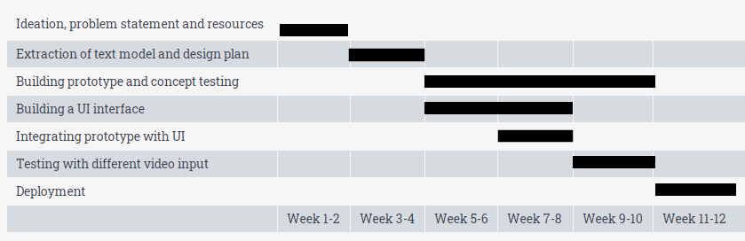
Planning
The following Gantt chart outlines the schedule plan for the implementation of the project :

Slide 7
Literature survey
A number of research papers from IEEE and other publications where studied and analyzed. The central concept in every paper was the different methods of rightly identifying a word as a hate word.
The titles of some of the papers are :
Text Censoring System for Filtering Malicious Content Using Approximate String Matching and Bayesian Filtering
Expressively vulgar: The socio-dynamics of vulgarity and its effects on sentiment analysis in social media
Detecting Offensive Language in Social Media to Protect Adolescent Online Safety

Slide 8
Design
A structural approach has been employed for the design of the project as the implementation of profanity filter involves different stages with each stage performing its activity.
Structural diagram :
INPUT TAB
Video is given input here
Video processes to next stage
FILTER TAB
Video is processed and filtered here
Video processes to next stage
OUTPUT TAB
The new modelled video can be downloaded

Slide 9
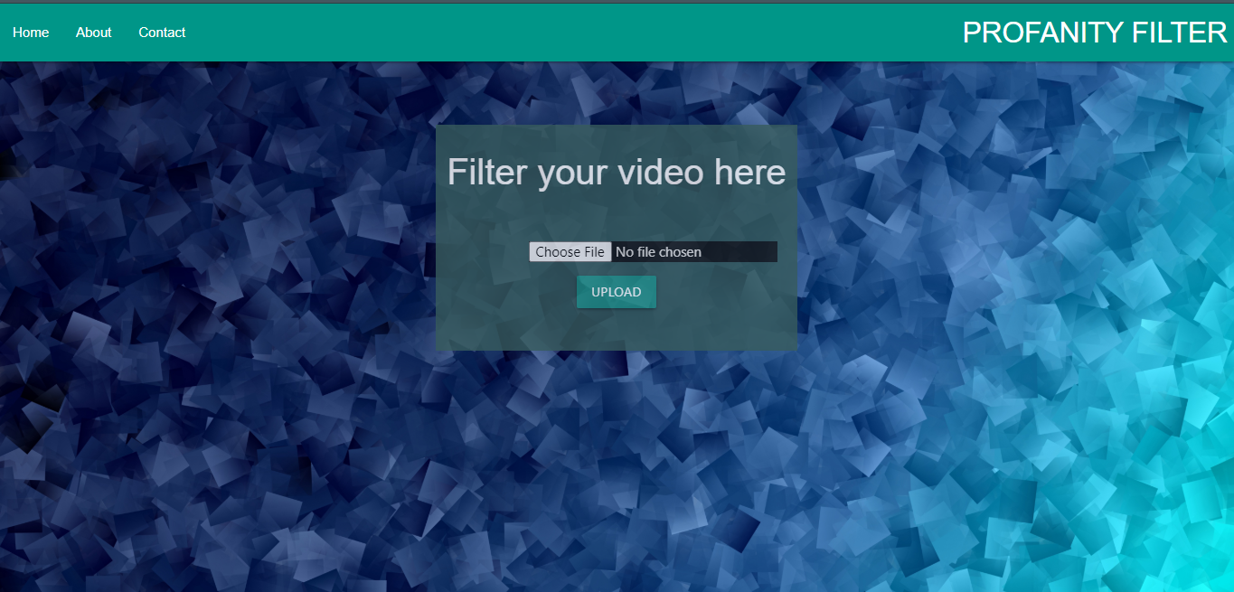
User interface – Home page

Slide 10
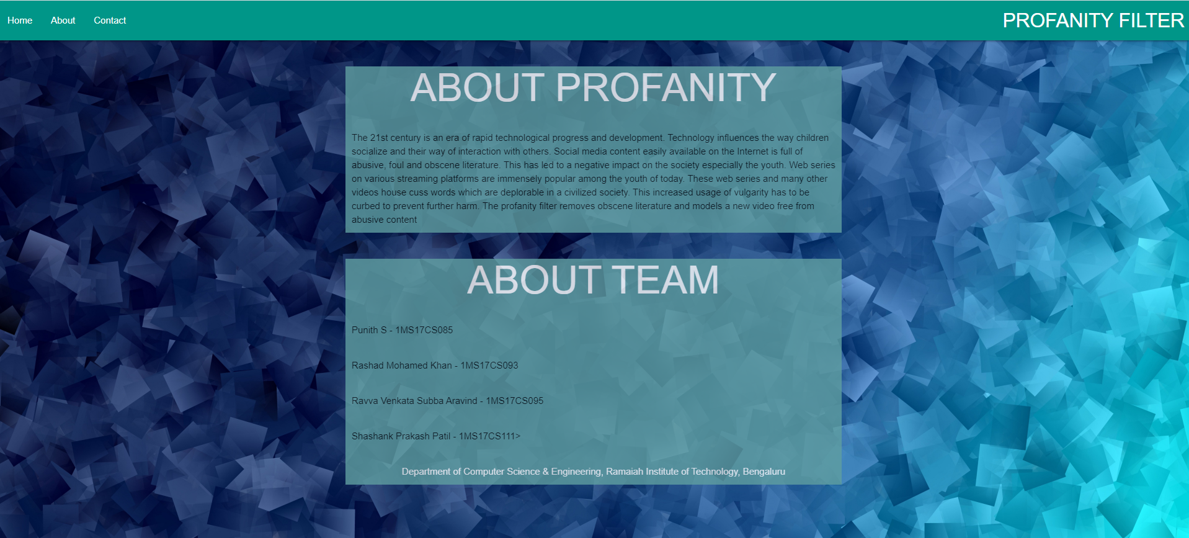
User interface – About page

Slide 11
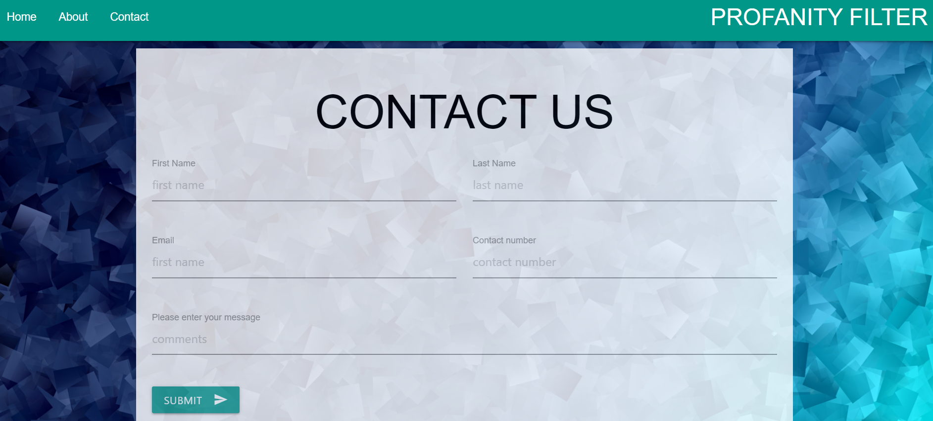
User interface – Contact page

Slide 12
Algorithm for audio conversion
For Converting audio file into wav format
Step1: start
Step2:extract audio(wav) from video(mp4) using ffmpeg
Step3: check the number of channels that wav file has using ffprobe and extract number by regular expression
Step4: if(no of channels ==’2’)
Split the wav file into right and left segments
Call convert function with either or right segments
else
call the convert function with the wav itself

Slide 13
Algorithm for speech recognition
Convert function
step1 : start
step2: declare ts array to empty
step3: response=set option parameter configuration and call the google API
step4: declare cuss words in an array
step5:split the response and check
if(splittedword in cuss words array)
get the timestamp
add to ts
step6: convert the time stamp into suitable format can be used with ffmpeg
step7:if(ts is not empty)
convert the video (mp4) into filtered (mp4) muting between ts
else:
return the actual video itself

Slide 14
Conclusion
The new video will have the word filtered added to the original video name
A prompt will be displayed to the user from which the new video can be downloaded
The downloaded video will be free from abusive words as all cuss words appearing in the video will be silenced

