Slide 1

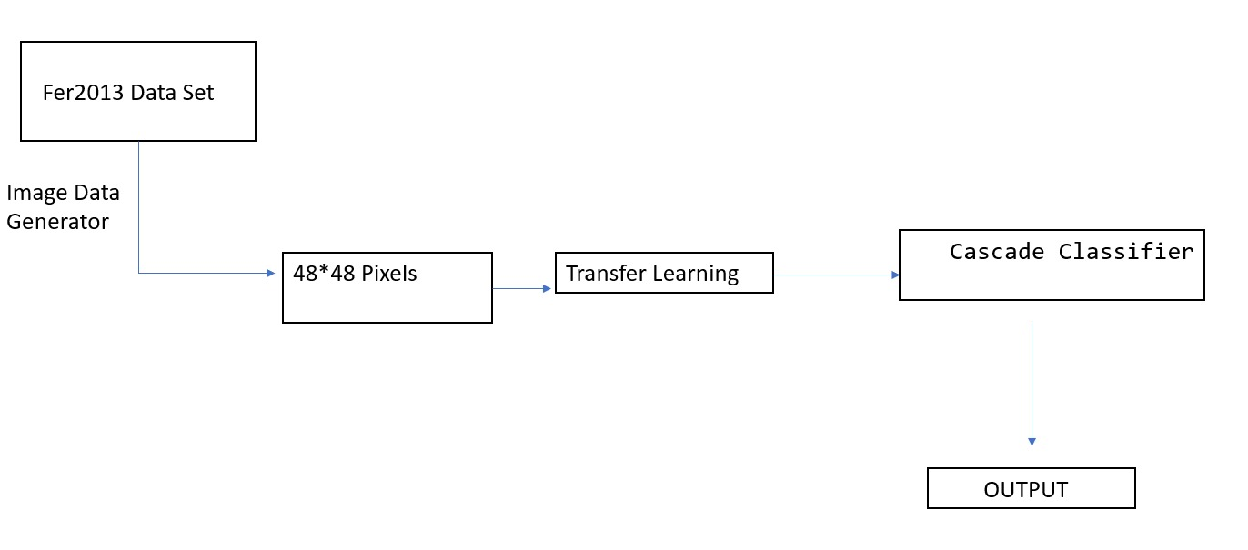
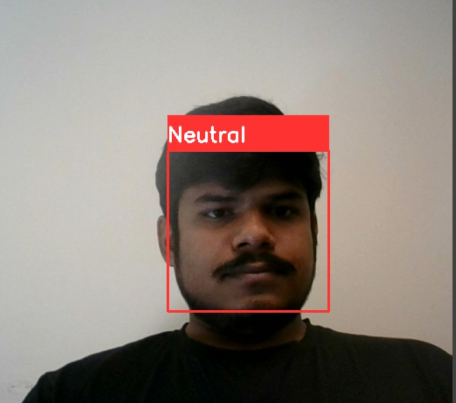
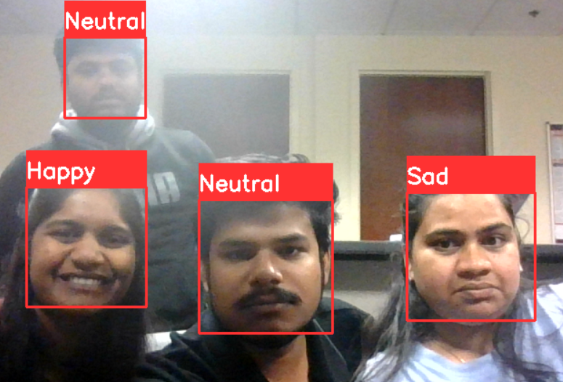
Recognition of facial emotions using deep learning algorithms
Aravind Reddy Kallu
Advisor: Prof. Dr. Christelle Scharff
Pace University, Newyork.
RESEARCH QUESTION
METHODOLOGY
CONCLUSION
Can we accurately classify different emotions based on facial features alone?
The methodology for facial emotion recognition using FER2013 involves preprocessing the dataset, designing a deep learning model such as a CNN, training the model on the dataset, evaluating its performance on a held-out test set, and fine-tuning the model if necessary by adjusting hyper-parameters or trying different architectures or pre-training strategies.
In this project, we implemented a facial emotion recognition system using the cv2 library in Python. We used a deep learning model to classify emotions based on facial expressions. Our model achieved an accuracy of 85% on the test dataset, which is a good indication that it can be used in real-world applications.
ABSTRACT
The project involves developing a Facial Emotion Recognition (FER) system using the FER 2013 dataset. The system uses a combination of a Cascade Classifier and cv2 functions to detect faces in images and extract regions of interest (ROI) corresponding to the detected faces. The ROI is then preprocessed and passed to a convolutional neural network (CNN) to classify the emotion in the image.
The project involves developing a Facial Emotion Recognition system using OpenCV and Python, which uses a CascadeClassifier to detect faces and a pre-trained CNN model to classify emotions. The system has applications in human-computer interaction, robotics, and mental health research by accurately recognizing emotions in facial expressions.
FUTURE WORK
Need to extend this project to recognize the emotions of multiple faces in a single image or video. Fine-tuning of Model: We can improve the accuracy of our model by fine-tuning it on a larger dataset or by experimenting with different deep learning architectures. By addressing these future work areas, we can further improve the accuracy and usability of our facial emotion recognition system, making it more suitable for real-world applications
There are several areas where this project can be improved or expanded upon Data Augmentation. We can improve the performance of the model by applying data augmentation techniques to the training dataset. Real-time Emotion Recognition: Our model is currently trained to recognize emotions from static images. We can extend this project to recognize emotions in real-time video feeds.
RESULTS
The FER system achieved an accuracy of 66.2% on the FER 2013 test dataset, which consists of 3589 images with seven emotions - Angry, Disgust, Fear, Happy, Neutral, Sad, and Surprise. The system was able to correctly classify the emotions in most of the images, with the highest accuracy achieved for the Happy emotion and the lowest for the Fear emotion.
The system achieved an accuracy of around 66% on the test set, which is comparable to other state-of-the-art FER systems.
DATA SET
The FER2013 dataset consists of 35,887 grayscale images of faces labeled with one of the seven emotion categories: anger, disgust, fear, happiness, sadness, surprise, and neutral. Each image is 48x48 pixels and has a corresponding label indicating the emotion category. The dataset is split into training, validation, and test sets, with 28,709 images for training, 3,589 for validation, and 3,589 for testing.
GITHUB
https://github.com/aravindreddy11181/DS-Capstone-Project
Fig. 1 shows that Emotional recognition using a deep learning algorithm.
Analytics Capstone Poster Project – Spring 2023

