Slide 1

Cloud-ATS — Azure Deployment
Infrastructure as Code + Secure Architecture

Slide 2
Why Terraform?
Automated Provisioning
Infrastructure as Reusable Code
Workspaces & Remote State
Transforms manual Azure deployments into repeatable automation—reduces human error and deployment time.
Architecture expressed as modules and variables promotes reuse across environments and teams.
Supports dev/prod workspaces with backend remote state in Azure Storage for safe collaboration and state locking.

Slide 3
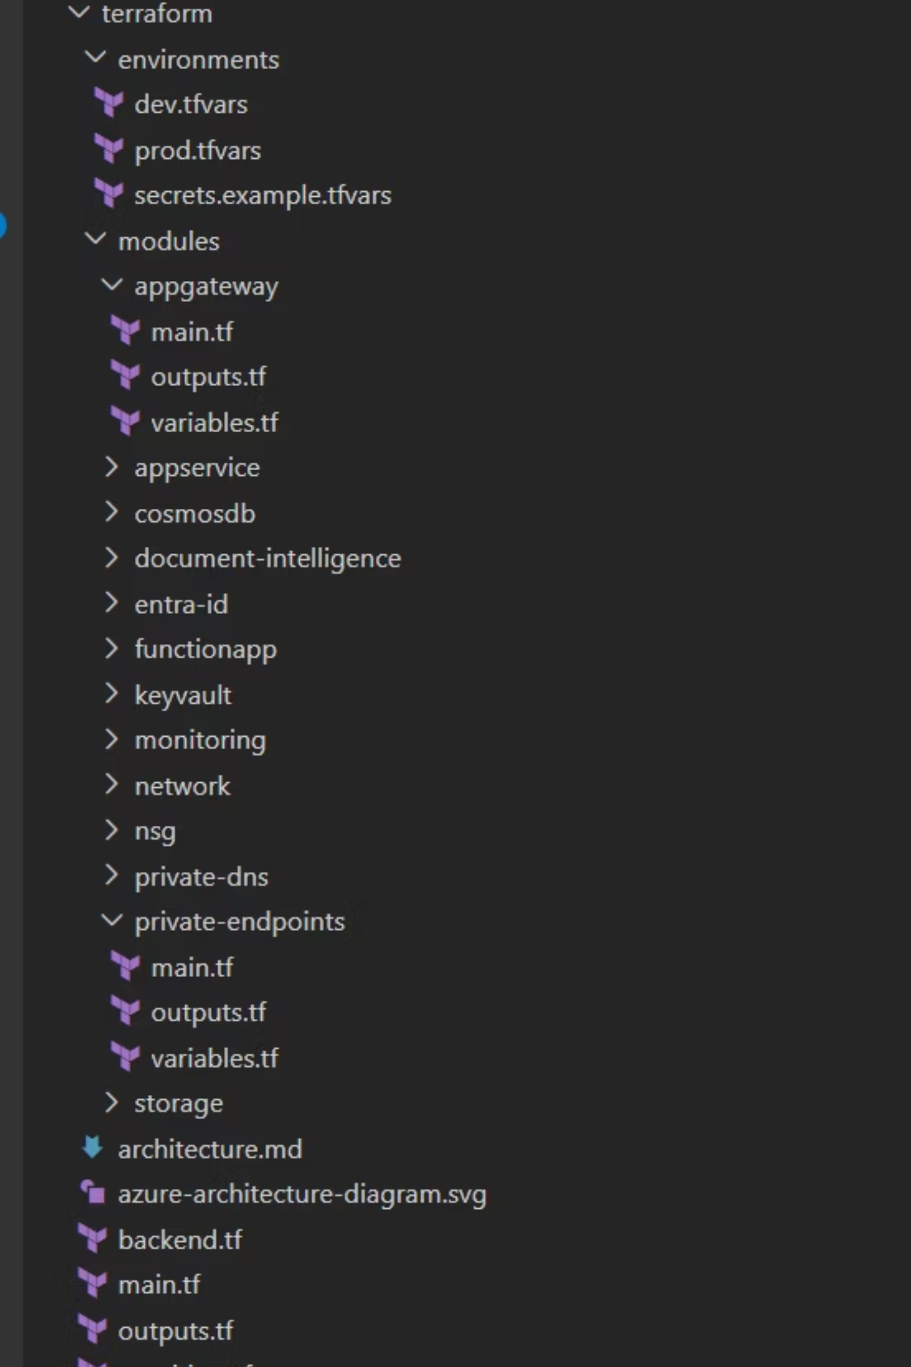
Repository Structure — Root
Organized layout enforces clarity between orchestration, inputs, and environments.

Slide 4


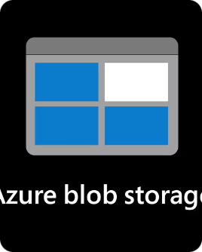




Services Used
Application Gateway WAF v2
Azure App Service (Linux)
Azure Storage (Blobs)
Azure Cosmos DB (MongoDB API)
Secure public ingress with OWASP rule sets, bot protection, and TLS termination.
Managed hosting for the Cloud-ATS web UI and API with deployment slots for safe rollouts.
Resume uploads with lifecycle policies and event-driven triggers to functions.
Low-latency document store for ATS records with regional replication options.
Azure Key Vault
Azure Functions
Azure Document Intelligence
Centralized secrets, certificates, and key management accessed via managed identities.
Event-driven resume processing and integration with Document Intelligence for parsing.
Optical and semantic extraction of resume fields—structured data output to Cosmos DB.

Slide 5
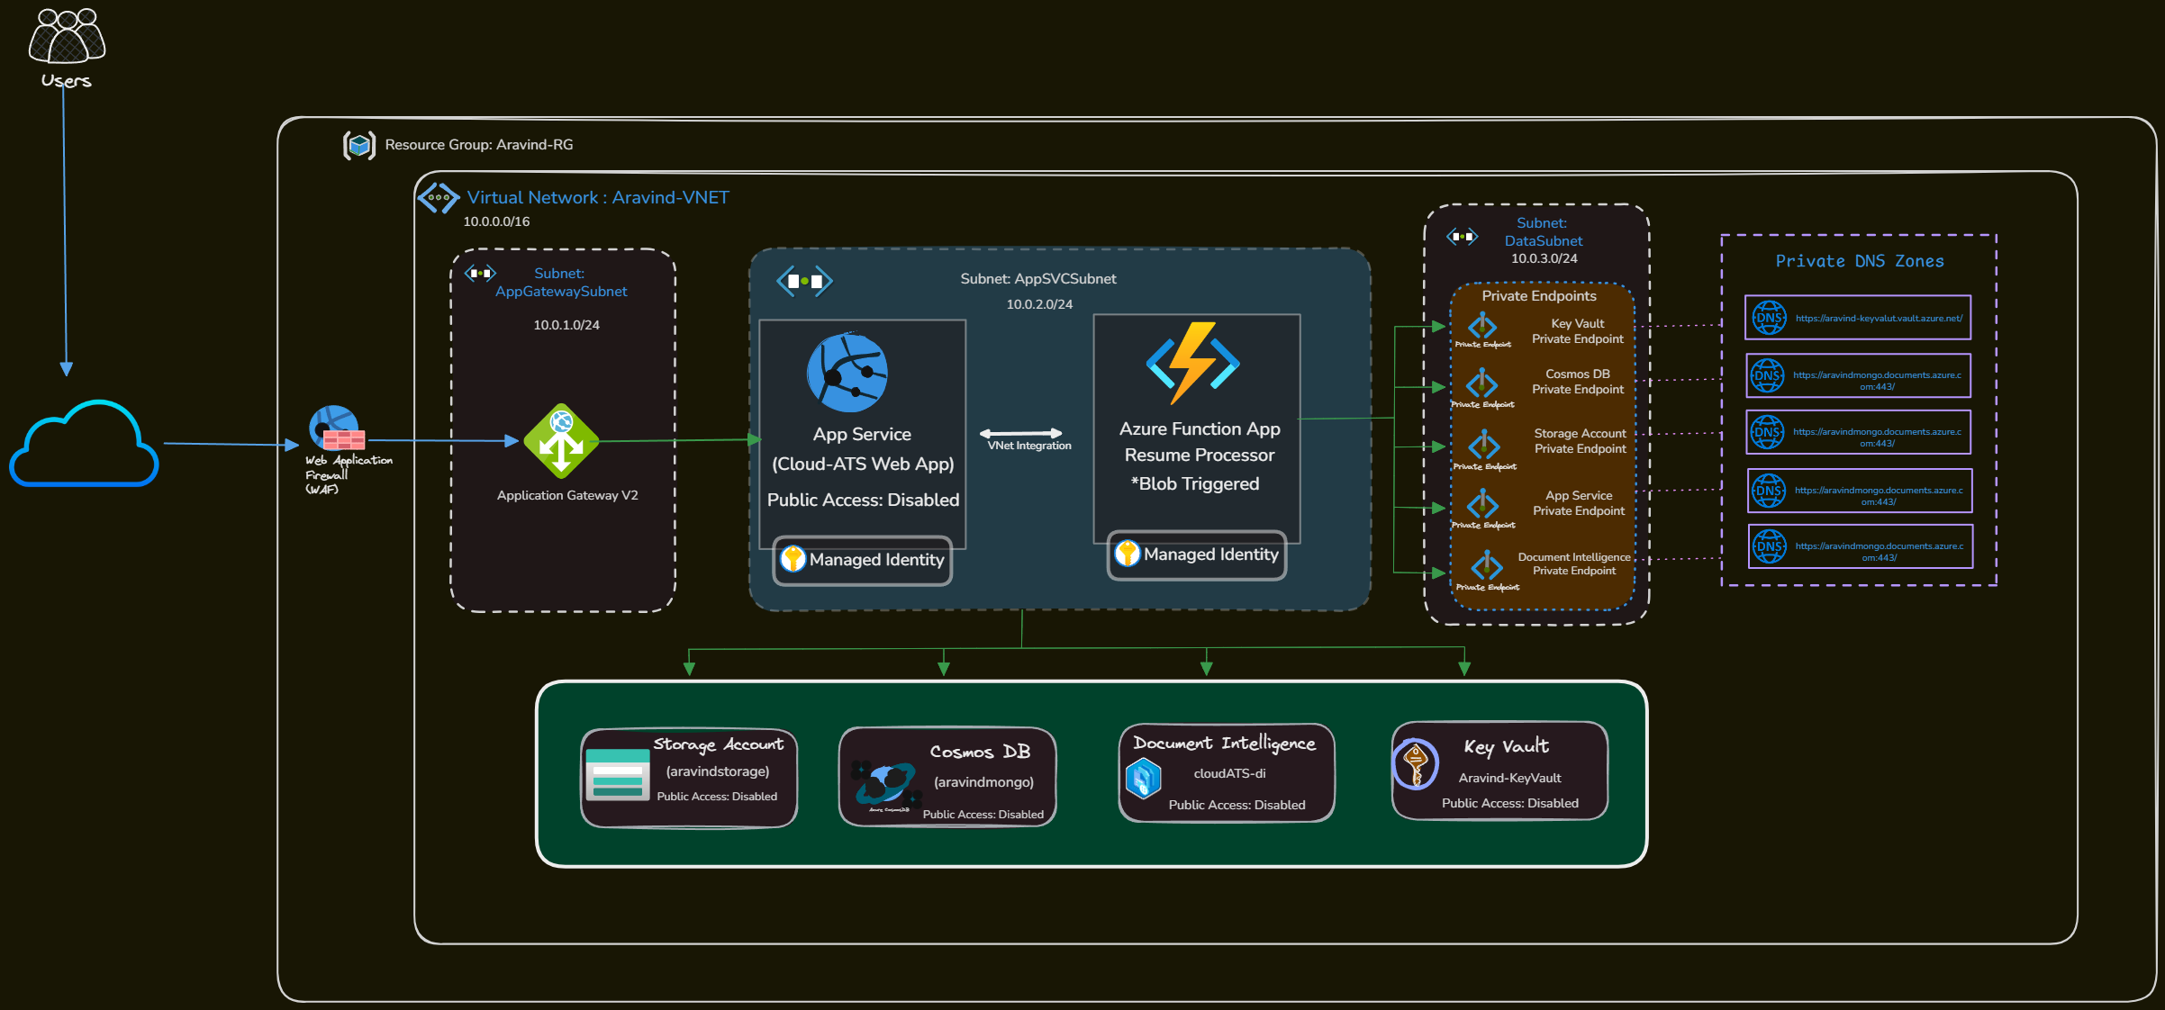
Azure Infra Architecture

Slide 6

Azure Functions — Role & Flow
01
Trigger
Blob created event for resume upload triggers the Function (Event Grid / Blob trigger).
02
Parse
Function calls Azure Document Intelligence to extract structured fields (name, email, experience).
03
Score & Persist
Compute ATS score, normalize fields, and update Cosmos DB with transactionally consistent writes.
04
Notify
Emit event / send email or webhook to notify downstream systems or users asynchronously.
Benefits: decoupling increases scalability, enables retry/replay semantics, and isolates heavy parsing from web requests.

Slide 7

Managed Identity & Access Patterns
Use system-assigned managed identities for compute resources to eliminate secrets in code and pipelines.
App Service & Functions use system-assigned identities for Key Vault and Storage access.
Key Vault access controlled via Azure RBAC and Key Vault access policies scoped to identities.
Storage and Cosmos DB access via role assignments (e.g., Storage Blob Data Contributor) scoped to managed identities.
Least privilege: grant minimal roles for required operations and scope to resource groups or resource IDs.

Slide 8
Thank You

