Slide 1
Finding similar Images using Earth Movers Distance
By Priyan and Aravind

Slide 2
Problem
To find the similarity (or differences) between image distributions.
To find the quantity “Earth Movers Distance” which measures the amount of dissimilarity.

Slide 3
Formulation of Problem.

Slide 4
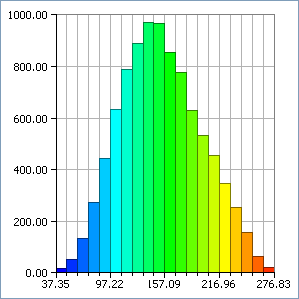
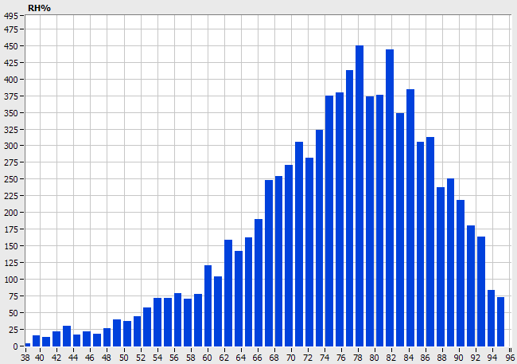
Image Representation
Image is represented using Histograms.
  The pictures are converted to gray-scale
  Each pixel has a value which ranges from 0 to 255,which shows the grayness of each pixel.
  Histogram represents the no. of pixels corresponding to each bin.

Slide 5
Earth Movers Distance(EMD)
Intuitively, given two distributions, one can be seen as a mass of earth properly spread in space, the other as collection of holes in the same space. Then, the EMD measures the least amount of work needed to fill the holes with earth.
Let I and J be the two distributions given. Let C_{i,j} be the “ground distance” between element i in first distribution and j in the second. We want set of flows f_{i,j} that minimizes the overall work.
The solution to this minimization problem gives us the EMD.

Slide 6
The Optimization Problem
Objective function:
    Minimize ∑ ∑ f_{i,j} C_{i,j}
Subject to:
  f_{i,j} >= 0 (The amount of earth moved can’t be negative)
  ∑f_{i,j} <= y_{j} , where y_{j} is the capacity of holes in the 2nd image.
  ∑f_{i,j} <= x_{i} , where x_{i} is the amount of earth to be moved.
iЄI
jЄJ
iЄI

Slide 7
Feasibility Condition
For the optimization to have a feasible solution the amount of earth to be moved and the amount of earth the holes could hold should be equal.
  Feasibility Condition:
    ∑ y_{j} = ∑ x_{i}
jЄJ
iЄI

Slide 8
Problem Type
It is a Constrained Optimization problem.
It belongs to the category of Linear Programming problem.
Has both Inequality and equality constraints.
Its actually a variation of Producer-Consumer Transportation problem.

Slide 9
How we solved the problem
Formulated the given problem to Non-Std. Linear Programming Problem.
Converted it to standard linear programming problem by introducing slack variables.
Used Two-Phase Simplex method to find initial Basic feasible point, and solved the Std. LPP
Found out “ground distances” to be used in the objective function using arbitrary image database.

Slide 10
Why Simplex ?
Few variations of Simplex can be highly efficient in calculating Earth Movers Distance. So we started with a generic Simplex method so we can improve it in the future.

Slide 11
Test Data
A group of images, similar and dissimilar to a sample image
Program should find the best matches.
The images are arranged in decreasing similarity with the sample image.

Slide 12
Future Enhancements
Implement a different variant of simplex which will make the EMD calculation efficient.
Better ground distance formulation using a bigger image database.
Extending EMD for color distributions.

Slide 13
References
Yossi Rubner, Carlo Tomasi, and Leonidas J. Guibas, A Metric for Distributions with Applications to Image Databases, 1998 IEEE International Conference on Computer Vision
Yossi Rubner, Carlo Tomasi, and Leonidas J. Guibas, The Earth Movers Distance as a Metric for Image Retrieval, 1998 IEEE PAMI.

Slide 14
Thank You

