Slide 1
DO NOT TRACK ME
MEMBERS : ARAVIND SENGUTTUVAN, PRAVEEN KUMAR SHANMUGAM
INSTRUCTOR: TAMARA DENNING

Slide 2
INTRODUCTION
As the smartphones transition to complete our human life, we all have secrets in it to safe guard.
Most of the users connect their smartphones to the internet 24x7.
Due to this reason, users are not aware of what information sensitive about them is given away in this Internet era of applications.

Slide 3
PROBLEM STATEMENT
“We focus on protecting smartphone user’s GPS location around user preconfigured sensitive locations”.

Slide 4
THREAT MODEL
The usual way of stealing the GPS activity of the user is as below. First, the application will ask for permission to allow access to the GPS location services during installation, and pretty much user is unaware of the GPS monitor activity afterwards.
When blocking location services, once users enter sensitive spaces, an intelligent attacker can guess this interruption in GPS and get to know the location.

Slide 5
RELATED WORK
“PlaceAvoider: Steering First-Person Cameras away from Sensitive Spaces”. It concentrates on blocking location services once users enter sensitive spaces but an intelligent attacker can guess this interruption in GPS and get to know the location.
“Protecting Location Privacy Through Path Confusion”. They confuse the adversary by a location perturbation algorithm which provides the same location as much as possible when the two users meet (or) nearby. The paper’s algorithm runs on the service end and provides radius within the quality of service constraint for that service in the service provider.

Slide 6
OUR IDEA
We propose to mock the original location to all the android applications when user feels he is around a sensitive location.
Whenever user enters a location space with a pre-configured radius around sensitive location, we try to mock locations by tracing along the circumference of that sensitive space
Since user smartphone is always connected to the internet and we can’t expect him to be read every notification about his location mocking, we notified the GPS mocking activity to one’s smart watch.

Slide 7
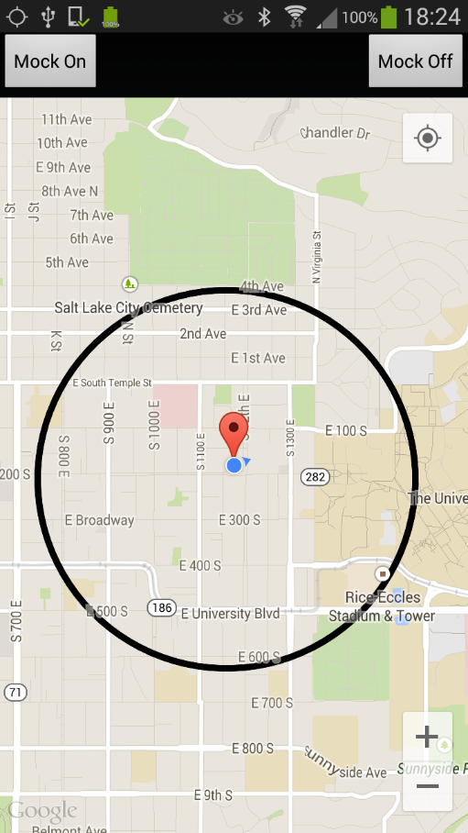
PRIVACY GEOFENCING

Slide 8
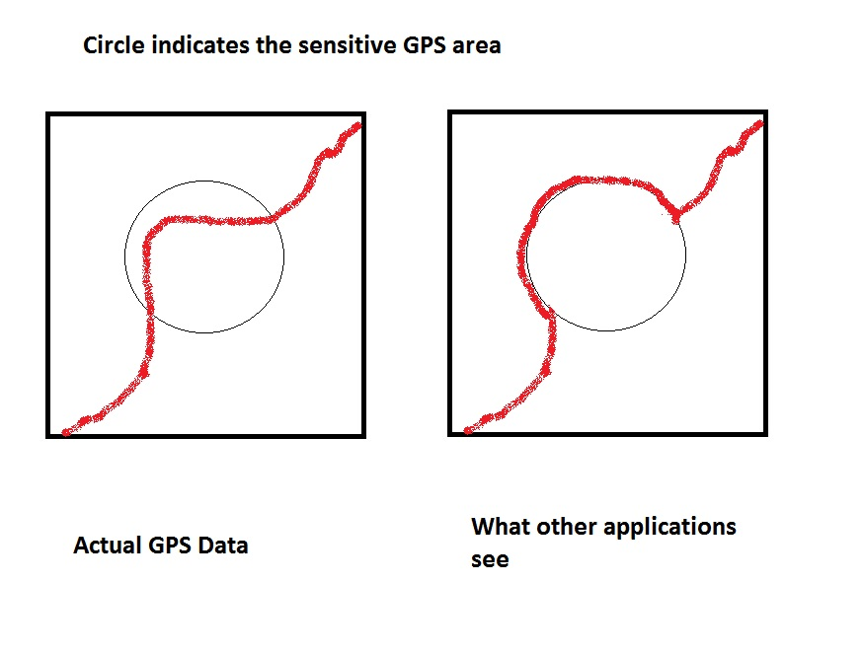
CIRCUMFERENCE TRACING (THE PUSH)

Slide 9
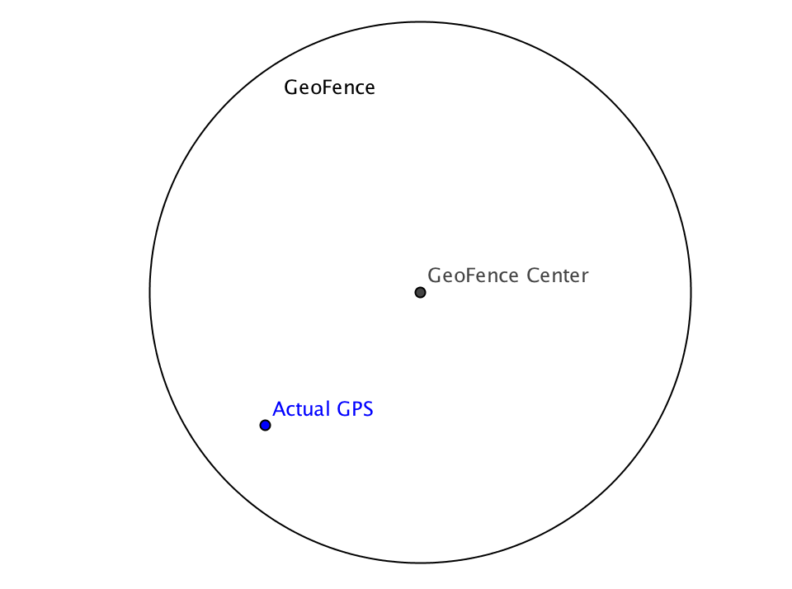
CIRCUMFERENCE TRACING (THE PUSH)

Slide 10
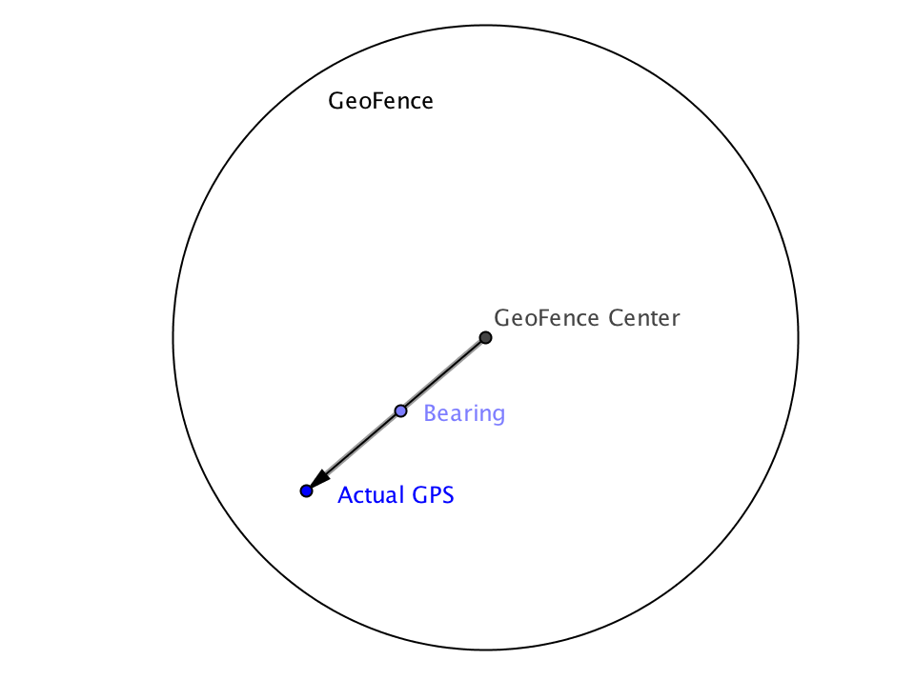
CIRCUMFERENCE TRACING (THE PUSH)

Slide 11
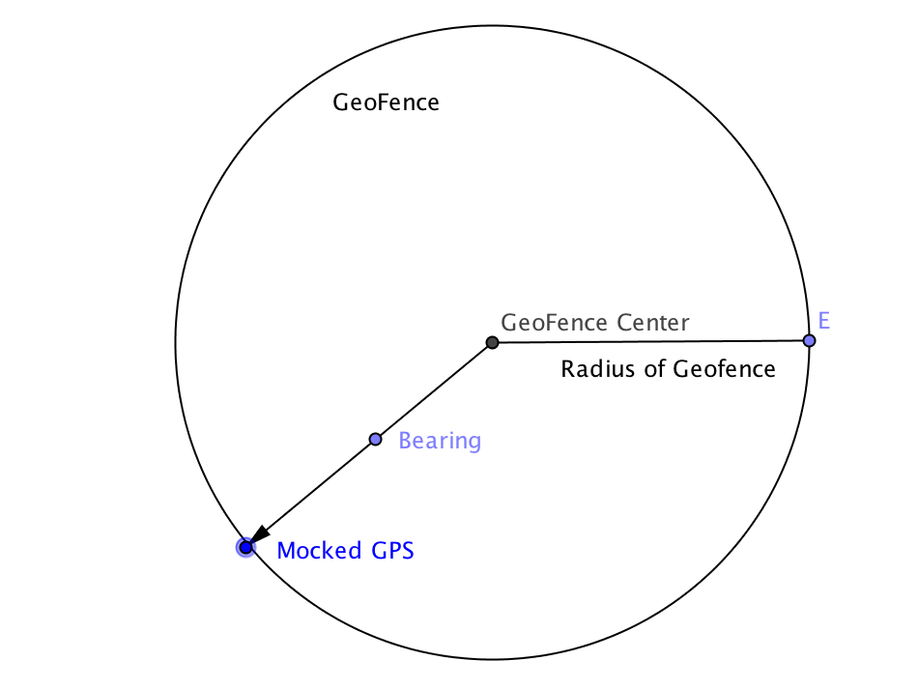
CIRCUMFERENCE TRACING (THE PUSH)

Slide 12
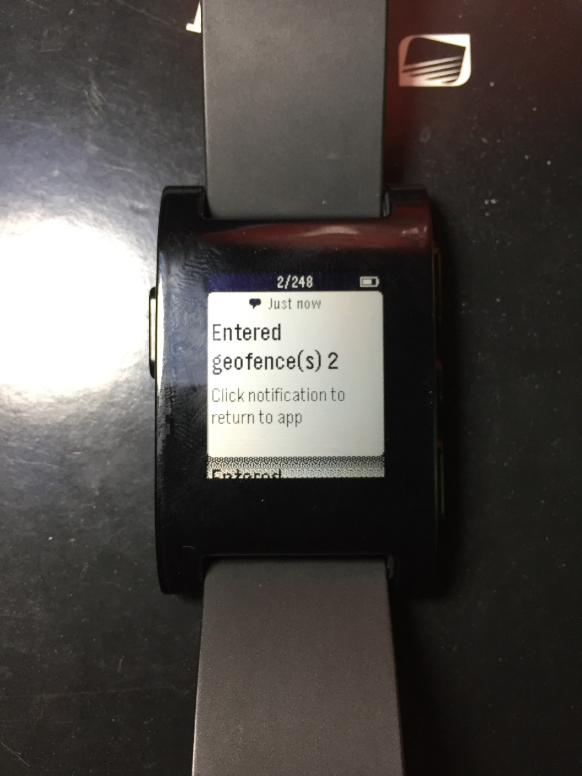
PRIVACY GEOFENCE ENTERED

Slide 13
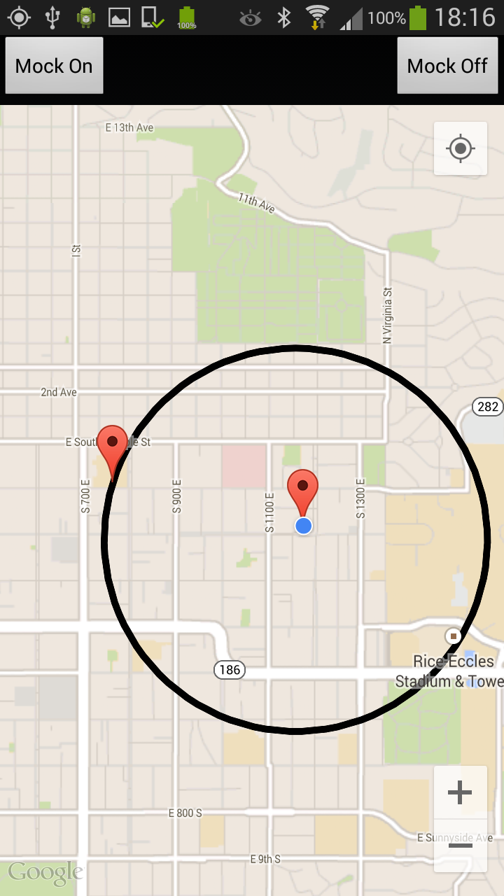
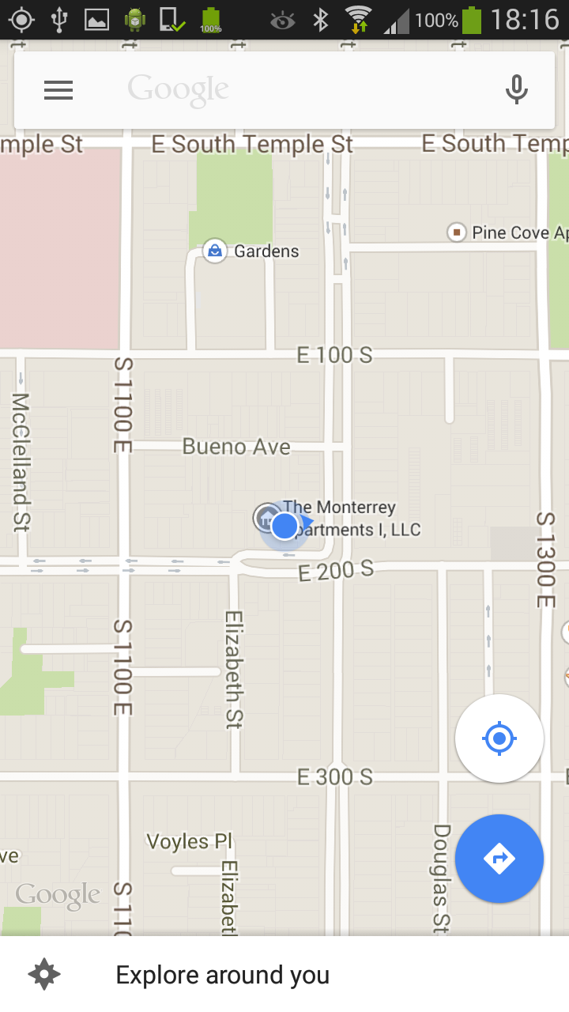
MOCK OFF
Our application
Other applications like Google maps

Slide 14
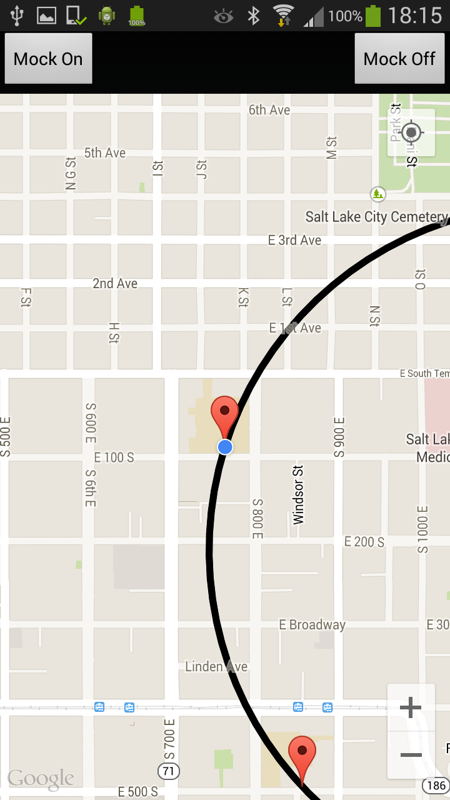
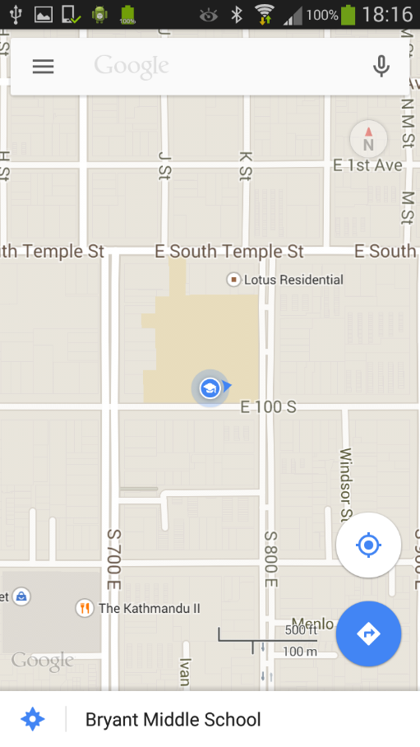
MOCK ON
Our application
Other applications like Google maps

Slide 15
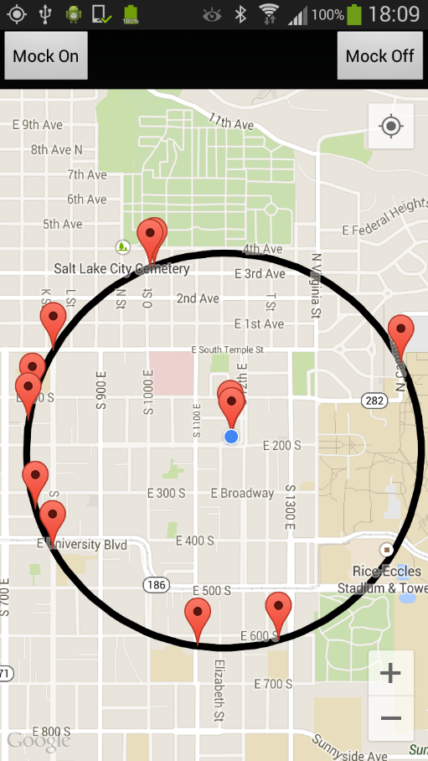
PATH TRACING

Slide 16
DEMO

Slide 17
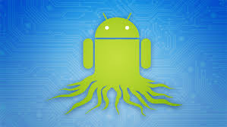
Challenges
Don’t Root.

Slide 18

Challenges
Zero changes to existing Applications

Slide 19

Challenges
Google Android Services – Play service. [Google keep changing :X]

Slide 20
Future work
We plan to arrive at more confusing mocking methods than naïve circumference tracing and mocking.
Mock location can be a sensitive location - Colliding privacy fences.
Use client only Geofence detection – battery drain.
Automatic mock location toggle on Privacy Geofence Enter & Exit.
App GPS stats – fine grained control.

Slide 21
REPO LINK
https://github.com/aravindsen/DNTMe

Slide 22
QUESTIONS????

