Slide 1


SMART INDIA HACKATHON 2025
Problem Statement ID – SIH 2025 (Operational Meteorological Intelligence)
Problem Statement Title - Live Geospatial Meteorological Intelligence & Unified Hazard Ingestion Dashboard for India
Theme - Disaster Management & Smart Governance
PS Category - Software
Team ID - 50617
Team Name - Antigravity (Promatrs)

Slide 2





Promatrs
Live Geospatial Meteorological Intelligence & Unified Hazard Ingestion Platform
PROBLEM STATEMENT
• Weather information across India is highly fragmented across separate portals (IMD bulletins, MOSDAC satellite images, regional DWR radars, static PDFs).
• Critical Decision Gap: Disaster commanders and citizens cannot correlate ground AWS observations, convective nowcasts, and official warnings on a single interactive map.
• Opaque & Misleading Alerts: Traditional apps display generic cloud icons or synthesize unverified forecasts instead of presenting genuine ground-truth telemetry and traceable official bulletins.
PROPOSED SOLUTION
• Real-Time Geospatial Intelligence: Ingests 1,165+ IMD AWS stations, INSAT-3DR satellite, and DWR Doppler radars into a single interactive GIS dashboard.
• Clear Tripartite Separation: Strictly distinguishes LIVE OBSERVATIONS (measured ground facts), NOWCASTS (0-3h severe convective events), and WARNINGS (official 1-5 day alerts).
• 100% Real Available Data: Zero simulated weather values; every reading has verified data provenance, timestamps, and data freshness indicators.
• Dynamic Station & Radar Ingestion: Spatial nearest-station matching with range limits; displays 'AWS/Radar Data Unavailable' rather than fabricating data.
• Sub-30s Automated Event & Warning GIS: Spatial district polygons, radar 250km rings, and WMO CAP protocol integration.
Who We Serve
Disaster Management Authorities (NDMA, SDMAs, EOCs)
Aviation, Agriculture & Infrastructure Planners
District Highway Engineers, First Responders & Citizens
Operational GIS Dashboard: Direct IMD Ingestion Active
Mandate: Zero Fabricated Weather Values • 1,165+ Operational IMD AWS Stations Ingested

Slide 3
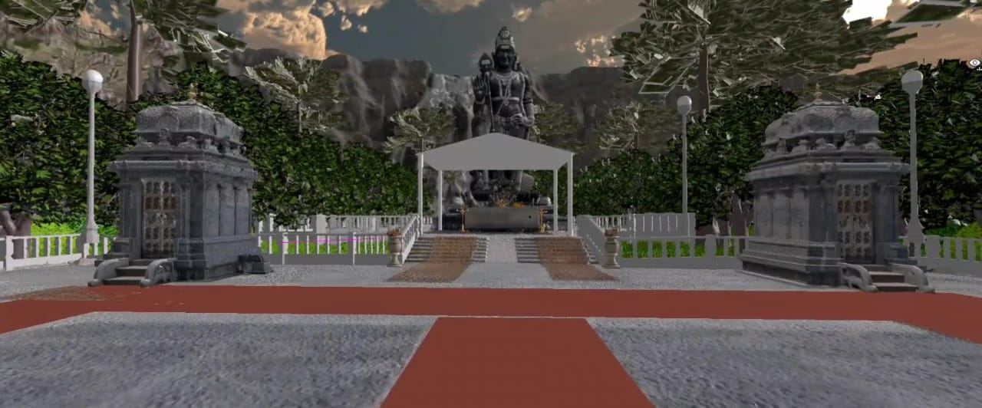
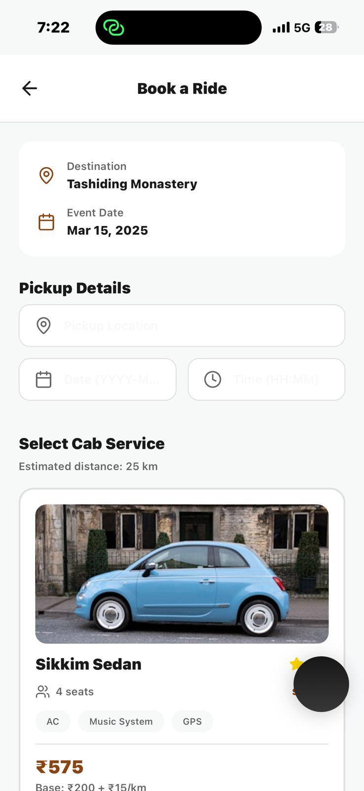

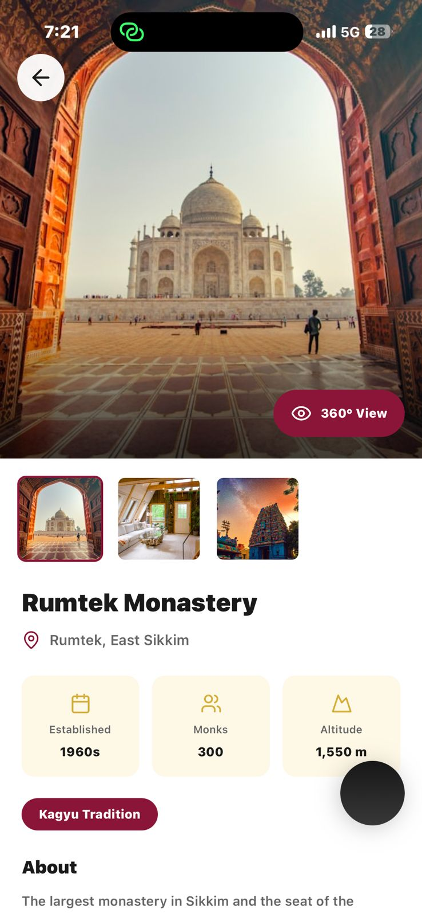


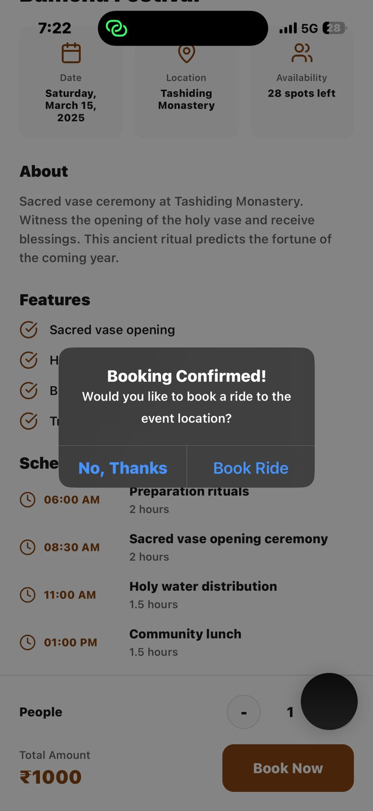
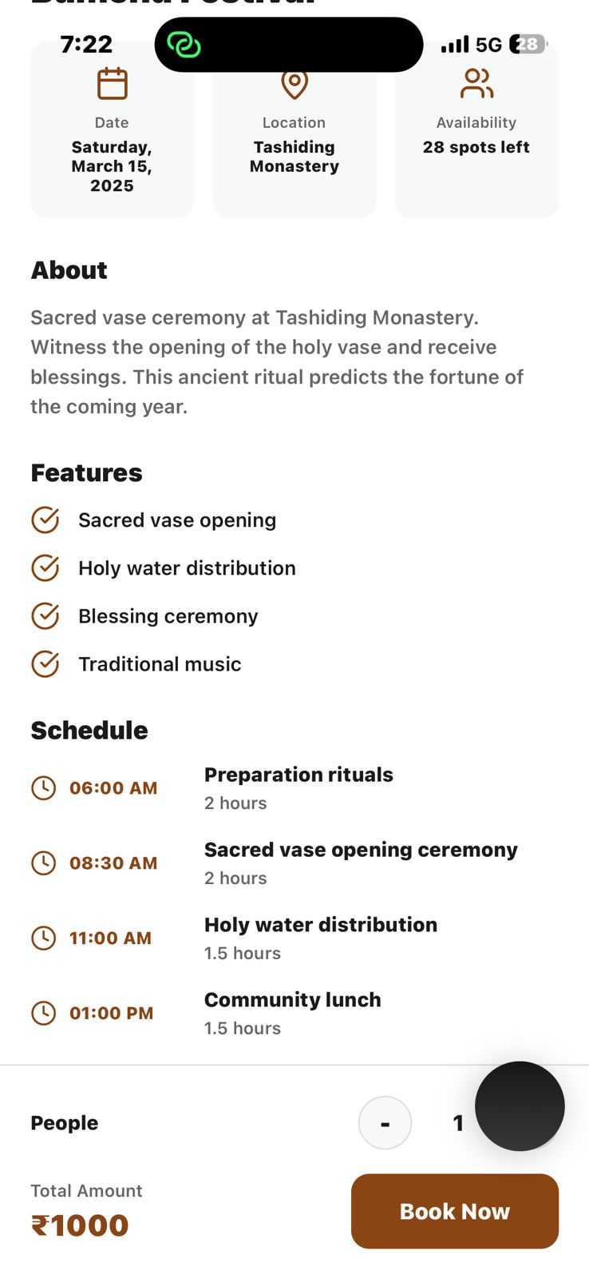
TECHNICAL APPROACH & DATA FLOW ARCHITECTURE
Promatrs
Multi-Source Data Flow Pipeline
Technologies & Ingestion Streams
• Ingestion: Automated authenticated fetchers (JWT + API Key) polling official IMD/MOSDAC endpoints.
• Validation: Coordinate bounding box (India 6°-38°N, 68°-98°E), physical sanity checks (-15°C to 55°C, 0-500 mm rain).
• Spatial Engine: Haversine distance matching connects selected location to nearest AWS (<120km) and DWR (<250km).
• Tripartite Classification: Keeps Observations (Gauges), Nowcasts (0-3h Convection), and Warnings (1-5 Day) distinct.
• GIS Engine: Renders administrative district polygons, warning heatmaps, radar range rings, and interactive inspection ping.
• Data Provenance: Traceable metadata (station ID, observation timestamp, received time, latency) on every metric.
• IMD AWS/ARG Network — Real-time ground observations (temp, humidity, 1h/24h rain, wind, MSLP)
• ISRO MOSDAC / INSAT-3DR — Rapid-scan geostationary TIR-1 cloud-top cooling & glaciation
• IMD Doppler Weather Radar — 250km volumetric PPI reflectivity (dBZ) & rain rates
• IMD NWFC APIs — Authoritative 0-3h nowcasts & 1-5 day district hazard bulletins
• Next.js 14 & Leaflet/MapLibre — GPU-accelerated GIS engine with district polygons
• FastAPI & Python Backend — Strict validation, Haversine spatial queries & caching
For detailed understanding, click here.

Slide 4

FEASIBILITY AND VIABILITY
Promatrs
Operational Feasibility
Technical Feasibility
Financial Feasibility
• Built specifically for State Disaster Management Authorities (SDMAs), district control rooms, and highway engineers.
• Zero learning curve: Clean operational layout (~65% map / ~35% context panel) showing what is happening and where.
• Proven, working system connecting directly to live official IMD and MOSDAC endpoints.
• High-speed geospatial querying using Haversine indexing without database deadlocks.
• Standard Open Geospatial Consortium (OGC) GeoJSON and WMO CAP-v1.2 XML protocol compliance.
• 100% Open-Source software stack (Next.js, Python, Leaflet, MapLibre, PostgreSQL) with zero proprietary GIS licensing fees.
• Utilizes public governmental meteorological services (IMD Open Data, ISRO MOSDAC, NASA GPM).
Feasibility
• Data Latency & Outages: Upstream feeds can experience network delays.
• Sensor Density: Remote mountain areas have fewer AWS stations within 120km.
• Radar Blind Spots: Mountain topography and 250km DWR range limits can leave valleys unmonitored.
Challenges and Risks
Risks and Mitigation
• Transparent Status: Display real status (🟢 LIVE, 🟡 DELAYED, 🟠 STALE, 🔴 UNAVAILABLE) and exact observation age.
• Strict 'Data Unavailable' Policy: Display honest absence of data rather than generating misleading synthetic numbers.
• Multi-Source Triangulation: Combine satellite cloud-top cooling with ground gauges when radar is outside 250km limit.

Slide 5
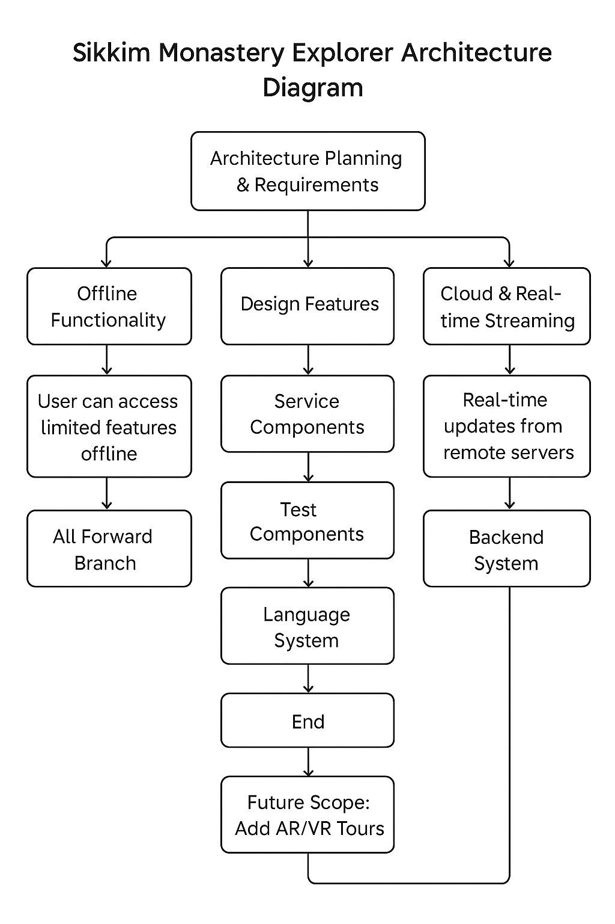



IMPACT AND BENEFITS
Promatrs
For Disaster Authorities & First Responders
• Unified situational awareness: eliminates switching across 6+ disparate portals during emergencies.
• Instant spatial correlation of official IMD warnings with ground-truth rainfall telemetry.
• Common Alerting Protocol (CAP) compliance for geo-targeted public safety broadcast.
For Agriculture, Infrastructure & Public Safety
• Farmers & district officers access genuine localized rainfall observations for irrigation & flood mitigation.
• Transport & highway departments monitor rainfall corridors to pre-emptively close inundated passes.
• Citizens receive geographically precise advisories without confusing raw meteorological jargon.
For Government & Meteorological Research
• Single consolidated spatial dashboard supporting MoES, NDMA, and state government operations.
• Defensible, verifiable data provenance: every value can be audited with station ID and observation timestamp.
• Scalable nationwide architecture capable of supporting all 36 States/UTs and 750+ districts.

Slide 6
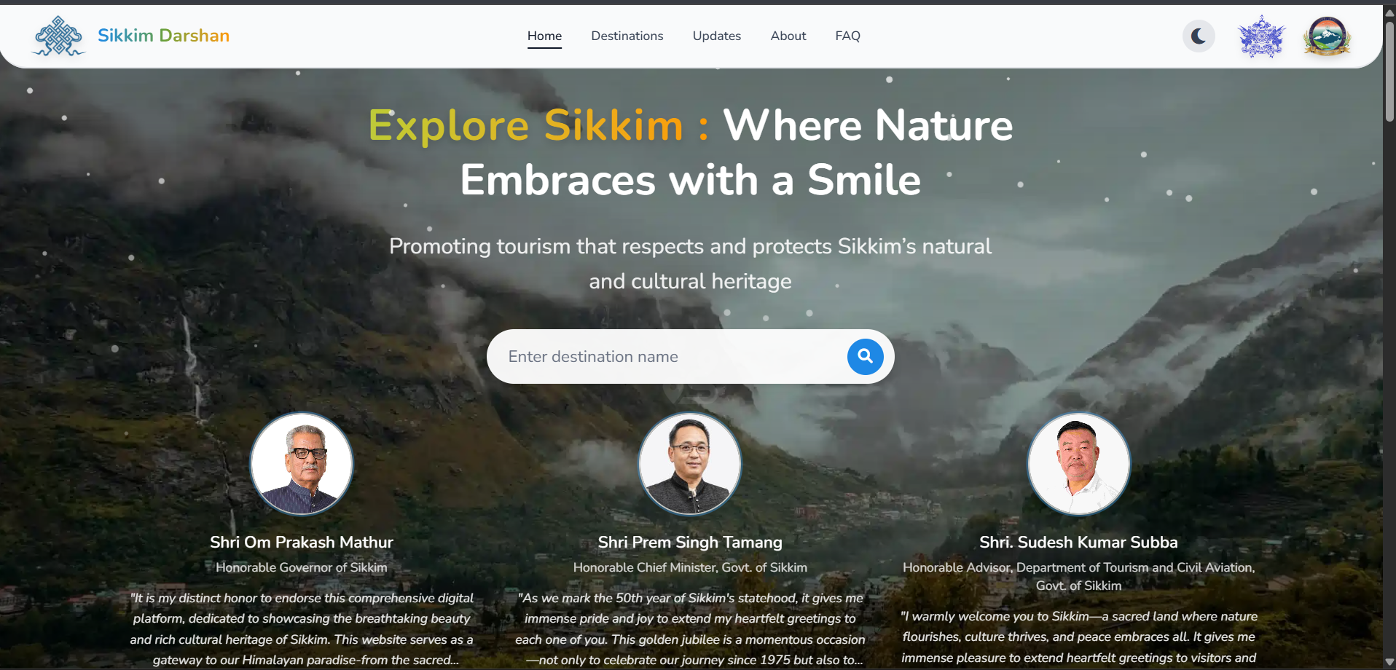
RESEARCH, REFERENCES & BENCHMARKS
Promatrs
Authoritative Standards & Government Initiatives
Benchmark Comparisons: Why This Platform?
• Commercial Weather Apps (AccuWeather, Google Weather): Focus on commercial consumer forecasts using global low-res models; blind to official IMD district nowcasts and radar sweeps.
• Official IMD Web Portals: Authoritative, but dispersed across multiple fragmented legacy websites with PDFs and static tables.
• Antigravity Intelligence Platform: Fuses authoritative IMD AWS, INSAT-3DR satellite, Doppler radar, and district warnings into one unified, real-time GIS operational command centre.
• IMD NWFC: National Weather Forecasting Centre operational bulletins, nowcasts, and AWS network standards.
• ISRO MOSDAC: Geostationary INSAT-3D/3DR rapid-scan infrared and water-vapour imagery protocols.
• NDMA SACHET: Common Alerting Protocol (CAP) standards for multi-hazard disaster warning dissemination.
• GSI Bhooskhalan & ISRO Bhuvan: Geospatial hazard mapping and terrain vulnerability standards.

Slide 7
SYSTEM ARCHITECTURE CREED & QUALITY STANDARD
Core Architectural Principles for Evaluators & Reviewers
1. REAL DATA: 100% genuine observations from IMD AWS, INSAT-3DR, and DWR radars. Zero fabricated weather values.
2. REAL GIS: Spatial representation via district polygons, warning zones, and radar range rings rather than cluttered icons.
3. CLEAR TRIPARTITE LOGIC: Ground Observations, Convective Nowcasts, and Official Warnings have distinct physical meanings.
4. TRACEABLE PROVENANCE: Every metric is traceable to station ID, observation time, received time, and data age.
5. DEFENSIVE FAILURES: Displays 'DATA UNAVAILABLE' with reason when a station/radar is out of range, rather than guessing.

