Slide 1


SMART INDIA HACKATHON 2025
Problem Statement ID – 26084
Problem Statement Title - Convective scale nowcasting for Thunderstorms, Hail & Cloudbursts (06 hr)
Organization - Ministry of Earth Sciences (MoES)
Department - National Centre for Medium Range Weather Forecasting (NCMRWF)
Category - Software | Theme - Disaster Management
Team ID - 50617 | Team Name - Antigravity (Promatrs)

Slide 2





Promatrs
Hyper-Local Convective-Scale Nowcasting Platform (0–6 hr Lead Time at 1–3 km)
PROBLEM STATEMENT (MoES / NCMRWF — PS 26084)
• Severe Convective Hazard: Thunderstorms, hail, downburst winds, and cloudbursts are India's deadliest rapid-onset hazards.
• NWP Computational Limitation: Traditional physics-based NWP models are too computationally slow to simulate violent storms developing within minutes, slipping through coarse grid resolutions.
• Short-Term Early Warning Gap: Existing systems lack hyper-local (1–3 km) 0–6 hour lead time nowcasts, leaving local administrations, aviation, and farming communities vulnerable to sudden devastation.
PROPOSED SOLUTION
• Multi-Source Data Fusion Engine: Real-time ingestion fusing Doppler Weather Radars (DWR reflectivity & velocity), geostationary satellite (INSAT-3D/3DR TIR-1 cloud-top cooling), and ground lightning detection networks.
• Early Convective Initiation (CI): Detects rapid storm genesis 30–60 minutes before severe radar reflectivity cores emerge.
• Dynamic Severe Storm Parameters: Real-time forecasting of lightning strike density, hail probability & MESH diameter, downburst wind velocity, and cloudburst threshold (≥100 mm/h).
• 1–3 km Interactive GIS Dashboard: Hyper-local hazard zones with real-time vector extrapolation and live countdown clocks for storm arrivals.
• Authoritative Data Integrity: Operates on genuine operational data streams with verifiable telemetry provenance.
Target Stakeholders
MoES / NCMRWF & Disaster Authorities (NDMA, SDMAs, EOCs)
Aviation Safety, Airport Towers & Low-Altitude Corridors
Rural Farming, District Engineers & Vulnerable Communities
Live Operational Dashboard: Multi-Source Fusion Active
NCMRWF Objective: 0–6h Lead Time • 1–3 km Hyper-Local Resolution • Live Arrival Countdown Clocks

Slide 3
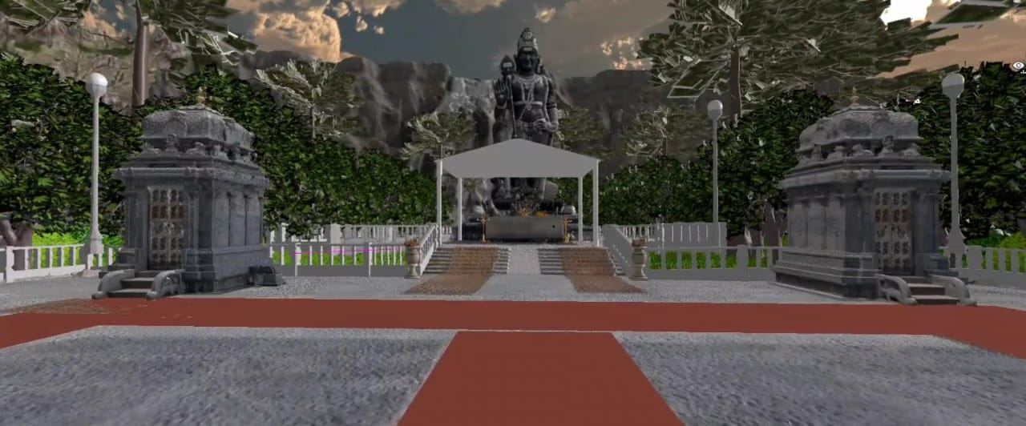
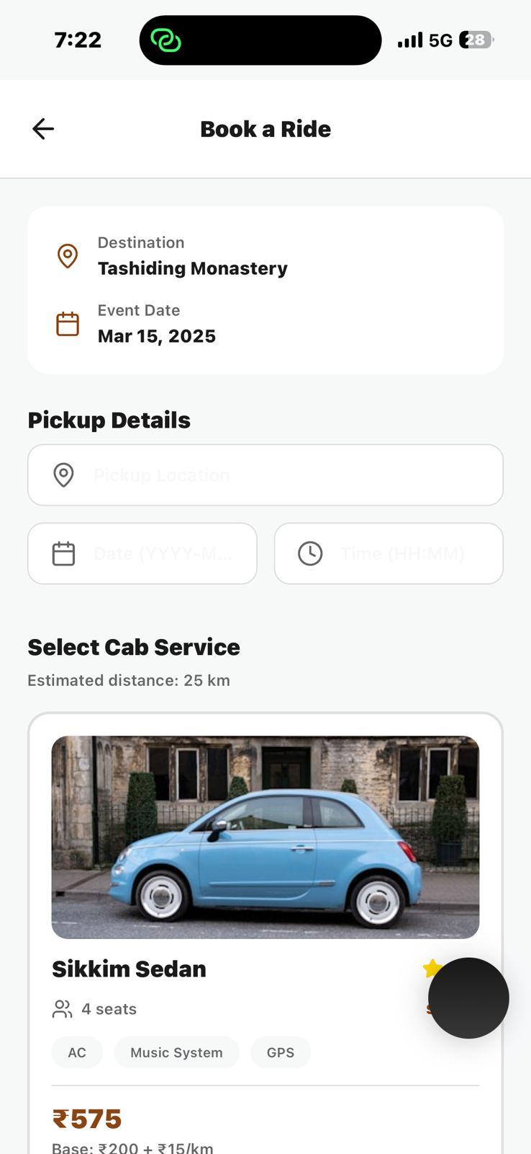

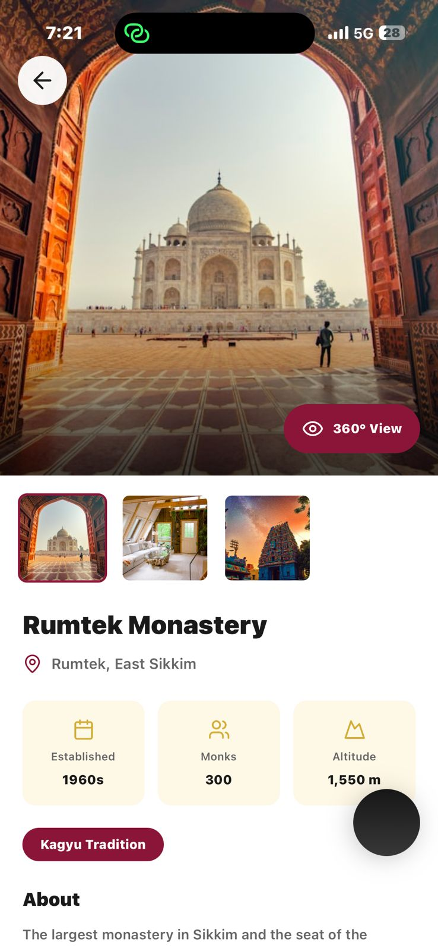


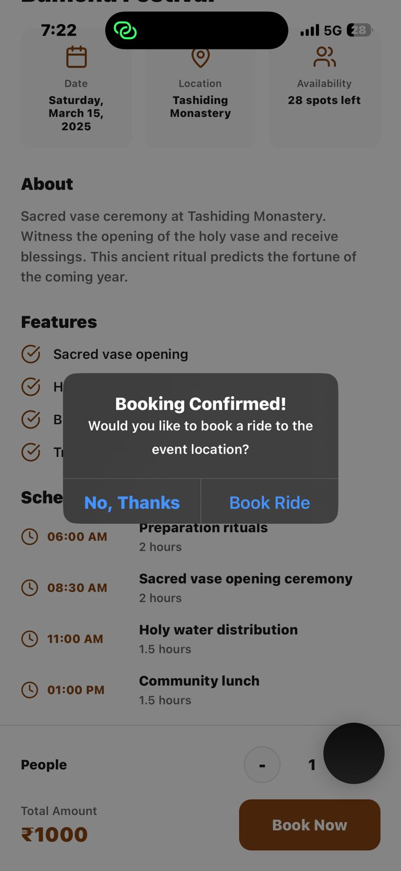
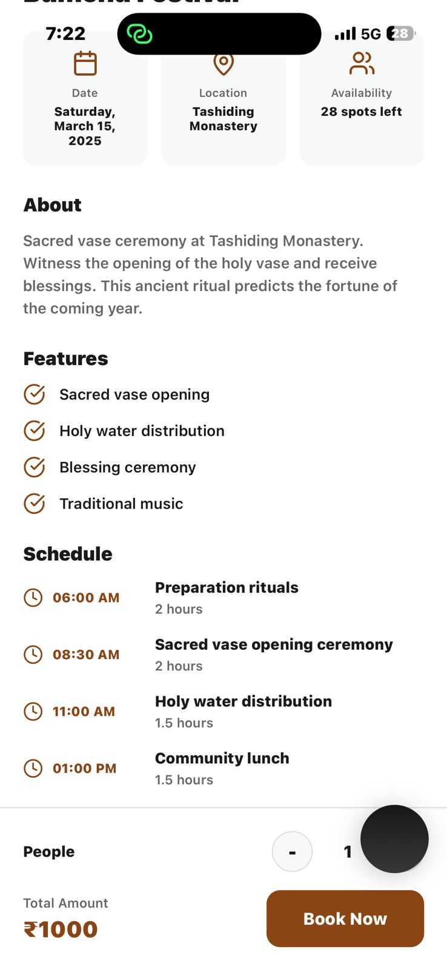
TECHNICAL APPROACH & DATA FLOW ARCHITECTURE
Promatrs
0–6h Convective Processing Pipeline
Multi-Source Ingestion & Fusion Streams
• High-Frequency Ingestion: Automated async pipelines ingest radar sweeps (10 min), satellite frames (15 min), and lightning feeds.
• QC & Multi-Sensor Fusion: Spatial alignment onto a unified 1–3 km grid, eliminating ground clutter and satellite parallax.
• Early Convective Initiation (CI): Optical flow + satellite thermal infrared cooling rates detect developing cumulus updrafts.
• Dynamic Storm Extrapolation: SCIT/TITAN-derived centroid tracking forecasts cell vectors and downburst corridors for 0–6 hours.
• Parameter Estimation: Real-time calculation of MESH hail size (mm), hail probability (%), downburst kts, and cloudburst rates (≥100 mm/h).
• Real-Time GIS & Live Countdown: Interactive hazard contours, storm motion vectors, and live T-minus arrival countdown timers.
• IMD Doppler Weather Radar (DWR) — Plan Position Indicator (PPI) reflectivity (dBZ) & Doppler radial velocity fields
• ISRO MOSDAC / INSAT-3DR — Rapid-scan geostationary TIR-1 cloud-top cooling rates (dT/dt < -4K/15min) for early CI
• Ground Lightning Detection Network — Real-time lightning strike density (strikes/km²/hr) & flash rate tracking
• IMD AWS/ARG Surface Network — 1,165+ ground stations for in-situ thermodynamic verification & pressure drops
• Next.js 14 & Leaflet/MapLibre Engine — High-performance GIS rendering 1–3 km hazard grids & vector motion
• FastAPI Convective Engine — Sub-30s inference pipeline computing storm cell trajectories & countdown clocks
For detailed understanding, click here.

Slide 4

FEASIBILITY AND VIABILITY
Promatrs
Operational Feasibility
Technical Feasibility
Financial Feasibility
• Purpose-built for NCMRWF forecasters, State Disaster Management Authorities (SDMAs), and District Emergency Operation Centres.
• Actionable Live Countdown Clocks: Replaces vague district forecasts with exact storm arrival countdowns (e.g., 'T-35 min to Hail Core').
• Operational Multi-Source Fusion: Bypasses computationally prohibitive NWP PDE-solvers with sub-30s real-time inference.
• Standardized Protocol Integration: Direct ingestion of operational DWR NetCDF/HDF5 radar sweeps, MOSDAC HDF, and CAP XML.
• Lightweight GPU WebGL GIS: Renders dynamic 1–3 km hazard polygons and live countdown clocks smoothly on any web browser.
• 100% Open-Source software stack (Next.js, Python/FastAPI, Leaflet, GeoTIFF, WebGL), eliminating costly GIS licensing fees.
• Leverages existing national infrastructure: IMD DWR network, ISRO INSAT-3DR, and IITM lightning sensor network.
Feasibility
• Radar Beam Blockage in Mountain Corridors: DWR beam blockage in complex Himalayan topography.
• Non-Linear Storm Evolution: Cells undergoing rapid split/merge dynamics during violent convection.
• Feed Disruption & Latency: Sporadic connectivity delays from remote radar and telemetry sites.
Challenges and Risks
Risks and Mitigation
• Multi-Source Triangulation: INSAT-3DR rapid cloud-top cooling and lightning density fill radar blind spots in mountain terrain.
• Morphological Ensemble Tracking: Hybrid optical flow and centroid kinematics handle cell splitting and merger transitions.
• Transparent Provenance: Telemetry latency and data source indicators displayed honestly on every monitored hazard cell.

Slide 5
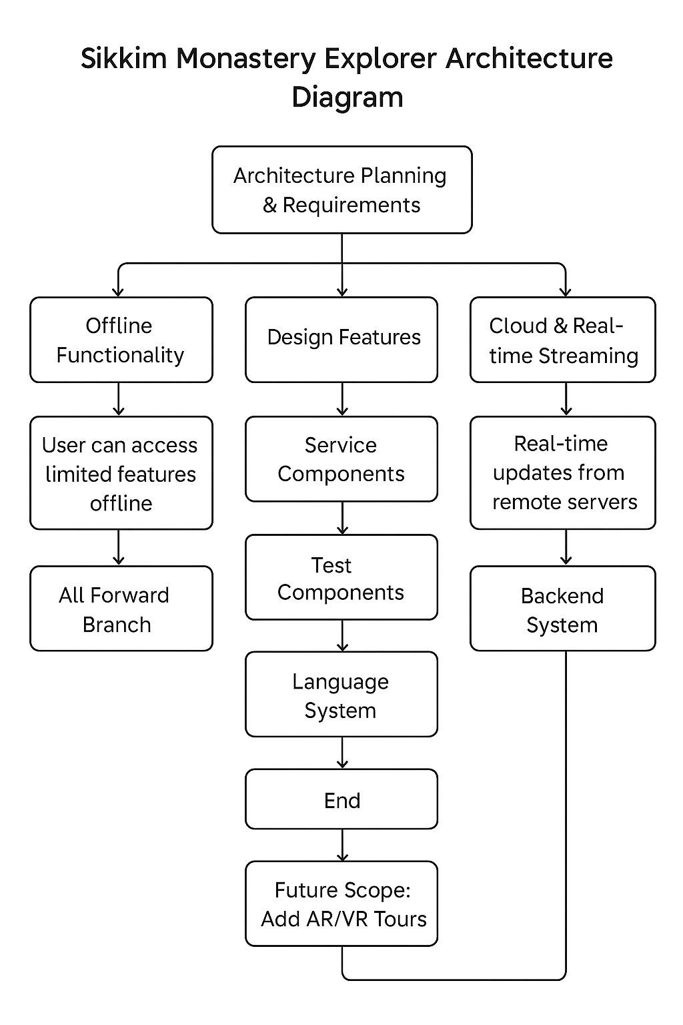



IMPACT AND BENEFITS
Promatrs
For NCMRWF, IMD & Disaster Authorities (NDMA / SDMAs)
• Bridges the Critical 0–6h Gap: Closes the temporal gap where traditional NWP is too slow to alert on localized convective bursts.
• 30–60 Min Early CI Advantage: Detects convective updrafts before destructive cloudburst and hail precipitation cores reach the ground.
• Zero False Alarm Fatigue: Hyper-local 1–3 km hazard zones ensure alerts target only the exact communities in the path of the storm.
For Aviation, Transport & Critical Infrastructure
• Severe Downburst Warnings: Radial velocity shear detection provides low-altitude windshear alerts for airport runways and flight corridors.
• Cloudburst Inundation Defense: Anticipates ≥100 mm/h deluge corridors, allowing railway and highway engineers to halt traffic pre-emptively.
• Power Grid Protection: Real-time lightning strike density tracking safeguards high-voltage transmission substations.
For Rural Agriculture & Farming Communities
• Hail Risk & MESH Sizing: Accurate hail probability and expected stone diameter warnings allow farmers to shelter livestock and orchards.
• Actionable Countdown Clocks: Simple, intuitive arrival countdowns (e.g., 'Thunderstorm arrival in 40 mins') on mobile-ready GIS maps.
• Scalable Pan-India Architecture: Ready for deployment across all 36 States/UTs and vulnerable agro-climatic zones.

Slide 6

RESEARCH, REFERENCES & BENCHMARKS
Promatrs
Authoritative Standards & Scientific Foundations
Benchmark Comparisons: Why This Platform?
• Physics-Based NWP Models (WRF / NCUM): High computational overhead, 6–12 hr cycle times, and 4–12 km resolution; unable to resolve rapid 15-minute convective genesis in real-time.
• Generic Commercial Weather Apps: Global statistical interpolation without Doppler velocity fields, hail MESH, or cloudburst thresholds.
• Proposed Convective Nowcasting System: Real-time Multi-Source Data Fusion, 1–3 km hyper-local resolution, 0–6 hour lead time, dynamic severe parameters (hail, lightning, downburst, cloudburst), and live arrival countdown clocks.
• MoES & NCMRWF Convective Modeling: Framework for high-resolution mesoscale weather prediction & nowcasting.
• IMD DWR Radar Algorithms: Severe storm identification, TITAN/SCIT cell tracking, and MESH hail estimation guidelines.
• ISRO MOSDAC INSAT-3D/3DR: Geostationary rapid-scan multispectral cloud-top cooling and convective initiation techniques.
• NDMA & WMO CAP Protocol: International Common Alerting Protocol (CAP v1.2) for authenticated multi-hazard alerting.

Slide 7
SYSTEM ARCHITECTURE CREED & EVALUATION STANDARDS
Five Pillars Aligned with MoES / NCMRWF Problem Statement 26084
1. MULTI-SOURCE DATA FUSION: Harmonizes DWR radar (reflectivity & velocity), INSAT-3DR satellite, and lightning networks.
2. 1–3 KM HYPER-LOCAL SPATIAL SCALE: Pinpoint hazard zones replacing coarse district-wide text bulletins.
3. 0–6 HOUR ACTIONABLE NOWCASTING: Fast kinematic extrapolation with live arrival countdown clocks for emergency response.
4. COMPREHENSIVE CONVECTIVE PARAMETERS: Live hail probability & MESH, downburst velocity, lightning density, & cloudburst thresholds.
5. PROVENANCE & RELIABILITY: 100% verified meteorological telemetry with zero synthetic data fabrication and explicit status metrics.

