Slide 1
Neural Network Implementation for MNIST Digit Recognition
in FPGA
FPGA Project Presentation
28×28 Input
5-Layer MLP
10-class Output
784 pixels per image
Hardware inference only
Digits 0–9

Slide 2
Introduction
Project
Hardware accelerator for MNIST digit classification on FPGA
Input → Prediction
Input
Processes 28×28 greyscale images (784 pixels per frame)
Hidden Layers
5-layer fully-connected perceptron (Layers 1–5)
28×28 pixel grid
Output
10-class classification — predicts digits 0 to 9
2
Focus
Hardware-only inference using pre-trained fixed-point weights
Predicted digit
MNIST Digit Recognition | FPGA Hardware Accelerator

Slide 3
Key Idea
1
Perceptron-based neural network
2
5 hidden layers
Fully-connected multi-layer perceptron mapped directly to FPGA RTL logic
784 inputs → 40 → 40 → 20 → 20 → 10 output classes
3
Pre-trained weights (software)
4
Hardware performs only inference
Weights and biases computed in Python and stored in .mif ROM files
No backpropagation on FPGA — pure forward pass, maximising speed and area efficiency
Key Idea | Software training → Hardware inference

Slide 4
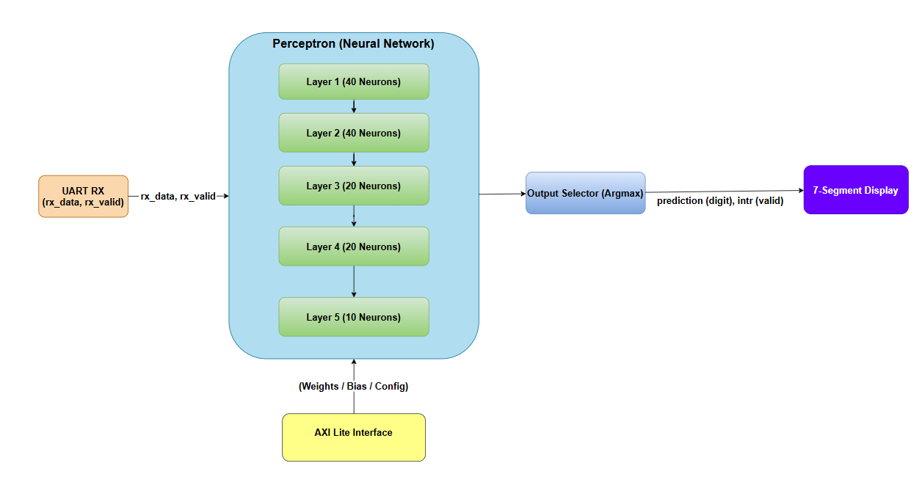
Neural Network Architecture
From Memory
Full system: UART RX → Perceptron (5 layers) → Output Selector (Argmax) → 7-Segment Display

Slide 5
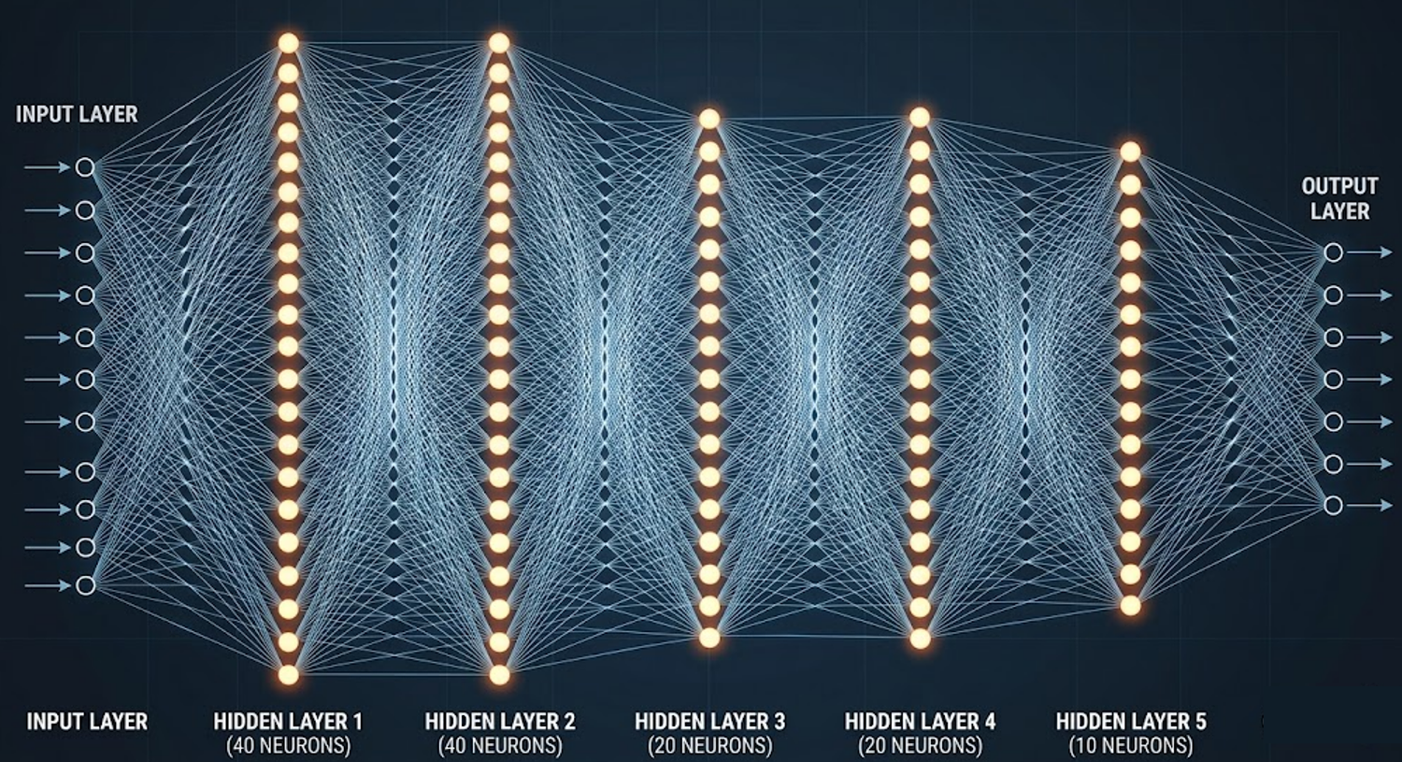

Slide 6
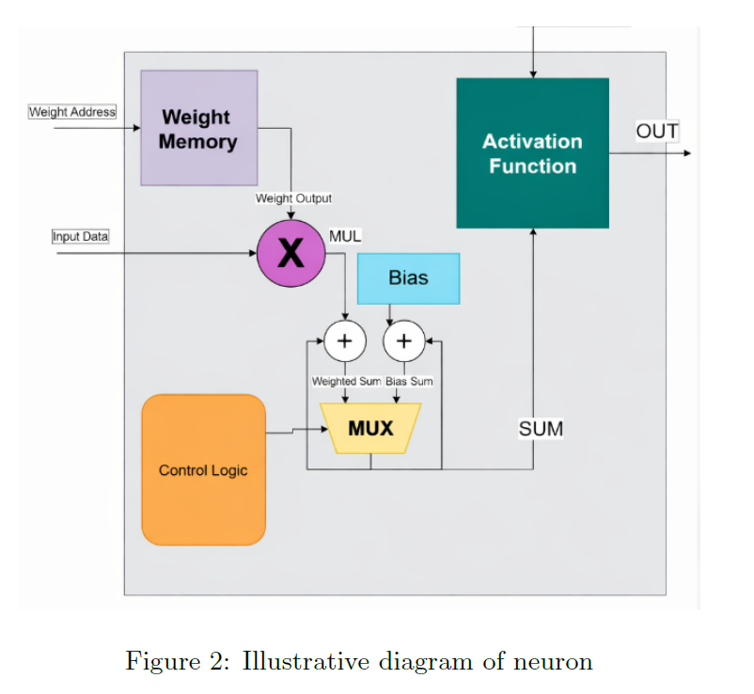
Neuron Architecture
Weight Memory
BRAM pre-loaded from .mif file
Addressed by r_addr counter
Multiply (MAC)
Q1.7 × Q1.7 → shift right 7
Result accumulated in 32-bit sum
Bias
Added after all weights
Preloaded into BRAM
Activation (ReLU)
Neg → 0 · Overflow → 127
Output: sum[7:0]
neuron.v | Weight Memory · MAC · Bias · ReLU Activation

Slide 7
Python Training Flow
01
Define Network Architecture
02
Training Data Generation
Specify layer sizes: [784, 40, 40, 20, 20, 10]
Activation functions and layer count configured here
Load MNIST dataset (60,000 training images)
Normalise pixel values to [0, 1] float range
03
Model Training
04
Generate Weights and Biases
Run gradient descent / Adam optimiser
Minimise cross-entropy loss over epochs
Quantise learned parameters to fixed-point Q format
Export to .mif files for FPGA ROM initialisation
Python workflow | Training runs on CPU/GPU → Weights exported to FPGA ROMs

Slide 8
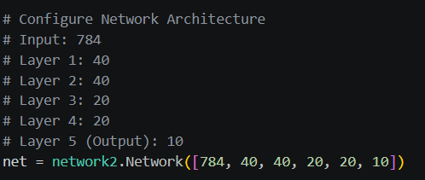
Define Network Architecture
Input: 784
28×28 pixels flattened to 1D vector
Layer 1–2: 40
Wider hidden layers capture complex features
Layer 3–4: 20
Input
784
Compression towards classification
L1/L2
40
L3/L4
20
Layer 5 (Output): 10
One neuron per digit class (0–9)
Output
10
network2.Network([784, 40, 40, 20, 20, 10]) | Python architecture definition

Slide 9
Number Format Optimizations
Input Pixel Data
Generated Weights
Generated Biases
Q1.7
Q4.4
Q5.3
8-bit · 1 integer + 7 fractional
Range: –1 to +0.992 · Resolution: 1/128
8-bit · 4 integer + 4 fractional
Range: –8 to +7.9375 · Resolution: 1/16
8-bit · 5 integer + 3 fractional
Range: –16 to +15.875 · Resolution: 1/8
Justification
Influence
Each Q format matches the dynamic range and precision needs of inputs, weights, and biases — minimising hardware cost while preserving accuracy.
Number format determines how well the network balances accuracy with FPGA efficiency — area, speed, and power all depend on bit-width choices.
Task: Change formats to float32 and compare accuracy results in Python
Fixed-point number formats | Q1.7 · Q4.4 · Q5.3

Slide 10
Training Results
95 %
93.5 %
97 %
3.5 %
Training Accuracy
Validation Accuracy
Float32 Accuracy
Accuracy Drop
Fixed-point Q format
On MNIST test set
Baseline comparison
Fixed-pt vs Float32
Format
Precision
Accuracy (%)
Notes
Q1.7 / Q4.4 / Q5.3
8-bit fixed-pt
93.5 %
FPGA implementation
Float32
32-bit floating
97%
Baseline
Expected outcome: Float32 should yield higher accuracy. Fixed-point introduces quantisation error but reduces FPGA resource usage significantly.
Training Results | Fixed-point Q format vs Float32 baseline

Slide 11
Top-Level Architecture – perceptron.v
Neuron Instance (×N per layer)
intr →
Input
Layer 1
Weight RAM (MIF)
in_data[7:0]
40 neurons · numWeight=784 · ReLU
SM 1: IDLE → SEND (serialise Layer 1 output)
Layer 2
Read addr counter
Hidden · numWeight=numNeuronLayer1 · ReLU
SM 2: IDLE → SEND (serialise Layer 2 output)
MAC (Q1.7 × Q1.7 >> 7)
Layer 3
Hidden layer · ReLU
SM 3: IDLE → SEND (serialise Layer 3 output)
32-bit accumulator
Layer 4
Hidden layer · ReLU
Bias add (pretrained)
SM 4: IDLE → SEND (serialise Layer 4 output)
Layer 5
Output layer · sigmoid/softmax
ReLU + saturation
outputSelector
argmax → out[31:0] + out_valid
out[7:0] outvalid

Slide 12
Perceptron Top-Level & Inter-Layer FSM
perceptron.v — IDLE / SEND state machine
Layer Wiring in perceptron.v
o_valid[0] asserted
(all neurons done)
IDLE
SEND
UART RX data
axis_in_data[7:0] + axis_in_data_valid
→ Layer 1 (40N)
x_in, x_valid | o_valid, x_out[319:0]
count == numNeuron
(serialisation done)
→ FSM₁ IDLE/SEND
holdData_1 → out_data_1 + valid_1
→ Layer 2 (40N)
x_in=out_data_1, x_valid=valid_1
IDLE actions:
SEND actions:
count ← 0
data_out_valid ← 0
Wait for o_valid[0]
out_data ← holdData[7:0]
holdData ← holdData >> 8
count++ | data_out_valid ← 1
→ FSM₂ IDLE/SEND
holdData_2 → out_data_2 + valid_2
→ Layer 3 (20N)
x_in=out_data_2, x_valid=valid_2
→ FSM₃ / Layer 4…
Same pattern for L3→L4→L5
Key Design Insight
Each layer's N neurons compute in PARALLEL (same clock cycle). The IDLE/SEND FSM then serialises the wide parallel output (N×8 bits) back to an 8-bit stream for the next layer.
→ Layer 5 (10N)
x5_out[79:0] → outputSelector
→ outputSelector
argmax → out[31:0] + out_valid = intr
Timing per layer
Layer 1: numWeight=784 clk cycles to compute + 40 clk cycles to serialise
Layers 2–5: numWeight cycles each (40,40,20,20) + their serialisation cycles

Slide 13
Layer Modules & Weight Memory
Layer1–5.v · weightMemory.v · .mif files
Layer
Neurons
Weights/N
Activation
MIF Files
weightMemory.v
L1
40
784
ReLU
w_1_0 … w_1_39
Type:
Synchronous ROM (reg array)
Init:
$readmemb() from .mif file at synthesis
L2
40
40
ReLU
w_2_0 … w_2_39
Width:
8 bits per entry (Q1.7)
Depth:
numWeight entries per neuron ROM
L3
20
40
ReLU
w_3_0 … w_3_19
Read:
Enabled by ren = myinputValid
L4
20
20
ReLU
w_4_0 … w_4_19
Address:
r_addr: 0 → numWeight-1 (sequential)
Latency:
1-cycle synchronous read
L5
10
20
ReLU
w_5_0 … w_5_9
.mif File Format
Binary encoded weights, one per line
$readmemb(biasFile, biasReg) loads at init
Total weights: 784×40 + 40×40 + 40×20 + 20×20 + 20×10 = 33,800 | Each 8-bit = ~33 KB BRAM

Slide 14
Neuron Internals – neuron.v
Weight RAM read
ROM initialised from .mif file
r_addr increments each valid cycle
Valid Signal Pipeline
1. myinputValid → weight_valid
Input latch (myinputd)
1-cycle pipeline register aligns
input with weight RAM read latency
2. weight_valid → mult_valid (mux_valid)
Multiply
Q1.7 × Q1.7 → Q2.14
Right-shift 7 bits → Q2.7
3. mux_valid fall edge → muxValid_f
32-bit Accumulate
sum <= sum + mul each cycle
32-bit prevents overflow
4. r_addr == numWeight & muxValid_f → sigValid
Bias addition
Added after last weight
`pretrained` flag loads from MIF
5. sigValid registered → outvalid (1-cycle pulse)
ReLU + Saturation
Neg → 0 | sum[30:7]≠0 → 127
Otherwise out = sum[7:0]
outvalid pulse
1-cycle strobe after activation
Triggers inter-layer state machine
Fixed-point: Q1.7 (8-bit)
Range: –1 to +0.992 · Resolution: 1/128
32-bit accumulator prevents intermediate overflow
neuron.v | Combinational ReLU · Sequential MAC pipeline · Registered outvalid

Slide 15
Output Selector — Argmax Module
outputSelector.v
Algorithm: Argmax over 10 classes
Example: Digit '3' Prediction
1. Capture all 10 neuron outputs (x5_out[79:0]) when i_valid[0] fires
2. Start counter at index 1, compare each slice to maxValue
3. If new slice > maxValue → update maxValue and store index
4. After 10 comparisons → assert o_data_valid with winning index
0
2
1
1
2
5
3
127
4
3
// outputSelector.v — key logic
5
8
if(start_valid) begin
6
0
maxValue ← i_data[7:0];
7
4
counter ← 1; o_data ← 0;
end else if(counter == numInput) {
8
2
o_data_valid ← 1;
9
6
end else if(counter != 0) {
→ o_data = 3 (predicted digit)
if($signed(slice) > maxValue)
Argmax selects index with highest activation
o_data ← counter;

Slide 16
UART Receiver & 7-Segment Display
uart_rx.v · seven_segment_ctrl.v · basys3_top.v
UART Receiver (uart_rx.v)
7-Segment Display (seven_segment_ctrl.v)
Baud rate:
115,200 bps
Input:
digit_val[3:0] (4-bit BCD digit 0–9)
Clock:
100 MHz (Basys3 Artix-7)
Display:
Basys3 4-digit 7-segment (an[3:0] + seg[6:0])
Clks/bit:
100,000,000 ÷ 115,200 = 868
Anodes:
an[3:0] — selects which digit is active
Data format:
8-bit, no parity, 1 stop bit
Segments:
seg[6:0] — encodes the digit pattern
States:
IDLE → START → DATA → STOP
Trigger:
intr pulse from perceptron → latch digit
Output:
rx_data[7:0] + data_valid
Reset:
btnC resets → display_digit = 0xF (blank)
Connection:
RsRx pin on Basys3 USB-UART
Update:
Latches nn_prediction when intr fires
Bit timing (868 clks each)
basys3_top.v connection:
IDLE
START
D0
D1
D2
D3
D4
D5
D6
D7
STOP
uart_rx → perceptron → outputSelector → always@(intr) latch → seven_segment_ctrl

Slide 17
Design Tradeoffs & Architecture Decisions
Parallel Neurons vs Area
No Layer Overlap (Sequential Pipeline)
✔ Max throughput – all neurons compute simultaneously
✔ Simple control, no inter-stage dependency hazards
✖ High LUT/RAM cost – Layer 1 alone: 40 × 784 × 8 = 250 Kbit
✖ Layer N idle while Layer N+1 processes
↻ Time-multiplex 1 neuron → proportionally longer latency
↻ Double-buffer + overlap → up to 2× throughput improvement
8-bit Q1.7 Fixed-Point
✔ Small multipliers, fast clock, low power
✖ Limited dynamic range; saturation at every layer boundary
↻ 16-bit or BFloat16 → higher accuracy, bigger hardware
Serial Inter-Layer Bus vs Wide Bus
✔ Minimal routing – 8-bit wire between layers, easy to add layers
✖ +NN cycles latency per layer pair (serialisation overhead)
↻ Wide parallel bus: 320-bit for Layer 1 → shorter but harder to route
Architecture tradeoffs | Area · Latency · Throughput · Accuracy

Slide 18
Verilog Module Map — File Structure
All source files
File
Role
Connections / Key signals
basys3_top.v
Top-level wrapper for Basys3 board
uart_rx + perceptron + seven_segment_ctrl
perceptron.v
5-layer MLP + 4 inter-layer IDLE/SEND FSMs
Layer1…5 + outputSelector
Layer1.v … Layer5.v
Instantiate N parallel neuron modules
neuron × (40,40,20,20,10)
neuron.v
Single neuron: weight ROM + MAC + bias + ReLU
weightMemory + relu (generate block)
weightMemory.v
Synchronous ROM, init from .mif file
r_addr counter driven by myinputValid
outputSelector.v
Argmax over 10-neuron outputs
i_data (80-bit) → o_data (32-bit index)
uart_rx.v
UART receiver, 115200 baud, 868 clks/bit
RsRx pin → rx_data[7:0] + rx_valid
seven_segment_ctrl.v
BCD → 7-seg encoding + anode multiplexing
digit_val[3:0] → an[3:0] + seg[6:0]
include.v
Global `define macros for architecture params
numNeuronLayerN, numWeightLayerN, actType
AXI-Lite interface for weight/bias loading
Wraps perceptron for standalone synthesis

Slide 19
Summary
FPGA Neural Network Accelerator – Key Takeaways
5-layer MLP
Layers 1–4 hidden (ReLU), Layer 5 output (Argmax), chained via AXI-Stream-like serial bus
Parallel MACs
All N neurons per layer compute simultaneously over numWeight clock cycles – throughput is maximised per layer
IDLE/SEND FSM
One state machine per inter-layer boundary serialises wide parallel output into 8-bit stream for the next layer
Fixed-point Q1.7
8-bit data path with 32-bit accumulator guards against overflow; ReLU with saturation clamps output to [0, 127]

Slide 20
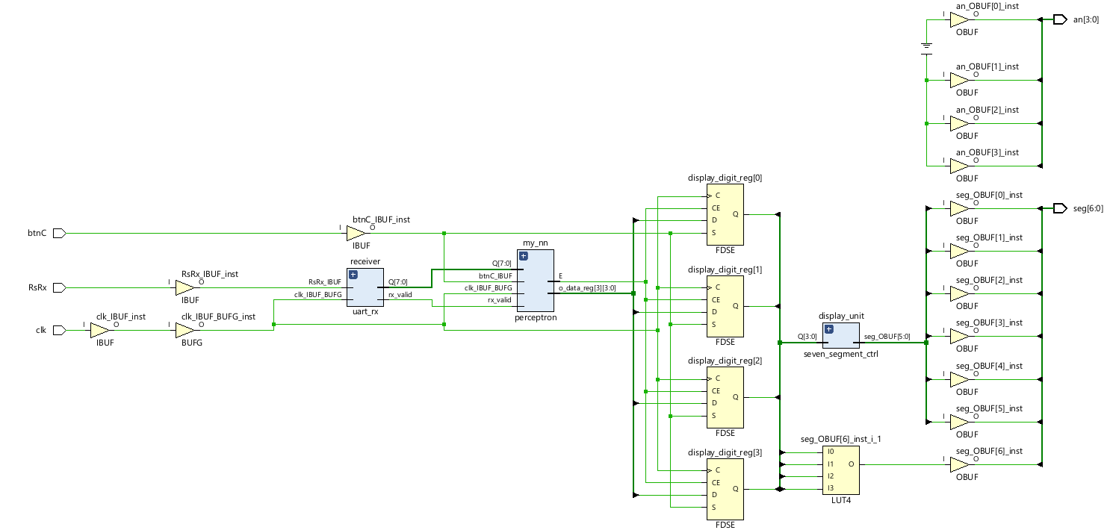
RTL Schematic
RTL Schematic of Top module

Slide 21
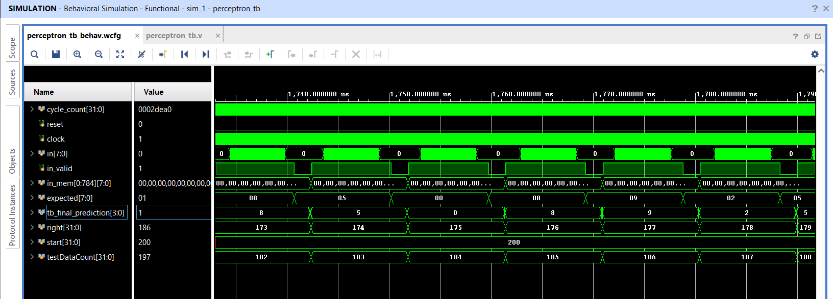
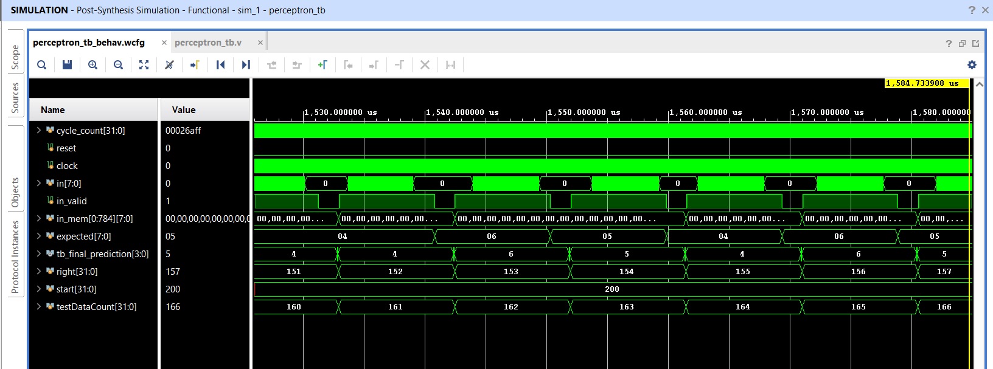
Waveforms
Behavioral Simulation
Post Synthesis-Functional Simulation

Slide 22
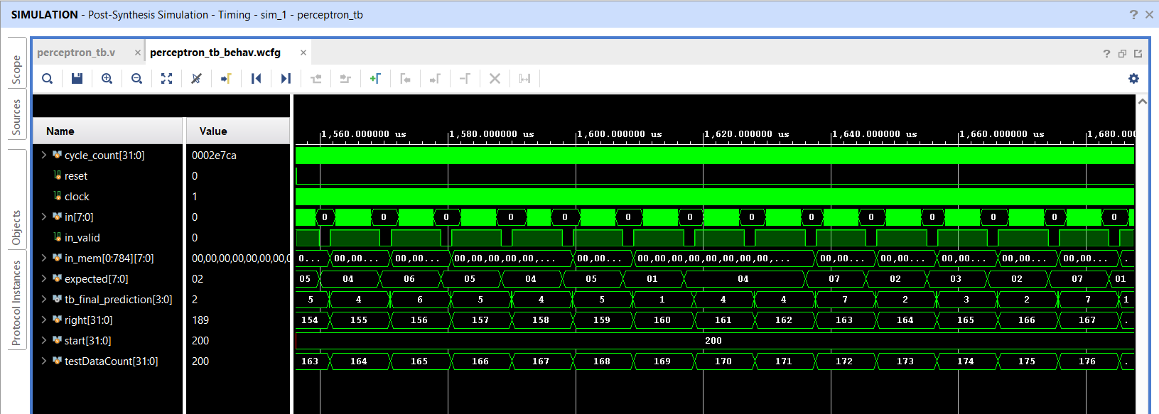
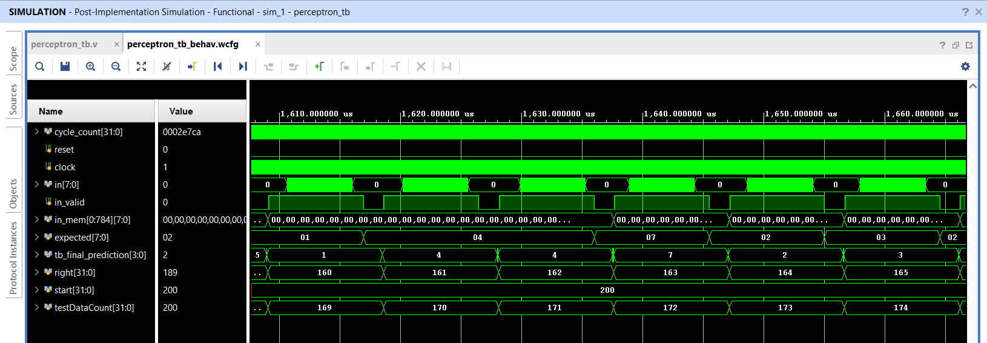
Post Synthesis-Timing Simulation
Post Implementation-Functional Simulation

Slide 23
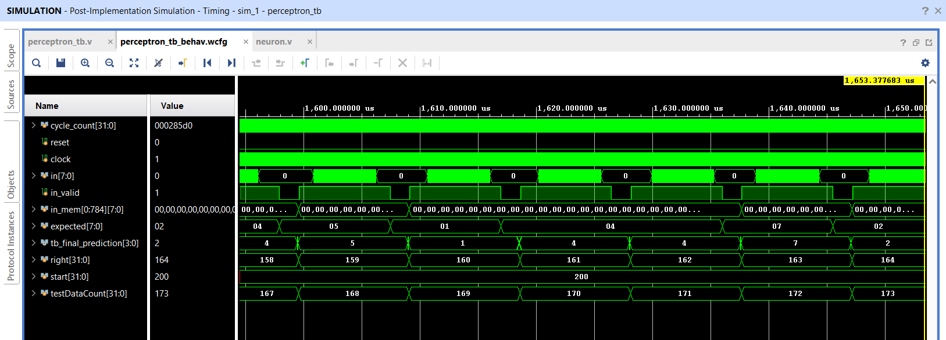
Post Implementation-Timing Simulation

Slide 24
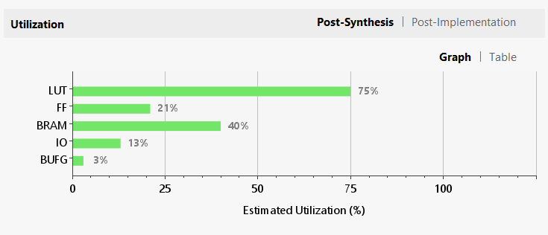
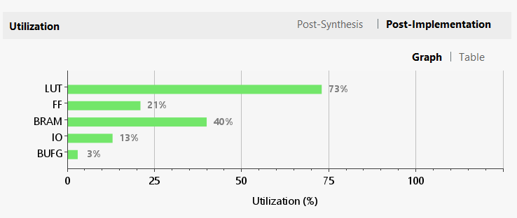
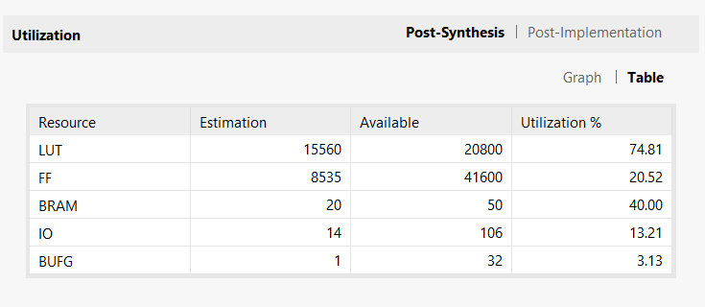
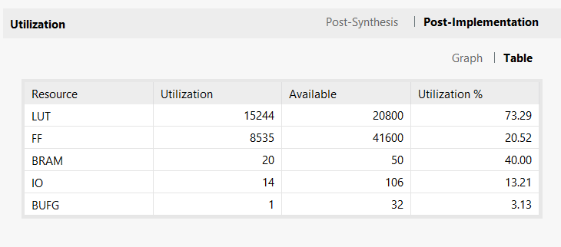
Utilization Report
Post-Synthesis Graph
Post-Implementation Graph
Post-Synthesis Table
Post-Implementation Table

Slide 25
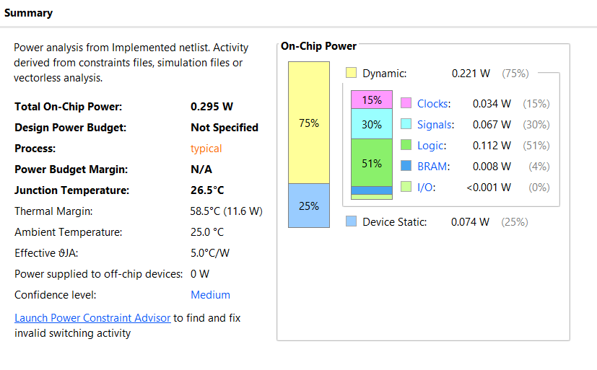
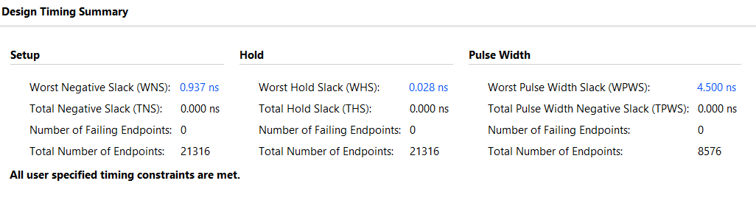
Power
Timing
Maximum Frequency of operation (Fmax) = 110.33 MHz

Slide 26
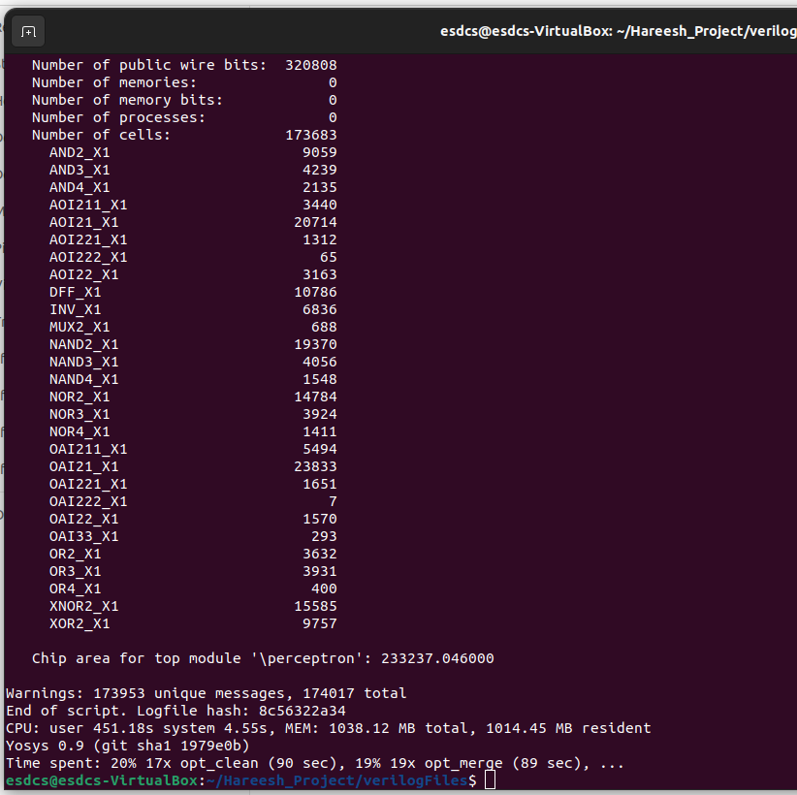
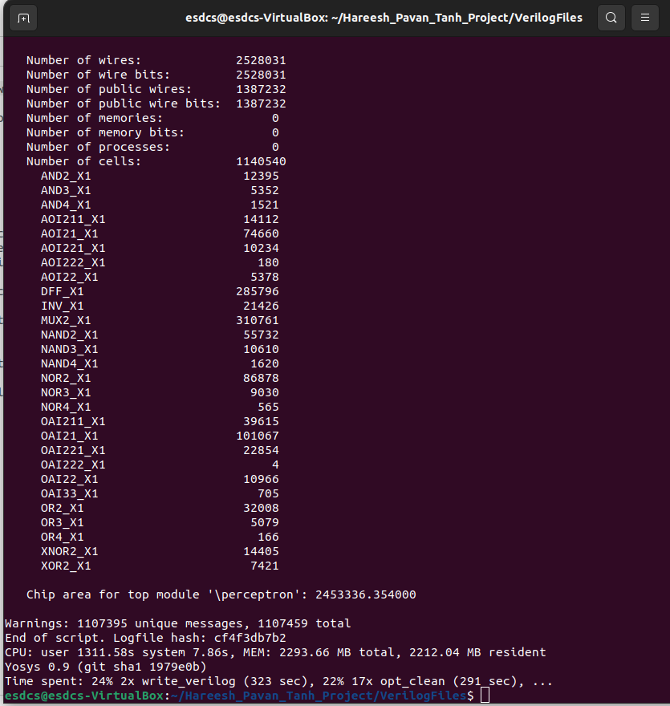
Area
Relu Area
Tanh Area

Slide 27
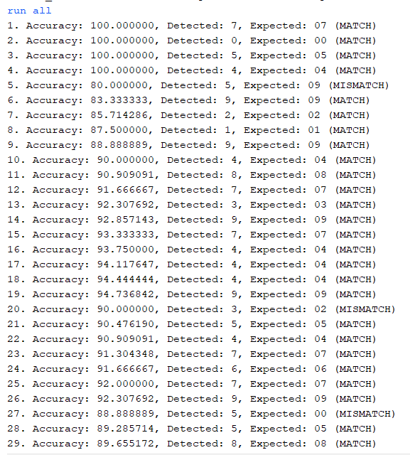
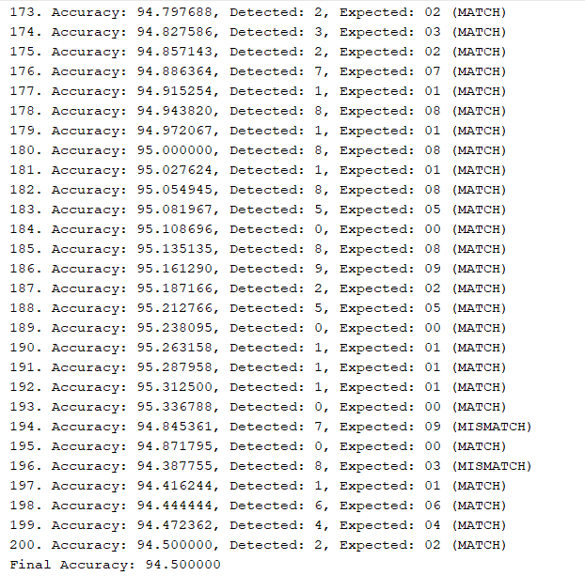
Test Results

