Slide 1
Country | Measure | Model | Precision | Recall | F-1_score | Accuracy
Malawi | FCS | baseline | 0.256 | 0.272 | 0.162 | 0.697
Malawi | rCSI | baseline | 0.549 | 0.356 | 0.375 | 0.674
Tanzania | FCS | baseline | 0.167 | 0.016 | 0.028 | 0.826
Tanzania | rCSI | baseline | 0.412 | 0.325 | 0.258 | 0.537
Uganda | FCS | baseline | 0.531 | 0.188 | 0.241 | 0.508
Malawi | FCS | Tree | 0.444 | 0.179 | 0.139 | 0.732
Malawi | rCSI | Tree | 0.410 | 0.727 | 0.518 | 0.587
Tanzania | FCS | Tree | 0.515 | 0.060 | 0.101 | 0.826
Tanzania | rCSI | Tree | 0.557 | 0.279 | 0.308 | 0.583
Uganda | FCS | Tree | 0.280 | 0.263 | 0.271 | 0.647
Malawi | FCS | RandomForest | 0.664 | 0.315 | 0.293 | 0.761
Malawi | rCSI | RandomForest | 0.483 | 0.660 | 0.537 | 0.632
Tanzania | FCS | RandomForest | 0.447 | 0.227 | 0.285 | 0.837
Tanzania | rCSI | RandomForest | 0.525 | 0.545 | 0.510 | 0.590
Uganda | FCS | RandomForest | 0.531 | 0.292 | 0.376 | 0.692
Malawi | FCS | xgBoost | 0.297 | 0.286 | 0.264 | 0.749
Malawi | rCSI | xgBoost | 0.458 | 0.503 | 0.452 | 0.590
Tanzania | FCS | xgBoost | 0.466 | 0.125 | 0.184 | 0.827
Tanzania | rCSI | xgBoost | 0.515 | 0.469 | 0.473 | 0.612
Uganda | FCS | xgBoost | 0.493 | 0.115 | 0.185 | 0.674

Slide 2
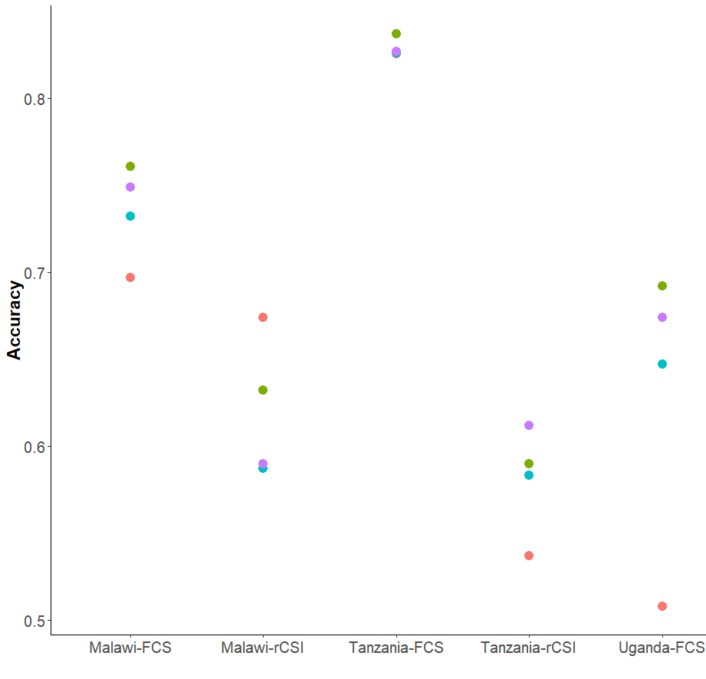
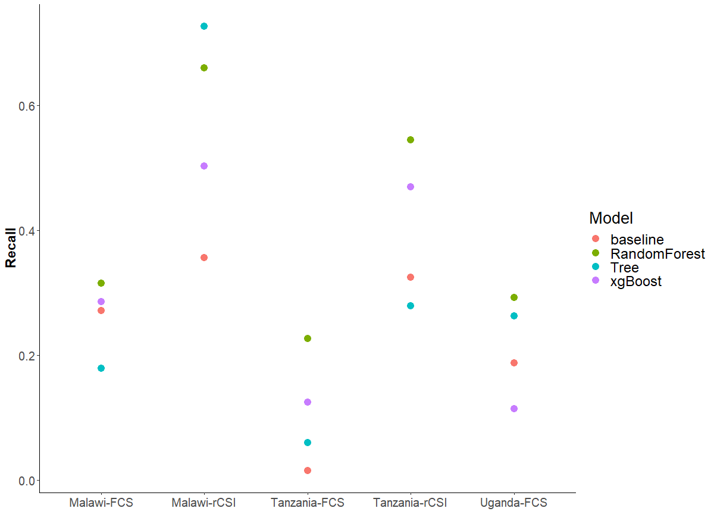
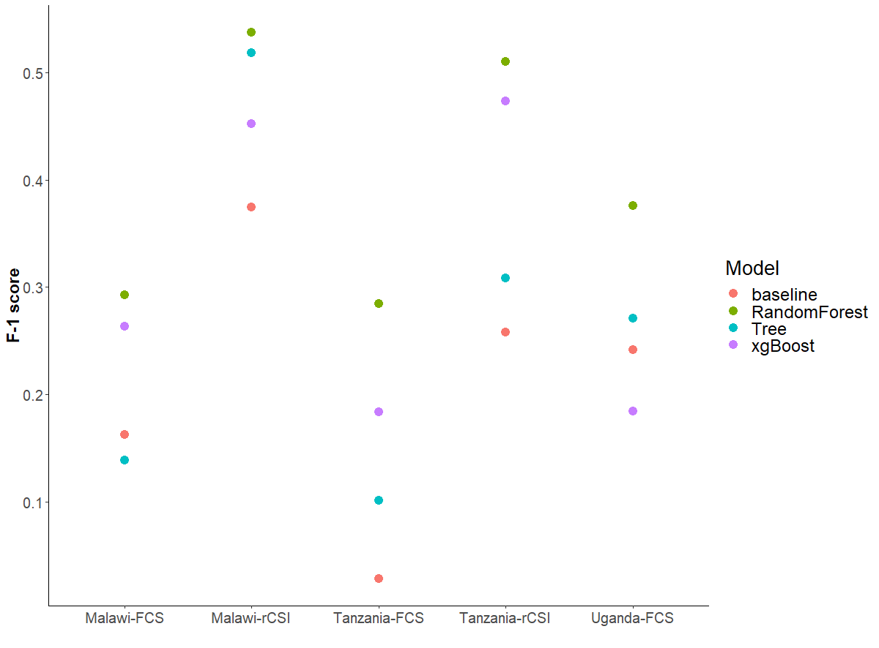

Slide 3
