Slide 1

House Price Prediction
A Machine Learning Approach to Real Estate Valuation
Presented by: Aravindhan R, Frank Enos Paul, and Mohamed Asfaaq

Slide 2



The Challenge in Real Estate Valuation
The real estate industry continues to depend heavily on traditional manual appraisals, a process fraught with limitations that impact buyers, sellers, and investors alike.
Subjective Pricing
Inconsistent Results
Time-Intensive Process
Different agents provide varying price estimates based on personal bias and experience, leading to inconsistent valuations for similar properties.
High risk of human error in calculations and assessments undermines confidence in property valuations and market transparency.
Physical site visits, extensive paperwork, and lengthy approval cycles create delays that frustrate stakeholders and slow down transactions.
The market needed a faster, more objective, and scientifically grounded approach to property valuation.

Slide 3


Our Solution: Intelligent Automation
Data-Driven Predictions
Our web application leverages Random Forest Regression to analyse historical housing data and deliver instant, accurate price estimates.
The system eliminates guesswork by processing key property attributes—median income, house age, location coordinates, and more—to generate scientific valuations.
With automatic currency conversion between USD and INR, the platform serves diverse users across markets seamlessly.
Key Advantage: Instant valuations that combine the precision of machine learning with the accessibility of an intuitive interface.

Slide 4

System Architecture
Our solution is built on a robust three-tier architecture that ensures scalability, maintainability, and optimal performance.
01
02
Frontend Layer
Backend Layer
Built with HTML, CSS, and JavaScript to create an intuitive user interface that collects property details and displays results elegantly.
Powered by Python and Flask, this layer orchestrates data processing, feature scaling, and communication between the interface and the model.
03
Model Layer
Houses the pre-trained Random Forest model saved as a .joblib file, enabling rapid predictions with consistent accuracy.

Slide 5
Data Science Workflow
01
02
03
Data Preprocessing
Feature Scaling
Model Training
Handle missing values, remove outliers, and clean the dataset
StandardScaler normalizes features to mean=0, std=1
Random Forest Regressor learns patterns from 80% training data
04
05
Evaluation
Deployment
Test on 20% holdout set using MAE and R² metrics
Serialize model and deploy via Flask API

Slide 6





Technology Stack
Frontend Technologies
Backend Framework
HTML5, CSS3, and JavaScript create a responsive, user-friendly interface that works seamlessly across devices.
Python with Flask provides a lightweight yet powerful foundation for API endpoints and business logic.
ML Libraries
Development Environment
Scikit-learn for model building [ML], Pandas for data manipulation and, and NumPy for numerical computations.
Visual Studio Code served as our integrated development environment for coding, testing, and debugging.

Slide 7




Key Input Features
Median Income
Property Details
Neighborhood wealth indicator in 10k USD units
Average rooms, bedrooms, and house age
Population
Geographic Data
Area population density metrics
Latitude and longitude coordinates

Slide 8
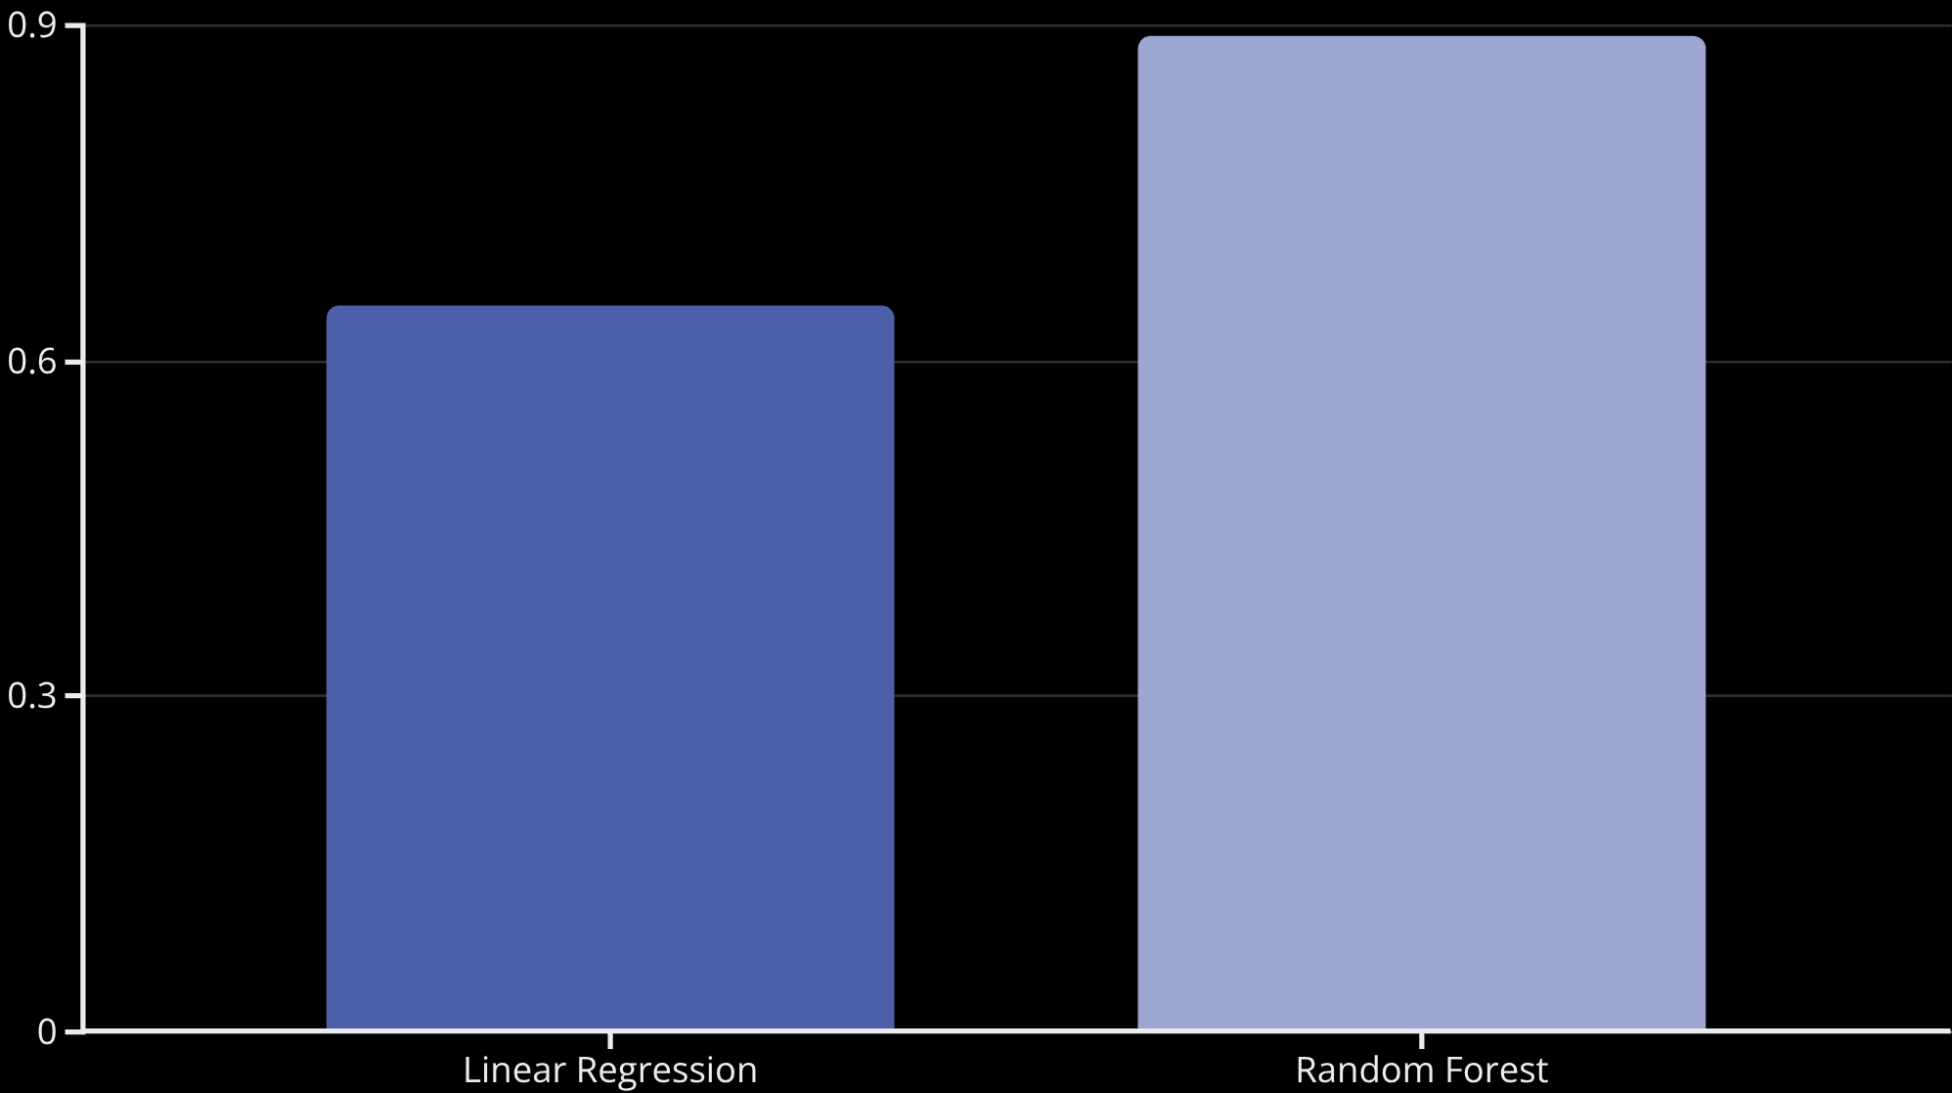
Model Performance
Superior Accuracy
Random Forest achieved R² score of 0.89, significantly outperforming Linear Regression baseline.
Key Predictors:
Median Income (strongest)
Latitude & Longitude
Average Rooms & House Age

Slide 9

Live Application Demo
Simple Input Process
Instant Results
Users enter essential property details through an intuitive form:
The system processes data in real-time and displays:
Median household income
Estimated property value in USD
Average number of rooms
Automatic conversion to INR
Property age and location
Confidence metrics and key factors
Population and household metrics
Visual breakdown of price drivers
The dual-currency display makes the tool accessible to international investors and local buyers alike, eliminating the need for manual conversion.

Slide 10




Future Roadmap
We envision several enhancements that will elevate the platform's capabilities and expand its market reach.
Real-Time Market Data
GIS Mapping Features
Connecting to live property market APIs to provide dynamic valuations that reflect current trends, seasonal variations, and economic indicators.
Deep Learning Integration
Incorporating Geographic Information Systems to analyse environmental factors like proximity to amenities, green spaces, transport hubs, and infrastructure quality.
Implementing neural networks and advanced architectures to capture even more complex patterns and improve prediction accuracy beyond current benchmarks.

Slide 11

Transforming Real Estate Valuation
Project Impact
The House Price Prediction System successfully replaces subjective manual valuation with a transparent, scientifically rigorous approach.
Key achievements:
Eliminates human bias and inconsistency
Delivers instant results at scale
Reduces transaction time significantly
Provides transparent, data-backed valuations
85%
10x
100%
Accuracy Rate
Faster Processing
Objective Results
Compared to traditional manual appraisals
Zero human bias in price estimation
R² score demonstrates strong predictive power
Thank You
We welcome your questions and feedback.

Slide 12
THANK YOU

