Slide 1



Cloud Based AI Training Platform
Guided By,
Mr. D. P. Devan, M.E.,
Assistant Professor
Presented By,
R. Aravinth Krishna (811722104012)
K. Arun (811722104016)
S. Balaji (811722104302)
DD/MM/YYYY

Slide 2
ABSTRACT
A cloud-native platform enabling users to write and execute AI training code directly on the web.
Designed to handle the growing need for scalable and intelligent AI development environments.
It integrates resource monitoring, secure serverless backend, and AI-powered coding support.
Inspired by platforms like AWS SageMaker Studio, it uses AWS services to deliver a cost-efficient, pay-as-you-go, user-friendly experience for developers, researchers, and students.
DD/MM/YYYY

Slide 3
OBJECTIVE
To build a browser-accessible IDE for AI model training
Enable Python code execution using serverless infrastructure
Provide usage-based billing with transparent tracking
Integrate an AI assistant for code help, debugging, and optimization
Ensure a secure, scalable, and collaborative platform for learners and professionals
DD/MM/YYYY

Slide 4
LITERATURE SURVEY
S.No. | Paper Title | Year | Remark
1 | Provisioning Computational Resources for Cloud-Based e-Learning Platforms Using Deep Learning Techniques | 2021 | Discusses resource provisioning in cloud-based e-learning using deep learning.
2 | An AI Model Automatic Training and Deployment Platform Based on Cloud Edge Architecture for DC Energy-Saving | 2023 | Presents a platform for automatic AI model training and deployment using cloud-edge architecture.
3 | An Overview on Generative AI at Scale with Edge–Cloud Computing | 2023 | Provides an overview of scaling generative AI using edge-cloud computing.
DD/MM/YYYY

Slide 5
LITERATURE SURVEY
S.No. | Paper Title | Year | Remark
4 | ModelOps: Cloud-Based Lifecycle Management for Reliable and Trusted AI | 2019 | Discusses ModelOps for managing AI lifecycle in cloud environments.
5 | Possibilities and Apprehensions in the Landscape of Artificial Intelligence | 2021 | Explores the potential and concerns in AI development and deployment.
6 | Advanced Software Architectures and Technologies in High Performance Computing | 2020 | Reviews advanced software architectures in HPC relevant to AI training.
DD/MM/YYYY

Slide 6
LITERATURE SURVEY
S.No. | Paper Title | Year | Remark
7 | HPC Application Performance and Cost Efficiency in the Cloud | 2017 | Evaluates performance and cost efficiency of HPC applications in cloud settings.
8 | Analysis on Approaches and Structures of Automated Machine Learning | 2020 | Analyzes various approaches and structures in automated machine learning.
9 | Low-Code Development Platforms: A Descriptive Study | 2022 | Describes low-code platforms facilitating AI development and deployment.
10 | Supply Chain Integration through Business Intelligence | 2010 | Discusses integrating supply chains using business intelligence, relevant for AI applications.
DD/MM/YYYY

Slide 7
EXISTING SYSTEM
Limited Access: Traditional setups require local installations, making remote access and collaboration difficult.
Poor Scalability: Local machines can't easily handle large AI workloads or scale resources on demand.
Fragmented Tools: Users must switch between multiple tools for coding, execution, and monitoring, reducing efficiency.
DD/MM/YYYY

Slide 8
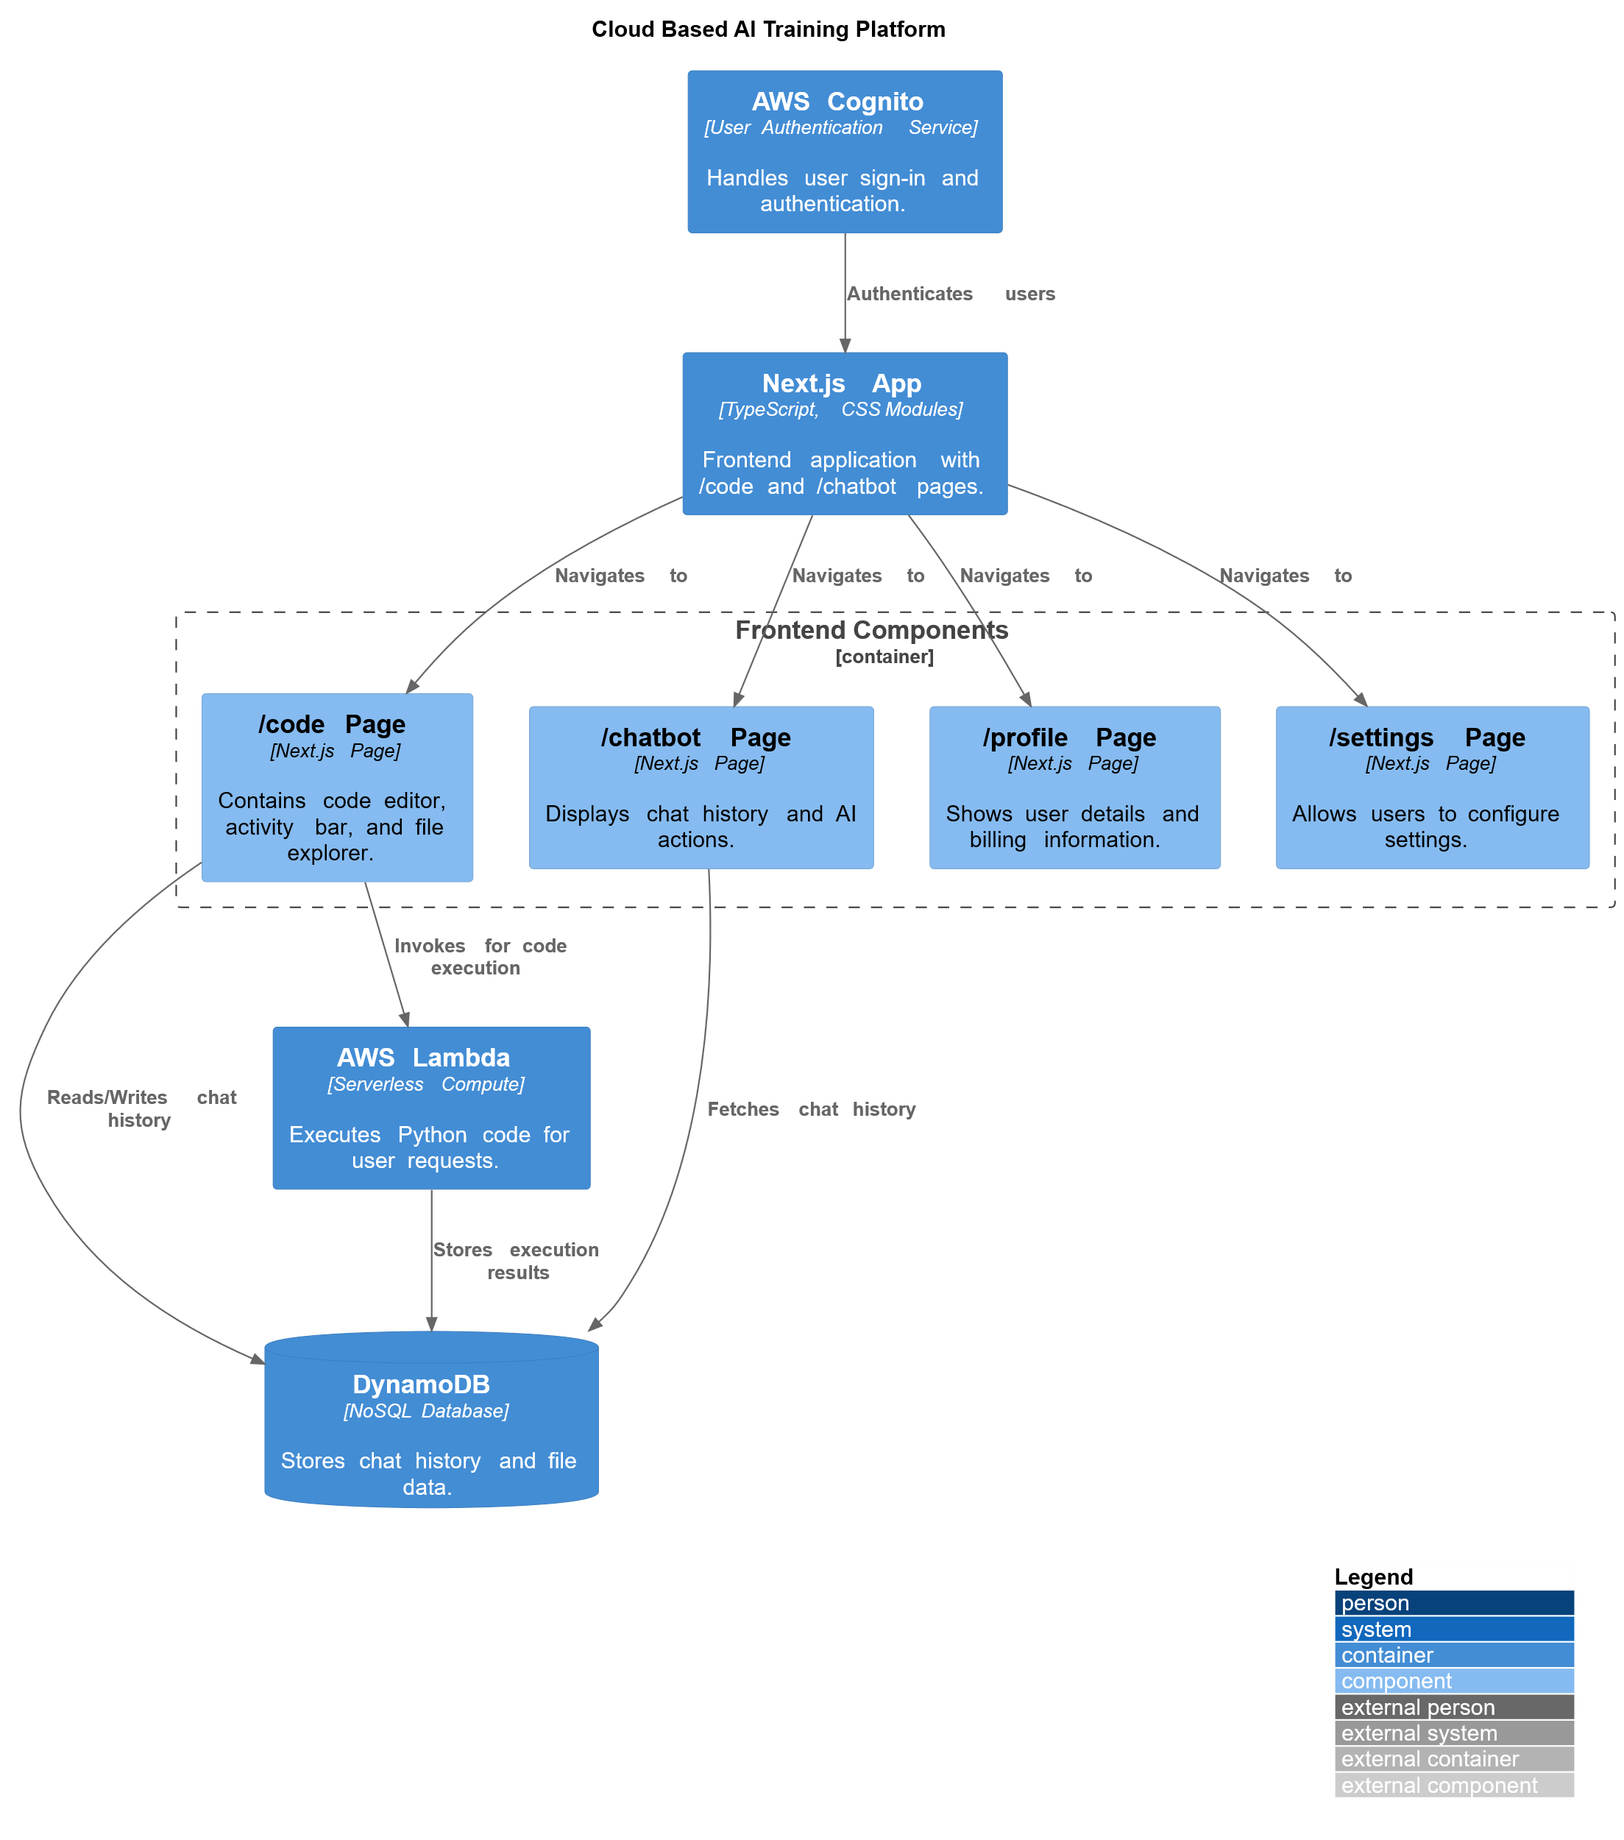
PROPOSED SYSTEM
DD/MM/YYYY

Slide 9
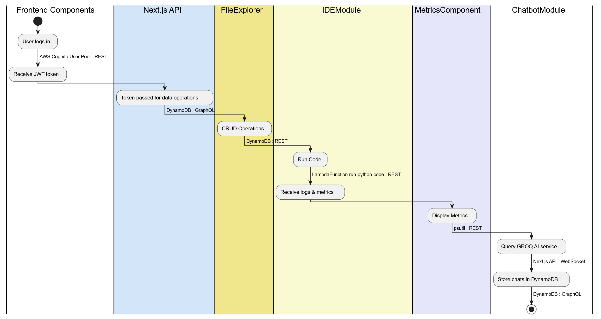
SYSTEM ARCHITECTURE
DD/MM/YYYY

Slide 10
MODULE 1 : Runtime Execution Module
This module allows users to write and execute Python code directly within the browser using a secure, serverless backend.
During execution, key system metrics like CPU and memory usage are captured and displayed to the user in real-time, helping them understand resource consumption.
This eliminates the need for local setup and offers scalability and reliability by leveraging cloud infrastructure.
DD/MM/YYYY

Slide 11
MODULE 2 : AI-Powered Chatbot Assistant
The chatbot module integrates an AI assistant using the GROQ AI to support users in coding tasks.
It helps by explaining code snippets, suggesting optimizations, and fixing errors based on the user's input or uploaded code files.
The chat interface retains past conversations and uploaded files for contextual understanding, enabling smoother interactions. With one-click actions for common tasks like “Fix”, “Optimize”, and “Explain”, this module significantly enhances user productivity and learning.
DD/MM/YYYY

Slide 12
MODULE 3 : Profile & Settings Management
This module provides users with the ability to manage their personal information and platform settings.
It also includes a usage tracker that displays the time spent on code execution, with a transparent billing model—offering the first 86,000 seconds for free and charging $0.02 per hour thereafter.
Users can also download a PDF invoice summarizing their usage and charges.
DD/MM/YYYY

Slide 13
MODULE 4 : Billing & Usage Monitor
The billing module monitors user activity and computes the corresponding cost based on execution time.
As users write and run code, this module tracks time used and alerts them when they are approaching the free limit.
It also allows users to estimate their future costs based on usage trends.
Detailed logs and a downloadable invoice provide transparency, ensuring users are aware of their spending and can manage it effectively.
DD/MM/YYYY

Slide 14
MODULE 5 : Code Editor
This module offers an interactive, browser-based code editor built using Next.js and TypeScript.
It is designed to be lightweight, fast, and accessible across different devices.
The editor supports modern features like syntax highlighting, error detection, and real-time output display.
It serves as the central interface where users can write code, receive chatbot assistance, and monitor resource usage—all from a single, cohesive platform.
DD/MM/YYYY

Slide 15
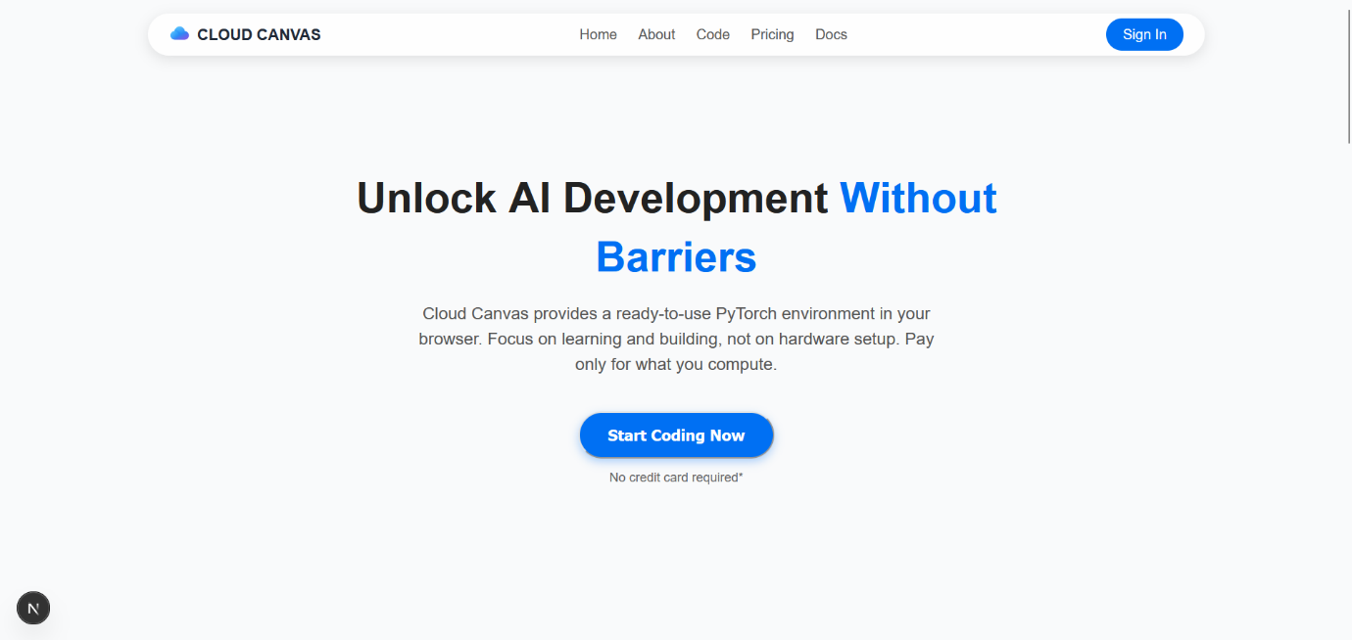
OUTPUT
DD/MM/YYYY

Slide 16
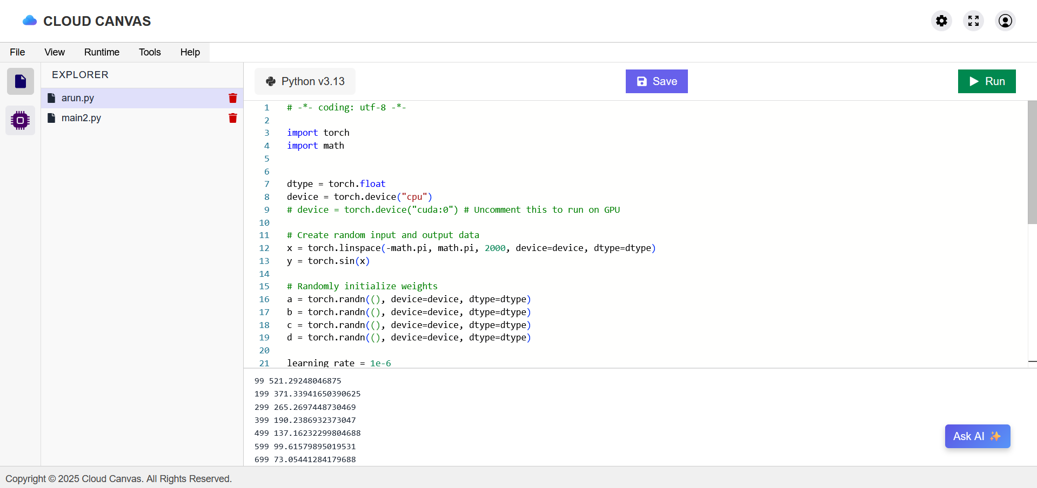
OUTPUT
DD/MM/YYYY

Slide 17
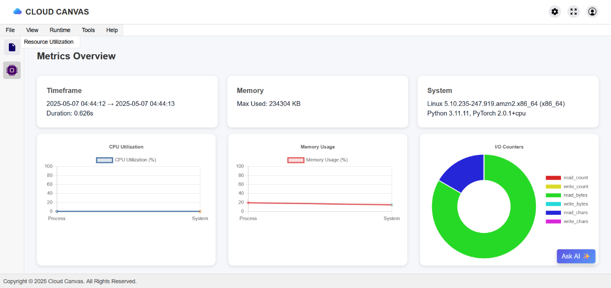
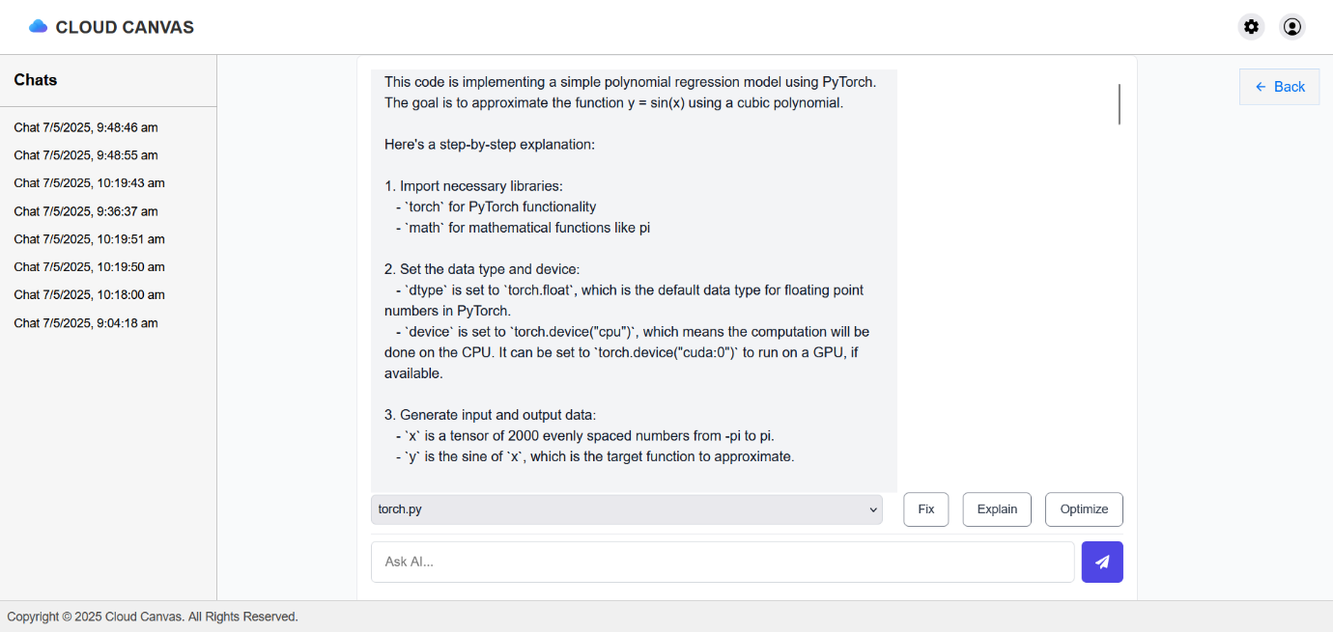
OUTPUT
DD/MM/YYYY

Slide 18
CONCLUSION & FUTURE ENHANCEMENT
Integrate Stripe/PayPal for direct billing
Add support for languages like R and Julia
Real-time collaborative coding
Predictive cost analytics dashboard
DD/MM/YYYY

Slide 19
REFERENCES
Gartner. (2024). Global Forecast on Generative AI Spending for 2025. VentureBeat.
Amazon Web Services. (2024). SageMaker Studio IDE Features. AWS Documentation.
Red Hat. (2023). Benefits of AI-Driven Development Platforms. Red Hat Blog.
nOps. (2024). Cloud Architecture Best Practices for Serverless Applications.
Google Cloud. (2024). Google Cloud Well-Architected Framework. Google Cloud Documentation.
DD/MM/YYYY

Slide 20

DD/MM/YYYY

