Slide 1
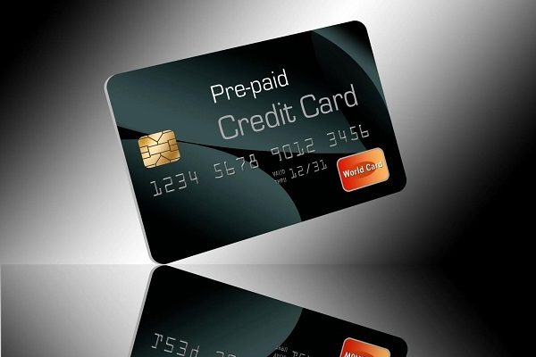

Challenge #8
Provide Insights to the Product Strategy Team
in the Banking Domain

Slide 2
Mitron Bank is a legacy financial institution headquartered in Hyderabad.
They want to introduce a new line of credit cards, aiming to broaden its product offerings and reach in the financial market.
Problem Statement

Slide 3
to analyse the provided sample data and report key findings to the strategy team of Mitron Bank.
to guide them in tailoring the credit cards to customer needs and market trends
Objective

Slide 4
Analysis
Calculate Spending data from fact_spends.csv for each customer_id corresponds to Each Customer
Find Income Utilization by dividing customer spending and average income
Income utilization = Spend / Income
If the customer income utilization is more than average income utilization then the customer is consider as Targeted Customer for the New Product.

Slide 5
Insights
Customer on age group from 25 – 45 are spending high and our Targeted customer also follows the same.
Married and Single Male are spending more than female customers.
Customer from Mumbai spend the most follow by Delhi, Bengaluru.
Customer from Chennai and Hyderabad are least spenders.

Slide 6
Insights
Salaried IT Employees spending more so they are our Targeted customers.
Government Employee use Credit card very less compare with IT Employees, Business owners, freelancers and other employee
Bengaluru Freelancer Customer spending was slightly over than Delhi Freelancer.

Slide 7
Recommendations
Launch your Credit card sales from Mumbai Bengaluru Delhi. These cities have high spending customer so chance of using credit card is also high. Its recommended to deploy more work force along these respective cities.
Customers from Chennai are not spending as much as these cities but They are Earning more so I see a huge potential market there, so try to give more localize offers to encourage their spending.

Slide 8
Recommendations
Nearly 75% of Credit card were used to pay Bills, Electronics, Health & Wellness, Groceries, Travel. Try to launch credit card with offers on these segments to make your product attractive on the Market.

Slide 9
Thank You

