Slide 1

Fundamentals of C#
Initialization and scope of variables
Program Flow
Class in Detail
Modifiers
Object in Detail

Slide 2
Data Types
Type | Represents | Range | Default Value
bool | Boolean value | True or False | False
byte | 8-bit unsigned integer | 0 to 255 | 0
char | 16-bit Unicode character | U +0000 to U +ffff | '\0'
decimal | 128-bit precise decimal values with 28-29 significant digits | (-7.9 x 10²⁸ to 7.9 x 10²⁸) / 10⁰ to 28 | 0.0M
double | 64-bit double-precision floating point type | (+/-)5.0 x 10⁻³²⁴ to (+/-)1.7 x 10³⁰⁸ | 0.0D
float | 32-bit single-precision floating point type | -3.4 x 10³⁸ to + 3.4 x 10³⁸ | 0.0F
int | 32-bit signed integer type | -2,147,483,648 to 2,147,483,647 | 0
long | 64-bit signed integer type | -9,223,372,036,854,775,808 to 9,223,372,036,854,775,807 | 0L
sbyte | 8-bit signed integer type | -128 to 127 | 0
short | 16-bit signed integer type | -32,768 to 32,767 | 0

Slide 3
Variables
Variables represent storage locations. Every variable has a type that determines what values can be stored in the variable.
Declare variables in C# using the following syntax:
datatype identifier;
For example:
int i;

Slide 4
Scope of a variable
The scope of a variable is the region of code from which the variable can be accessed.
Local and Global Variable
A local variable is in scope until a closing brace indicates the end of the block statement or method in which it was declared.
A variable declared at the top of a program or outside of a function is considered a global scope variable

Slide 5
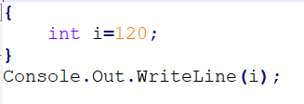

What will be the output of below program?

Slide 6
Constants
Constant is a variable whose value cannot be changed throughout its lifetime
Prefixing a variable with the const keyword when it is declared and initialized designates that variable as constant
Example: const int a=300;

Slide 7
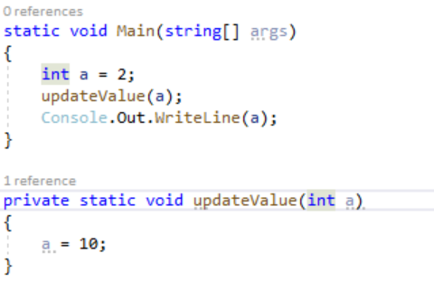
What will be the output of below program?

Slide 8
Value Type and Reference Type
A Value Type holds the data within its own memory allocation and a Reference Type contains a pointer to another memory location that holds the real data.
ref keyword in C# is used for passing or returning references of values to or from Methods. It means that any change made to a value that is passed by reference will reflect this change since you are modifying the value at the address and not just the value.

Slide 9
Program Flow
The statements that allow you to control the flow of your program rather than execute every line of code in the order it appears in the program
Conditional Statements
if Statement
Switch Case Statement

Slide 10
Program Flow- Loops
The for Loop
for loops provide a mechanism for iterating through a loop whereby you test whether a particular condition holds true before you perform another iteration.
Syntax of for loop
The initializer is the expression evaluated before the first loop is executed (usually initializing a local variable as a loop counter).
The condition is the expression checked before each new iteration of the loop (this must evaluate to true for another iteration to be performed).
The iterator is an expression evaluated after each iteration
(usually incrementing the loop counter).

Slide 11
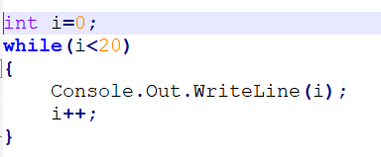
Program Flow- Loops
The while Loop
Like the for loop, while is a pretest loop. The syntax is similar, but while loops take only one expression
do while Loop
do…while loop is the post-test version of the while loop

Slide 12

Questions

Slide 13

Thank you!

