Slide 1

Object Oriented Programming in Detail
Class vs Object
Encapsulation
Abstraction
Inheritance
Polymorphism
Interface

Slide 2
Class vs Object
Class is a logical entity. Object is a physical entity.
A class is a blueprint from which you can create the instance, i.e., objects.
An object is the instance of the class

Slide 3
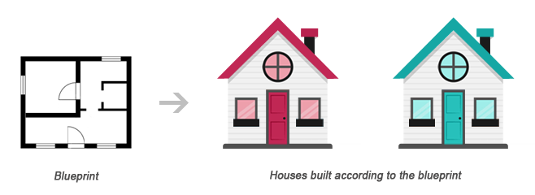
Class vs Object
Class
Objects

Slide 4
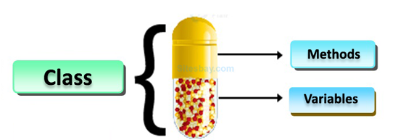
Encapsulation
Binding together the data and the functions that manipulates them.
In other words, Encapsulation is a mechanism to wrap up variables(data) and methods(code) together as a single unit.

Slide 5
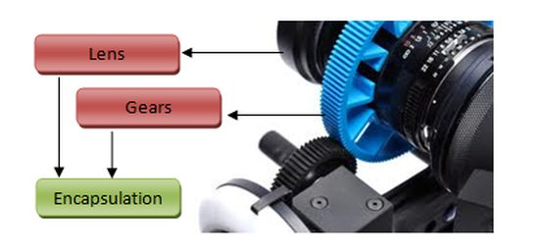
Encapsulation

Slide 6
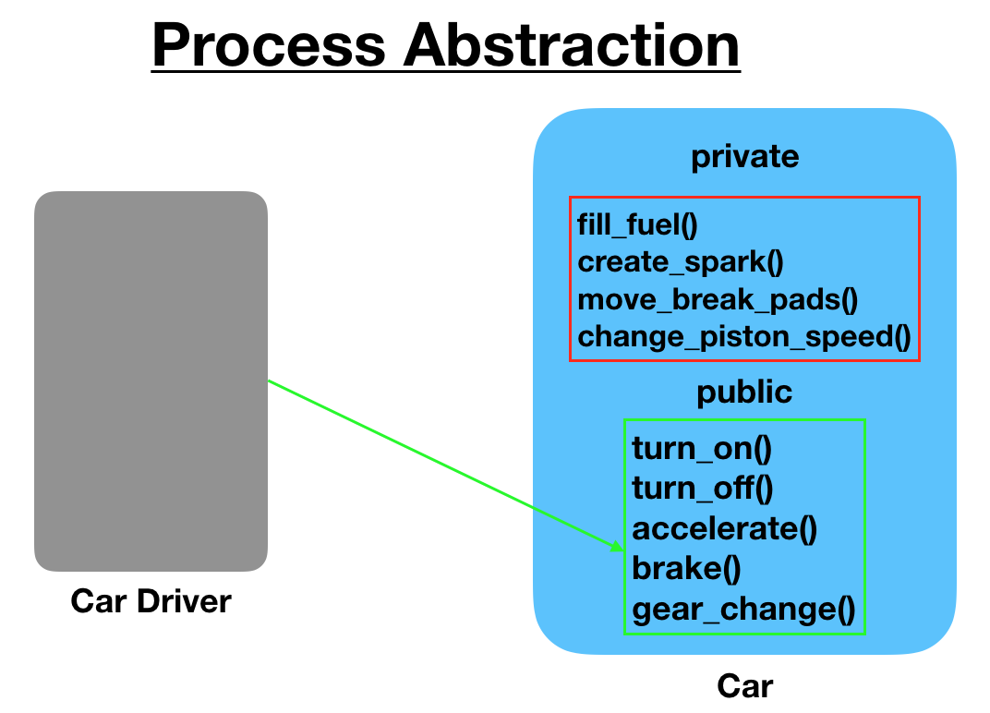
Abstraction
Process of hiding the implementation details and showing only functionality to the user.
Abstraction lets you focus on what the object does instead of how it does it.

Slide 7
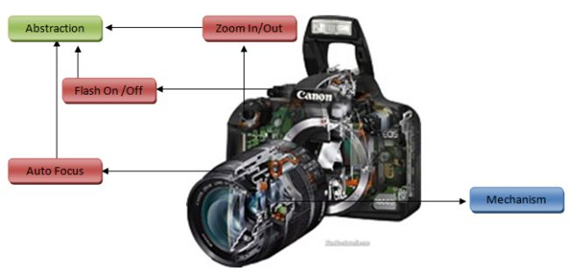
Abstraction

Slide 8
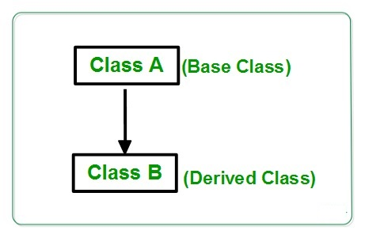
Inheritance
Mechanism of acquiring the features and behaviours of a class by another class.
The class whose members are inherited is called the base class, and the class that inherits those members is called the derived class.

Slide 9
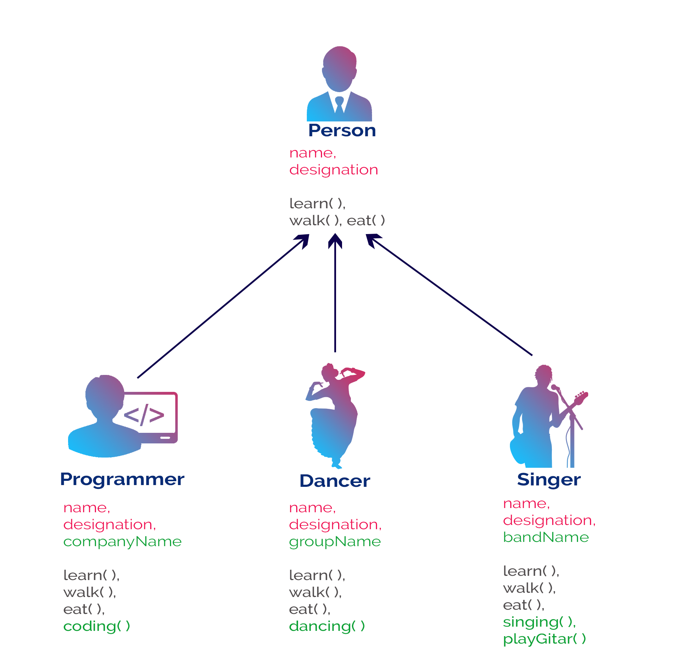
Inheritance

Slide 10
Polymorphism
Polymorphism literally means “many forms”
Polymorphism refers to the ability of a variable, function, or object to take on multiple forms
It enables the reusability of code

Slide 11
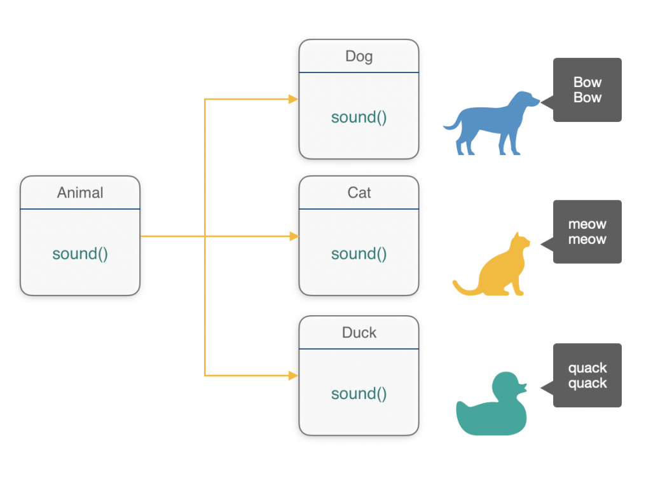
Polymorphism

Slide 12
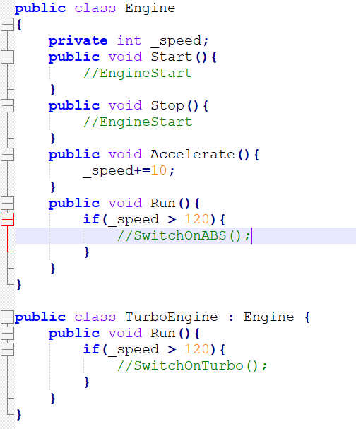
Polymorphism

Slide 13
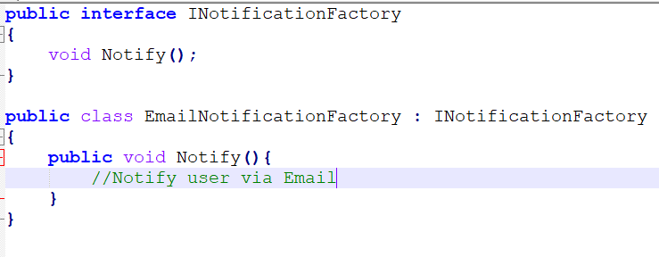
Interface
An interface is a contract between itself and any class that implements it. Interface can have methods, properties, or events.
It contains only declaration of its members and implementation of its members will be given by the class who implements the interface.

Slide 14
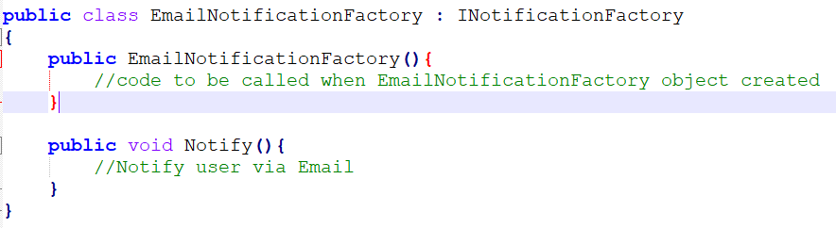
Class Constructors
A constructor of a class is a method that gets called when a class is instantiated using the new function.
A constructor for a class has the same name as the class name

Slide 15
Class Fields/Properties
Properties enable a class to expose a public way of getting and setting values, while hiding implementation or verification code.
One basic pattern for implementing a property involves using a private backing field for setting and retrieving the property value. The get accessor returns the value of the private field, and the set accessor may perform some data validation before assigning a value to the private field.

Slide 16
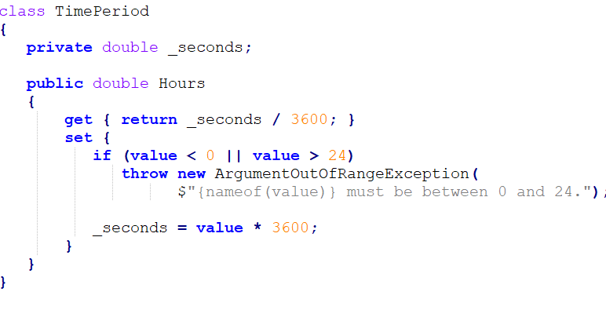
Class Fields/Properties

Slide 17
Access Modifiers
Access Modifiers are keywords that define the accessibility of a member, class or variable in a program
 | public | protected | private
Entire program | Yes | No | No
Containing class | Yes | Yes | Yes
Derived types | Yes | Yes | No

Slide 18
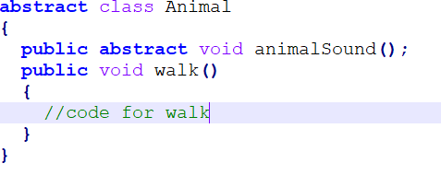
Abstract Class
Abstract class is a restricted class that cannot be used to create objects (to access it, it must be inherited from another class)
Abstract method can only be used in an abstract class, and it does not have a body. The body is provided by the derived class (inherited from).

Slide 19
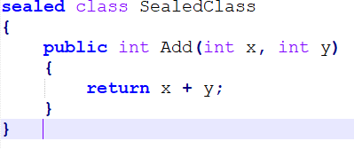
Sealed Class
A sealed class, in C#, is a class that cannot be inherited by any class but can be instantiated.
The design intent of a sealed class is to indicate that the class is specialized and there is no need to extend it to provide any additional functionality through inheritance to override its behaviour.

Slide 20
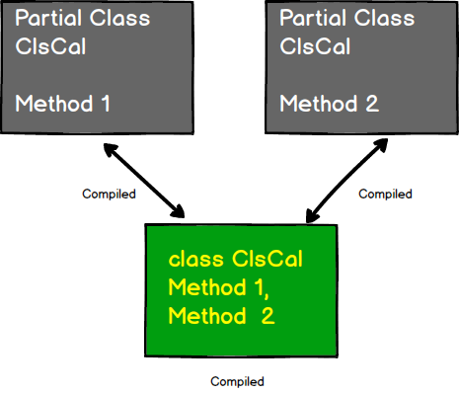
Partial Class
A partial class is a special feature of C#. It provides a special ability to implement the functionality of a single class into multiple files and all these files are combined into a single class file when the application is compiled.

Slide 21
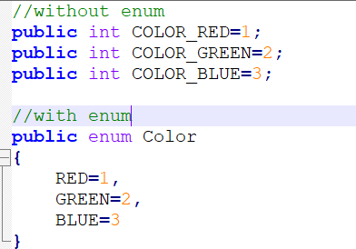
Enums
An enum is a special "class" that represents a group of constants (unchangeable/read-only variables).
They are a robust alternative to the simple String or int constants.

Slide 22
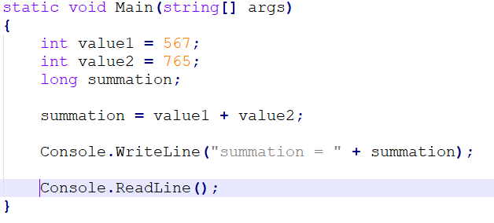
Type Casting
When the variable of one data type is changed to another data type is known as the Type Casting.
Implicit : For the implicit conversion, there is not any need for the special syntax.

Slide 23
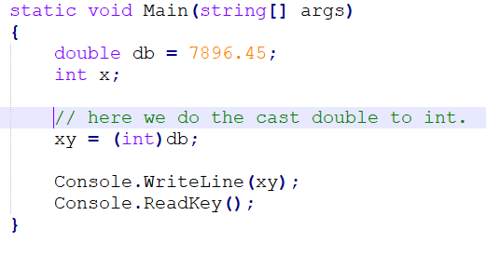
Type Casting
Explicit : Explicit conversion will be done with the cast operator ()

Slide 24
Collections and Data structures
Generic Collections
Non-Generic Collections
Selecting a Collection Class

Slide 25
Generic Collections
A generic collection is strongly typed (you can store one type of objects into it) so that we can eliminate runtime type mismatches, it improves the performance by avoiding boxing and unboxing.
Generic collections are type-safe at compile time. Because of this, generic collections typically offer better performance.
Example:
Dictionary<TKey,TValue>
List<T>
Queue<T>
Stack<T>

Slide 26
Non Generic Collections
Non Generic Collections are general-purpose data structure that works on object references, so it can handle any type of object, but not in a safe-type manner.
Example:
Hashtable
Array
ArrayList
Stack
Queue

Slide 27
Selecting a Collection Class
Use Queue or Stack if the following conditions met
Do you need a sequential list where the element is typically discarded after its value is retrieved?
Do you need to access the elements in a certain order, such as FIFO, LIFO, or random?
Use List, Dictionary or Hashtable if the following conditions met
Do you need to access each element by index?
Do you need to sort the elements differently from how they were entered?

Slide 28

Questions

Slide 29

Thank you!

