Slide 1

Fundamentals of Git
What is Version Control System?
Types of Version Control
Introduction to Git
Git Basics
Best Practices of Git

Slide 2
Version Control System
Version control is a system that records changes to a file or set of files over time so that you can recall specific versions later.
It helps developers keep every version of the code and it allows them to revert selected files back to a previous state, revert the entire project back to a previous state, compare changes over time, see who last modified something that might be causing a problem, who introduced an issue and when, and more.

Slide 3

Version Control System

Slide 4

Version Control System

Slide 5
Types of Version Control
Centralized Version Control Systems
Distributed Version Control Systems

Slide 6
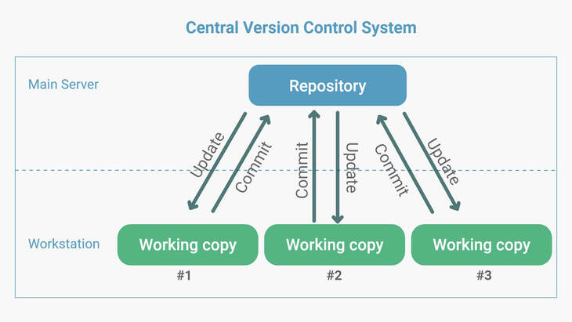
Centralized Version Control
Centralized Version Control Systems have a single server that contains all the versioned files, and a number of clients that check out files from that central place.

Slide 7
Distributed Version Control
A distributed version control system (DVCS) is a type of version control where the complete codebase, including its full version history, is mirrored on every developer's computer.
Thus, if any server dies, and these systems were collaborating via that server, any of the client repositories can be copied back up to the server to restore it.

Slide 8
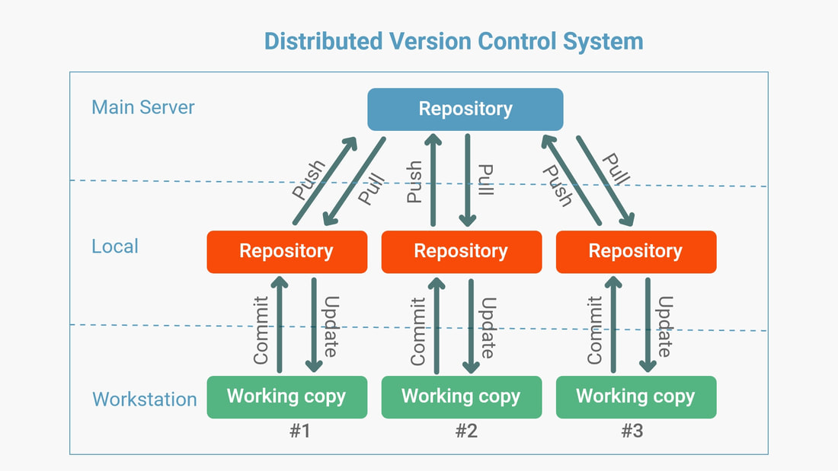
Distributed Version Control

Slide 9
Git
Git is a free and open source distributed version control system designed to handle everything from small to very large projects with speed and efficiency.
Advantages
Free and Open source
Fast performance
Scalable

Slide 10
Using Git
Command Line
Code Editors and IDE
Visual Studio Code
Visual Studio
Graphical User Interfaces
Git Desktop
GitLab
SourceTree

Slide 11
Git Installation
Open https://git-scm.com/download/win
Download Standalone installer
Follow the installation instructions of downloaded exe
Once installation is completed, verify by typing below command in Command Prompt(cmd)
git --version

Slide 12
Git Commands
git init
git add
git commit
git branch
git remote
git push

Slide 13
GitHub and Git
Create a local repository
Add few files
Commit the files
Create repository in GitHub
Push files from local to GitHub

Slide 14
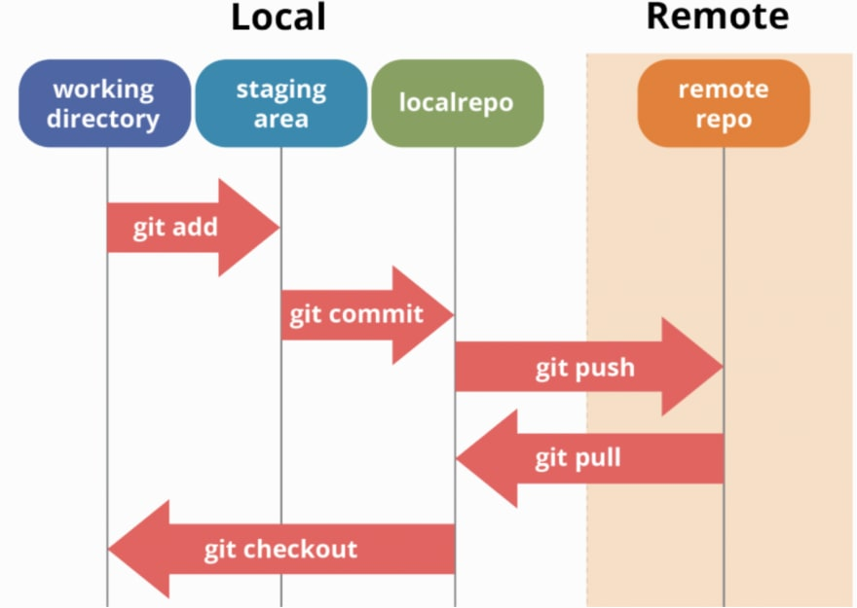
How Git works?

Slide 15
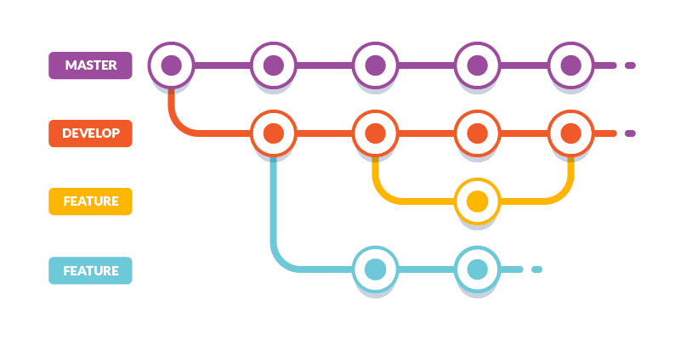
Git Branching

Slide 16



GIT GUI Clients

Slide 17
GitHub Desktop
Open https://desktop.github.com/
Download for Windows
Follow the installation instructions in exe

Slide 18
Why command line?
GUI tools have limitations
GUI tools are not always available
Possible to automate

Slide 19

Questions

Slide 20

Thank you!

