Slide 1




Fundamentals of Web, Html, CSS and JS
Web Application
HTML
CSS
JS
Bootstrap

Slide 2
Web Application
A web application is application software that runs on a web server, unlike desktop application that run locally on the operating system of the device. Web applications are accessed by the user through a web browser with an active network connection.
Advantages
Cross Platform
More manageable
Always up to date
Cost-Effective

Slide 3
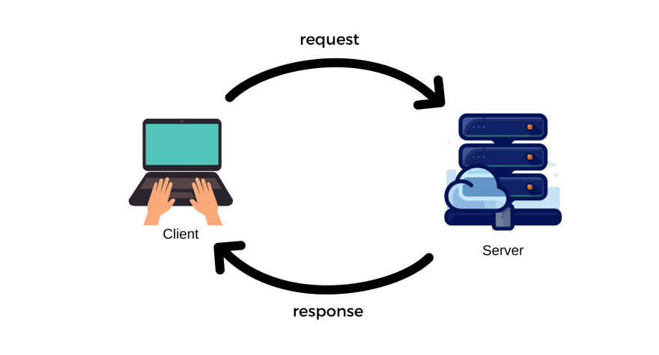
How Web Application Works ?

Slide 4
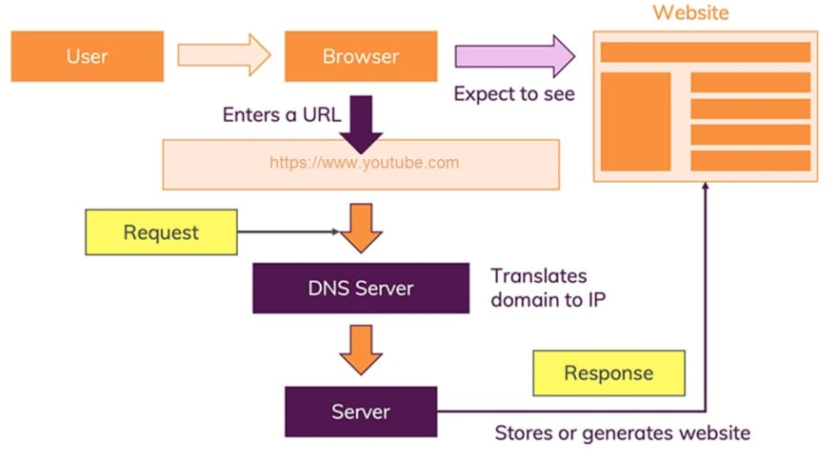
How Web Application Works ?

Slide 5
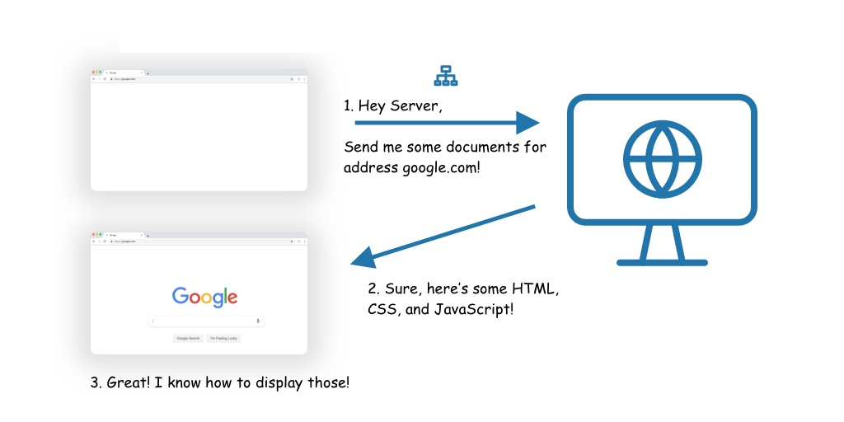
Browser
Browser understands only HTML, CSS and JS

Slide 6
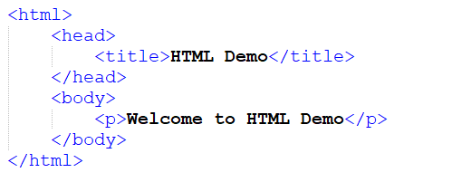
HTML
HyperText Markup Language (HTML) is the standard markup language for documents designed to be displayed in a web browser.

Slide 7
HTML
Basic Tags
Text
List
Link
Images
Tables
Forms
Comments

Slide 8
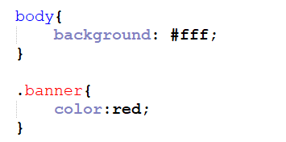
CSS
Cascading Style Sheets is a style sheet language used for describing the presentation of a document written in a markup language such as HTML.

Slide 9
CSS
Syntax
Colors
Backgrounds
Fonts
Measurement Unit
Text
Margin
Padding

Slide 10
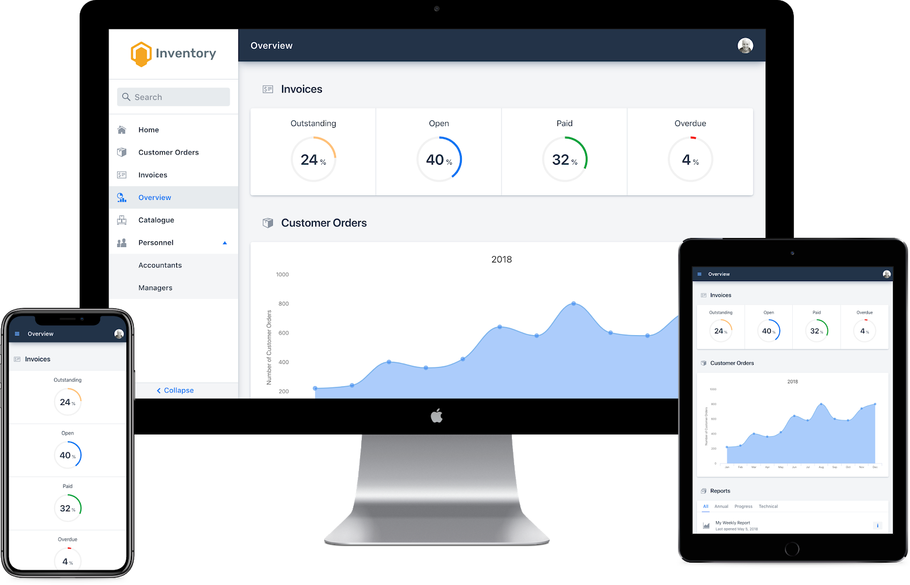
Responsive Apps
A responsive web app refers to a design that responds effectively to the behaviour of the users and the environment depending on the size of the screen, orientation and platform.

Slide 11
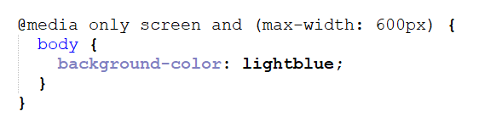
CSS – Media Queries
Media query is a CSS technique introduced in CSS3.
It uses the @media rule to include a block of CSS properties only if a certain condition is true.

Slide 12
Bootstrap
Bootstrap is a free and open-source CSS framework directed at responsive, mobile-first front-end web development.
It contains HTML, CSS and JavaScript-based design templates for typography, forms, buttons, navigation, and other interface components.

Slide 13
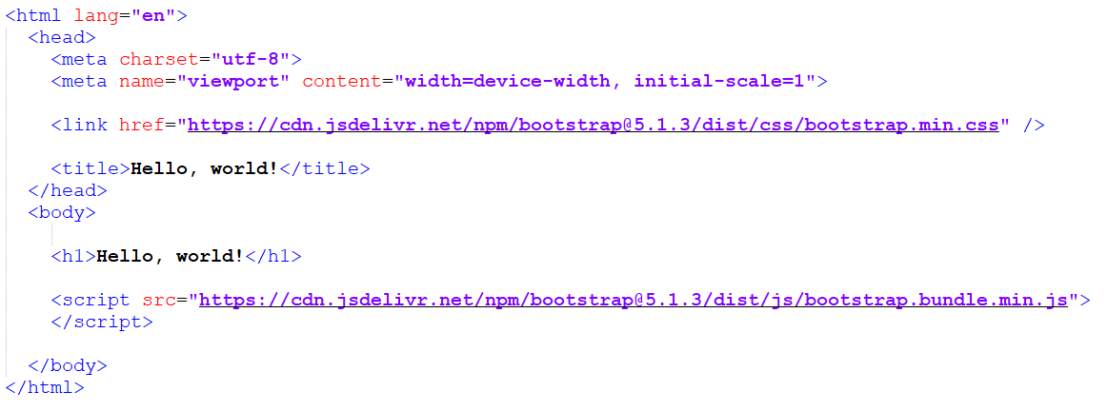
Bootstrap-Starter Code

Slide 14
Bootstrap
Grid System
Typography
Tables
Alerts
Buttons
Forms and Controls
Navigation bar

Slide 15
Bootstrap
 | Extra small devices Phones | Small devices Tablets | Medium devices Desktops | Large devices Desktops
Container width | 0-576px | 577- 768px | 769 - 970px | 971- 1170px
Class prefix | .col-xs- | .col-sm- | .col-md- | .col-lg-

Slide 16

Questions

Slide 17

Thank you!

