Slide 1
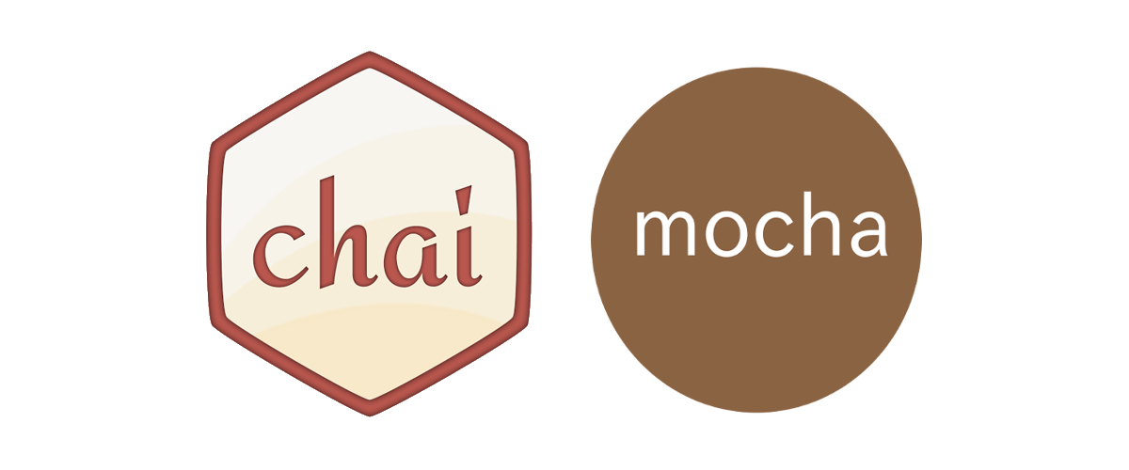
Mocha and Chai- Javascript Unit Testing
NodeJs
NPM
Mocha
Chai

Slide 2

Node.js is an open-source, cross-platform, back-end JavaScript runtime environment that runs on the V8 engine and executes JavaScript code outside a web browser

Slide 3
Runtime Environment for executing JavaScript Code
We often use Node to build back-end services(API)

Slide 4
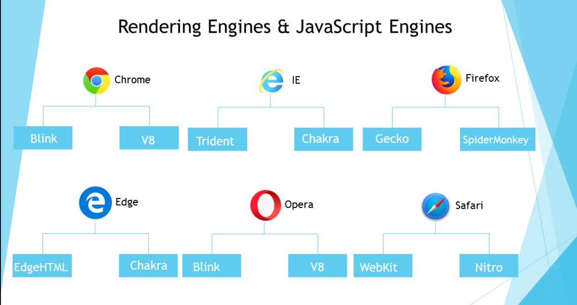
Javascript Runtime Environment?

Slide 5

Package Manager for JavaScript modules

Slide 6

Mocha is a feature-rich JavaScript test framework running on Node.js and in the browser
https://mochajs.org/

Slide 7

Chai is a BDD / TDD assertion library for node and the browser that can be delightfully paired with any javascript testing framework.
https://www.chaijs.com/

Slide 8

Questions

Slide 9

Thank you!

