Slide 1

Fundamentals of RDBMS
Database
What is RDBMS?
Introduction to SQL
Normalization
What is NoSQL database?

Slide 2
Database
A database is an organized collection of data, so that it can be easily accessed and managed.
The main purpose of the database is to operate a large amount of information by storing, retrieving, and managing data.

Slide 3
Components of Database
Table
Field/Column
Row
Constraints
Procedures
Functions
Indexes

Slide 4
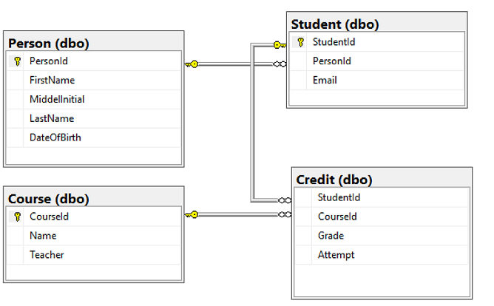
Database Example

Slide 5
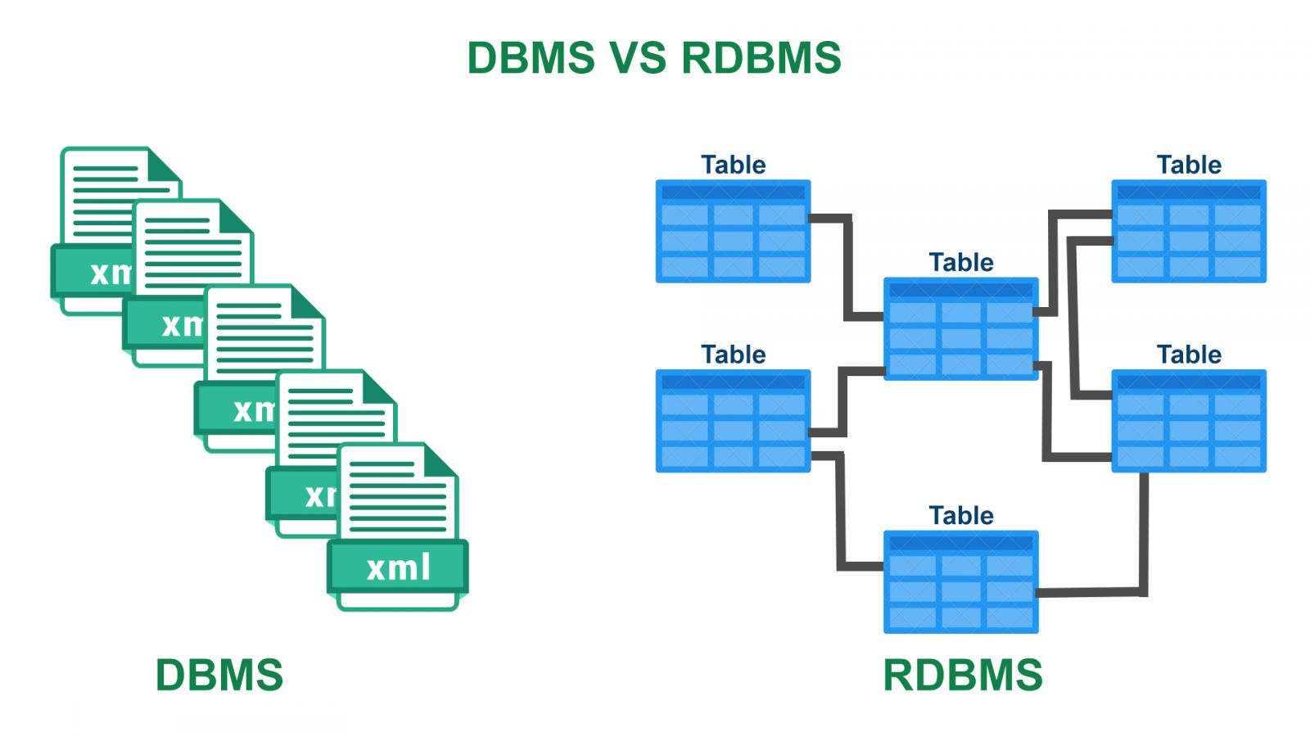
RDBMS
A database management system (DBMS) that incorporates the relational-data model, normally including a Structured Query Language (SQL) application programming interface.

Slide 6
SQL
SQL is Structured Query Language, which is a computer language for storing, manipulating and retrieving data stored in a relational database.
SQL is the standard language for Relational Database System. All the Relational Database Management Systems (RDMS) like MySQL, MS Access, Oracle, Sybase, Informix, Postgres and SQL Server use SQL as their standard database language.

Slide 7
Applications of SQL
Allows users to access data in the relational database management systems
Allows users to describe the data
Allows users to create and drop databases and tables
Allows users to create view, stored procedure, functions in a database.

Slide 8

SQL Syntax -Select
Select Statement- SELECT statement is used to select data from a database.
The data returned is stored in a result table, called the result-set.

Slide 9

SQL WHERE
The WHERE clause is used to filter records.
It is used to extract only those records that fulfil a specified condition.

Slide 10
Tools required to learn SQL
SQL Server
https://go.microsoft.com/fwlink/?linkid=866658
SQL Management Studio
https://docs.microsoft.com/sql/ssms/download-sql-server-management-studio-ssms

Slide 11
Normalization
Normalization is the process of organizing the data in the database.
Normalization is used to minimize the redundancy from a relation or set of relations. It is also used to eliminate undesirable characteristics like Insertion, Update, and Deletion Anomalies.
Normalization divides the larger table into smaller and links them using relationships

Slide 12
Normalization - Advantages
Normalization helps to minimize data redundancy.
Greater overall database organization.
Data consistency within the database.
Enforces the concept of relational integrity.
Much more flexible database design.

Slide 13
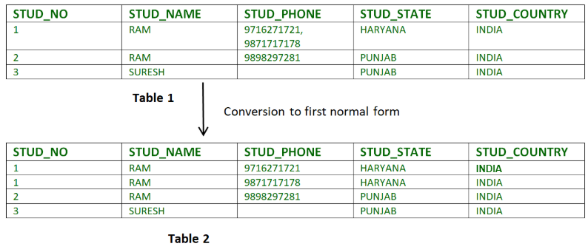
1NF (First Normal Form) Rules
Each table cell should contain a single value.
Each record needs to be unique.
E.g. Table without Normalization

Slide 14
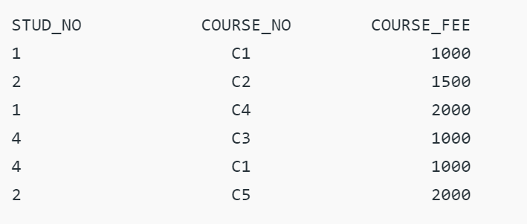
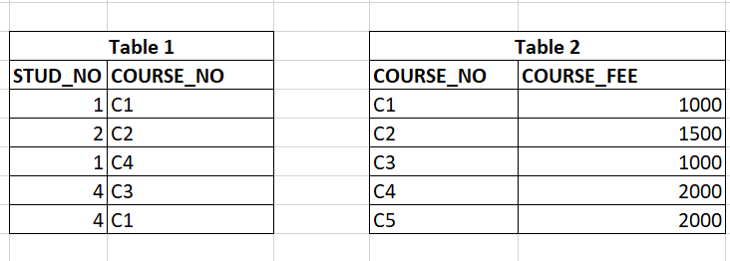
2NF (Second Normal Form) Rules
To be in second normal form, a relation must be in first normal form and relation must not contain any partial dependency.

Slide 15
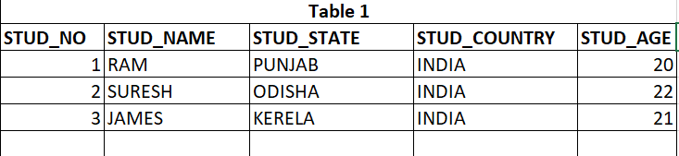
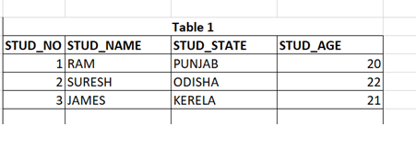
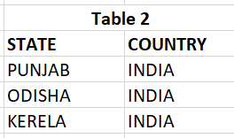
3NF (Third Normal Form) Rules
A relation is in third normal form, if there is no transitive dependency for non-prime attributes as well as it is in second normal form.

Slide 16

Questions

Slide 17

Thank you!

