Slide 1
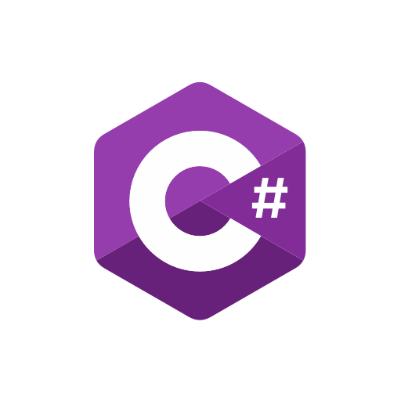




Welcome
Presenter : Aravinth Pandidurai

Slide 2
Course Modules
Object Oriented Programming using C#
HTML 5, CSS 3, Bootstrap, Javascript
React
Redux and Thunk
Advanced C#
Microservices using ASP.NET Core

Slide 3
Programming
Process of writing code which can be executed on computer or on any device
Types of Programming
Functional programming
Object Oriented Programming

Slide 4
Object Oriented Programming
Object Oriented programming (OOP) is a programming paradigm that relies on the concept of classes and objects.
It is used to structure a software program into simple, reusable pieces of code blueprints (usually called classes)

Slide 5
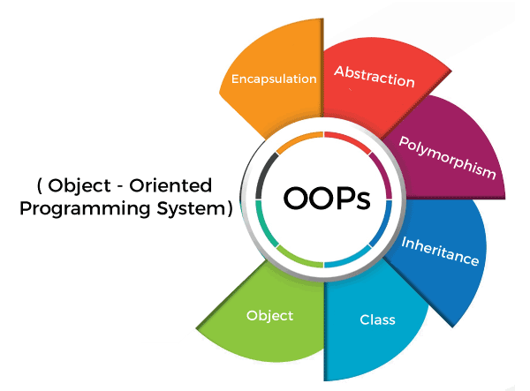
Object Oriented Programming

Slide 6
.NET
.NET is a free, cross-platform, open source developer platform for building many different types of applications.
You can build applications for web, mobile, desktop, games, and IoT using .NET

Slide 7
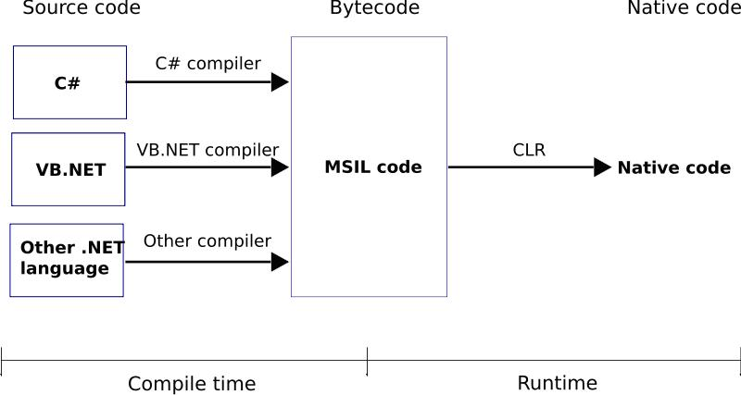
How .NET works?

Slide 8
C# is a simple & powerful object-oriented programming language developed by Microsoft.
Advantages of C#
Automatic Garbage Collection
Type-Safe
Familiar Syntax
Cross Platform
Better Integrity and Interoperability

Slide 9

Hello World Application –C#

Slide 10
Algorithm
An algorithm is a set of well-defined instructions to solve a particular problem. It takes a set of input and produces a desired output
Example
Step 1: Start
Step 2: Declare variables num1, num2 and sum.
Step 3: Read values num1 and num2.
Step 4: Add num1 and num2 and assign the result to sum.
sum←num1+num2
Step 5: Display sum
Step 6: Stop

Slide 11

Questions

Slide 12

Thank you!

