Slide 1

MVC – Web Development- High Level
Evolution of Web Development
MVC
API
SPA
HTTP

Slide 2
Evolution of Web
Static Web Pages
(HTML, CSS, JS)
Dynamic Web Pages
using server side scripting
Languages
(ASP, JSP, PHP)
MVC
(ASP.NET MVC, Ruby on Rails, Java-Spring)
API
(ASP.NET Web API)
SPA
(ReactJs, Angular)

Slide 3
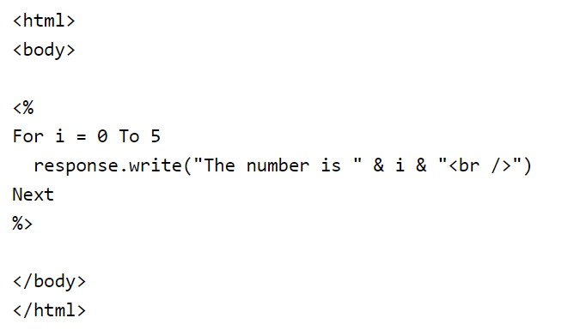
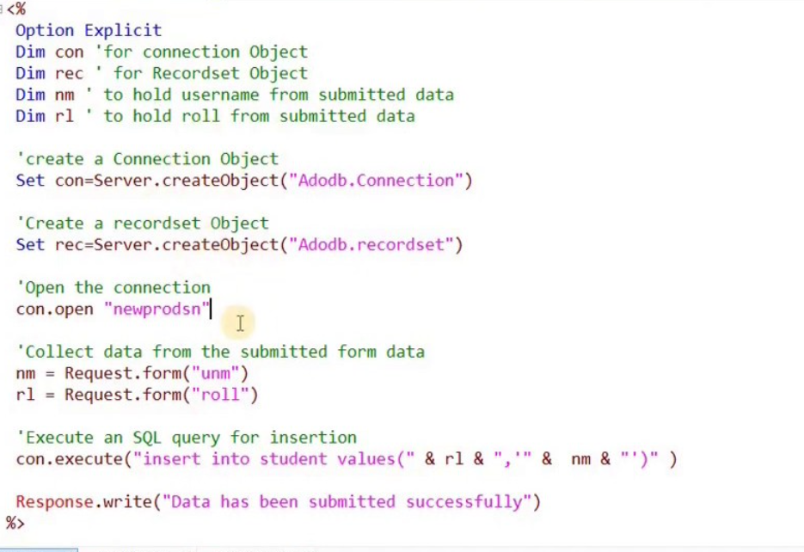
Classic ASP (Server Side Scripting Example)

Slide 4
Separation of Concerns
Separation of concerns is a software architecture design pattern/principle for separating an application into distinct sections

Slide 5
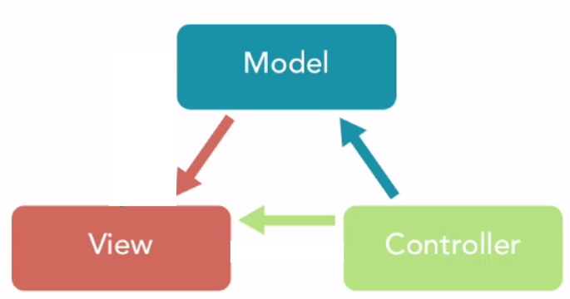
MVC
MVC (Model-View-Controller) is a pattern in software design commonly used to implement user interfaces, data, and controlling logic.
It emphasizes a separation between the software's business logic and display.

Slide 6
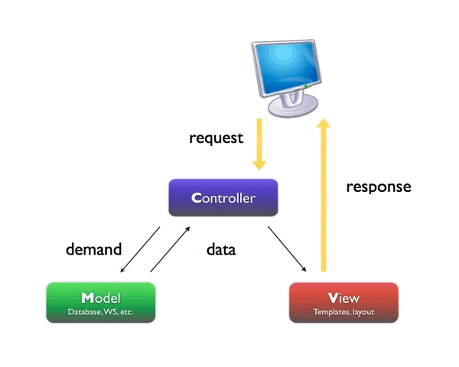
MVC

Slide 7
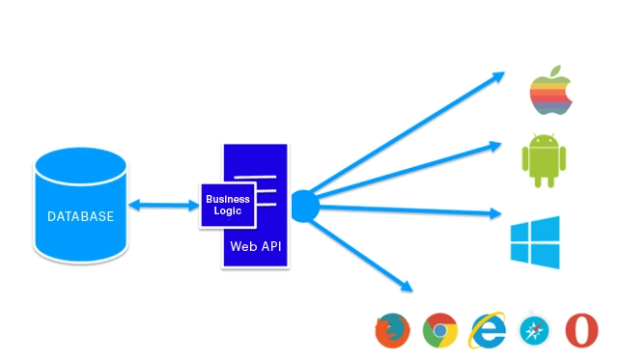
API
API stands for Application Programming Interface. A Web API is an application programming interface for the Web.

Slide 8
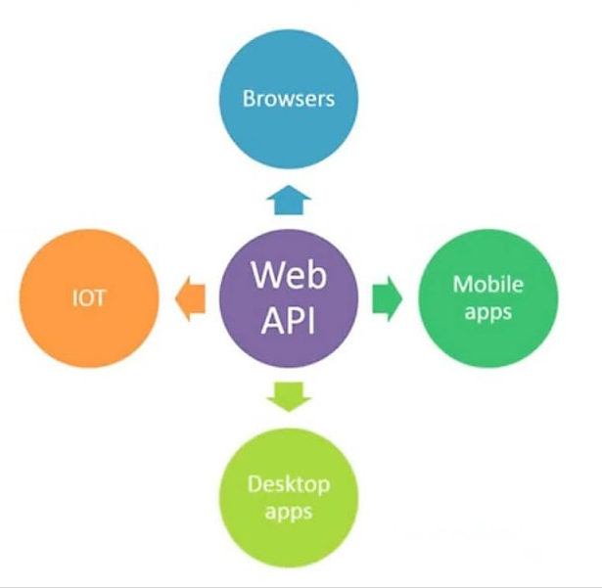
API

Slide 9
SPA
An SPA (Single-page application) is a web app implementation that loads only a single web document, and then updates the body content of that single document via JavaScript APIs such as XMLHttpRequest, $.ajax and Fetch when different content is to be shown.

Slide 10
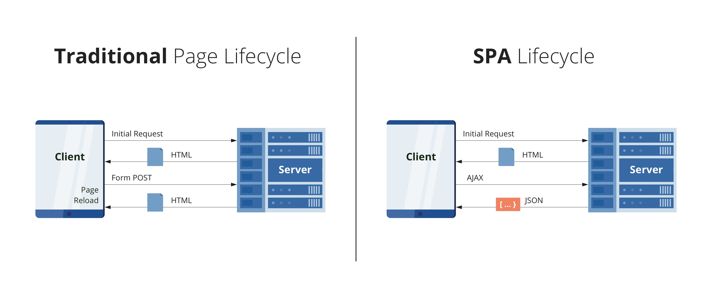
SPA

Slide 11
SPA ( ASP.NET and React)
SQL Server Database
Data Access Layer
ASP.NET Web API
React

Slide 12
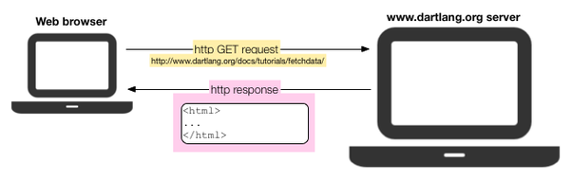
HTTP GET

Slide 13
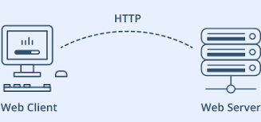
HTTP POST

Slide 14

Questions

Slide 15

Thank you!

