Slide 1
Digital Forensics – COMP 5350/6350
Ananya Ravipati

Slide 2
Overview
Quiz
Linux Memory Acquisition
LiME

Slide 3
Linux Memory Acquisition – Preliminary Steps
Data on victim machine shouldn’t be altered
The disk you are copying the images to should be sanitized
Use a write blocker

Slide 4
Linux Tools - History
/dev/mem
Window into main memory
Character device
Suitable application can read from and write to RAM (dd /cat)
Disadvantages
Corrupt file system/instability
Why? Because many systems do no map RAM contiguously from physical offset 0
Only addresses the first 896MB of RAM
Limitation for any system that has greater capacity of RAM

Slide 5
Linux Tools - History
/dev/kmem
Character device
Difference between /dev/mem and /dev/kmem is /dev/kmem exports virtual address space
ptrace
Debugging interface
Acquires memory of only running processes
Optimal for examining single process (code and data)

Slide 6
Modern tools
/proc/kcore
fmem
LiME
/proc/kcore – This file represents the physical memory of system

Slide 7
fmem
This is improved version of /dev/mem
It checks if the physical pages are available in main memory before accessing
No limitation of 896MB RAM
Disadvantage:
Requires help of /proc/iomem (In other words, it needs help to determine RAM mappings.)
Needs deep knowledge of physical memory layout

Slide 8

fmem
Using fmem we can export/access the ranges above

Slide 9
LiME
It stands for Linux Memory Extractor
Loadable kernel module
All acquisition is done at kernel level – Avoids context switches
Multiple acquisition formats
Download link
https://github.com/504ensicsLabs/LiME
It comes with a make file. Run “make”
For using on different platforms, we need to cross compile.

Slide 10
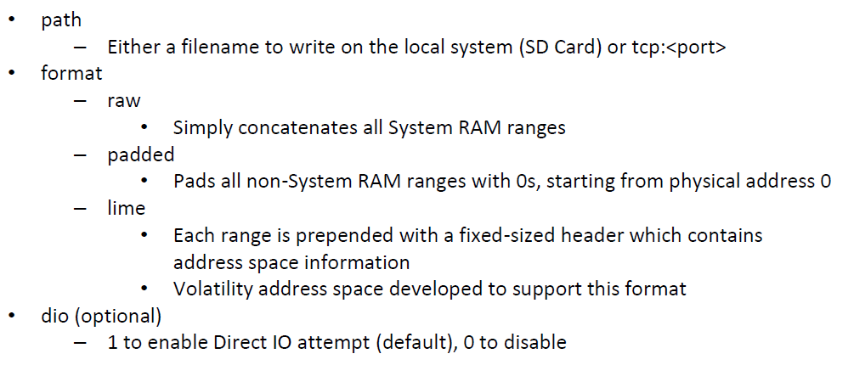
Parameters

Slide 11
Sidenotes
Never compile LiME on victim machines
It alters the file space
Acquisition over TCP
On victim machine
On Forensic WS
nc <ip address of victim> < port number> > filename

Slide 12
Follow up
Examining the .lime file using “volatility”

