Slide 1
Digital Forensics – COMP 5350/6350 Spring
-ARavipati

Slide 2
Today’s Topics
Volatility
What is volatility?
Why do we need volatility?
How to build a Linux profile in volatility for analyzing memory dump

Slide 3
What we know
LiMe – Used this tool to acquire memory
Things to remember
We acquired the memory image as root
We are assuming the Linux VM as a normal computer – There are different ways to capture the virtual machine images (Snapshot/pause, clone, Host disk, introspection)
Other details – Remotely acquired the image, Format acquired in - .lime

Slide 4
Volatility
It is implemented in Python
Tool runs anywhere Python can be installed
Python is well known for libraries that support forensic and reverse engineering
Completely open collection of tools
Used for digital artifact extraction from volatile memory samples
It supports multiple operating systems – Windows, Linux, Mac OS (32 and 64 bit)

Slide 5
Volatility
Modular design helps in cross compiling the code for new OS’s and architectures
Source code is available – helps in understanding the tool better
Supported by large organization – Google, DoD, academic communities, antivirus companies..
Efficient resource utilization (algorithm, memory usage, speed)
Wide range of applications – explore kernel memory, drive malware sandbox, virtual machine introspection

Slide 6
Volatility
Most tools are Windows OS dependent
Windows kernel debugging tools
Volatility gives information on unallocated space, indirect artifacts

Slide 7
What Volatility doesn’t offer
Memory acquisition
No GUI
Not bug free
produces complex and difficult to reproduce problems

Slide 8
The Volatility Framework
VTypes
Overlays
Objects and Classes
Profiles
(Most OS and their applications are written in C)

Slide 9
VTypes
It is common practice to use data structures to organize variables and attributes
Volatility is written in Python – How do we represent data structures in C
VTypes enables to represent structures whose member names, offsets, and types all match the ones used by the operating system
When the instance of structure defined by VType is encountered python source code knows how to interpret

Slide 10
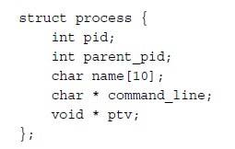
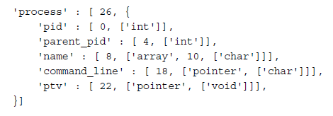
VType Example
In C
In VType

Slide 11
Overlays
Overlays are needed when void pointers are in play.
A void pointer is a pointer to data whose type is unknown or arbitrary at the time of the allocation
Debugging information is not enough to understand type of the data
Once the type is determined by reverse engineering or trial and error – Overlays overrides automated definition
They provide convenience and consistency

Slide 12

Overlay Example

Slide 13
Address Space
interface that provides flexible and consistent access to data in RAM
handles virtual-to-physical-address translation
Transparently accounts for differences in memory dump file formats (for example, the proprietary headers added to Microsoft crash dumps or the compression schemes used in hibernation files).
Volatility uses stacked AS model

Slide 14
Volatility AS
It helps in providing abstraction
User need not worry about the differences (such as how data is stored, compressed, etc) between raw dumps, crash dumps, or hibernation files, in other words, different memory formats

Slide 15
Objects and Classes
A Volatility object (or just object for short) is an instance of a structure that exists at a specific address within an address space (AS)
Objects are created object.obj() API
It is used to access any of the structures members
An object class has methods and properties attached to object
Object class helps in code sharing and use of API’s within framework

Slide 16
Profile
A profile is a collection of the VTypes, overlays, and object classes for a specific operating system version and hardware architecture (x86, x64, ARM)
It also includes metadata, system calls, low-level types of native languages and their sizes, address of critical global variables and functions

Slide 17
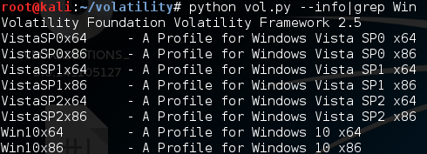
Profiles
Volatility has Windows profiles pre-built
To get available profiles use python vol.py –info|grep Win

Slide 18
Profiles for Linux
Linux is different due to the large number of kernel versions, subkernel versions, and customized kernels
So, Linux Profile need to be built before analyzing the memory dump

Slide 19
Software setup
Dwarfdump
parses the debugging information from ELF files, such as the Linux kernel and kernel modules – gives structure definitions
gcc to compile C files
Kernel headers – For Ubuntu/Debian
linux-headers-`uname -r`

Slide 20
Steps in creating profile
Cd Volatility/tools/linux
“make”
head module.dwarf > You will have debug info in this file
Find system.map – it is usually in /boot files
zip /volatility/plugins/overlays/linux/LinuxP1.zip /path/to/module.dwarf /path/to/system.map
To use profile

Slide 21
To use profile
python vol.py –profile=LinuxP1 –f /path/to/mem_imagefile pslist
LinuxP1 – name of the profile I built, you should use the name you gave while building the profile.

