Slide 1
TU/E · MULTI-DISCIPLINARY CBL · GROUP 5
Creative Bowl Lab
Making meditation visible — where a singing bowl, a heartbeat,
and a living body become one image.
FINAL PRESENTATION · 19 JUNE 2026
Arav Madan · Joris Geleijns · Henk · Alice Ribeiro Mota Vieira · Mahiraa · Alejandra Otero Bozzano

Slide 2
SIX DISCIPLINES, ONE INSTALLATION
A living artwork, built across the table
COMPUTER SCIENCE
PSYCHOLOGY & TECH
ARCHITECTURE
Arav Madan
Joris Geleijns
Henk
Signal pipeline, TouchDesigner, Arduino link
Meaning, perception, the health research
Space, the participant's position, atmosphere
CHEMICAL ENG.
INDUSTRIAL DESIGN
MECHANICAL ENG.
Alice R. M. Vieira
Mahiraa
Alejandra O. Bozzano
Bowl frequency experiments, materials
Requirements, Arduino & physical build
Cymatics model, report architecture
CREATIVE BOWL LAB
THE TEAM
GROUP 5 · 02 / 16

Slide 3
THE GOAL
Can you watch yourself calm down?
Students live under near-constant stress. Meditation and sound can genuinely settle the body — but that shift is invisible. You feel it; you never see it.
Our goal: an interactive installation that turns a moment of calm into something you can watch happen, in real time, around your own body.
WHY IT'S A CHALLENGING GOAL
Original. There is no off-the-shelf version of this — we designed the whole sound-to-image chain ourselves.
Complex. Fusing live bowl sound, a heartbeat and body-tracking into one GPU image, in real time.
Innovative. It makes an invisible state — your body calming — into something you can watch.
CREATIVE BOWL LAB
GOAL & MOTIVATION
GROUP 5 · 03 / 16

Slide 4
WHY IT WORKS — THE EVIDENCE
Sound slows the body down
↑ HRV
↓ HR / BP
↓ Anxiety
Singing bowls
Music & the heart
Bowl therapy
Bowl meditation lowered the stress index and raised heart-rate variability versus silence.
Music increases parasympathetic (“rest-and-digest”) activity and lowers heart rate and blood pressure.
A 2025 systematic review links singing-bowl therapy to reduced anxiety and improved sleep.
Trivedi & Saboo, 2019
Mojtabavi et al., 2020
Cai et al., 2025
An honest framing: we present this as relaxation and mood support — a calming experience — not a proven medical treatment.
CREATIVE BOWL LAB
SCIENTIFIC GROUNDING
GROUP 5 · 04 / 16

Slide 5
HOW WE GOT HERE
A triple-diamond design process
01
›
02
›
03
EXPLORE
CONVERGE
REFOCUS
Photography, music,
poetry, engineering art
Bowl + sound, lens filter,
poetry with sensors
One clear story: bowl +
heartbeat + body
Each diamond widened with ideas, then narrowed with research and a €100 reality check.
CREATIVE BOWL LAB
DESIGN PROCESS
GROUP 5 · 05 / 16

Slide 6
DECISIONS & MID-TERM FEEDBACK
Why the scope is what it is
Mid-term jury: “not visualised · too complex · unclear.” Our response — cut to one clear, visible story. Every decision below follows from that.
Photography
Too static — it never read as a living, reacting thing.
Dropped
Lens / camera filter
Expensive and physically large for an 8-week, €100 build.
Dropped
Physical fluid rig
Subtle and fragile — reborn as digital cymatics on screen.
Folded in
Poetry
Negligible measurable body effect; it diluted the story.
Dropped
Bowl + heartbeat + body
Research-backed, interactive, and every discipline contributes.
Chosen
CREATIVE BOWL LAB
WHAT WE DISCARDED & WHY
GROUP 5 · 06 / 16

Slide 7
REQUIREMENTS & SCOPE
What the piece must do
MUST
SHOULD
COULD
WON'T
— React in real time
— Track the body
— Extra instruments
— Medical claims
— Bowl sound → colour
— Work fully offline
— Background removal
— Cloud / internet
— Heartbeat → pulse
— Feel calm & immersive
— Recorded keepsake
— Paid services
— Run on one laptop
— Each discipline visible
— Multiple people
— Custom hardware lab
Hard constraints: €100 budget · no internet at the demo · one webcam · six disciplines · ready for 19 June
CREATIVE BOWL LAB
REQUIREMENTS (MOSCOW)
GROUP 5 · 07 / 16

Slide 8
THE CONCEPT
Three signals, one image
One person. One bowl. One camera. — woven into a single living visual field.
THE BOWL
THE HEARTBEAT
THE BODY
sets the colour
sets the pulse
sets the shape
Its frequency picks the chakra hue and the cymatic pattern.
Every beat makes the whole image gently throb — and tints it.
The camera finds you, and the visuals wrap around your form.
CREATIVE BOWL LAB
THE CONCEPT
GROUP 5 · 08 / 16

Slide 9
USER-CENTRED DESIGN
Anyone can walk up and feel it
No instructions
Made for any body
You are the interface — step in and it simply responds. Nothing to read, nothing to operate.
MediaPipe tracks any height and any pose, so the visuals find every visitor the same way.
Calming by design
The space leads you
Slow motion, soft colour and a dark, quiet space — built to settle a stressed visitor, not overload them.
One bowl, one focus, black surroundings — the piece guides the whole experience without a word.
Every design choice met one test: would a stressed stranger understand it in five seconds?
CREATIVE BOWL LAB
USER-CENTRED DESIGN
GROUP 5 · 09 / 16

Slide 10
HOW IT WORKS
Inputs → processing → outputs
INPUTS
PROCESSING
OUTPUTS
→
→
Bowl audio
FFT / Goertzel
Colour & cymatics
microphone
nearest chakra, 396–963 Hz
→
→
Heartbeat
BPM → LFO
Pulsing throb & tint
Arduino pulse sensor
smoothed pulse
→
→
The body
MediaPipe pose
Aura wraps the body
webcam
head, hands, torso
All of it runs on the GPU in TouchDesigner — one laptop, one webcam, no internet.
CREATIVE BOWL LAB
SYSTEM PIPELINE
GROUP 5 · 10 / 16

Slide 11
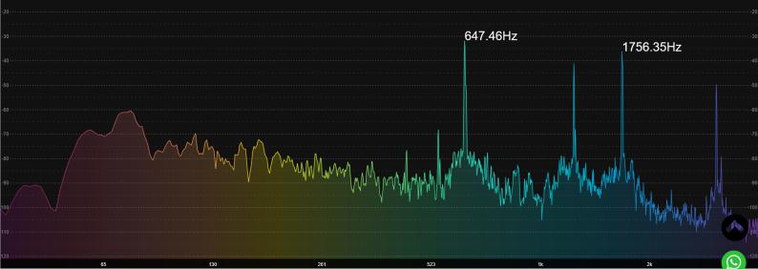
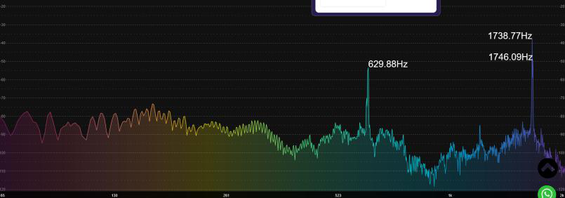
PROTOTYPE & FEASIBILITY
A working prototype — and we tested it
647 Hz
629 Hz
EMPTY BOWL
+ 0.1 L WATER
Measured live on the real bowl — f ∝ √(k/m): more water → more mass → a lower note. Overtones near 1756 Hz make it an inharmonic resonator.
ALREADY VALIDATED
✓ Bowl frequencies measured — 647 Hz, falling to 629 Hz with water
✓ Body tracking runs live — head & torso at 0.97 / 0.99 confidence, no browser
✓ Particle system smoke-tested — 1031 of 2048 gather to a still hand
✓ The whole show runs on one laptop, fully offline
CREATIVE BOWL LAB
PROTOTYPE & FEASIBILITY
GROUP 5 · 11 / 16

Slide 12

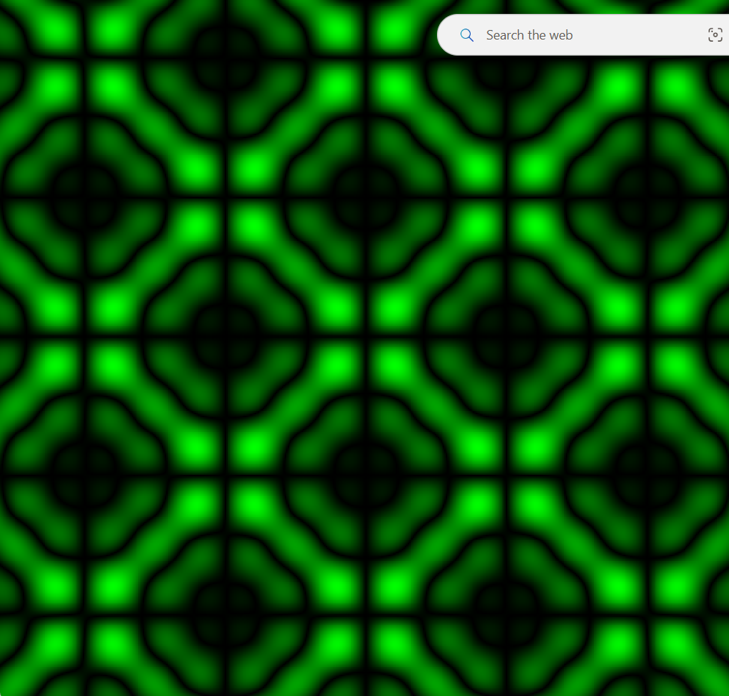


SOUND BECOMES COLOUR
Frequency → chakra → cymatics
NEAREST SOLFEGGIO CHAKRA (396–963 Hz)
Root
396 Hz
release
Sacral
417 Hz
change
Solar Plexus
528 Hz
energy
Heart
639 Hz
← the bowl, 647 Hz
Throat
741 Hz
expression
Third Eye
852 Hz
intuition
Crown
963 Hz
awakening
CREATIVE BOWL LAB
SOUND → COLOUR
GROUP 5 · 12 / 16
One equation, sin(kx)·sin(ky) — denser as the note rises.

Slide 13
THE HEARTBEAT
Your pulse sets the rhythm — and the colour
An Arduino pulse sensor reads your heart rate, then smooths it into a low-frequency pulse that drives the whole image.
Every beat, the visuals gently throb — the way a calm body breathes.
BPM → COLOUR
< 62
62–72
72–85
≥ 85
calm
resting
neutral
elevated
Calmer heart → cool violets and cyans. Faster heart → warm ambers and oranges.
pulse sensor → BPM → smoothed → heartbeat LFO
CREATIVE BOWL LAB
HEARTBEAT → PULSE
GROUP 5 · 13 / 16

Slide 14
THE BODY
The visuals wrap around you
A single webcam feeds MediaPipe pose tracking — it finds your head, hands and torso many times a second, fully on-device.
The aura and a 2,048-particle field follow you: particles gather to still hands, and scatter from fast ones, so motion becomes light.
On-device tracking — no internet, no markers
2,048 GPU particles — gather & scatter with your hands
One-Euro smoothing — the aura glides, never snaps
CREATIVE BOWL LAB
BODY → SHAPE
GROUP 5 · 14 / 16

Slide 15
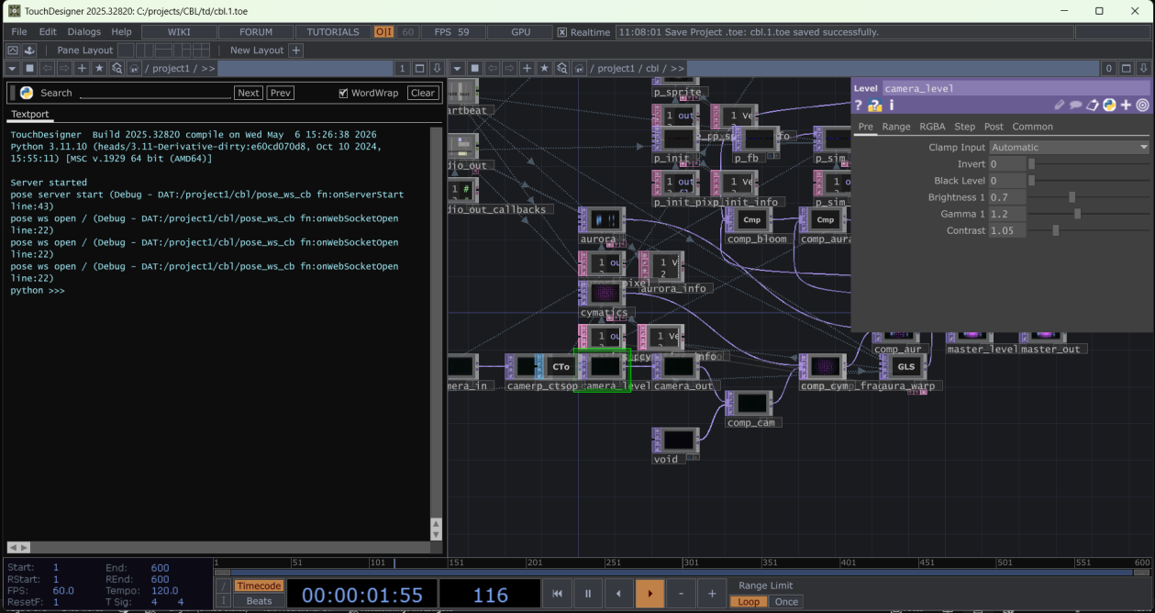
THE EXPERIENCE
You become part of the artwork
1
You step in front of the installation.
▶ LIVE DEMO
2
The Tibetan bowl is played.
3
Your heartbeat is read as the bowl keeps ringing.
4
Sound, pulse and body turn into a live visual field.
5
As you settle, the colours cool and slow — you see yourself calm.
The real engine: our TouchDesigner network, running live.
CREATIVE BOWL LAB
THE EXPERIENCE
GROUP 5 · 15 / 16

Slide 16
REFLECTION & NEXT STEPS
What we fixed — and where we go next
FROM THE MIDTERM FEEDBACK
WHAT'S NEXT
“Idea wasn't visualised”
— More instruments
→ now a live, reacting installation
kalimba, tuning fork, chimes — to reach every chakra
“Too complex”
— Live Arduino BPM
→ one clear story: sound + body + calm
flash the sensor, verify the pulse on stage
“Not explained clearly”
— Floating body
→ this deck and a live demo
drop the room so the person floats on black
Thank you.
Creative Bowl Lab · Group 5 · TU/e
CREATIVE BOWL LAB
REFLECTION
GROUP 5 · 16 / 16

