Slide 1
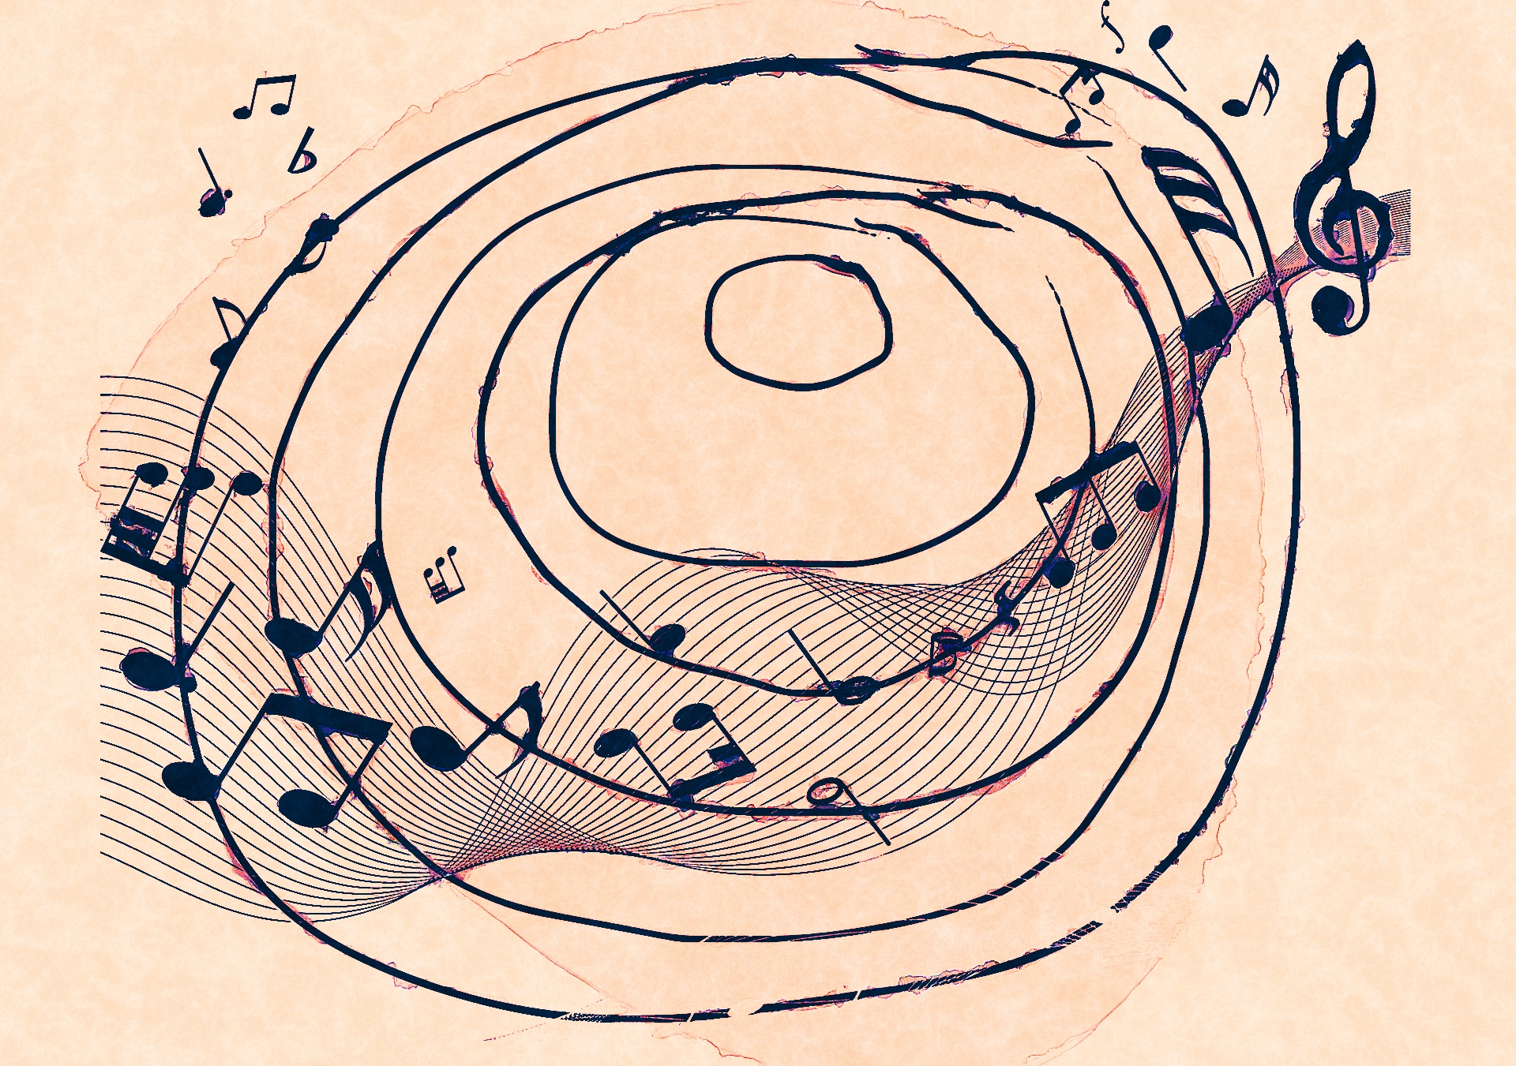
Music Genre Classification
Shruti Misra and Manuja Sharma

Slide 2
Goal
Compare the performance of Gaussian Mixture Models, Support Vector Machines, Convolutional Neural Networks (CNNs), Convolutional Recurrent Neural Networks (CRNNs) to classify audio tracks into 10 different musical genres

Slide 3
Dataset
The Million Song Dataset (MSD) consists of audio features and metadata for 1,000,000 contemporary music tracks from 44,745 unique artists. Data for each track includes textual features such as artist and album names, numerical descriptors such as duration and audio features.
The Million Song Dataset does not include any genre labels. However, external groups have proposed genre labels for some of the tracks by accessing external music tagging databases such as the CD2C tagtraum genre annotations. (Schreiber (2015)).
We use the CD2C variant with non-ambiguous annotations, that is, tracks with multiple genre labels are not included. We classify tracks into 10 different genres; Rap, Rock, RnB, Electronic, Metal, Blues, Pop, Jazz, Country, Reggae.
We used a subset of the Million Song Dataset, that consists of 40,000 training samples and 10,000 test samples The training and test sets are balanced. Additionally, the dataset we used only consists of the audio features for each track and does not contain textual or numerical descriptors.

Slide 4
Features
The features for each audio track are partitioned into bins of 120 segments.
A segment corresponds to an automatically identified, roughly continuous sections of audio with similar perceptual quality.
The number of segments per track is fixed to 120. For each segment, the following audio features are available: 12 timbre features, 12 chroma features and loudness at start of segment concatenated in that order.
Consequently, each segment is characterized by a 25 dimensional vector. Furthermore, each audio track is represented by a total of 3,000 features (120x25 = 3000). Every feature has been normalized by subtracting the mean and dividing by the standard deviation.

Slide 5
Neural Network
Baseline
Convolutional Neural Network (CNN)
Used for image classification
Layers: 7
Activation: ReLu, Softmax
Loss: Cross Entropy
Training: 15 mins on GPU (K80)
Validation: 10% of training set
Convolutional Recurrent Neural Network (CRNN)
Used for images with texts classification
Recently for audio classification
Layers: 9
CNN: 4 layers
LSTM: 2 layers
Input Size: 120x25x1
Activation: ReLu, Softmax
Training: 25 mins on GPU (K80)
Validation: 10% of training set
Loss: Cross Entropy
Optimizer: Adam
Random Classification
Randomly assigned class to dataset
Gaussian Mixture Model (GMM)
Each segment as a data point
Input size: 40,000 x 25
Training: 8 minutes
Validation: 5 fold CV
Support Vector Machine (SVM)
Input Size: Data x 3000
Training: 1 hr on GPU (K80)

Slide 6
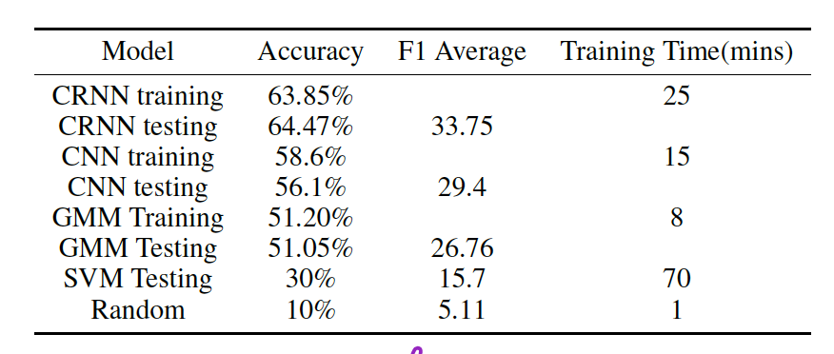
Results
Model | Accuracy | F1 Score (Mean)
CRNN | 64.47 % | 33.75
CNN | 56.1 % | 29.4
GMM | 51.05 | 26.76
SVM | 26 % | 15.7
Random | 10 % | 5.11
Evaluation Metrics for different models
Related work with the dataset has 66% accuracy
CRNN and GMM Timbre features alone performed better than Chroma features

Slide 7
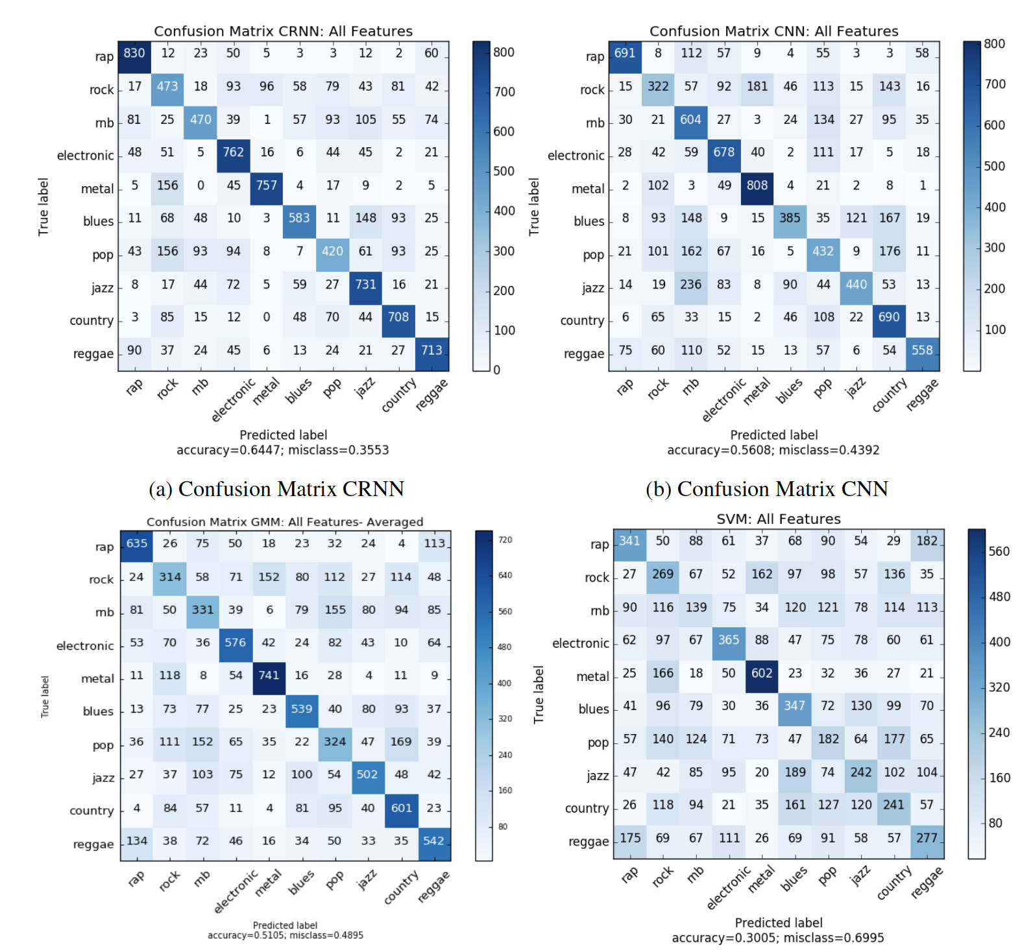

Slide 8
Conclusion
The random classification as expected performed the worst with around 10% accuracy.
Our most prominent baseline was the Gaussian Mixture Model, where each genre corresponded to a GMM. Our best GMM classifier was trained over all features averaged over all segments and garnered an accuracy of 51.05%.
We also trained a Support Vector classifier as a baseline. However, this model did not fare too well, providing an accuracy of only 26.64%.
We then implemented CNN and CRNN neural network models and both outperformed all the baselines.
CRNN performed the best with an accuracy of 64.47%.
We also concluded that timbral features provided more information about music genre than chroma or pitch features. As part of future work, we can look at obtaining raw audio data and extracting our own features to characterize different genres more accurately.
Furthermore, incorporating textual data such as year of release, artist and lyrics might also help improve performance.

