Slide 1
Micro-robots
Task - 1, Arav Toshniwal, Robomanipal

Slide 2
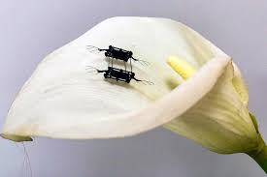
Definition
Microrobots are miniaturized devices, ranging from a few micrometers to millimeters in size, designed to perform specific tasks in micro-scale environments
These are generally modelled off nature.
Taking inspiration from insects like bees and water striders.

Slide 3
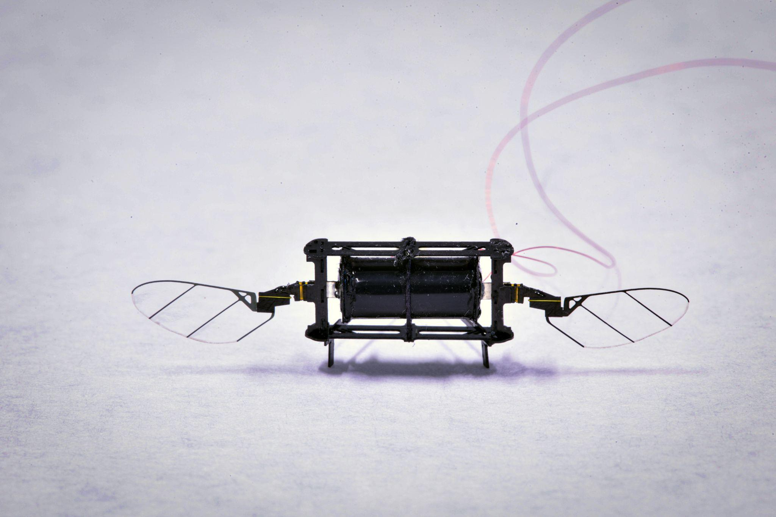
MIT’s RoboBees
It is a type of microrobot being developed by MIT, USA
Inspired by how bees take flight in real life.
They are lighter than 80 milligrams.

Slide 4
Challenges in developing in such a robot
Design & Fabrication
Motors
Power Supply

Slide 5
Design & Fabrication
Wings: The wings of the RoboBee are typically made from polyimide, a lightweight and flexible polymer material. It is heat resistant and ideal for high speed flapping.
Body: Its body is typically made of carbon fibre as it is lightweight, strong and very rigid, thus it is also used in the RoboBees’ wing hinges.

Slide 6
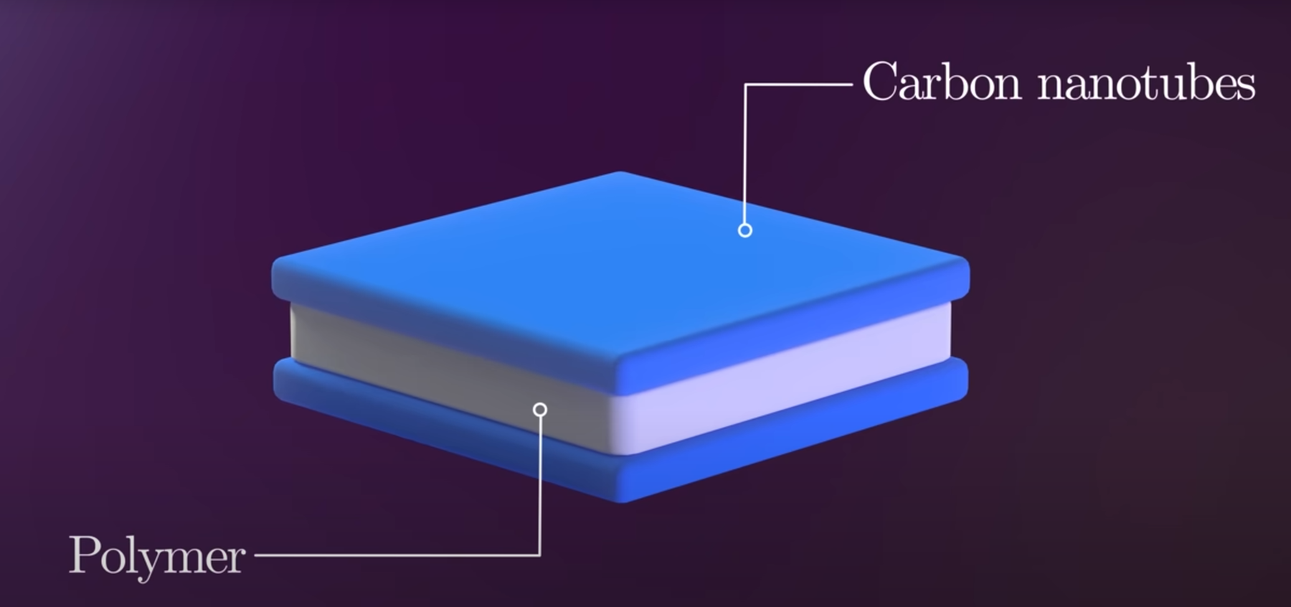
Accuators
At this scale, motors are too heavy thus the creators of the RoboBee had to be creative.
They used a flexible polymer and coated it on both sides with carbon nanotubes, effectively creating two conducting surfaces.
Thus when opposite charges are applied on both, the attractive force compresses the polymer.
When same charge is applied the polymer stretches.
When many of such rolled into tubes the force amplifies causes the wings to flap.

Slide 7



Slide 8
Power Supply
A battery small enough to fit weighs too much to fly.
Two solutions - Tether and wireless
Tether:
RoboBee is connected to an external power source through a lightweight tether, provides a continuous and stable power supply.
Wireless:
Uses a focused laser aimed at a small photovoltaic cell onboard the RoboBee photovoltaic cell converts laser light into electrical energy. It enables untethered, autonomous flight without the need for an onboard battery.

Slide 9
Applications
Precision Pollination
Environmental Monitoring
Search and Rescue Operations
Surveillance and Reconnaissance
Distributed Swarm Robotics
Scientific Exploration
Medical and Bioengineering Research

Slide 10
Sources
https://news.mit.edu/2021/micro-robots-artificial-muscles-1216
https://news.mit.edu/2021/researchers-introduce-new-generation-tiny-agile-drones-0302
https://wyss.harvard.edu/technology/robobees-autonomous-flying-microrobots/
https://news.mit.edu/2025/fast-agile-robotic-insect-could-someday-aid-mechanical-pollination-0115
https://www.youtube.com/watch?v=H6q6pYZ9Fho

