Slide 1

TrustCheck
Hybrid Fake Review Detection System
Academic Project
Team Members Arav Wahi- S24CSEU1949 Aditya Patidar- S24CSEU1942 Payal Kaushik- S24CSEU1669 Aayush K. Singh- S24CSEU1943
Machine Learning | NLP | FastAPI | SQLite

Slide 2
Problem Statement
Online reviews strongly influence customer decisions, but fake and manipulated reviews distort trust in digital marketplaces. Customers are pushed toward poor-quality products, honest sellers lose visibility, and platforms suffer reputational damage. As AI-generated content becomes more persuasive, detecting deceptive reviews with simple filters is no longer sufficient.
Customer Risk
Misleading ratings affect real purchase decisions.
Seller Impact
Genuine sellers lose to manipulated visibility.
Platform Trust
Credibility declines when spam looks authentic.

Slide 3
Motivation
TrustCheck was created in response to the intersection of e-commerce scale and generative AI. Fake reviews are no longer obvious spam; many are polished, emotionally convincing, and strategically written to influence buyers. This project aims to give users an independent authenticity signal instead of forcing them to rely only on star ratings or hidden platform moderation.
Transparency
Speed
Scalability
Expose fraud signals in a user-facing way.
Generate trust estimates instantly.
Keep the design ready for larger datasets.

Slide 4
Proposed Solution
Input
Processing
Output
Manual review entry, product URL, or CSV upload.
NLP + metadata analysis with fraud indicators.
Trust score, anomaly score, and suspicious/genuine label.
User Input -> TrustCheck Analysis Engine -> Decision Support Result

Slide 5
System Architecture
TrustCheck is organized as a five-layer flow that moves from data collection to actionable review authenticity scoring.
User Input
FastAPI Backend
NLP Processing
Model Layer
Database
User Input
Backend
NLP
Forms, URLs, and CSV ingestion.
Routing, validation, orchestration.
Token cleanup, sentiment gap, readability, repetition.
Model
Database
TF-IDF plus engineered feature fusion.
Amazon-style raw reviews and analysis records.

Slide 6
Working / Algorithm
1. Input Collection
2. Preprocessing
Review text, rating, votes, verification, and metadata are collected.
The text is cleaned, tokenized, and normalized for NLP analysis.
3. Feature Extraction
4. Feature Fusion
Sentiment, readability, repetition, lexical diversity, and reviewer velocity are computed.
TF-IDF text features are merged with numeric fraud indicators.
5. Prediction
The model returns label, trust score, and anomaly score.

Slide 7
Core Features
Manual Analysis
URL-Based Analysis
Single review scoring for quick evaluation.
Batch analysis through product link ingestion.
Dashboard
History
Suspicious trends and overall trust metrics.
Stored analysis records for traceability.
CSV Upload
Bulk import using Amazon-style review format.

Slide 8
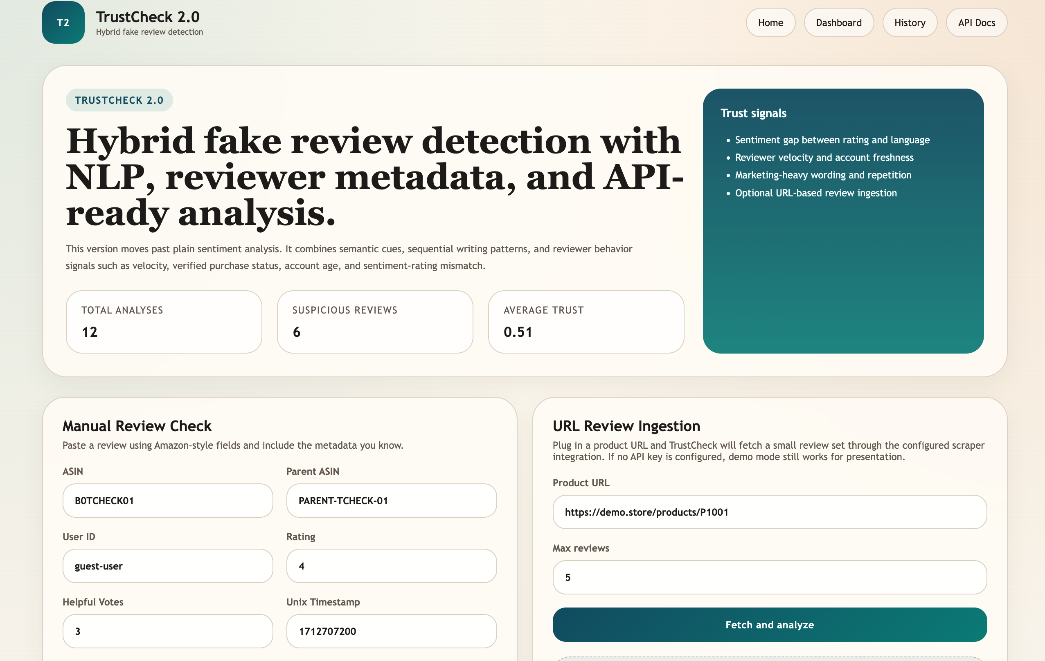
User Interface Showcase
Home Page

Slide 9
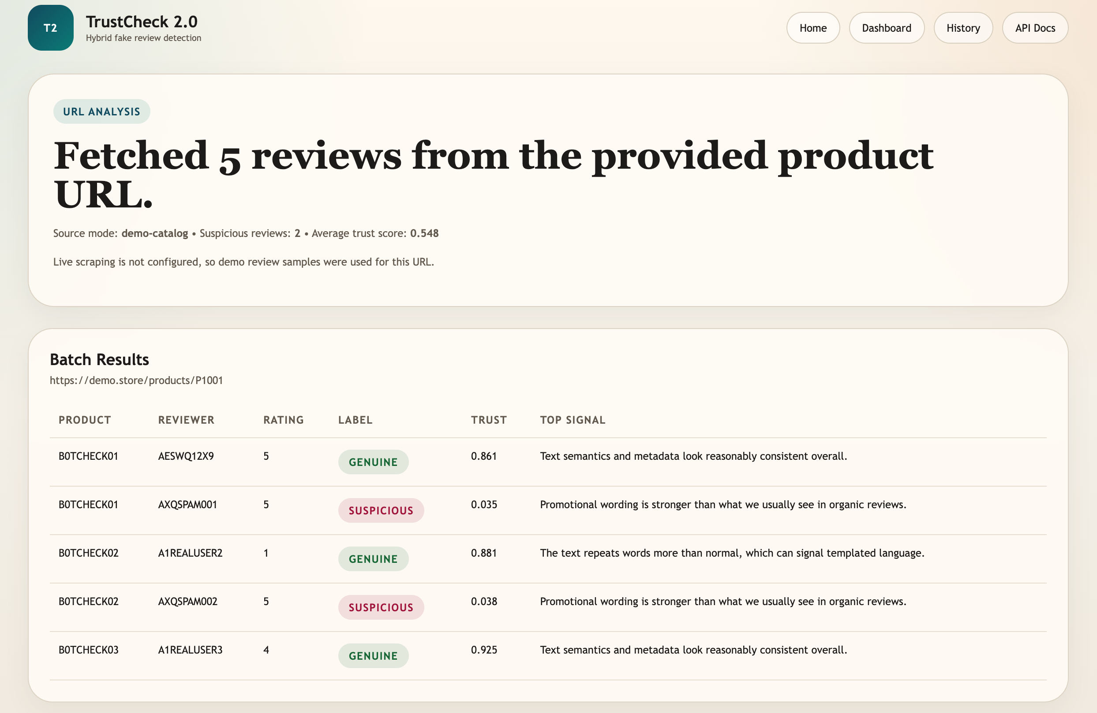
User Interface Showcase
Results Page

Slide 10
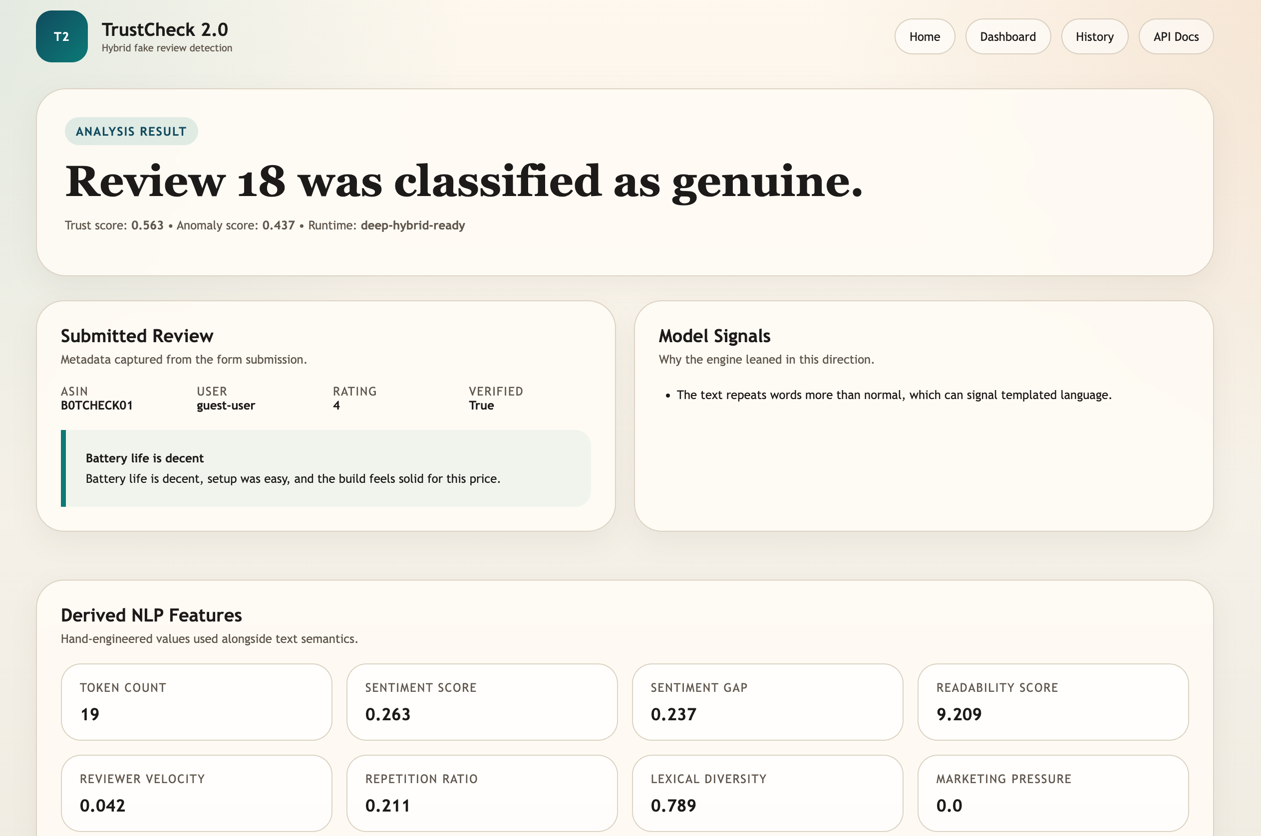
User Interface Showcase
Analysis Page

Slide 11
Tech Stack
FastAPI
Python
SQLite
Modern API backend for forms and JSON routes.
Core language for backend, NLP, and automation.
Lightweight structured storage for local deployment.
TF-IDF
Feature Fusion
NLP Engineering
Text representation for stable baseline scoring.
Combines text vectors and reviewer metadata.
Sentiment gap, readability, repetition, velocity.

Slide 12
Performance & Current Scope
The current version uses a stable baseline model that is easy to run locally and reliable for academic demonstration. The architecture is intentionally modular, which means the present build is suitable for evaluation today while still being ready for more advanced scaling tomorrow.
Stable Inference
Runs cleanly on a local project setup.
Modular Backend
FastAPI architecture supports future expansion.
Scale Ready
Deep-model path already exists in the codebase.

Slide 13
Future Scope
Transformer + BiLSTM
Larger Datasets
Move from baseline inference to a richer hybrid deep model.
Train on Amazon Reviews 2023 or SNAP-scale review corpora.
Multilingual Support
Real-Time Scraping
Extend the pipeline for mixed-language review text.
Integrate live review ingestion for continuous monitoring.

Slide 14
Conclusion
TrustCheck 1.4 shows how machine learning and NLP can improve trust in digital commerce. By combining text signals, reviewer behavior, and a user-facing interface, the system moves beyond basic sentiment analysis and delivers a more practical approach to fake review detection. It is a strong academic foundation for future research and real-world deployment.
Thank You

