Slide 1
Bellabeat Case Study – Unlocking Health Insights from Fitbit Data
Google Data Analytics Capstone Project
Prepared by: Abhishek Singh Rawat
Date: 10-09-2025

Slide 2
Business Task (Ask)
Bellabeat wants to understand health behavior patterns from smart devices.
Key Questions:
• What are the main activity, sleep, and health trends among users?
• How are steps correlated with calorie expenditure?
• What role does sleep play in activity levels?
• How do users engage with heart rate and weight tracking?
• How can Bellabeat apply these insights to its product strategy?

Slide 3
Dataset (Prepare)
Source: Fitbit Fitness Tracker Dataset (Kaggle, 33 users)
Data used: daily activity, sleep, calories, weight, heart rate
Tools: RStudio (tidyverse, lubridate, ggplot2)
Limitations: Small sample, short timeframe, inconsistent tracking

Slide 4
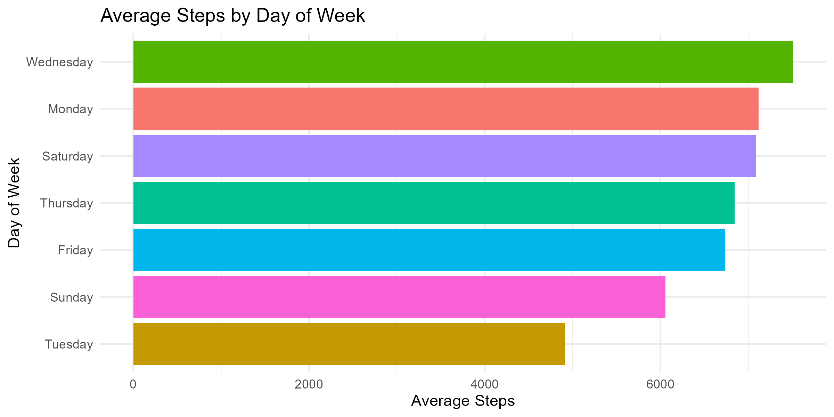
Daily Activity
Key Point: Avg steps < 10k/day; more activity on weekdays than weekends.

Slide 5
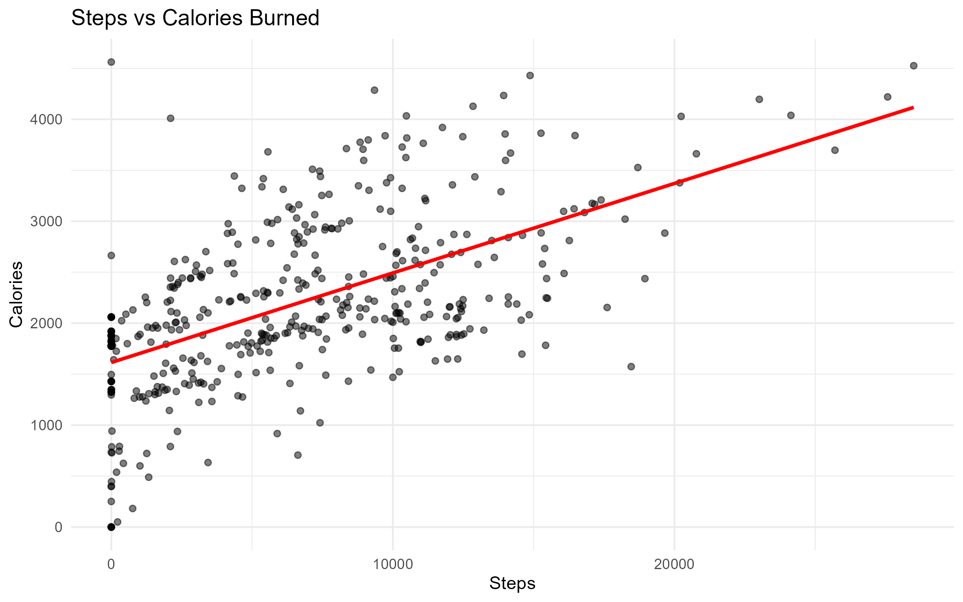
Calories vs Steps
Key Point: Strong positive correlation → steps are reliable calorie predictor.

Slide 6
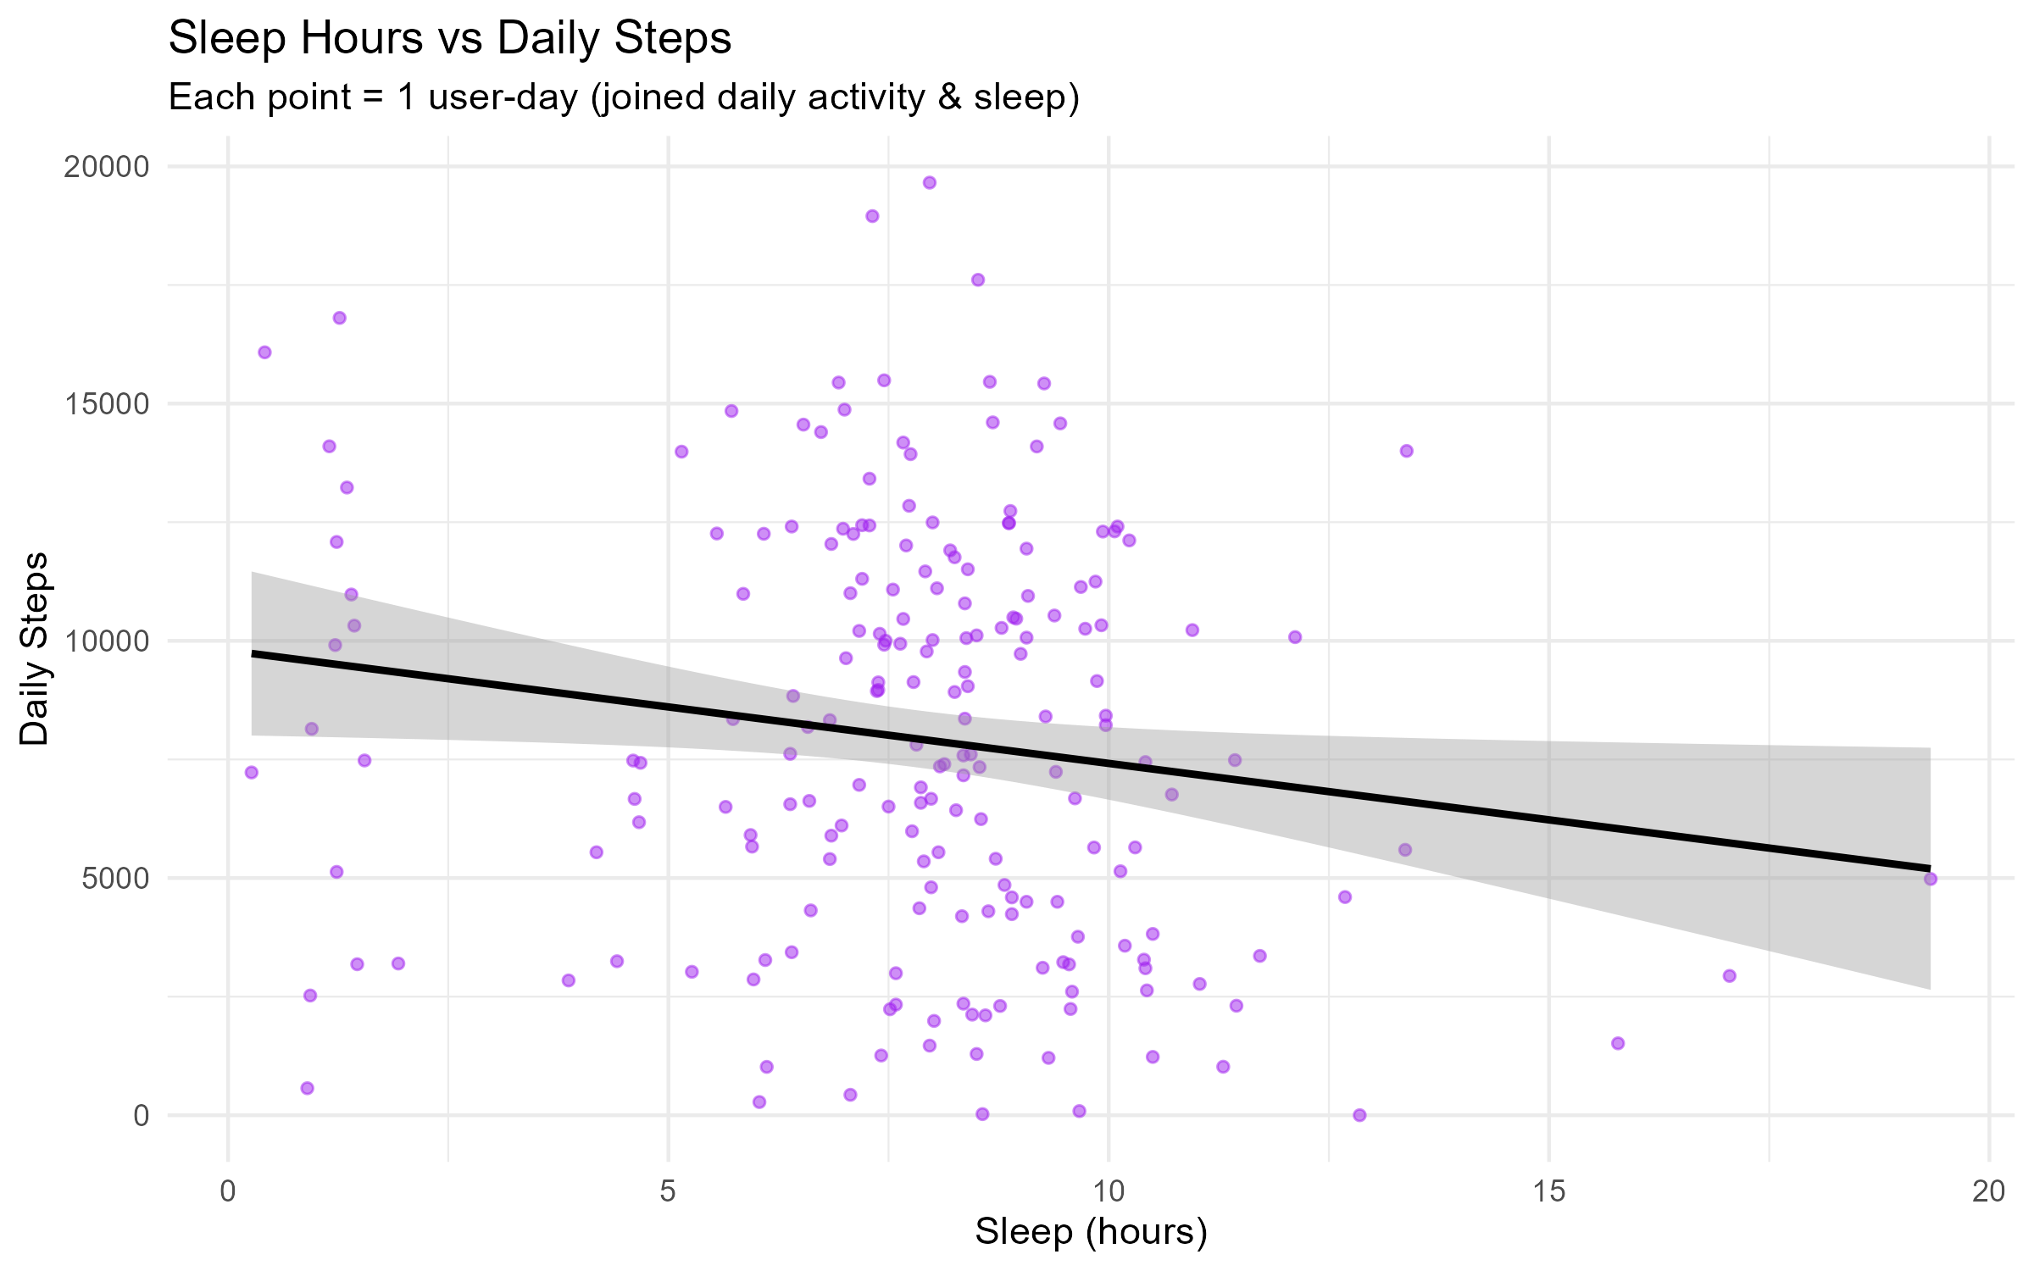
Sleep Patterns
Key Point: Avg sleep 5–7 hrs (below recommended); weak positive link with steps.

Slide 7
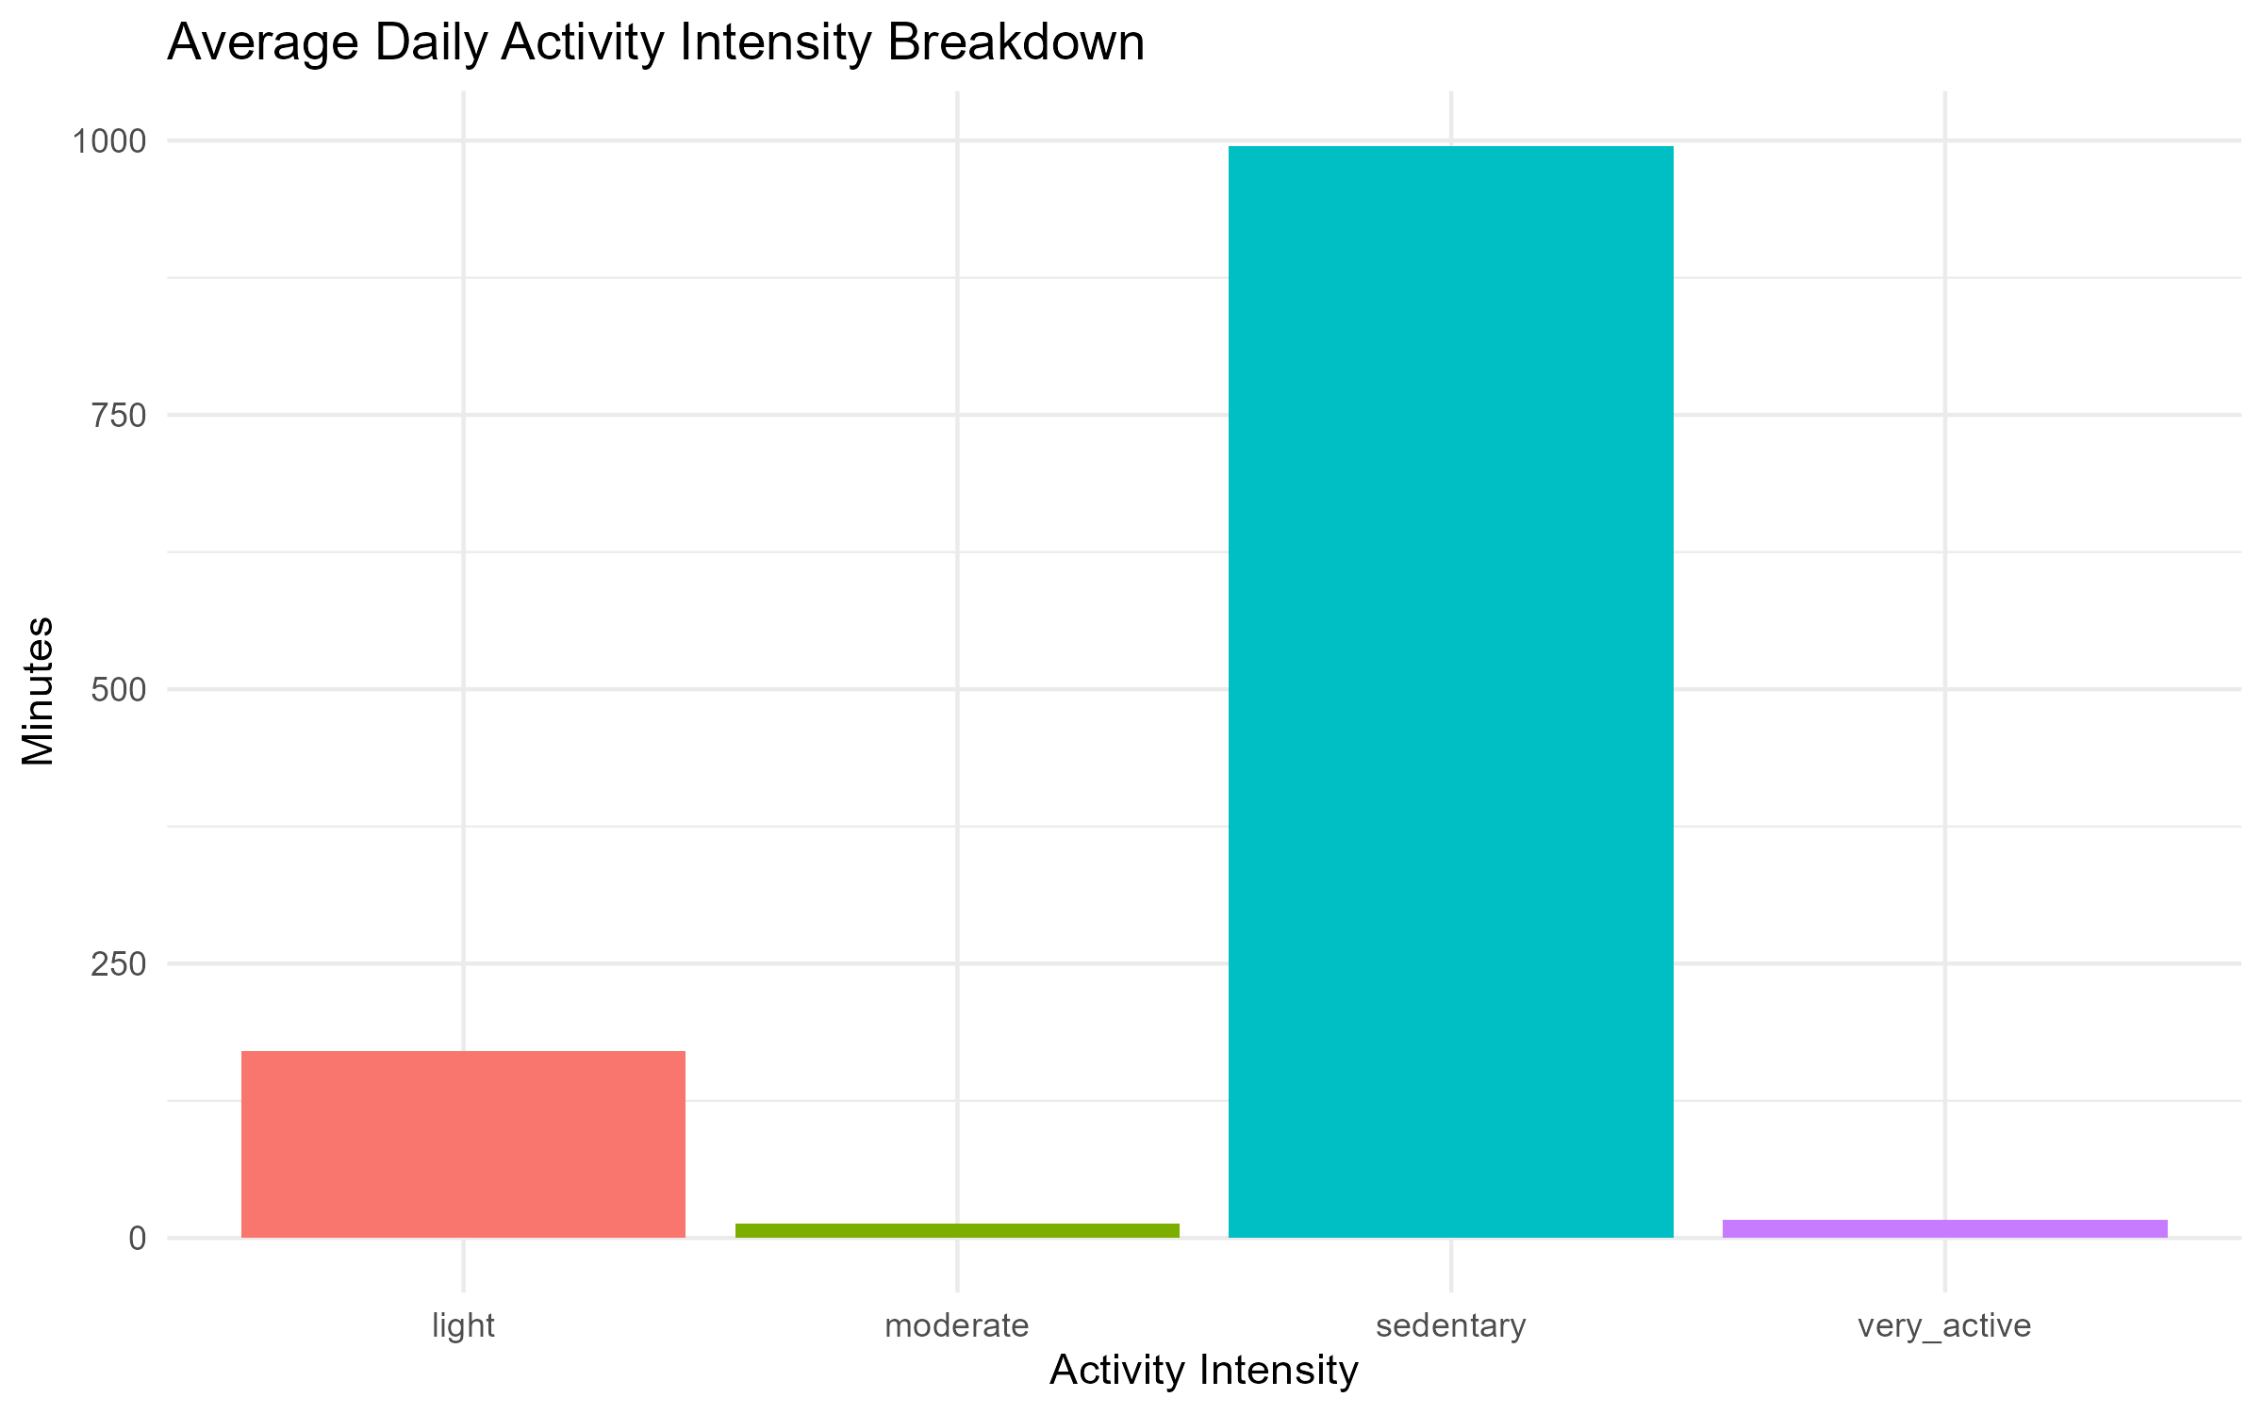
Activity Intensity
Key Point: Majority of time sedentary; little vigorous activity.

Slide 8
Weight Logging
User ID | Log Count | Average BMI
1503960366 | 1 | 23.0
1927972279 | 1 | 46.2
2347167796 | 1 | 24.8
2873212765 | 2 | 21.6
2891001357 | 1 | 25.0
4445114986 | 1 | 35.0
4558609924 | 1 | 27.1
4702921684 | 1 | 26.1
6962181067 | 14 | 24.2
8253242879 | 1 | 29.5
8877689391 | 9 | 25.7
Key Point: Very few users log weight → underutilized feature

Slide 9
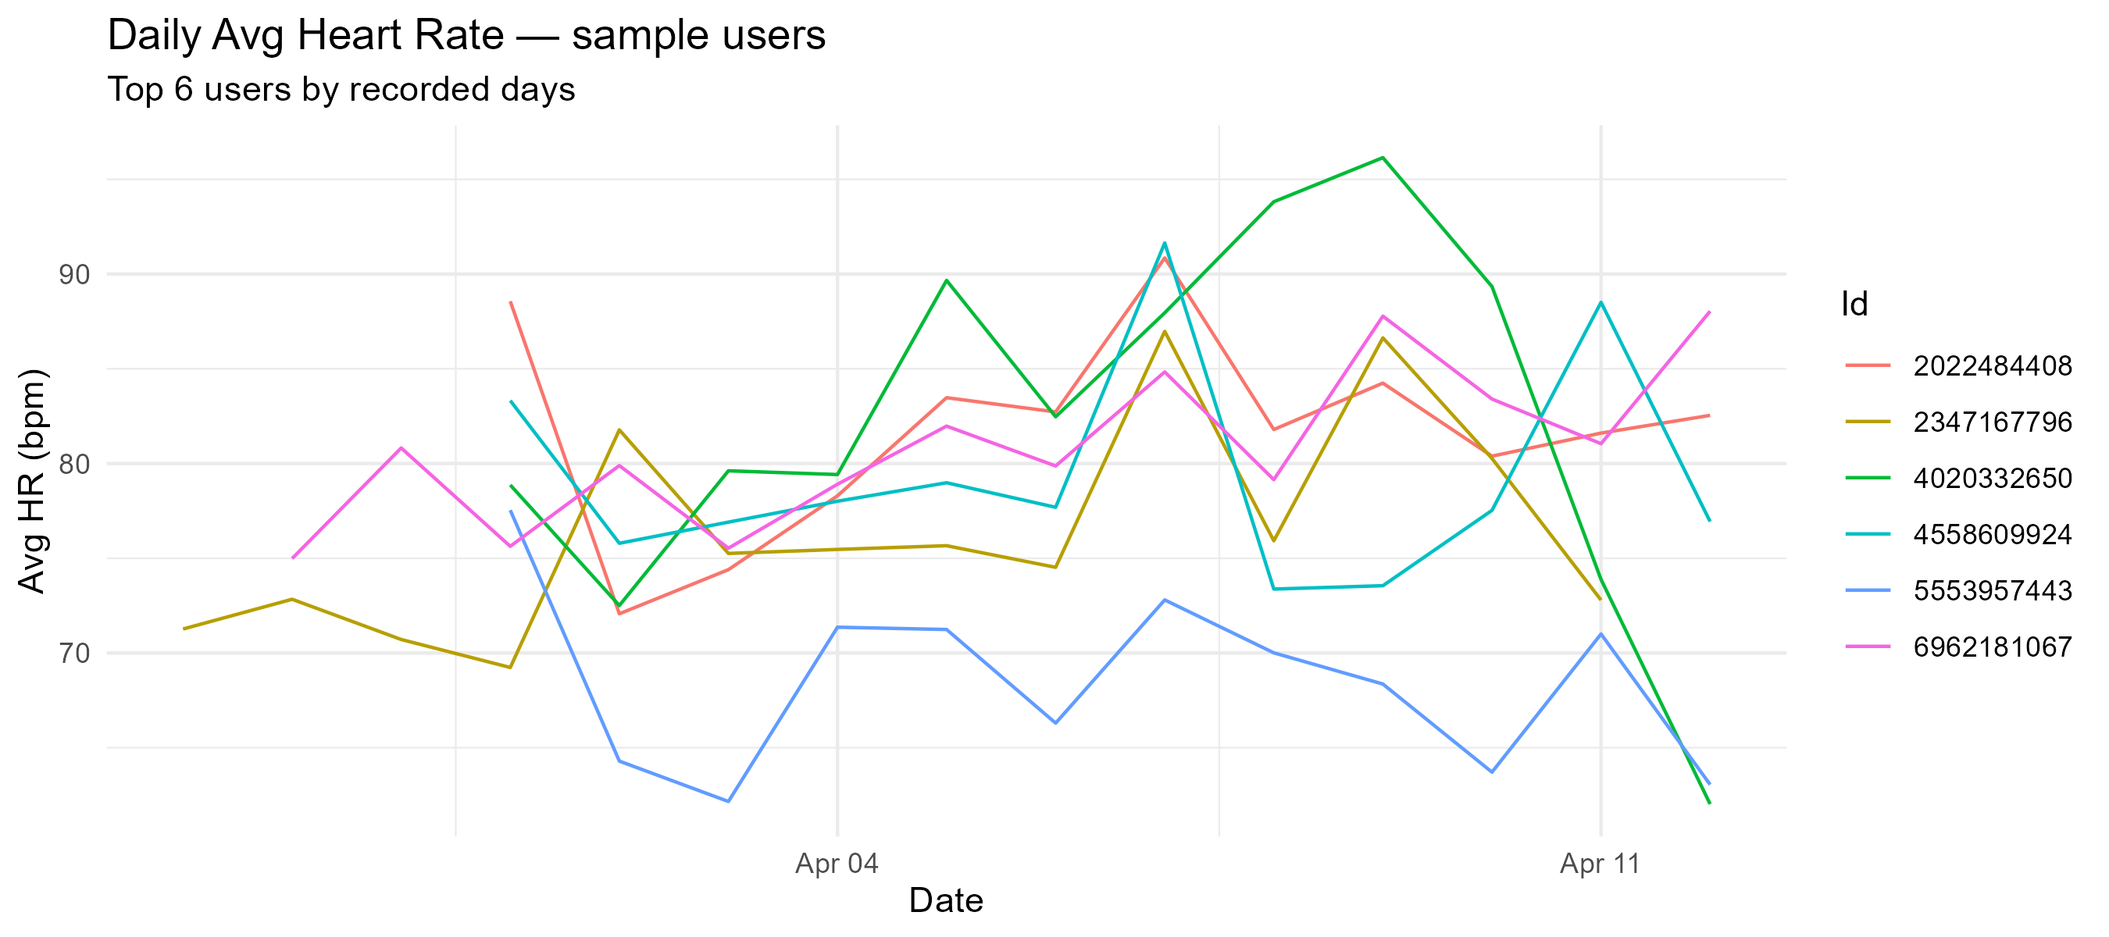
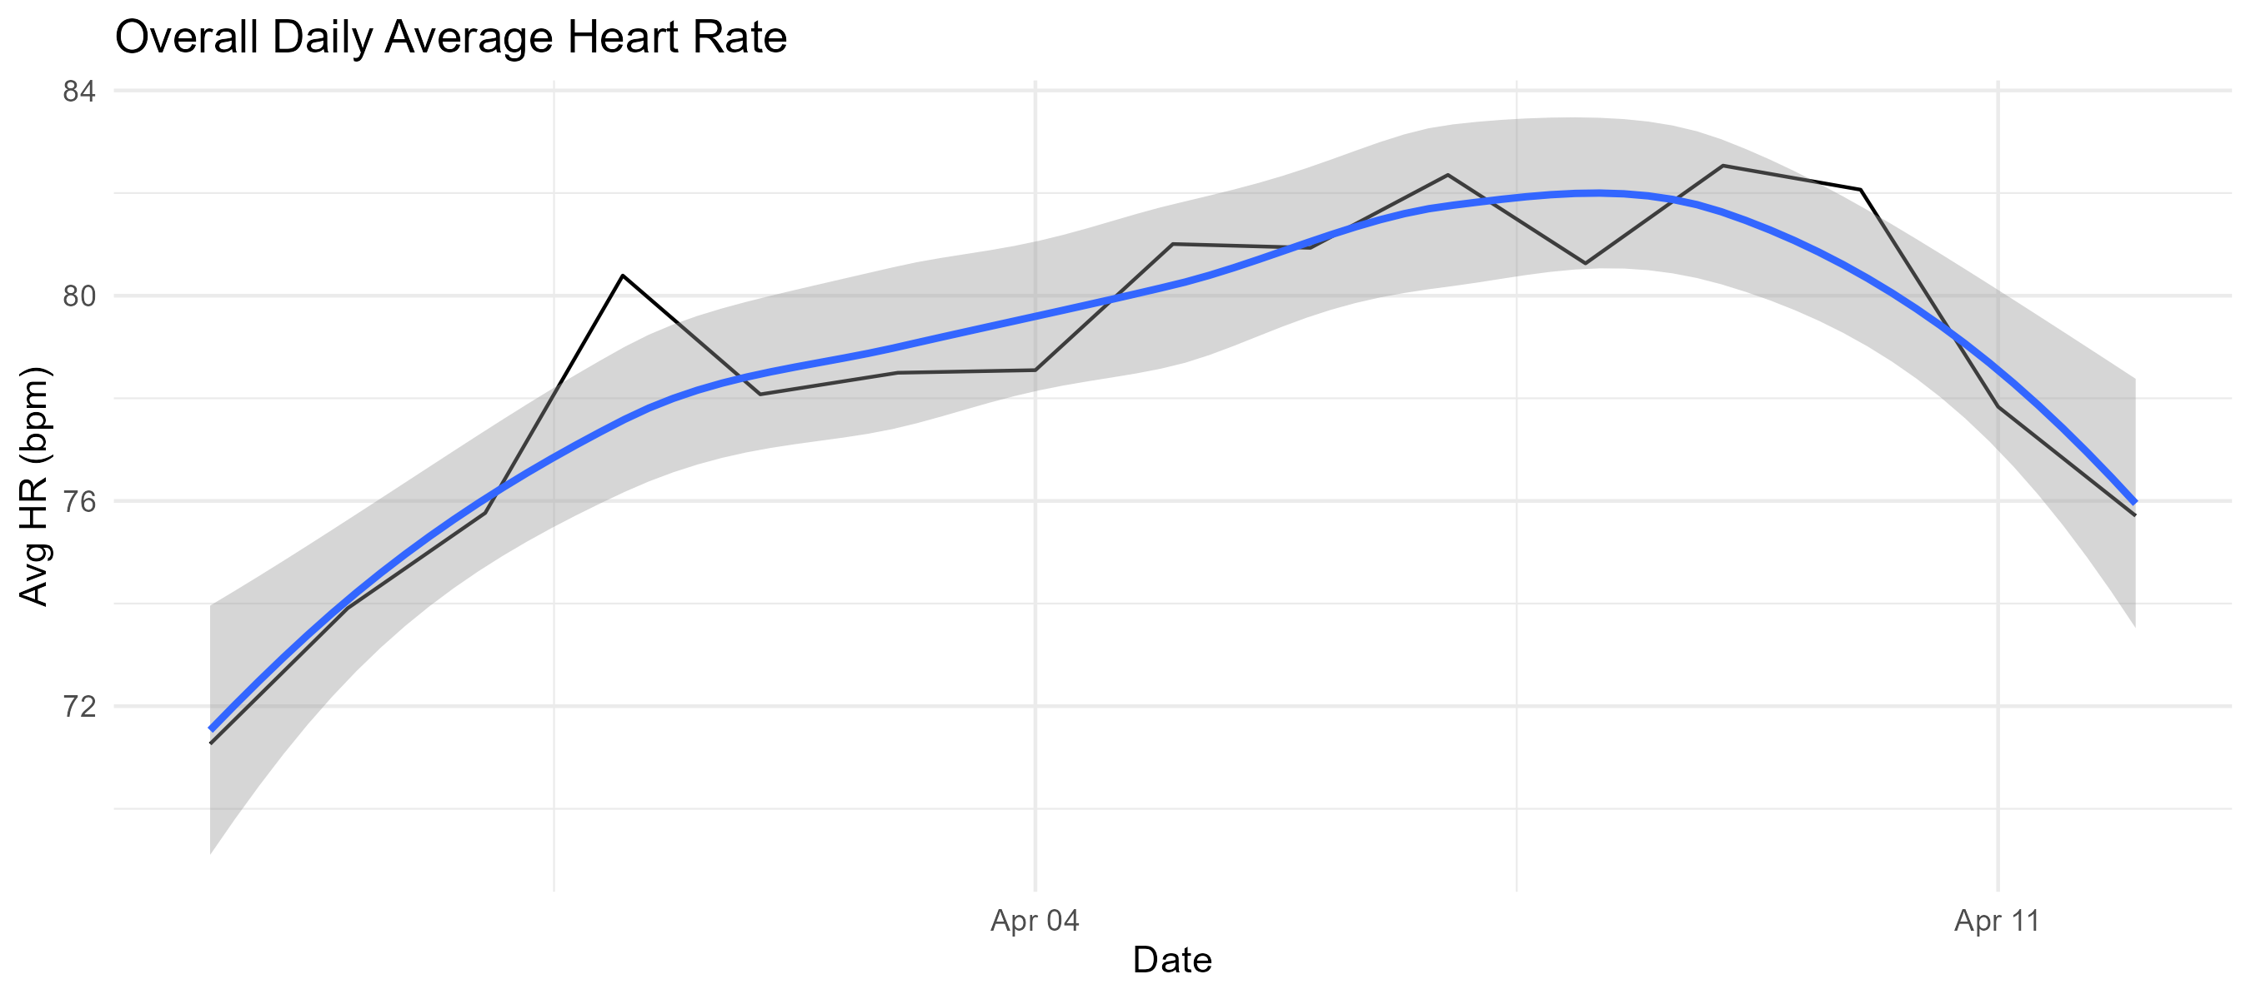
Heart Rate Insights
Stable population averages; big individual differences → personalization opportunity.

Slide 10
Recommendations
1. Encourage Daily Movement – step reminders, daily challenges
2. Promote Active Breaks – reduce sedentary time
3. Enhance Sleep Coaching – bedtime reminders, insights
4. Boost Weekend Engagement – gamified challenges
5. Improve Weight Tracking – smart scale integration
6. Personalize HR Insights – stress monitoring, adaptive workouts

Slide 11
Conclusion
Users are largely sedentary and sleep less than recommended
Steps and calories strongly correlated – steps are actionable metric
Weight tracking underutilized
Heart rate variability indicates potential for personalization
By implementing these insights, Bellabeat can enhance engagement and promote healthier lifestyles.

