Slide 1


Java – Logic Day 01
Ver. 0.1

Slide 2
Day 01
1
Goal Material

Slide 3
Goal Material
Java Structure
Naming Convention
Data Type
Looping For, While, Do While
Hello World
Study Case – Logic 01

Slide 4
Day 01
2
Java Structure

Slide 5
Object − Objects have states and behaviors.

Slide 6
Class − A class can be defined as a template/blueprint that describes the behavior/state that the object of its type supports.

Slide 7
Method - A method is basically a behavior. A class can contain many methods. It is in methods where the logics are written, data is manipulated and all the actions are executed.

Slide 8
Java Introduction
Object − Objects have states and behaviors.
Class − A class can be defined as a template/blueprint that describes the behavior/state that the object of its type supports.
Methods − A method is basically a behavior.
Instance Variables − Each object has its unique set of instance variables.

Slide 9
Day 01
3
Naming Convention

Slide 10
Java – Basic Syntax
Case Sensitivity − Java is case sensitive.
Class Names − For all class names the first letter should be in Upper Case. If several words are used to form a name of the class, each inner word's first letter should be in Upper Case.
Method Names − All method names should start with a Lower Case letter. If several words are used to form the name of the method, then each inner word's first letter should be in Upper Case.
Program File Name − Name of the program file should exactly match the class name.
public static void main(String args[]) − Java program processing starts from the main() method which is a mandatory part of every Java program.

Slide 11
Java – Identifier
Names used for classes, variables, and methods are called identifiers.

Slide 12
Java – Identifier Rule
All identifiers should begin with a letter (A to Z or a to z), currency character ($) or an underscore (_).
After the first character, identifiers can have any combination of characters.
A key word cannot be used as an identifier.
Most importantly, identifiers are case sensitive.
Examples of legal identifiers: age, $salary, _value, __1_value.
Examples of illegal identifiers: 123abc, -salary.

Slide 13
Java – Modifier
Access Modifiers − default, public , protected, private
Non-access Modifiers − final, abstract, strictfp

Slide 14
Java - Variable
Local Variables
Class Variables (Static Variables)
Instance Variables (Non-static Variables)

Slide 15
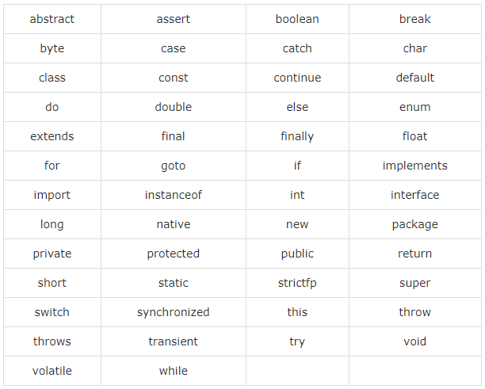
Java - Keyword

Slide 16
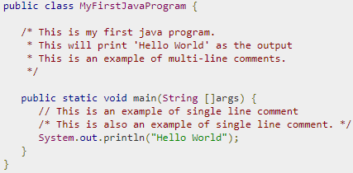
Java - Comment
Java supports single-line and multi-line comments very similar to C and C++. All characters available inside any comment are ignored by Java compiler.

Slide 17
Day 01
4
Data Type

Slide 18
Basic Data Type
There are two data types available in Java −
Primitive Data Types
Reference/Object Data Types

Slide 19
Primitive Data Types
Primitive datatypes are predefined by the language and named by a keyword
byte
short
int
log
Float
Double
Bollean
Char

Slide 20
Reference Data Type
Reference variables are created using defined constructors of the classes.
Class objects and various type of array variables come under reference datatype.
Default value of any reference variable is null.
A reference variable can be used to refer any object of the declared type or any compatible type.

Slide 21
Day 01
5
Looping

Slide 22
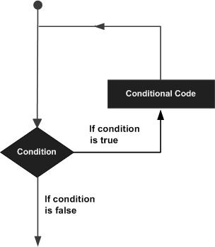
Java - Loop
A loop statement allows us to execute a statement or group of statements multiple times

Slide 23
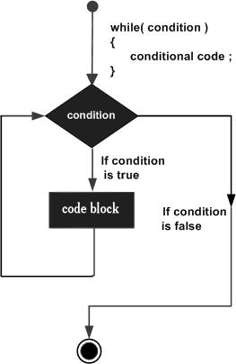
Loop - While
while(Boolean_expression) {
// Statements
}
statement(s) may be a single statement or a block of statements. The condition may be any expression, and true is any non zero value.
When executing, if the boolean_expression result is true, then the actions inside the loop will be executed. This will continue as long as the expression result is true.
When the condition becomes false, program control passes to the line immediately

Slide 24
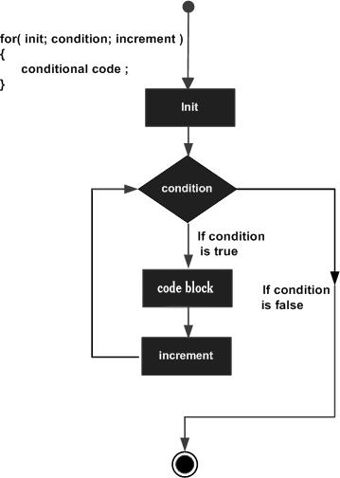
for(initialization; Boolean_expression; update) {
// Statements
}

Slide 25
For - Loop
The initialization step is executed first, and only once.
Next, the Boolean expression is evaluated. If it is true, the body of the loop is executed. If it is false, the body of the loop will not be executed and control jumps to the next statement past the for loop.
After the body of the for loop gets executed, the control jumps back up to the update statement. This statement allows you to update any loop control variables. This statement can be left blank with a semicolon at the end.
The Boolean expression is now evaluated again. If it is true, the loop executes and the process repeats (body of loop, then update step, then Boolean expression). After the Boolean expression is false, the for loop terminates.

Slide 26
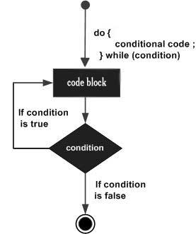
do while loop
do {
// Statements
}while(Boolean_expression);

Slide 27
do while loop
Notice that the Boolean expression appears at the end of the loop, so the statements in the loop execute once before the Boolean is tested.
If the Boolean expression is true, the control jumps back up to do statement, and the statements in the loop execute again. This process repeats until the Boolean expression is false

Slide 28
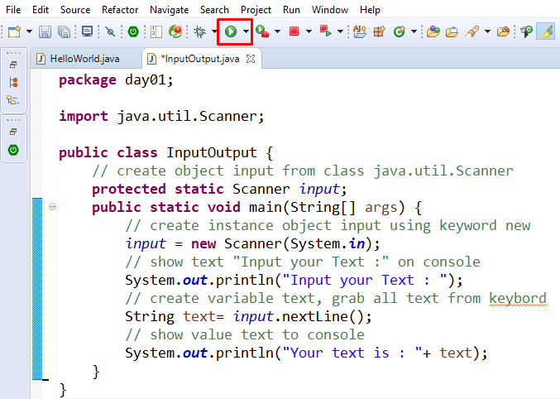
Input – Output

Slide 29
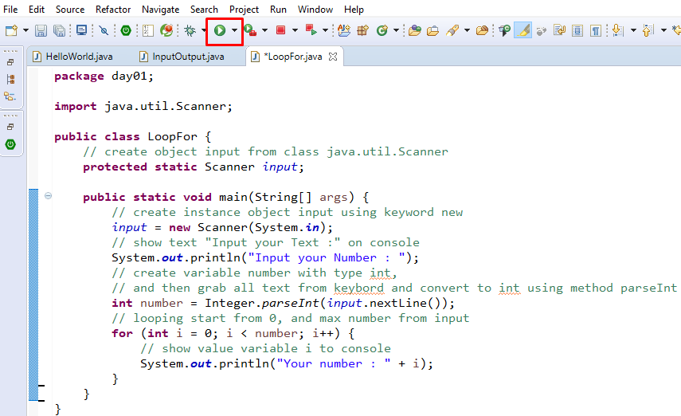
Looping for

Slide 30
Day 01
6
Hello World

Slide 31
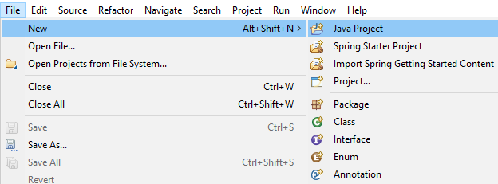
Create New Project
Open STS or Eclipse, then create new project,
File -> New -> Java Project

Slide 32
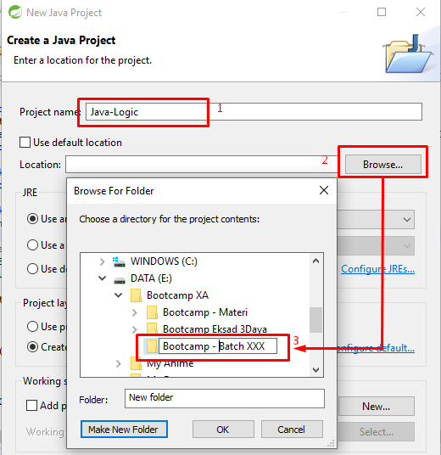
Create New Project
1. Fill then name project “Java Logic”
2. Find your location to put your java project
3. Create folder or directory
4. Clik OK.

Slide 33
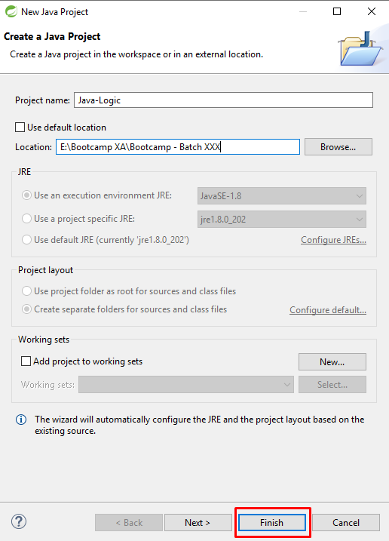
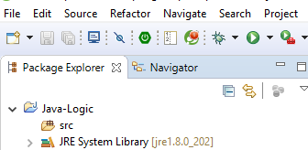

Slide 34
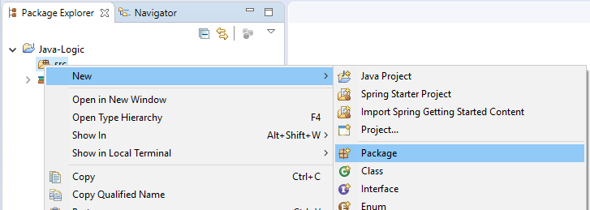
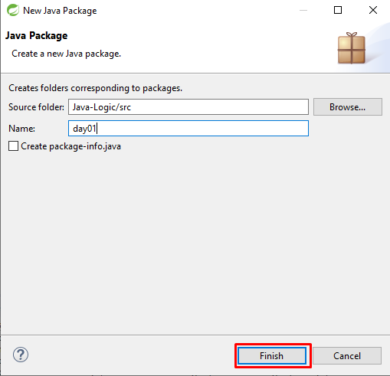
New Package
Righ Click on src -> New -> Package
Every Day, you must create new package

Slide 35
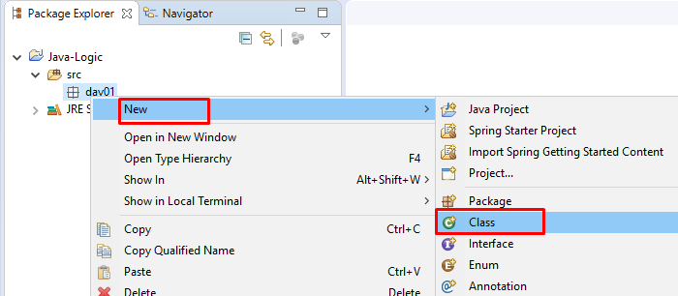
Create New Class
Right Click on package day01 -> new -> class

Slide 36
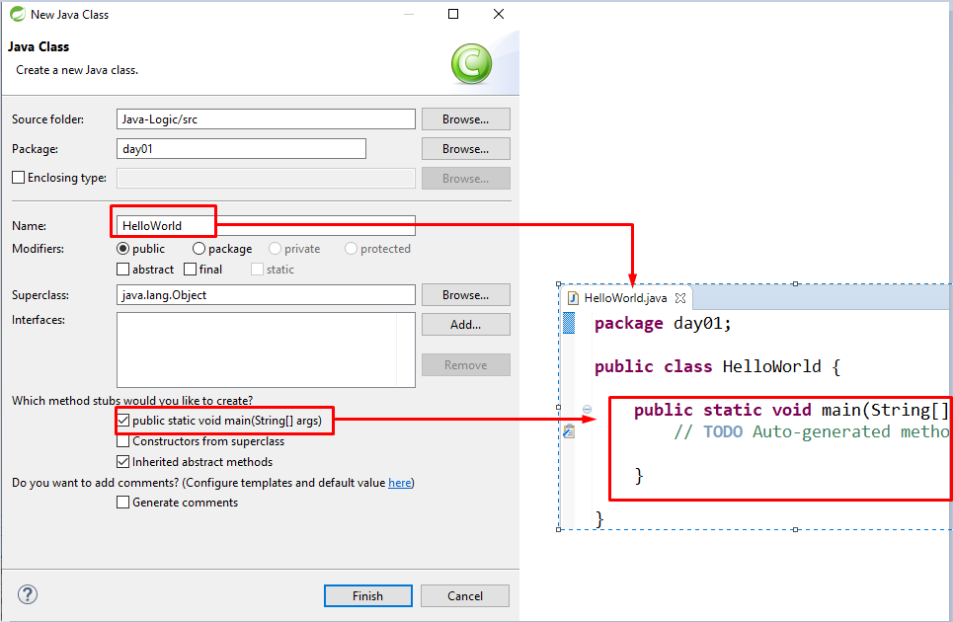
Create New Class

Slide 37
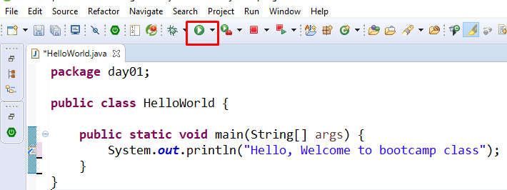
Create Hello World
Type source code below on your editor and then run your code with click read mark.

Slide 38
Day 01
7
Study Case – Logic 01

Slide 39
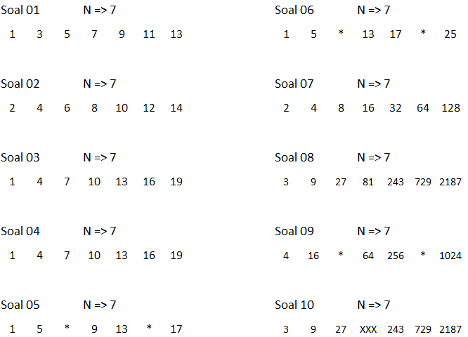
Case Study – Logic 01

Slide 40
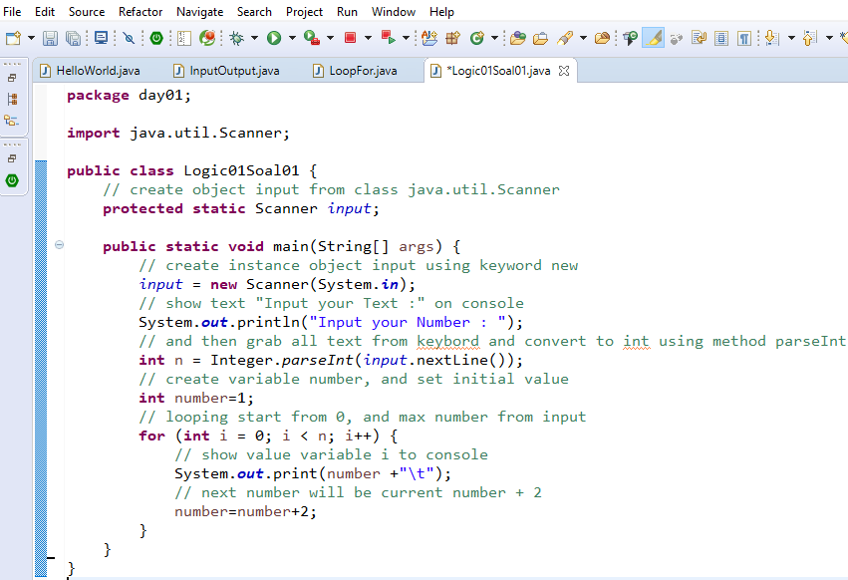
Logic 01 Soal 01

Slide 41
GOOD LUCK!

Slide 42
THANKS!
Any questions?
Contact Your Trainer

