Slide 1


Java – Logic Day 03
Ver. 0.1

Slide 2
Day 03
1
Goal Material

Slide 3
Goal Material
Array Introduction
Array 1 Dimention
Array 2 Dimention

Slide 4
Day 03
2
Array Introduction

Slide 5
Array is a data structure which stores a fixed-size sequential collection of elements of the same type.

Slide 6
Declaring Array
Array is data type reference
Must specify the type of array the variable can reference
// preferred way.
dataType[] arrayRefVar;
Or
// works but not preferred way.
dataType arrayRefVar[];
Note − The style dataType[] arrayRefVar is preferred. The style dataType arrayRefVar[] comes from the C/C++ language and was adopted in Java to accommodate C/C++ programmers.
// preferred way.
double[] myList;
Or
// works but not preferred way.
double myList[];

Slide 7
Creating Array
To create an array by using the new operator with the following syntax :
arrayRefVar = new dataType[arraySize];
It creates an array using new dataType[arraySize].
It assigns the reference of the newly created array to the variable arrayRefVar.

Slide 8
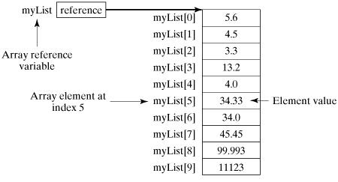
Array Example
Following statement declares an array variable, myList, creates an array of 10 elements of double type and assigns its reference to myList
double[] myList = new double[10];

Slide 9
Processing Array
When processing array elements, we often use either for loop or foreach loop because all of the elements in an array are of the same type and the size of the array is known.

Slide 10
Day 03
2
Array 1 Dimention

Slide 11
Array 1 Dimention
Create Array
datatype[] nameArray = new datatype[length];
Example:
int[] arrayInt = new int[9];
String[] arrayString = new String[9];
Double[] arrayDouble = new Double[9];

Slide 12
Read Element Array
Change value element array:
int[] array = new int[9];
int number = 1;
for(int i=0; i < array.length; i++){
array[i]=number;
number = number + 3;
}
Read value element array:
int[] array = new int[9];
for(int i=0; i < array.length; i++){
System.out.println(array[i]);
}

Slide 13
Day 03
3
Array 2 Dimention

Slide 14
Array 2 Dimention
Create Array
datatype[][] arrayName = new datatype[length1][length2];
Example :
int[][] arrayInt = new int[9][5];
String[][] arrayString = new String[9][9];
Double[][] arrayDouble = new Double[9][9];

Slide 15
Change Value Element Array
Change value element array using nested loop:
int[][] array = new int[9][9];
int number = 1;
for(int i=0; i < array.length; i++){
for(int j=0; j < array[i].length; j++){
array[i][j]=number;
}
number = number + 3;
}

Slide 16
Read Element Array
Read value element array using nested loop:
int[][] array = new int[9][9];
for(int i=0; i < array.length; i++){
for(int j=0; j < array[i].length; j++){
System.out.print(array[i][j]);
}
System.out.println();
}

Slide 17
Day 03
4
Study Case – Logic 03

Slide 18
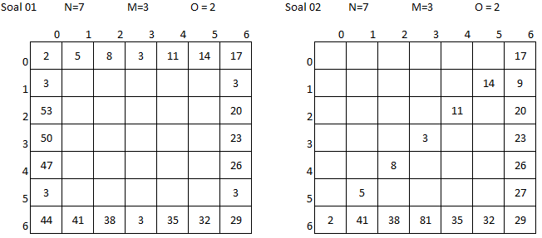
Study Case – Logic 03

Slide 19
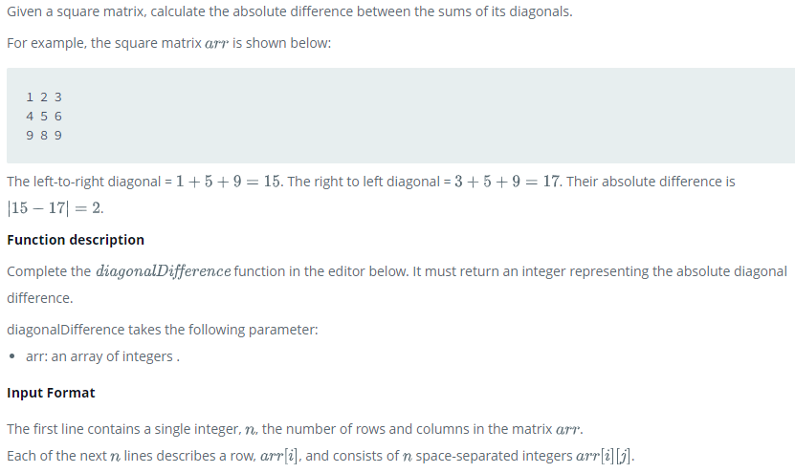
Study Case – Logic 03

Slide 20
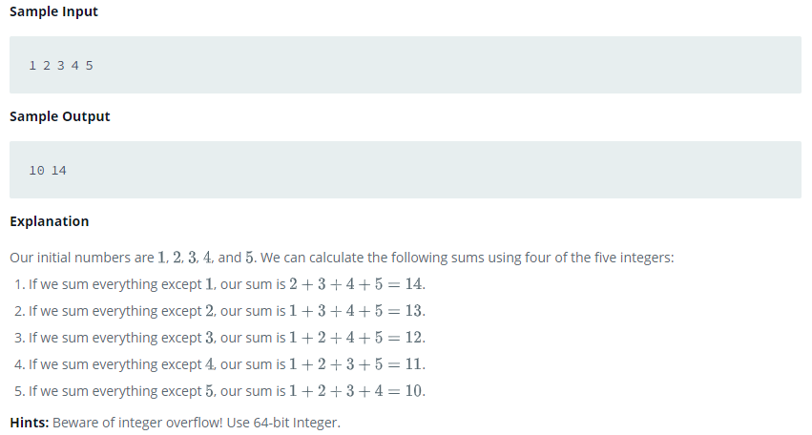
Study Case – Logic 03

Slide 21
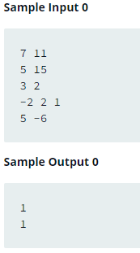
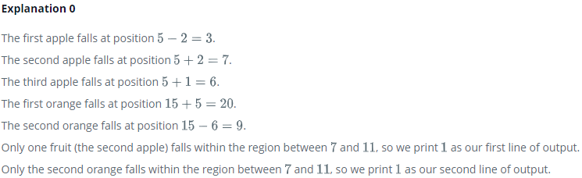
Study Case – Logic 03

Slide 22
GOOD LUCK!

Slide 23
THANKS!
Any questions?
Contact Your Trainer

