Slide 1


Java – Logic Day 02
Ver. 0.1

Slide 2
Day 02
1
Goal Material

Slide 3
Goal Material
Nested If – Else
Switch – Case
Study Case – Logic 02

Slide 4
Day 02
2
Java Method

Slide 5
A method is basically a behavior. A class can contain many methods. It is in methods where the logics are written, data is manipulated and all the actions are executed.

Slide 6
Java – Kind of Method
Method with return value – using data type
Method non return value – using void

Slide 7
Java – Method Return Type
modifier returnType nameOfMethod (Parameter List) {
// method body
}
modifier − It defines the access type of the method and it is optional to use.
returnType − Method may return a value.
nameOfMethod − This is the method name. The method signature consists of the method name and the parameter list.

Slide 8
Java – Method Return Type
Parameter List − The list of parameters, it is the type, order, and number of parameters of a method. These are optional, method may contain zero parameters.
method body − The method body defines what the method does with the statements

Slide 9
Java – Method Return Type
public static int methodName(int a, int b) {
// body
}
public static − modifier
int − return type
methodName − name of the method
a, b − formal parameters
int a, int b − list of parameter

Slide 10
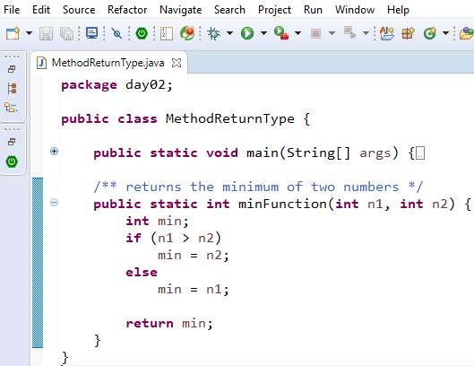
Java – Example Method Return Type

Slide 11
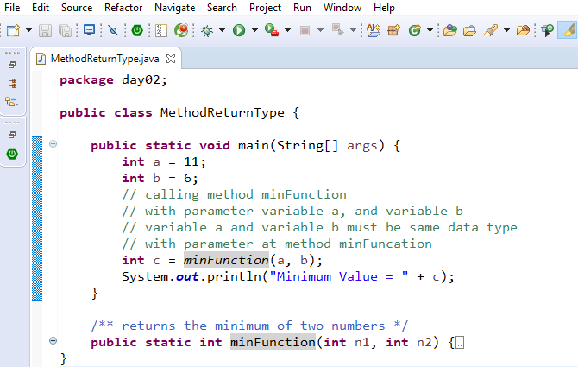
Java – Calling Method Return Type

Slide 12
Java – Method Non Return Type
modifier void nameOfMethod (Parameter List) {
// method body
}
modifier − It defines the access type of the method and it is optional to use.
void − non return type.
nameOfMethod − This is the method name. The method signature consists of the method name and the parameter list.

Slide 13
Java – Method Non Return Type
Parameter List − The list of parameters, it is the type, order, and number of parameters of a method. These are optional, method may contain zero parameters.
method body − The method body defines what the method does with the statements

Slide 14
Java – Method Non Return Type
public static void methodName(int a, int b) {
// body
}
public static − modifier
void − non return type
methodName − name of the method
a, b − formal parameters
int a, int b − list of parameter

Slide 15
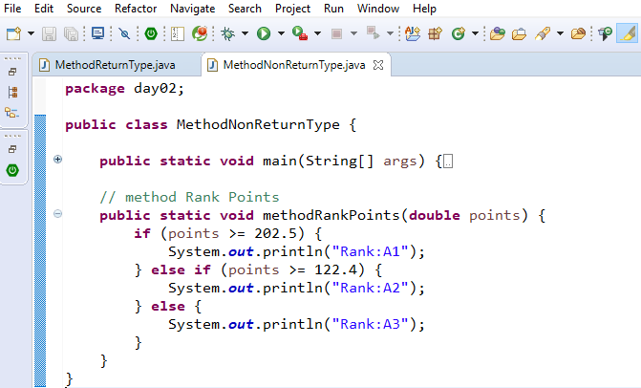
Java – Example Method Non Return Type

Slide 16
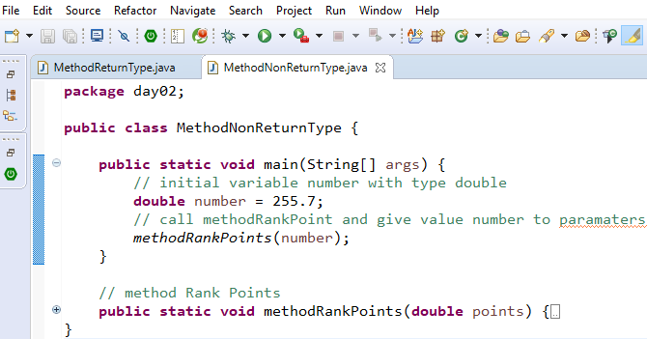
Java – Calling Method Non Return Type

Slide 17
Day 02
3
Nested If – Else

Slide 18
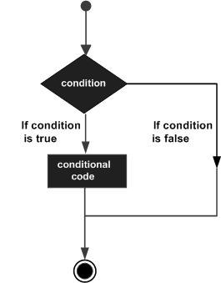
Java – Decision Making
Decision making structures have one or more conditions to be evaluated or tested by the program, along with a statement or statements that are to be executed if the condition is determined to be true, and optionally, other statements to be executed if the condition is determined to be false

Slide 19
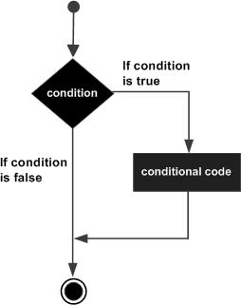
Java – If Statement
if(Boolean_expression) {
// Statements will execute if the
//Boolean expression is true
}
If the Boolean expression evaluates to true then the block of code inside the if statement will be executed. If not, the first set of code after the end of the if statement (after the closing curly brace) will be executed.

Slide 20
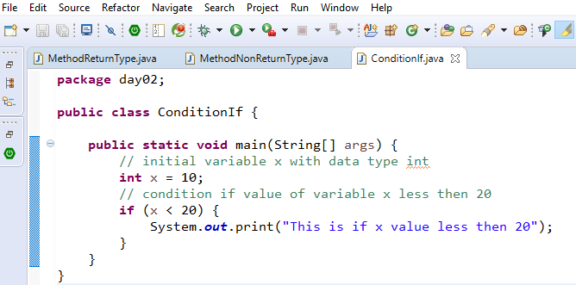
Java – If Statement Example

Slide 21
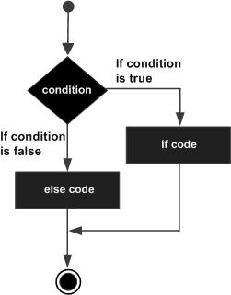
Java – If Else Statement
if(Boolean_expression) {
// Executes when the Boolean expression is true
}else {
// Executes when the Boolean expression is false
}
If the boolean expression evaluates to true, then the if block of code will be executed, otherwise else block of code will be executed..

Slide 22
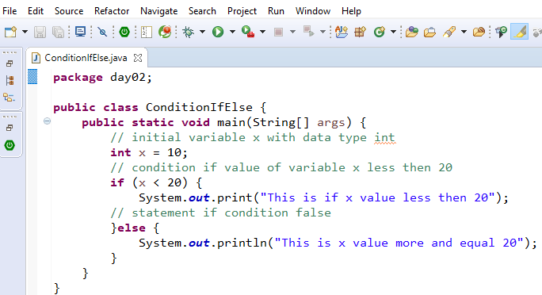
Java – If Else Statement Example

Slide 23
Java – Nested If Statement
if(Boolean_expression 1) {
// Executes when the Boolean expression 1 is true
if(Boolean_expression 2) {
// Executes when the Boolean expression 2 is true
}
}
You can nest else if...else in the similar way as we have nested if statement.

Slide 24
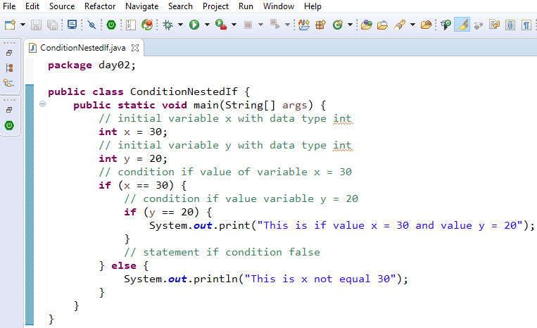
Java – Nested If Statement Example

Slide 25
Day 02
4
Switch – Case

Slide 26
Java – Switch Case Syntax
switch(expression) {
case value :
// Statements
break; // optional
case value :
// Statements
break; // optional
// You can have any number of case statements.
default : // Optional
// Statements
}

Slide 27
Java – Switch Case Rule
The variable used in a switch statement can only be integers, convertable integers (byte, short, char), strings and enums.
You can have any number of case statements within a switch. Each case is followed by the value to be compared to and a colon.
The value for a case must be the same data type as the variable in the switch and it must be a constant or a literal.
When the variable being switched on is equal to a case, the statements following that case will execute until a break statement is reached.
When a break statement is reached, the switch terminates, and the flow of control jumps to the next line following the switch statement.
Not every case needs to contain a break. If no break appears, the flow of control will fall through to subsequent cases until a break is reached.
A switch statement can have an optional default case, which must appear at the end of the switch. The default case can be used for performing a task when none of the cases is true. No break is needed in the default case.

Slide 28
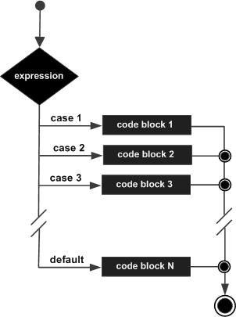
Java – Switch Case Diagram

Slide 29
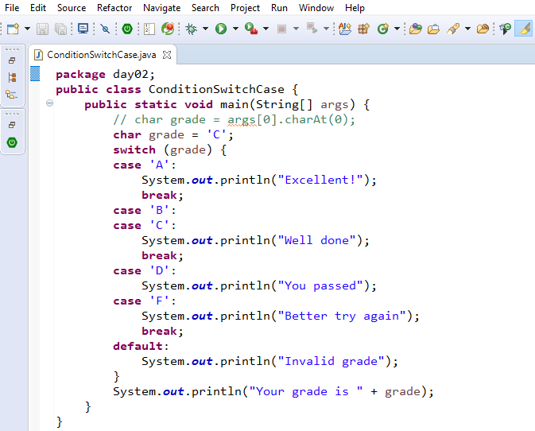
Java – Swith Case Example

Slide 30
Day 02
5
Study Case – Logic 02

Slide 31
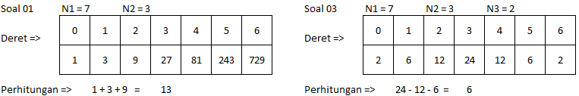
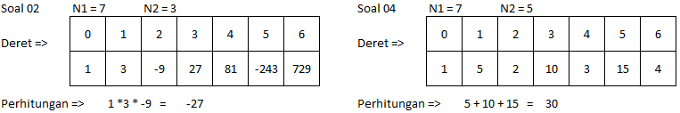
Study Case – Logic 02

Slide 32
Study Case – Logic 02

Slide 33
GOOD LUCK!

Slide 34
THANKS!
Any questions?
Contact Your Trainer

