Slide 1


Java – Logic Day 01
Ver. 0.1

Slide 2
Day 01
1
Java Structure

Slide 3
Java Introduction
Object − Objects have states and behaviors.
Class − A class can be defined as a template/blueprint that describes the behavior/state that the object of its type supports.
Methods − A method is basically a behavior.
Instance Variables − Each object has its unique set of instance variables.

Slide 4
Java – Basic Syntax
Case Sensitivity − Java is case sensitive.
Class Names − For all class names the first letter should be in Upper Case. If several words are used to form a name of the class, each inner word's first letter should be in Upper Case.
Method Names − All method names should start with a Lower Case letter. If several words are used to form the name of the method, then each inner word's first letter should be in Upper Case.
Program File Name − Name of the program file should exactly match the class name.
public static void main(String args[]) − Java program processing starts from the main() method which is a mandatory part of every Java program.

Slide 5
Names used for classes, variables, and methods are called identifiers.

Slide 6
Java – Identifier Rule
All identifiers should begin with a letter (A to Z or a to z), currency character ($) or an underscore (_).
After the first character, identifiers can have any combination of characters.
A key word cannot be used as an identifier.
Most importantly, identifiers are case sensitive.
Examples of legal identifiers: age, $salary, _value, __1_value.
Examples of illegal identifiers: 123abc, -salary.

Slide 7
Java – Modifier
Access Modifiers − default, public , protected, private
Non-access Modifiers − final, abstract, strictfp

Slide 8
Java - Variable
Local Variables
Class Variables (Static Variables)
Instance Variables (Non-static Variables)

Slide 9
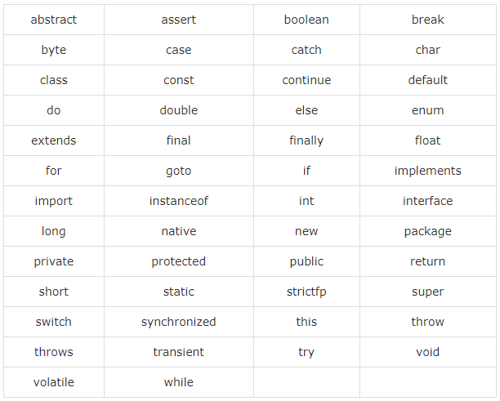
Java - Keyword

Slide 10
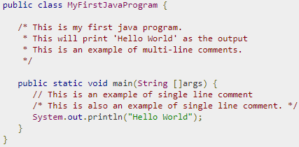
Java - Comment
Java supports single-line and multi-line comments very similar to C and C++. All characters available inside any comment are ignored by Java compiler.

Slide 11
Basic Data Type
There are two data types available in Java −
Primitive Data Types
Reference/Object Data Types

Slide 12
Primitive Data Types
Primitive datatypes are predefined by the language and named by a keyword
byte
short
int
log
Float
Double
Bollean
Char

Slide 13
Reference Data Type
Reference variables are created using defined constructors of the classes.
Class objects and various type of array variables come under reference datatype.
Default value of any reference variable is null.
A reference variable can be used to refer any object of the declared type or any compatible type.

Slide 14
Java Operator
Arithmetic Operators
Relational Operators
Bitwise Operators
Logical Operators
Assignment Operators
Misc Operators

Slide 15
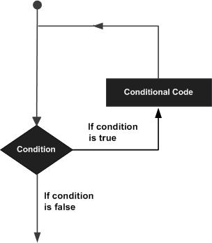
Java - Loop
A loop statement allows us to execute a statement or group of statements multiple times

Slide 16
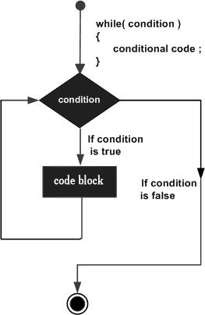
Loop - While
while(Boolean_expression) {
// Statements
}
statement(s) may be a single statement or a block of statements. The condition may be any expression, and true is any non zero value.
When executing, if the boolean_expression result is true, then the actions inside the loop will be executed. This will continue as long as the expression result is true.
When the condition becomes false, program control passes to the line immediately

Slide 17
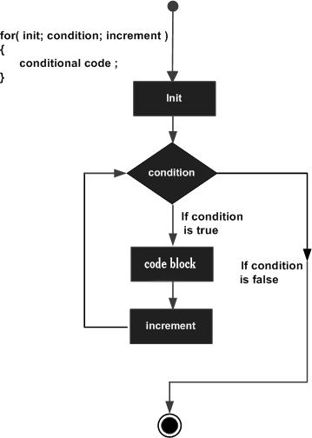
for(initialization; Boolean_expression; update) {
// Statements
}

Slide 18
For - Loop
The initialization step is executed first, and only once.
Next, the Boolean expression is evaluated. If it is true, the body of the loop is executed. If it is false, the body of the loop will not be executed and control jumps to the next statement past the for loop.
After the body of the for loop gets executed, the control jumps back up to the update statement. This statement allows you to update any loop control variables. This statement can be left blank with a semicolon at the end.
The Boolean expression is now evaluated again. If it is true, the loop executes and the process repeats (body of loop, then update step, then Boolean expression). After the Boolean expression is false, the for loop terminates.

Slide 19
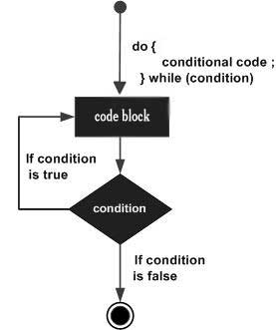
do while loop
do {
// Statements
}while(Boolean_expression);

Slide 20
do while loop
Notice that the Boolean expression appears at the end of the loop, so the statements in the loop execute once before the Boolean is tested.
If the Boolean expression is true, the control jumps back up to do statement, and the statements in the loop execute again. This process repeats until the Boolean expression is false

Slide 21
Day 01
2
Hello World

Slide 22
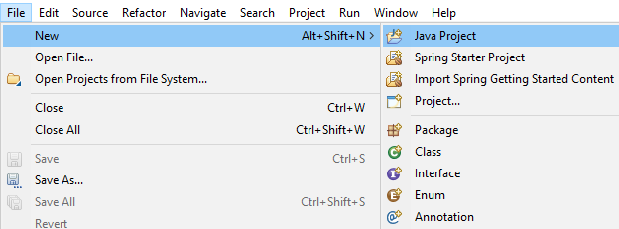
Create New Project
Open STS or Eclipse, then create new project,
File -> New -> Java Project

Slide 23
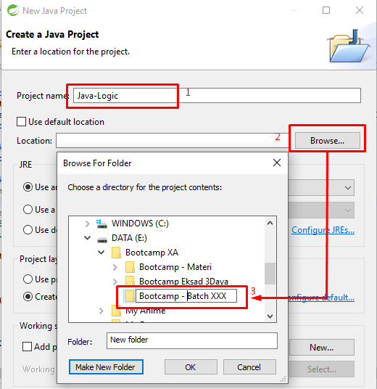
Create New Project
1. Fill then name project “Java Logic”
2. Find your location to put your java project
3. Create folder or directory
4. Clik OK.

Slide 24
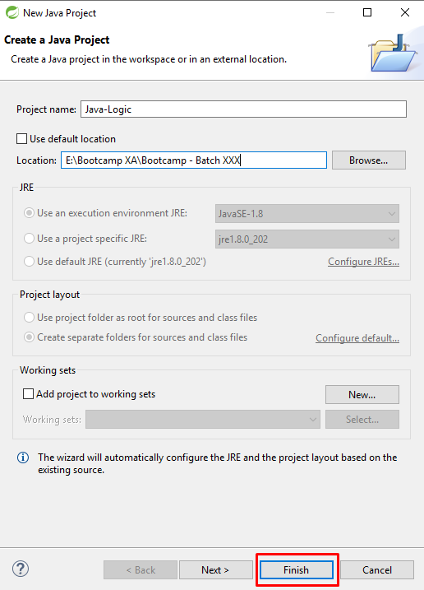
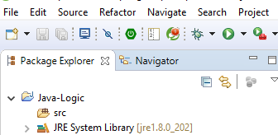

Slide 25
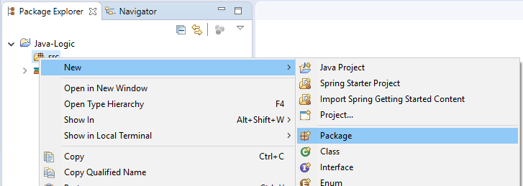
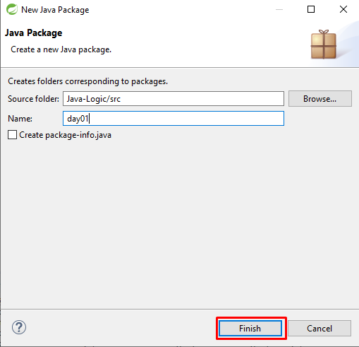
New Package
Righ Click on src -> New -> Package
Every Day, you must create new package

Slide 26
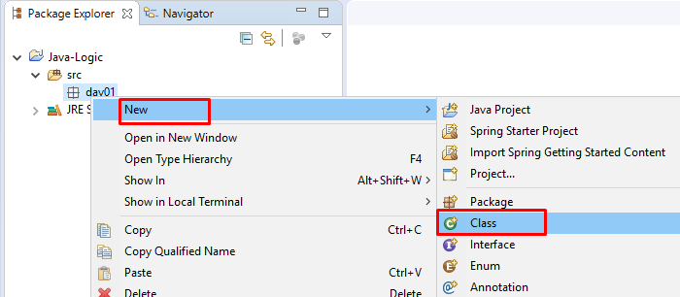
Create New Class
Right Click on package day01 -> new -> class

Slide 27
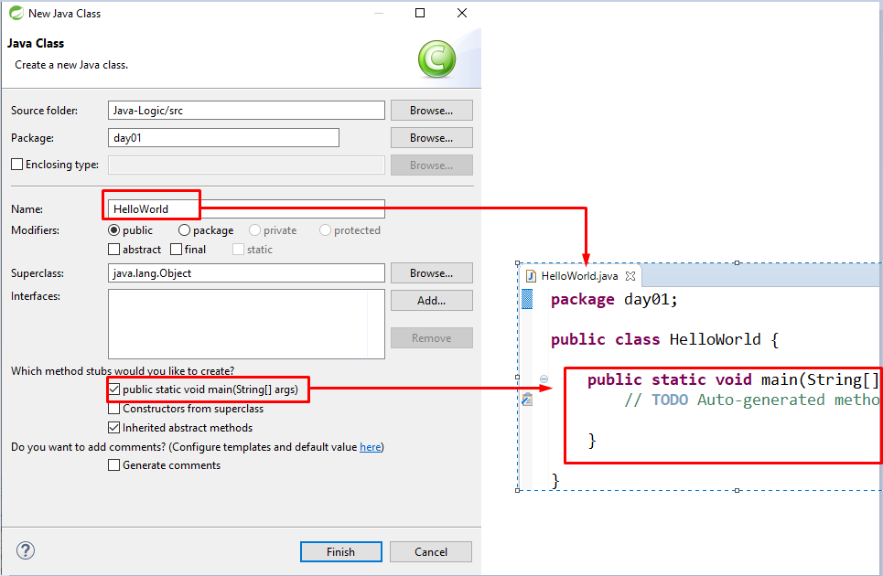
Create New Class

Slide 28
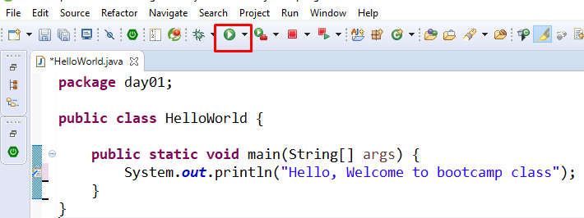
Create Hello World
Type source code below on your editor and then run your code with click read mark.

Slide 29
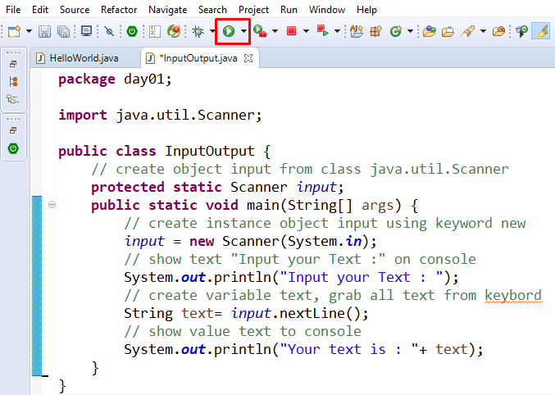
Input – Output

Slide 30
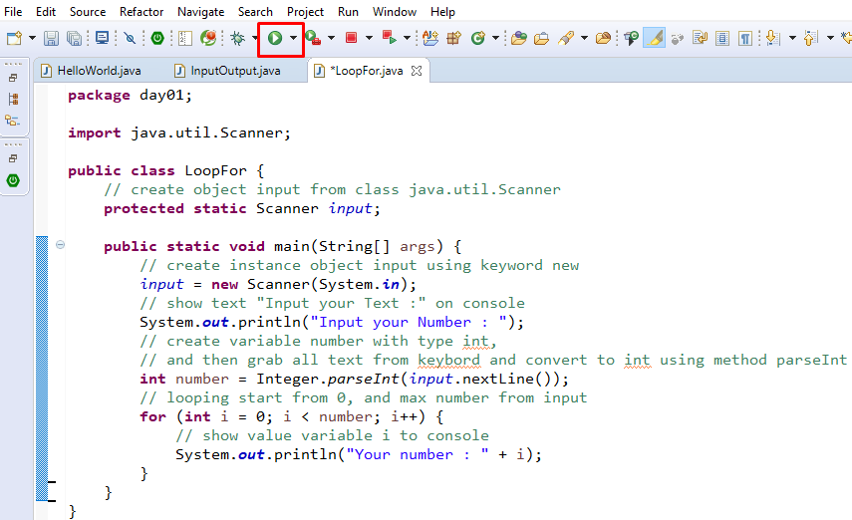
Looping for

Slide 31
Day 01
3
Logic - 01

Slide 32
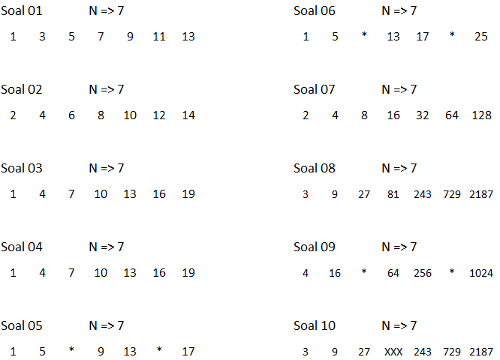
Case Study

Slide 33
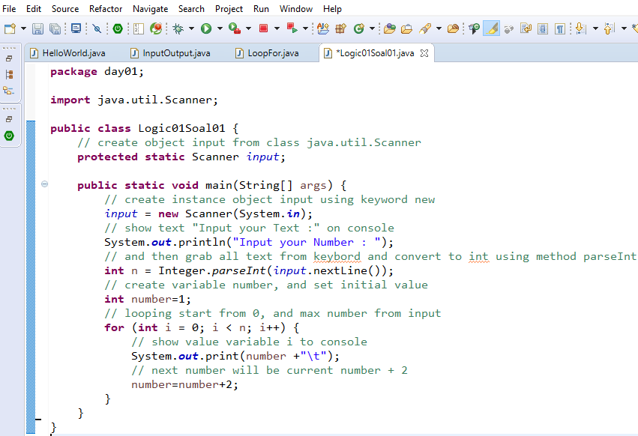
Logic 01 Soal 01

