Slide 1


Java – Logic Day 06
Ver. 0.1

Slide 2
Day 06
1
Goal Material

Slide 3
Goal Material

Slide 4
Day 06 - Inheritance
2
Inheritance

Slide 5
Inheritance in Java
Inheritance in Java is a mechanism in which one object acquires all the properties and behaviors of a parent object. It is an important part of OOPs (Object Oriented programming system).
The idea behind inheritance in Java is that you can create new classes that are built upon existing classes. When you inherit from an existing class, you can reuse methods and fields of the parent class. Moreover, you can add new methods and fields in your current class also.
Inheritance represents the IS-A relationship which is also known as a parent-child relationship.

Slide 6
Why use inheritance in java
For Method Overriding (so runtime polymorphism can be achieved).
For Code Reusability.

Slide 7
Terms used in Inheritance
Class: A class is a group of objects which have common properties. It is a template or blueprint from which objects are created.
Sub Class/Child Class: Subclass is a class which inherits the other class. It is also called a derived class, extended class, or child class.
Super Class/Parent Class: Superclass is the class from where a subclass inherits the features. It is also called a base class or a parent class.
Reusability: As the name specifies, reusability is a mechanism which facilitates you to reuse the fields and methods of the existing class when you create a new class. You can use the same fields and methods already defined in the previous class.

Slide 8
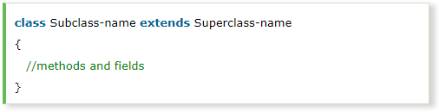
The syntax of Java Inheritance
The extends keyword indicates that you are making a new class that derives from an existing class. The meaning of "extends" is to increase the functionality.
In the terminology of Java, a class which is inherited is called a parent or superclass, and the new class is called child or subclass.

Slide 9
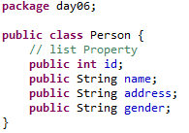
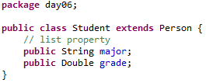

Slide 10
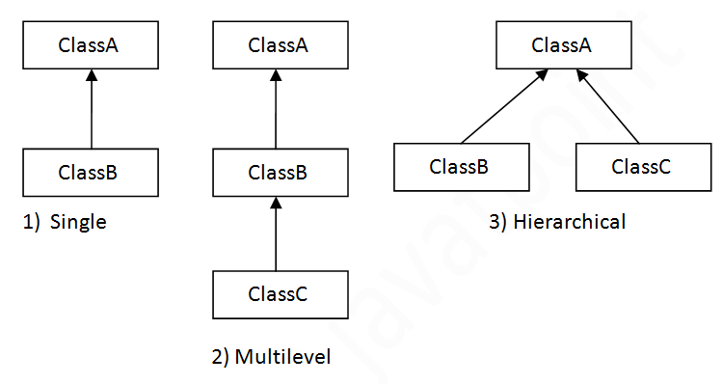
Types of inheritance in java
On the basis of class, there can be three types of inheritance in java: single, multilevel and hierarchical.
In java programming, multiple and hybrid inheritance is supported through interface only. We will learn about interfaces later.

Slide 11
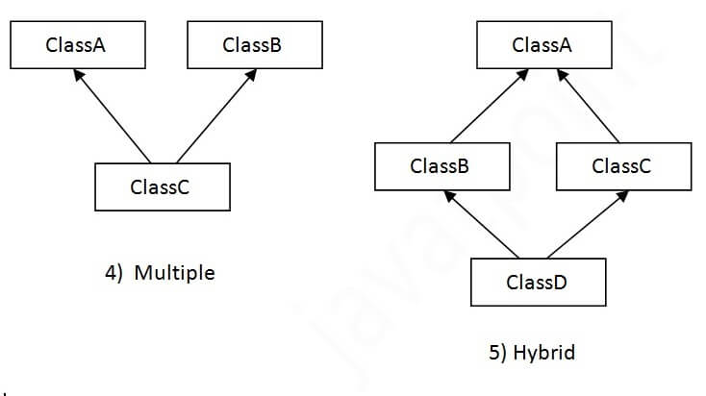
Types of inheritance in java
When one class inherits multiple classes, it is known as multiple inheritance. For Example:

Slide 12
Why multiple inheritance is not supported in java?
To reduce the complexity and simplify the language, multiple inheritance is not supported in java.
Consider a scenario where A, B, and C are three classes. The C class inherits A and B classes. If A and B classes have the same method and you call it from child class object, there will be ambiguity to call the method of A or B class.
Since compile-time errors are better than runtime errors, Java renders compile-time error if you inherit 2 classes. So whether you have same method or different, there will be compile time error.

Slide 13
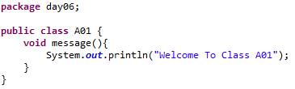
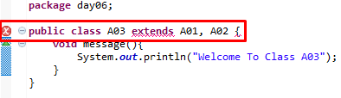
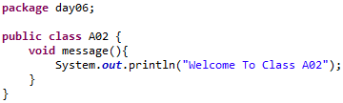
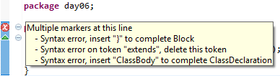
Why multiple inheritance is not supported in java?

Slide 14
Day 06 - Inheritance
3
Agregation

Slide 15
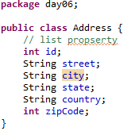
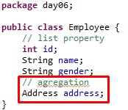
Aggregation in Java
If a class have an entity reference, it is known as Aggregation. Aggregation represents HAS-A relationship.
Consider a situation, Employee object contains many informations such as id, name, emailId etc. It contains one more object named address, which contains its own informations such as city, state, country, zipcode etc. as given below.
Why use Aggregation?
For Code Reusability.

Slide 16
When use Aggregation?
Code reuse is also best achieved by aggregation when there is no is-a relationship.
Inheritance should be used only if the relationship is-a is maintained throughout the lifetime of the objects involved; otherwise, aggregation is the best choice.

Slide 17
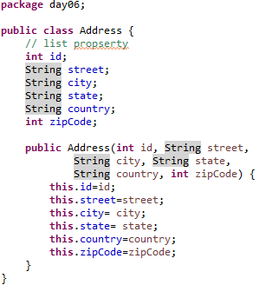
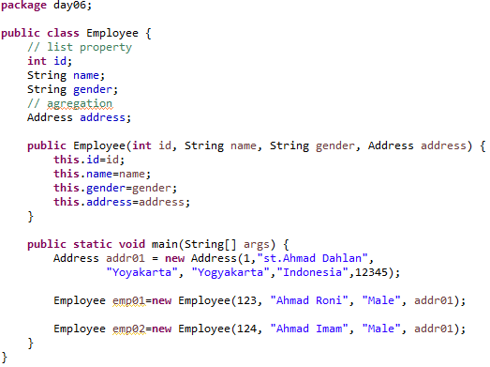
Aggregation Example

Slide 18
Day 06 - Polymorphism
4
Method Overloading

Slide 19
Method Overloading in Java
If a class has multiple methods having same name but different in parameters, it is known as Method Overloading.
If we have to perform only one operation, having same name of the methods increases the readability of the program.
Suppose you have to perform addition of the given numbers but there can be any number of arguments, if you write the method such as a(int,int) for two parameters, and b(int,int,int) for three parameters then it may be difficult for you as well as other programmers to understand the behavior of the method because its name differs.
So, we perform method overloading to figure out the program quickly.

Slide 20
Advantage of method overloading
Method overloading increases the readability of the program.
Different ways to overload the method
There are two ways to overload the method in java
By changing number of arguments
By changing the data type

Slide 21
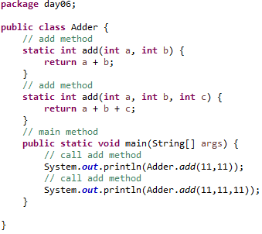
1) Method Overloading: changing no. of arguments
In this example, we have created two methods, first add() method performs addition of two numbers and second add method performs addition of three numbers.
In this example, we are creating static methods so that we don't need to create instance for calling methods.

Slide 22
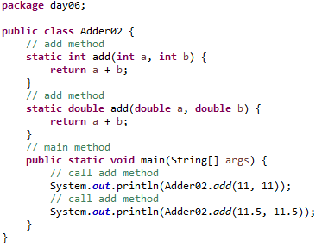
2) Method Overloading: changing data type of argumentsIn
this example, we have created two methods that differs in data type. The first add method receives two integer arguments and second add method receives two double arguments.

Slide 23
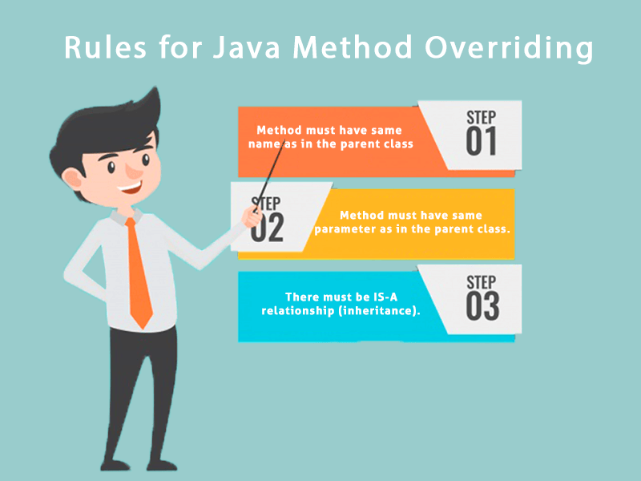
Rules for Java Method Overriding
The method must have the same name as in the parent class
The method must have the same parameter as in the parent class.
There must be an IS-A relationship (inheritance).

Slide 24
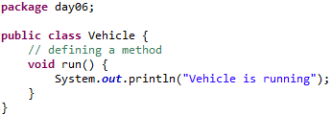
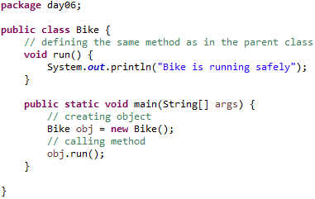
Example of method overriding
In this example, we have defined the run method in the subclass as defined in the parent class but it has some specific implementation. The name and parameter of the method are the same, and there is IS-A relationship between the classes, so there is method overriding.

Slide 25
Question and Answer
Can we override static method?
No, a static method cannot be overridden. It can be proved by runtime polymorphism, so we will learn it later.
Why can we not override static method?
It is because the static method is bound with class whereas instance method is bound with an object. Static belongs to the class area, and an instance belongs to the heap area.
Can we override java main method?
No, because the main is a static method.

Slide 26
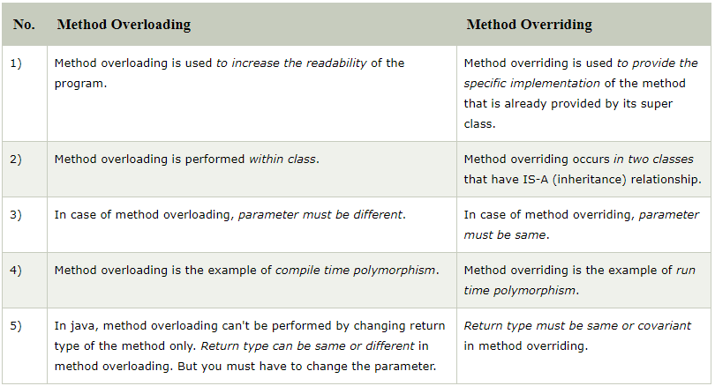
Method Overloading Vs. Method Overriding

Slide 27
Day 06 - Polymorphism
5
Method Overridding

Slide 28
Method Overriding in Java
If subclass (child class) has the same method as declared in the parent class, it is known as method overriding in Java.
In other words, If a subclass provides the specific implementation of the method that has been declared by one of its parent class, it is known as method overriding.
Usage of Java Method Overriding
Method overriding is used to provide the specific implementation of a method which is already provided by its superclass.
Method overriding is used for runtime polymorphism

Slide 29
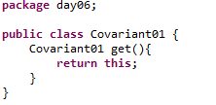
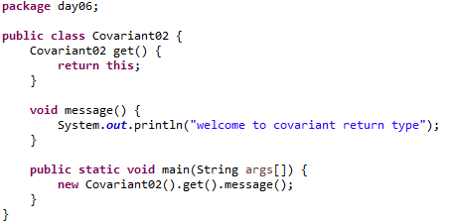
Covariant Return Type
The covariant return type specifies that the return type may vary in the same direction as the subclass.
Before Java5, it was not possible to override any method by changing the return type. But now, since Java5, it is possible to override method by changing the return type if subclass overrides any method whose return type is Non-Primitive but it changes its return type to subclass type. Let's take a simple example:

Slide 30
How is Covariant return types implemented?
Java doesn't allow the return type based overloading but JVM always allows return type based overloading. JVM uses full signature of a method for lookup/resolution. Full signature means it includes return type in addition to argument types. i.e., a class can have two or more methods differing only by return type. javac uses this fact to implement covariant return types.

Slide 31
Day 06 - Polymorphism
6
super Keyword

Slide 32
Super Keyword in Java
The super keyword in Java is a reference variable which is used to refer immediate parent class object.
Whenever you create the instance of subclass, an instance of parent class is created implicitly which is referred by super reference variable.

Slide 33
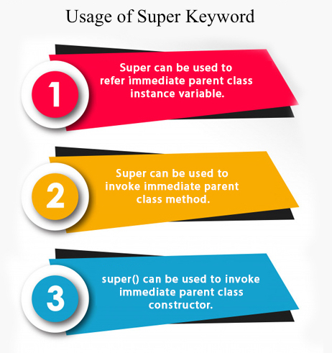
Super Keyword in Java
Usage of Java super Keyword
super can be used to refer immediate parent class instance variable.
super can be used to invoke immediate parent class method.
super() can be used to invoke immediate parent class constructor.

Slide 34
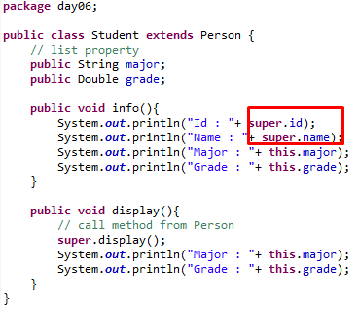
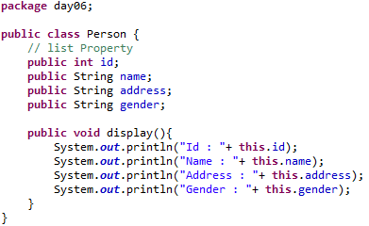
1) super is used to refer immediate parent class instance variable.
We can use super keyword to access the data member or field of parent class. It is used if parent class and child class have same fields.
Class Person :
Class Student :

Slide 35
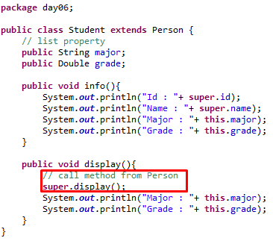
2) super can be used to invoke parent class method
The super keyword can also be used to invoke parent class method. It should be used if subclass contains the same method as parent class. In other words, it is used if method is overridden.
Class Person :
Class Student :

Slide 36
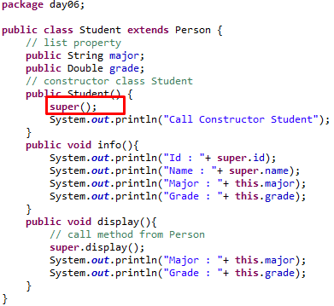
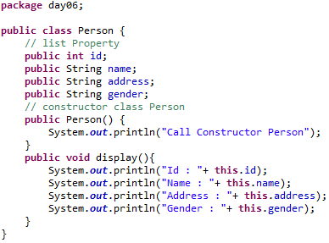
3) super is used to invoke parent class constructor.
The super keyword can also be used to invoke the parent class constructor. Let's see a simple example:
Class Person :
Class Student :

Slide 37
super example: real use
Let's see the real use of super keyword. Here, Emp class inherits Person class so all the properties of Person will be inherited to Emp by default. To initialize all the property, we are using parent class constructor from child class. In such way, we are reusing the parent class constructor.

Slide 38
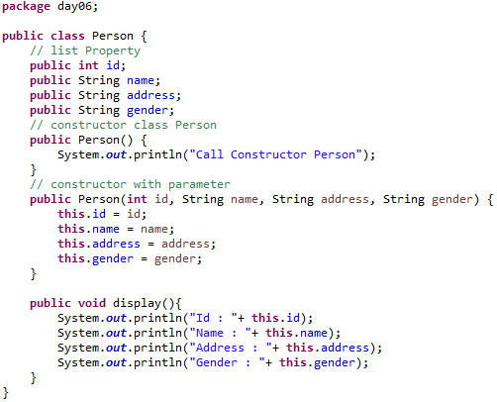
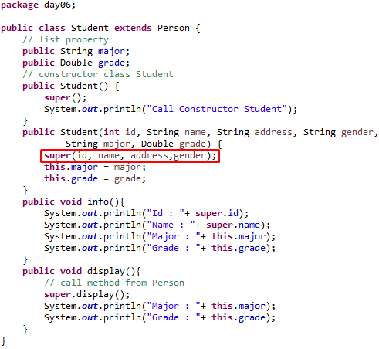
super example: real use

Slide 39
Day 06 - Polymorphism
7
Instance initializer block

Slide 40

Instance Initializer block
Instance Initializer block is used to initialize the instance data member. It run each time when object of the class is created.
The initialization of the instance variable can be done directly but there can be performed extra operations while initializing the instance variable in the instance initializer block.
What is the use of instance initializer block while we can directly assign a value in instance data member?

Slide 41
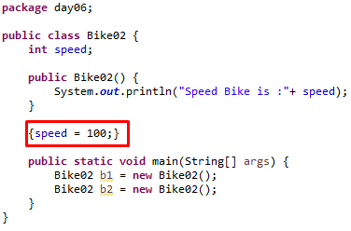
Why use instance initializer block?
Suppose I have to perform some operations while assigning value to instance data member e.g. a for loop to fill a complex array or error handling etc.

Slide 42
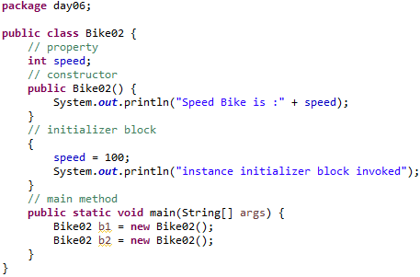
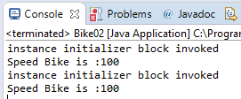
Instance Initializer block
There are three places in java where you can perform operations:
method
constructor
Block
What is invoked first, instance initializer block or constructor?

Slide 43
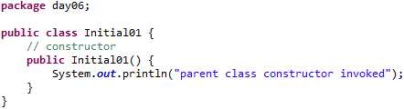
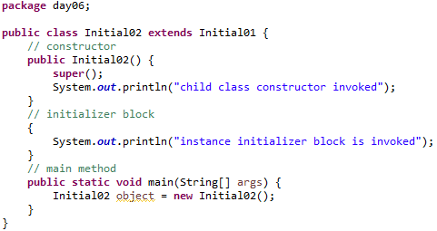
Rules for instance initializer block
There are mainly three rules for the instance initializer block. They are as follows:
The instance initializer block is created when instance of the class is created.
The instance initializer block is invoked after the parent class constructor is invoked (i.e. after super() constructor call).
The instance initializer block comes in the order in which they appear.

Slide 44
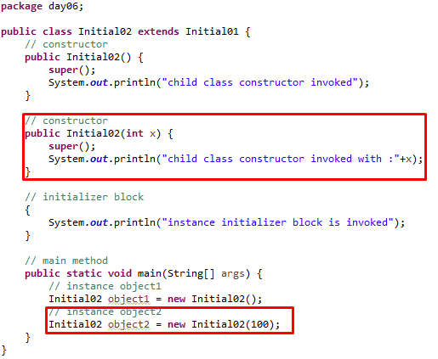
Another example of instance block

Slide 45
Day 06 - Polymorphism
8
final keyword

Slide 46
Final Keyword in Java
The final keyword in java is used to restrict the user. The java final keyword can be used in many context. Final can be:
variable
method
class
The final keyword can be applied with the variables, a final variable that have no value it is called blank final variable or uninitialized final variable. It can be initialized in the constructor only. The blank final variable can be static also which will be initialized in the static block only. We will have detailed learning of these. Let's first learn the basics of final keyword

Slide 47
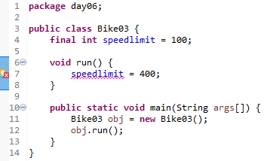
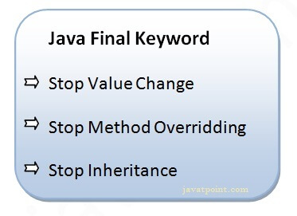
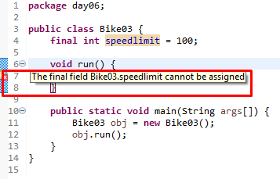
1) Java final variable
If you make any variable as final, you cannot change the value of final variable(It will be constant).
Example of final variable
There is a final variable speedlimit, we are going to change the value of this variable, but It can't be changed because final variable once assigned a value can never be changed.

Slide 48
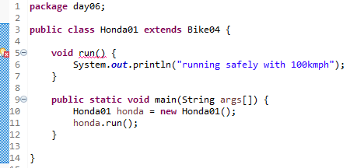
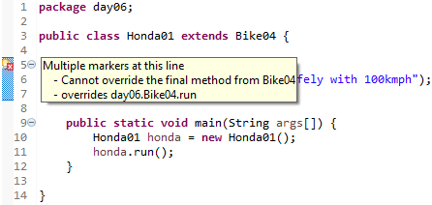
2) Java final method
If you make any method as final, you cannot override it.

Slide 49
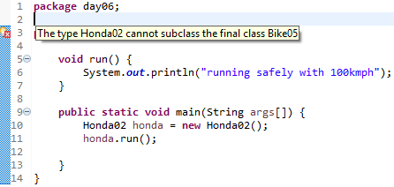


3) Java final class
If you make any class as final, you cannot extend it.

Slide 50
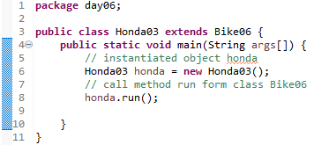
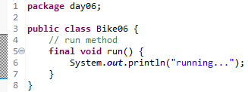
Q : Is final method inherited?
Answer : Yes, final method is inherited but you cannot override it. For Example:

Slide 51
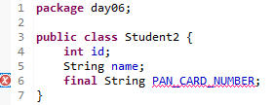
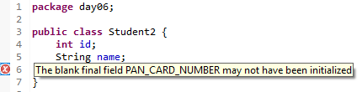
Q: What is blank or uninitialized final variable?
A final variable that is not initialized at the time of declaration is known as blank final variable.
If you want to create a variable that is initialized at the time of creating object and once initialized may not be changed, it is useful. For example PAN CARD number of an employee.
It can be initialized only in constructor.

Slide 52
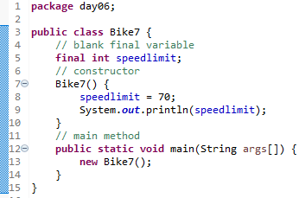
Q: Can we initialize blank final variable?
Answer: Yes, but only in constructor. For example:

Slide 53
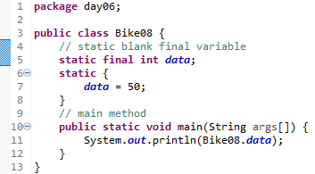
static blank final variable
A static final variable that is not initialized at the time of declaration is known as static blank final variable. It can be initialized only in static block.

Slide 54
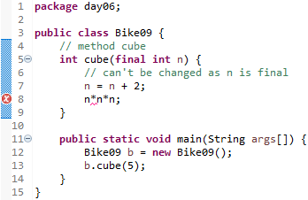
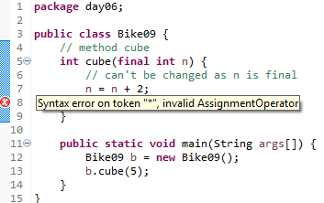
Q) What is final parameter?
Answer : If you declare any parameter as final, you cannot change the value of it.

Slide 55
Q) Can we declare a constructor final?
Answer : No, because constructor is never inherited.

Slide 56
Day 06 - Polymorphism
9
Runtime Polymorphism

Slide 57
Runtime Polymorphism in Java
Runtime polymorphism or Dynamic Method Dispatch is a process in which a call to an overridden method is resolved at runtime rather than compile-time.
In this process, an overridden method is called through the reference variable of a superclass. The determination of the method to be called is based on the object being referred to by the reference variable.
Let's first understand the upcasting before Runtime Polymorphism.

Slide 58
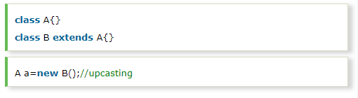


Upcasting
If the reference variable of Parent class refers to the object of Child class, it is known as upcasting. For example:
For upcasting, we can use the reference variable of class type or an interface type. For Example:

Slide 59
Example of Java Runtime Polymorphism

Slide 60
Day 06 - Polymorphism
10
Dynamic Binding

Slide 61
Day 06 - Polymorphism
11
instanceof Operator

Slide 62
Day 06
12
Study Case

Slide 63
GOOD LUCK!

Slide 64
THANKS!
Any questions?
Contact Your Trainer

Slide 65
THIS IS A SLIDE TITLE
Here you have a list of items
And some text
But remember not to overload your slides with content
Your audience will listen to you or read the content, but won’t do both.

Slide 66
Environment
EDIT IN GOOGLE SLIDES
Click on the button under the presentation preview that says "Use as Google Slides Theme".
You will get a copy of this document on your Google Drive and will be able to edit, add or delete slides.
You have to be signed in to your Google account.
EDIT IN POWERPOINT®
Click on the button under the presentation preview that says "Download as PowerPoint template". You will get a .pptx file that you can edit in PowerPoint.
Remember to download and install the fonts used in this presentation (you’ll find the links to the font files needed in the Presentation design slide)
More info on how to use this template at www.slidescarnival.com/help-use-presentation-template
This template is free to use under Creative Commons Attribution license. You can keep the Credits slide or mention SlidesCarnival and other resources used in a slide footer.

Slide 67

HELLO!
I am Jayden Smith
I am here because I love to give presentations.
You can find me at @username

Slide 68
TRANSITION HEADLINE
1
Let’s start with the first set of slides

Slide 69
Quotations are commonly printed as a means of inspiration and to invoke philosophical thoughts from the reader.

Slide 70
THIS IS A SLIDE TITLE
Here you have a list of items
And some text
But remember not to overload your slides with content
Your audience will listen to you or read the content, but won’t do both.

Slide 71
BIG CONCEPT
Bring the attention of your audience over a key concept using icons or illustrations

Slide 72
YOU CAN ALSO SPLIT YOUR CONTENT
White
Is the color of milk and fresh snow, the color produced by the combination of all the colors of the visible spectrum.
Black
Is the color of coal, ebony, and of outer space. It is the darkest color, the result of the absence of or complete absorption of light.

Slide 73
IN TWO OR THREE COLUMNS
Yellow
Is the color of gold, butter and ripe lemons. In the spectrum of visible light, yellow is found between green and orange.
Blue
Is the colour of the clear sky and the deep sea. It is located between violet and green on the optical spectrum.
Red
Is the color of blood, and because of this it has historically been associated with sacrifice, danger and courage.

Slide 74

A PICTURE IS WORTH A THOUSAND WORDS
A complex idea can be conveyed with just a single still image, namely making it possible to absorb large amounts of data quickly.

Slide 75

Want big impact?
USE BIG IMAGE

Slide 76
USE CHARTS TO EXPLAIN YOUR IDEAS
White
Gray
Black

Slide 77
AND TABLES TO COMPARE DATA
Yellow | 10 | 20
Blue | 30 | 15
Orange | 5 | 24

Slide 78
MAPS
OUR OFFICE

Slide 79
89,526,124
Whoa! That’s a big number, aren’t you proud?

Slide 80
89,526,124$
185,244 users
100%
That’s a lot of money
And a lot of users
Total success!

Slide 81
OUR PROCESS IS EASY
first
second
last

Slide 82
LET’S REVIEW SOME CONCEPTS
Yellow
Is the color of gold, butter and ripe lemons. In the spectrum of visible light, yellow is found between green and orange.
Blue
Is the colour of the clear sky and the deep sea. It is located between violet and green on the optical spectrum.
Red
Is the color of blood, and because of this it has historically been associated with sacrifice, danger and courage.
Yellow
Is the color of gold, butter and ripe lemons. In the spectrum of visible light, yellow is found between green and orange.
Blue
Is the colour of the clear sky and the deep sea. It is located between violet and green on the optical spectrum.
Red
Is the color of blood, and because of this it has historically been associated with sacrifice, danger and courage.

Slide 83

GRAPH TITLE
You can insert graphs from Google Sheets

Slide 84
Place your screenshot here
ANDROID PROJECT
Show and explain your web, app or software projects using these gadget templates.

Slide 85
iPHONE PROJECT
Show and explain your web, app or software projects using these gadget templates.
Place your screenshot here

Slide 86
Place your screenshot here
TABLET PROJECT
Show and explain your web, app or software projects using these gadget templates.

Slide 87
Place your screenshot here
DESKTOP PROJECT
Show and explain your web, app or software projects using these gadget templates.

Slide 88
THANKS!
Any questions?
You can find me at
@username & user@mail.me

Slide 89
CREDITS
Special thanks to all the people who made and released these awesome resources for free:
Presentation template by SlidesCarnival
Photographs by Startup Stock Photos

Slide 90
PRESENTATION DESIGN
This presentation uses the following typographies and colors:
Titles: Roboto Condensed
Body copy: Roboto Condensed
You can download the fonts on this page:
https://material.io/guidelines/resources/roboto-noto-fonts.html
Navy #3f5378 · Dark navy #263248 · Yellow #ff9800
You don’t need to keep this slide in your presentation. It’s only here to serve you as a design guide if you need to create new slides or download the fonts to edit the presentation in PowerPoint®

Slide 91
SlidesCarnival icons are editable shapes.
This means that you can:
Resize them without losing quality.
Change line color, width and style.
Isn’t that nice? :)
Examples:

Slide 92
😉
Now you can use any emoji as an icon!
And of course it resizes without losing quality and you can change the color.
How? Follow Google instructions https://twitter.com/googledocs/status/730087240156643328
✋👆👉👍👤👦👧👨👩👪💃🏃💑❤😂😉😋😒😭👶😸🐟🍒🍔💣📌📖🔨🎃🎈🎨🏈🏰🌏🔌🔑 and many more...

