Slide 1


Java – Logic Day 07
Ver. 0.1

Slide 2
Day 07
1
Goal Material

Slide 3
Goal Material
Abstract Class
Interface
Nested Interface
Abstract vs Interface
Package
Access Modifier
Encaptulation

Slide 4
Day 07
2
Abstract Class

Slide 5
Abstraction
Abstraction is a process of hiding the implementation details and showing only functionality to the user.
Another way, it shows only essential things to the user and hides the internal details, for example, sending SMS where you type the text and send the message. You don't know the internal processing about the message delivery.
Abstraction lets you focus on what the object does instead of how it does it.
Ways to achieve Abstraction
There are two ways to achieve abstraction in java :
Abstract class (0 to 100%)
Interface (100%)

Slide 6
Abstract class in Java
A class which is declared as abstract is known as an abstract class. It can have abstract and non-abstract methods. It needs to be extended and its method implemented. It cannot be instantiated.

Slide 7
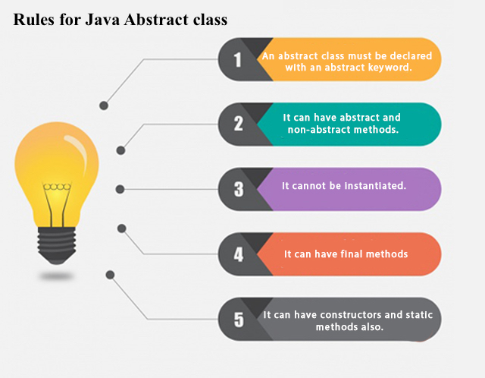
Points to Remember
An abstract class must be declared with an abstract keyword.
It can have abstract and non-abstract methods.
It cannot be instantiated.
It can have constructors and static methods also.
It can have final methods which will force the subclass not to change the body of the method.

Slide 8
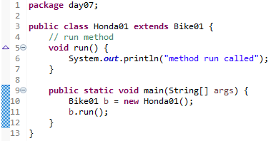

Abstract Method in Java
A method which is declared as abstract and does not have implementation is known as an abstract method.

Slide 9
Understanding the real scenario of Abstract class
In this example, Shape is the abstract class, and its implementation is provided by the Rectangle and Circle classes.
Mostly, we don't know about the implementation class (which is hidden to the end user), and an object of the implementation class is provided by the factory method.
A factory method is a method that returns the instance of the class. We will learn about the factory method later.
In this example, if you create the instance of Rectangle class, draw() method of Rectangle class will be invoked.

Slide 10

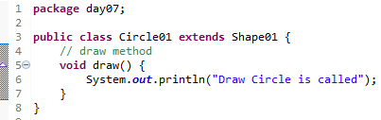
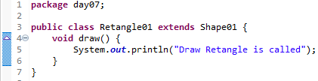
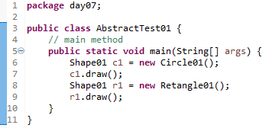
Understanding the real scenario of Abstract class

Slide 11

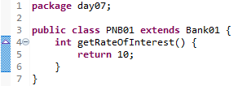
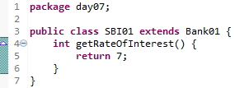
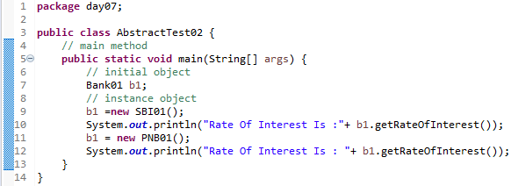
Understanding the real scenario of Abstract class

Slide 12
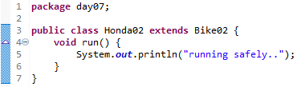
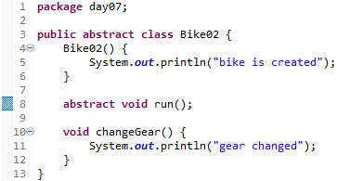
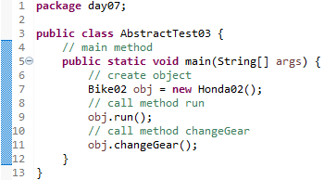
Abstract class having constructor, data member and methods
An abstract class can have a data member, abstract method, method body (non-abstract method), constructor, and even main() method.

Slide 13
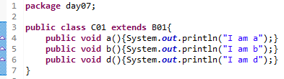
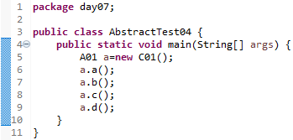
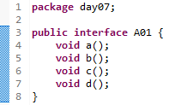
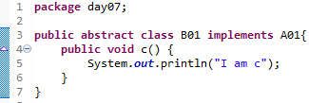
Another real scenario of abstract class
The abstract class can also be used to provide some implementation of the interface. In such case, the end user may not be forced to override all the methods of the interface.

Slide 15
Day 07
3
Interface

Slide 16
interface in java
An interface in java is a blueprint of a class. It has static constants and abstract methods.
The interface in Java is a mechanism to achieve abstraction. There can be only abstract methods in the Java interface, not method body. It is used to achieve abstraction and multiple inheritance in Java.
In other words, you can say that interfaces can have abstract methods and variables. It cannot have a method body.
Java Interface also represents the IS-A relationship.
It cannot be instantiated just like the abstract class.
Since Java 8, we can have default and static methods in an interface.
Since Java 9, we can have private methods in an interface.

Slide 17
Why use Java interface?
There are mainly three reasons to use interface. They are given below.
It is used to achieve abstraction.
By interface, we can support the functionality of multiple inheritance.
It can be used to achieve loose coupling.
How to declare an interface?
An interface is declared by using the interface keyword. It provides total abstraction; means all the methods in an interface are declared with the empty body, and all the fields are public, static and final by default. A class that implements an interface must implement all the methods declared in the interface.

Slide 18
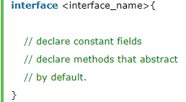
Syntax

Slide 19
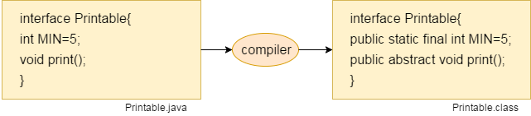
Internal addition by the compiler
In other words, Interface fields are public, static and final by default, and the methods are public and abstract.

Slide 20
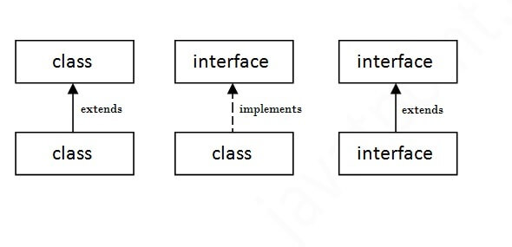
The relationship between classes and interfaces
As shown in the figure given below, a class extends another class, an interface extends another interface, but a class implements an interface.

Slide 21

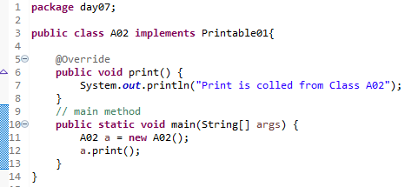
Java Interface Example
In this example, the Printable interface has only one method, and its implementation is provided in the A6 class.

Slide 22
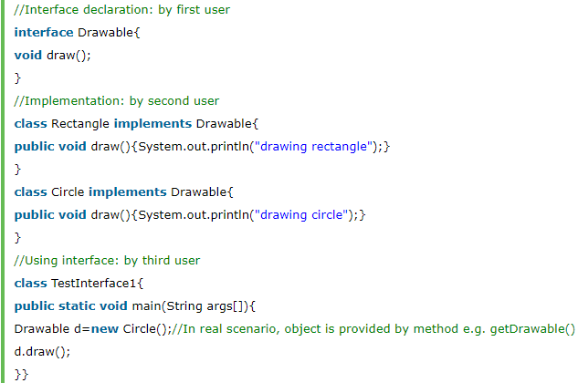
Java Interface Example: Drawable
In this example, the Drawable interface has only one method. Its implementation is provided by Rectangle and Circle classes. In a real scenario, an interface is defined by someone else, but its implementation is provided by different implementation providers. Moreover, it is used by someone else. The implementation part is hidden by the user who uses the interface.

Slide 23
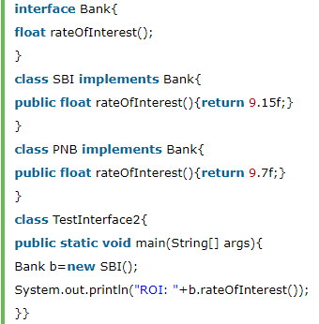
Java Interface Example: Bank
Let's see another example of java interface which provides the implementation of Bank interface.

Slide 24
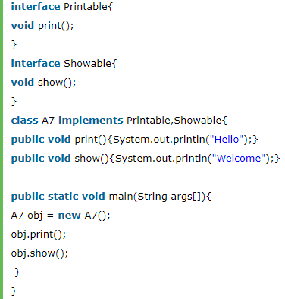
Multiple inheritance in Java by interface
If a class implements multiple interfaces, or an interface extends multiple interfaces, it is known as multiple inheritance.

Slide 25
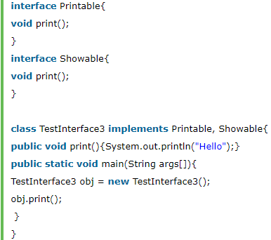
Question and Answer
Q) Multiple inheritance is not supported through class in java, but it is possible by an interface, why?
As we have explained in the inheritance chapter, multiple inheritance is not supported in the case of class because of ambiguity. However, it is supported in case of an interface because there is no ambiguity. It is because its implementation is provided by the implementation class. For example:
As you can see in the above example, Printable and Showable interface have same methods but its implementation is provided by class TestTnterface1, so there is no ambiguity.

Slide 26
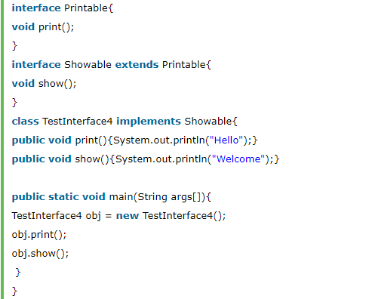
Interface inheritance
A class implements an interface, but one interface extends another interface.

Slide 27
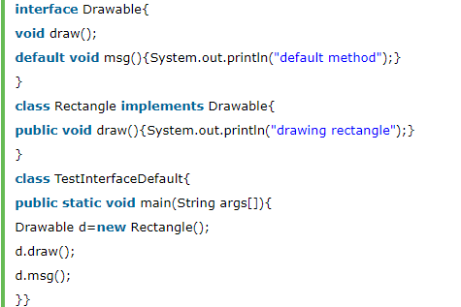
Java 8 Default Method in Interface
Since Java 8, we can have method body in interface. But we need to make it default method. Let's see an example:

Slide 28
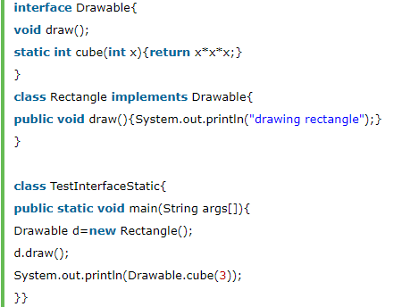
Java 8 Static Method in Interface
Since Java 8, we can have static method in interface. Let's see an example:

Slide 29

Q) What is marker or tagged interface?
An interface which has no member is known as a marker or tagged interface, for example, Serializable, Cloneable, Remote, etc. They are used to provide some essential information to the JVM so that JVM may perform some useful operation.

Slide 30
Day 07
4
Nested Interface

Slide 31
Java Nested Interface
An interface i.e. declared within another interface or class is known as nested interface. The nested interfaces are used to group related interfaces so that they can be easy to maintain. The nested interface must be referred by the outer interface or class. It can't be accessed directly.
Points to remember for nested interfaces :
There are given some points that should be remembered by the java programmer.
Nested interface must be public if it is declared inside the interface but it can have any access modifier if declared within the class.
Nested interfaces are declared static implicitely.

Slide 32
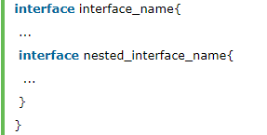
Syntax
Syntax of nested interface which is declared within the interface
Syntax of nested interface which is declared within the class

Slide 33
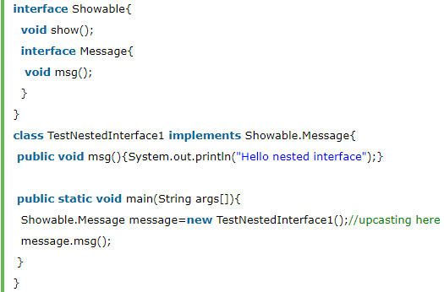
Example of nested interface which is declared within the interface
In this example, we are going to learn how to declare the nested interface and how we can access it.
As you can see in the above example, we are acessing the Message interface by its outer interface Showable because it cannot be accessed directly. It is just like almirah inside the room, we cannot access the almirah directly because we must enter the room first. In collection frameword, sun microsystem has provided a nested interface Entry. Entry is the subinterface of Map i.e. accessed by Map.Entry.

Slide 34

Internal code generated by the java compiler for nested interface Message
The java compiler internally creates public and static interface as displayed below:.

Slide 35
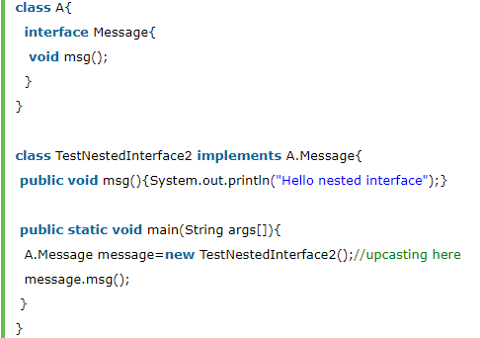
Example of nested interface which is declared within the class
Let's see how can we define an interface inside the class and how can we access it.

Slide 36

Can we define a class inside the interface?
Yes, If we define a class inside the interface, java compiler creates a static nested class. Let's see how can we define a class within the interface:

Slide 37
Day 07
5
Abtraction vs Interface

Slide 38
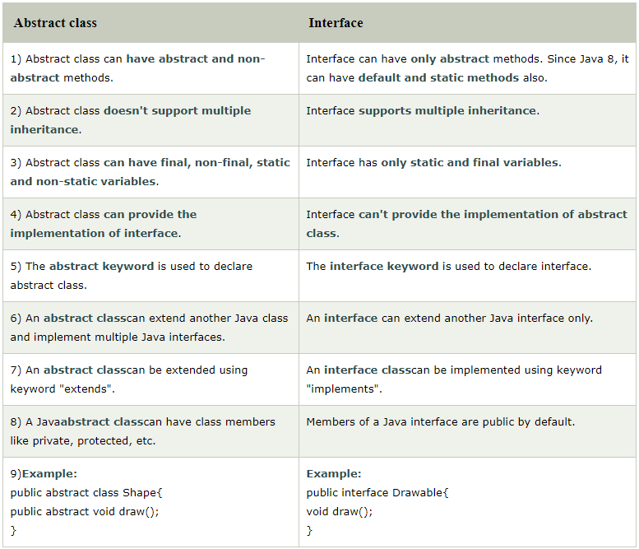

Slide 39
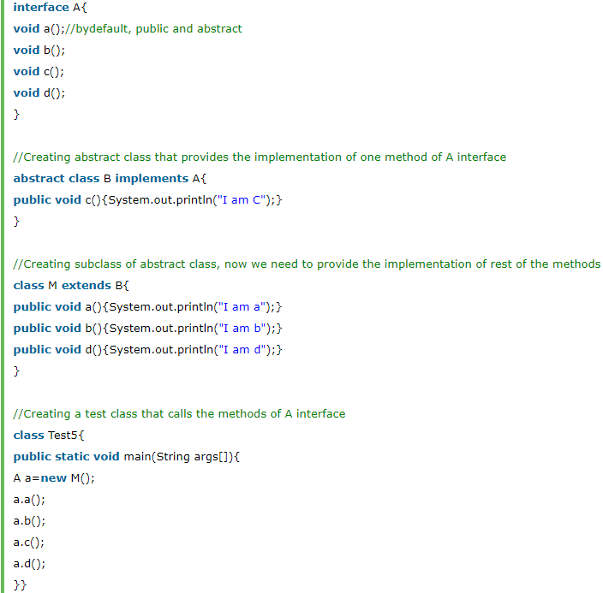

Slide 40
Day 07
6
Package

Slide 41
Day 07
7
Access Modifier

Slide 42
Day 07
8
Encaptulation

Slide 43
Day 07
9
Study Case

Slide 44
THIS IS A SLIDE TITLE
Here you have a list of items
And some text
But remember not to overload your slides with content
Your audience will listen to you or read the content, but won’t do both.

Slide 45
Environment
EDIT IN GOOGLE SLIDES
Click on the button under the presentation preview that says "Use as Google Slides Theme".
You will get a copy of this document on your Google Drive and will be able to edit, add or delete slides.
You have to be signed in to your Google account.
EDIT IN POWERPOINT®
Click on the button under the presentation preview that says "Download as PowerPoint template". You will get a .pptx file that you can edit in PowerPoint.
Remember to download and install the fonts used in this presentation (you’ll find the links to the font files needed in the Presentation design slide)
More info on how to use this template at www.slidescarnival.com/help-use-presentation-template
This template is free to use under Creative Commons Attribution license. You can keep the Credits slide or mention SlidesCarnival and other resources used in a slide footer.

Slide 46

HELLO!
I am Jayden Smith
I am here because I love to give presentations.
You can find me at @username

Slide 47
TRANSITION HEADLINE
1
Let’s start with the first set of slides

Slide 48
Quotations are commonly printed as a means of inspiration and to invoke philosophical thoughts from the reader.

Slide 49
THIS IS A SLIDE TITLE
Here you have a list of items
And some text
But remember not to overload your slides with content
Your audience will listen to you or read the content, but won’t do both.

Slide 50
BIG CONCEPT
Bring the attention of your audience over a key concept using icons or illustrations

Slide 51
YOU CAN ALSO SPLIT YOUR CONTENT
White
Is the color of milk and fresh snow, the color produced by the combination of all the colors of the visible spectrum.
Black
Is the color of coal, ebony, and of outer space. It is the darkest color, the result of the absence of or complete absorption of light.

Slide 52
IN TWO OR THREE COLUMNS
Yellow
Is the color of gold, butter and ripe lemons. In the spectrum of visible light, yellow is found between green and orange.
Blue
Is the colour of the clear sky and the deep sea. It is located between violet and green on the optical spectrum.
Red
Is the color of blood, and because of this it has historically been associated with sacrifice, danger and courage.

Slide 53

A PICTURE IS WORTH A THOUSAND WORDS
A complex idea can be conveyed with just a single still image, namely making it possible to absorb large amounts of data quickly.

Slide 54

Want big impact?
USE BIG IMAGE

Slide 55
USE CHARTS TO EXPLAIN YOUR IDEAS
White
Gray
Black

Slide 56
AND TABLES TO COMPARE DATA
 | A | B | C
Yellow | 10 | 20 | 7
Blue | 30 | 15 | 10
Orange | 5 | 24 | 16

Slide 57
MAPS
OUR OFFICE

Slide 58
89,526,124
Whoa! That’s a big number, aren’t you proud?

Slide 59
89,526,124$
185,244 users
100%
That’s a lot of money
And a lot of users
Total success!

Slide 60
OUR PROCESS IS EASY
first
second
last

Slide 61
LET’S REVIEW SOME CONCEPTS
Yellow
Is the color of gold, butter and ripe lemons. In the spectrum of visible light, yellow is found between green and orange.
Blue
Is the colour of the clear sky and the deep sea. It is located between violet and green on the optical spectrum.
Red
Is the color of blood, and because of this it has historically been associated with sacrifice, danger and courage.
Yellow
Is the color of gold, butter and ripe lemons. In the spectrum of visible light, yellow is found between green and orange.
Blue
Is the colour of the clear sky and the deep sea. It is located between violet and green on the optical spectrum.
Red
Is the color of blood, and because of this it has historically been associated with sacrifice, danger and courage.

Slide 62

GRAPH TITLE
You can insert graphs from Google Sheets

Slide 63
Place your screenshot here
ANDROID PROJECT
Show and explain your web, app or software projects using these gadget templates.

Slide 64
iPHONE PROJECT
Show and explain your web, app or software projects using these gadget templates.
Place your screenshot here

Slide 65
Place your screenshot here
TABLET PROJECT
Show and explain your web, app or software projects using these gadget templates.

Slide 66
Place your screenshot here
DESKTOP PROJECT
Show and explain your web, app or software projects using these gadget templates.

Slide 67
THANKS!
Any questions?
You can find me at
@username & user@mail.me

Slide 68
CREDITS
Special thanks to all the people who made and released these awesome resources for free:
Presentation template by SlidesCarnival
Photographs by Startup Stock Photos

Slide 69
PRESENTATION DESIGN
This presentation uses the following typographies and colors:
Titles: Roboto Condensed
Body copy: Roboto Condensed
You can download the fonts on this page:
https://material.io/guidelines/resources/roboto-noto-fonts.html
Navy #3f5378 · Dark navy #263248 · Yellow #ff9800
You don’t need to keep this slide in your presentation. It’s only here to serve you as a design guide if you need to create new slides or download the fonts to edit the presentation in PowerPoint®

Slide 70
SlidesCarnival icons are editable shapes.
This means that you can:
Resize them without losing quality.
Change line color, width and style.
Isn’t that nice? :)
Examples:

Slide 71
😉
Now you can use any emoji as an icon!
And of course it resizes without losing quality and you can change the color.
How? Follow Google instructions https://twitter.com/googledocs/status/730087240156643328
✋👆👉👍👤👦👧👨👩👪💃🏃💑❤😂😉😋😒😭👶😸🐟🍒🍔💣📌📖🔨🎃🎈🎨🏈🏰🌏🔌🔑 and many more...

