Slide 1


Java – Logic Day 05
Ver. 0.1

Slide 2
Day 05
1
Goal Material

Slide 3
Goal Material
Class
Property
Method

Slide 4
Day 05
2
Class and object

Slide 5
Object Oriented Concept
Object-Oriented Programming is a paradigm that provides many concepts such as inheritance, data binding, polymorphism, etc.
Simula is considered the first object-oriented programming language. The programming paradigm where everything is represented as an object is known as a truly object-oriented programming language.
Smalltalk is considered the first truly object-oriented programming language.
The popular object-oriented languages are Java, C#, PHP, Python, C++, etc.
The main aim of object-oriented programming is to implement real-world entities for example object, classes, abstraction, inheritance, polymorphism, etc.

Slide 6
Java – Basic Syntax
Case Sensitivity − Java is case sensitive.
Class Names − For all class names the first letter should be in Upper Case. If several words are used to form a name of the class, each inner word's first letter should be in Upper Case.
Method Names − All method names should start with a Lower Case letter. If several words are used to form the name of the method, then each inner word's first letter should be in Upper Case.
Program File Name − Name of the program file should exactly match the class name.
public static void main(String args[]) − Java program processing starts from the main() method which is a mandatory part of every Java program.

Slide 7
Names used for classes, variables, and methods are called identifiers.

Slide 8
Java – Identifier Rule
All identifiers should begin with a letter (A to Z or a to z), currency character ($) or an underscore (_).
After the first character, identifiers can have any combination of characters.
A key word cannot be used as an identifier.
Most importantly, identifiers are case sensitive.
Examples of legal identifiers: age, $salary, _value, __1_value.
Examples of illegal identifiers: 123abc, -salary.

Slide 9
Java – Modifier
Access Modifiers − default, public , protected, private
Non-access Modifiers − final, abstract, strictfp

Slide 10
Java - Variable
Local Variables
Class Variables (Static Variables)
Instance Variables (Non-static Variables)

Slide 11
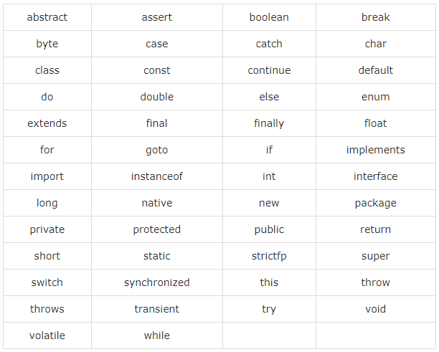
Java - Keyword

Slide 12
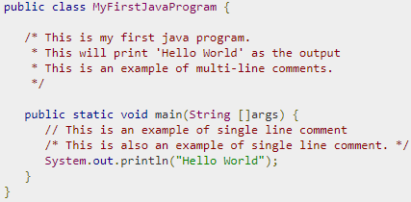
Java - Comment
Java supports single-line and multi-line comments very similar to C and C++. All characters available inside any comment are ignored by Java compiler.

Slide 13
Basic Data Type
There are two data types available in Java −
Primitive Data Types
Reference/Object Data Types

Slide 14
Primitive Data Types
Primitive datatypes are predefined by the language and named by a keyword
byte
short
int
log
Float
Double
Bollean
Char

Slide 15
Reference Data Type
Reference variables are created using defined constructors of the classes.
Class objects and various type of array variables come under reference datatype.
Default value of any reference variable is null.
A reference variable can be used to refer any object of the declared type or any compatible type.

Slide 16
Java Operator
Arithmetic Operators
Relational Operators
Bitwise Operators
Logical Operators
Assignment Operators
Misc Operators

Slide 17
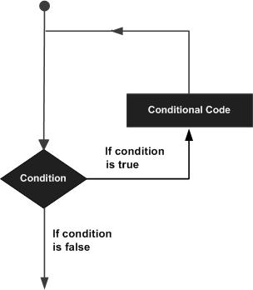
Java - Loop
A loop statement allows us to execute a statement or group of statements multiple times

Slide 18
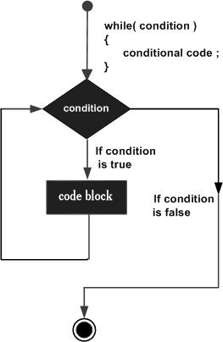
Loop - While
while(Boolean_expression) {
// Statements
}
statement(s) may be a single statement or a block of statements. The condition may be any expression, and true is any non zero value.
When executing, if the boolean_expression result is true, then the actions inside the loop will be executed. This will continue as long as the expression result is true.
When the condition becomes false, program control passes to the line immediately

Slide 19
Day 01
Hello World

Slide 20
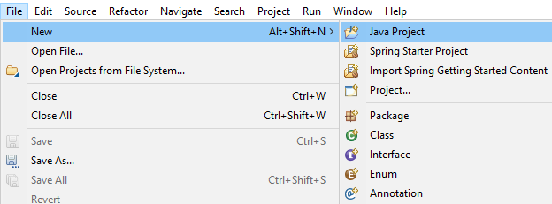
Create New Project
Open STS or Eclipse, then create new project,
File -> New -> Java Project

Slide 21
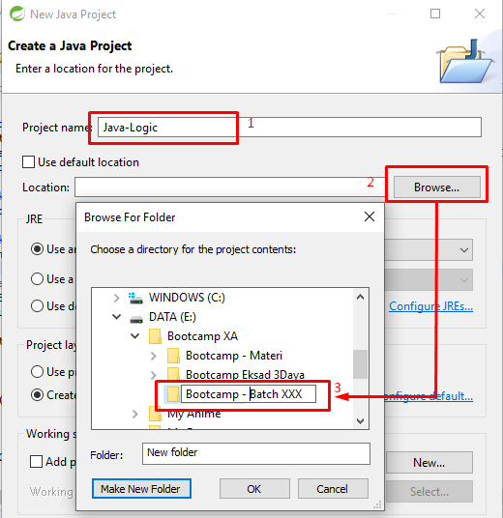
Create New Project
1. Fill then name project “Java Logic”
2. Find your location to put your java project
3. Create folder or directory
4. Clik OK.

Slide 22
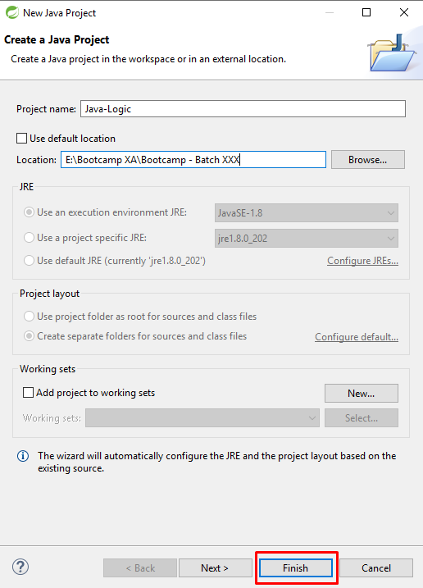
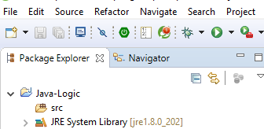

Slide 23
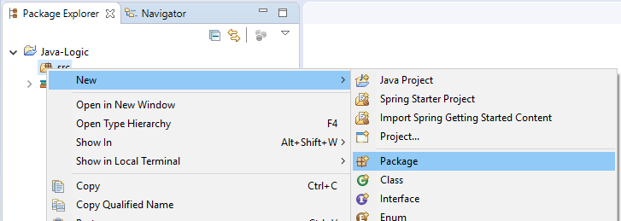
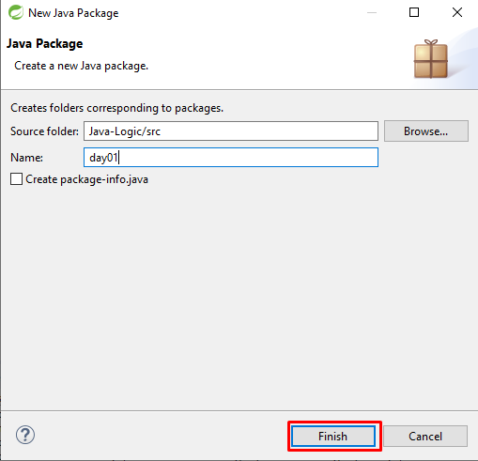
New Package
Righ Click on src -> New -> Package
Every Day, you must create new package

Slide 24
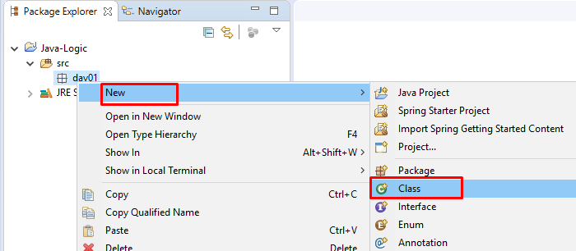
Create New Class
Right Click on package day01 -> new -> class

Slide 25
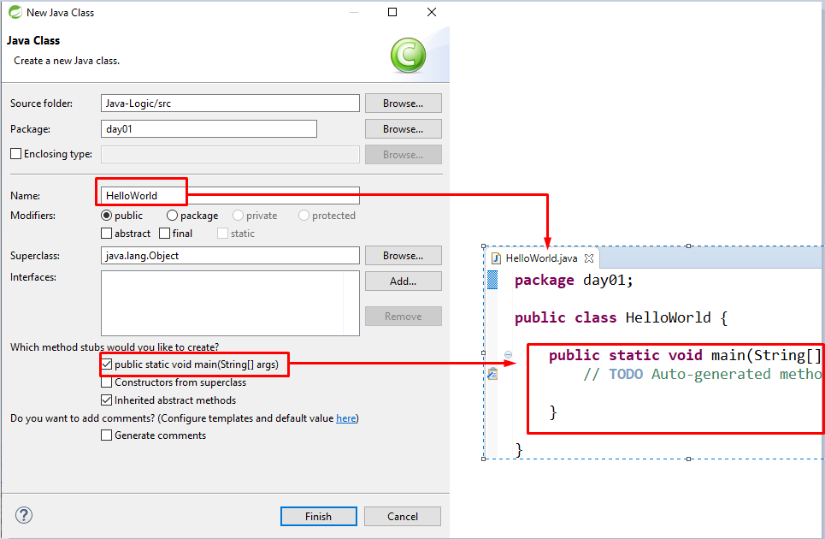
Create New Class

Slide 26
Day 01
2
Logic - 01

Slide 27
THIS IS A SLIDE TITLE
Here you have a list of items
And some text
But remember not to overload your slides with content
Your audience will listen to you or read the content, but won’t do both.

Slide 28
Environment
EDIT IN GOOGLE SLIDES
Click on the button under the presentation preview that says "Use as Google Slides Theme".
You will get a copy of this document on your Google Drive and will be able to edit, add or delete slides.
You have to be signed in to your Google account.
EDIT IN POWERPOINT®
Click on the button under the presentation preview that says "Download as PowerPoint template". You will get a .pptx file that you can edit in PowerPoint.
Remember to download and install the fonts used in this presentation (you’ll find the links to the font files needed in the Presentation design slide)
More info on how to use this template at www.slidescarnival.com/help-use-presentation-template
This template is free to use under Creative Commons Attribution license. You can keep the Credits slide or mention SlidesCarnival and other resources used in a slide footer.

Slide 29
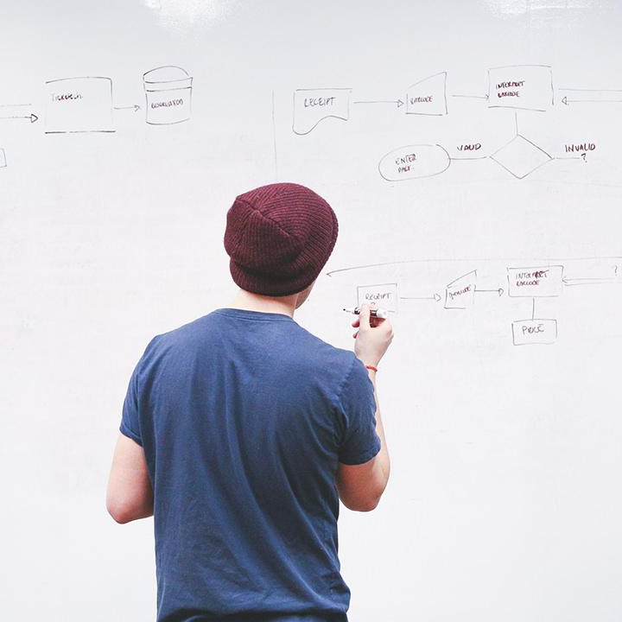
HELLO!
I am Jayden Smith
I am here because I love to give presentations.
You can find me at @username

Slide 30
TRANSITION HEADLINE
1
Let’s start with the first set of slides

Slide 31
Quotations are commonly printed as a means of inspiration and to invoke philosophical thoughts from the reader.

Slide 32
THIS IS A SLIDE TITLE
Here you have a list of items
And some text
But remember not to overload your slides with content
Your audience will listen to you or read the content, but won’t do both.

Slide 33
BIG CONCEPT
Bring the attention of your audience over a key concept using icons or illustrations

Slide 34
YOU CAN ALSO SPLIT YOUR CONTENT
White
Is the color of milk and fresh snow, the color produced by the combination of all the colors of the visible spectrum.
Black
Is the color of coal, ebony, and of outer space. It is the darkest color, the result of the absence of or complete absorption of light.

Slide 35
IN TWO OR THREE COLUMNS
Yellow
Is the color of gold, butter and ripe lemons. In the spectrum of visible light, yellow is found between green and orange.
Blue
Is the colour of the clear sky and the deep sea. It is located between violet and green on the optical spectrum.
Red
Is the color of blood, and because of this it has historically been associated with sacrifice, danger and courage.

Slide 36

A PICTURE IS WORTH A THOUSAND WORDS
A complex idea can be conveyed with just a single still image, namely making it possible to absorb large amounts of data quickly.

Slide 37

Want big impact?
USE BIG IMAGE

Slide 38
USE CHARTS TO EXPLAIN YOUR IDEAS
White
Gray
Black

Slide 39
AND TABLES TO COMPARE DATA
 | A | B | C
Yellow | 10 | 20 | 7
Blue | 30 | 15 | 10
Orange | 5 | 24 | 16

Slide 40
MAPS
OUR OFFICE

Slide 41
89,526,124
Whoa! That’s a big number, aren’t you proud?

Slide 42
89,526,124$
185,244 users
100%
That’s a lot of money
And a lot of users
Total success!

Slide 43
OUR PROCESS IS EASY
first
second
last

Slide 44
LET’S REVIEW SOME CONCEPTS
Yellow
Is the color of gold, butter and ripe lemons. In the spectrum of visible light, yellow is found between green and orange.
Blue
Is the colour of the clear sky and the deep sea. It is located between violet and green on the optical spectrum.
Red
Is the color of blood, and because of this it has historically been associated with sacrifice, danger and courage.
Yellow
Is the color of gold, butter and ripe lemons. In the spectrum of visible light, yellow is found between green and orange.
Blue
Is the colour of the clear sky and the deep sea. It is located between violet and green on the optical spectrum.
Red
Is the color of blood, and because of this it has historically been associated with sacrifice, danger and courage.

Slide 45
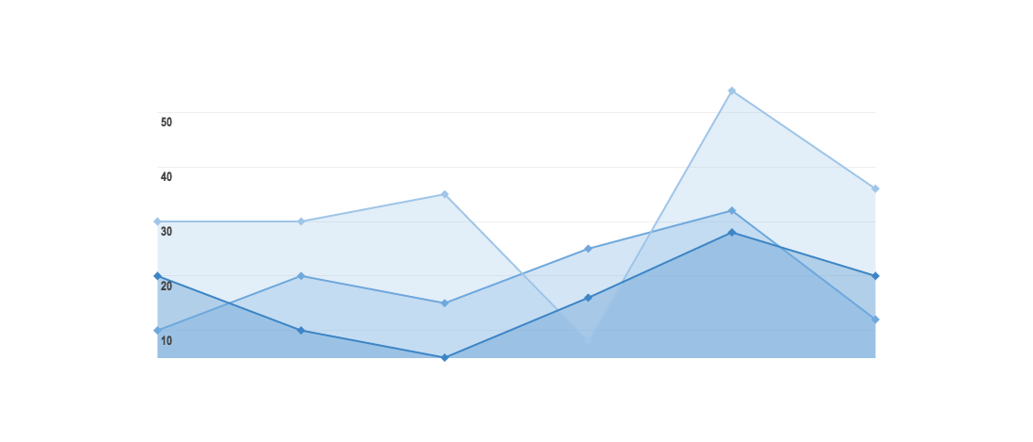
GRAPH TITLE
You can insert graphs from Google Sheets

Slide 46
Place your screenshot here
ANDROID PROJECT
Show and explain your web, app or software projects using these gadget templates.

Slide 47
iPHONE PROJECT
Show and explain your web, app or software projects using these gadget templates.
Place your screenshot here

Slide 48
Place your screenshot here
TABLET PROJECT
Show and explain your web, app or software projects using these gadget templates.

Slide 49
Place your screenshot here
DESKTOP PROJECT
Show and explain your web, app or software projects using these gadget templates.

Slide 50
THANKS!
Any questions?
You can find me at
@username & user@mail.me

Slide 51
CREDITS
Special thanks to all the people who made and released these awesome resources for free:
Presentation template by SlidesCarnival
Photographs by Startup Stock Photos

Slide 52
PRESENTATION DESIGN
This presentation uses the following typographies and colors:
Titles: Roboto Condensed
Body copy: Roboto Condensed
You can download the fonts on this page:
https://material.io/guidelines/resources/roboto-noto-fonts.html
Navy #3f5378 · Dark navy #263248 · Yellow #ff9800
You don’t need to keep this slide in your presentation. It’s only here to serve you as a design guide if you need to create new slides or download the fonts to edit the presentation in PowerPoint®

Slide 53
SlidesCarnival icons are editable shapes.
This means that you can:
Resize them without losing quality.
Change line color, width and style.
Isn’t that nice? :)
Examples:

Slide 54
😉
Now you can use any emoji as an icon!
And of course it resizes without losing quality and you can change the color.
How? Follow Google instructions https://twitter.com/googledocs/status/730087240156643328
✋👆👉👍👤👦👧👨👩👪💃🏃💑❤😂😉😋😒😭👶😸🐟🍒🍔💣📌📖🔨🎃🎈🎨🏈🏰🌏🔌🔑 and many more...

