Slide 1


Java – Logic Day 02
Ver. 0.1

Slide 2
Day 02
1
Java if-else

Slide 3
Java If-else Statement
The Java if statement is used to test the condition. It checks boolean condition: true or false. There are various types of if statement in java.
if statement
if-else statement
if-else-if ladder
nested if statement

Slide 4
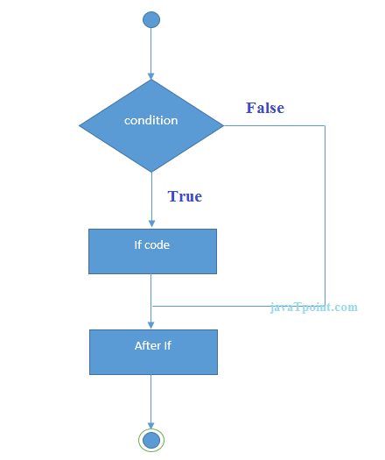

Java if Statement
Example :
The Java if statement tests the condition. It executes the if block if condition is true.
Syntax :

Slide 5
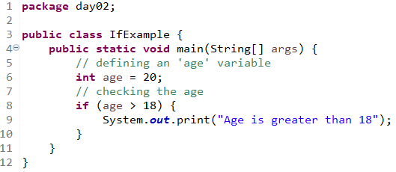
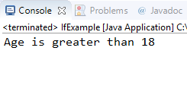
Java if Statement
Example :
Output :

Slide 6
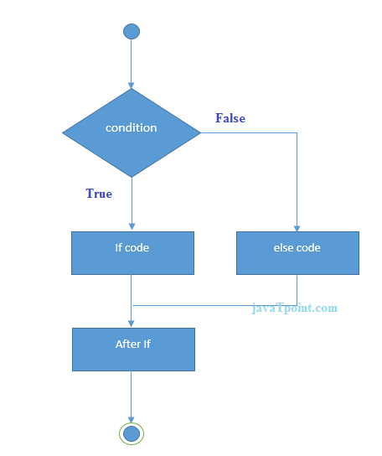
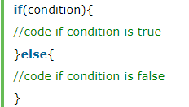
Java if-else Statement
The Java if-else statement also tests the condition. It executes the if block if condition is true otherwise else block is executed.
Syntax :

Slide 7
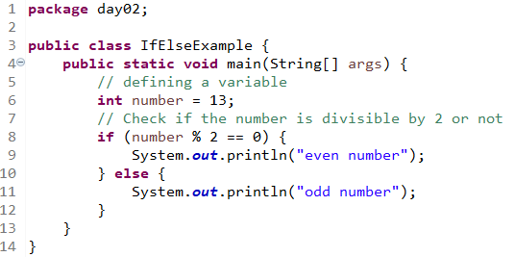
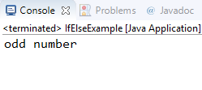
Java if-else Statement
Example :
Output :

Slide 8
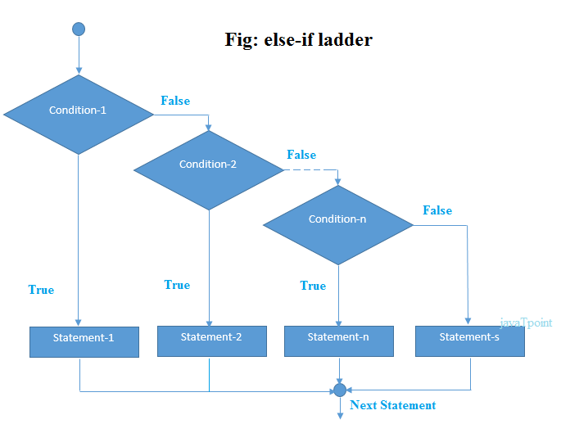
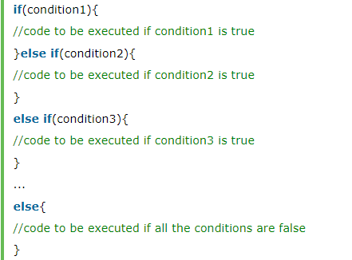
Java if-else-if ladder Statement
The if-else-if ladder statement executes one condition from multiple statements.
Syntax :

Slide 9
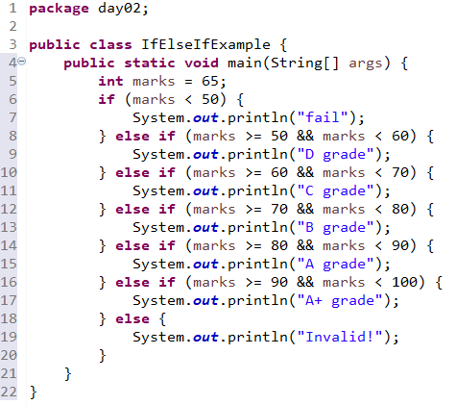

Java if-else-if ladder Statement
Example :
Output :

Slide 10
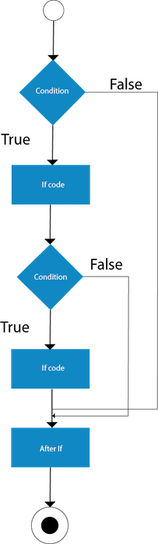
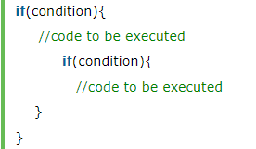
Java Nested if statement
The nested if statement represents the if block within another if block. Here, the inner if block condition executes only when outer if block condition is true.
Syntax :

Slide 11
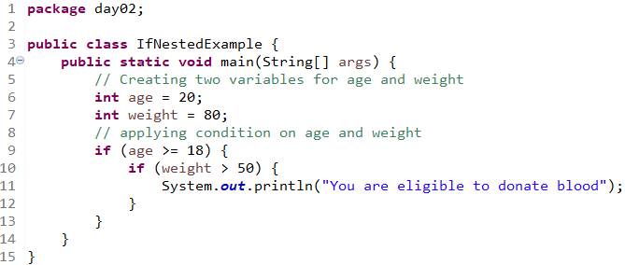

Java Nested if statement
Example 1 :
Output 1:

Slide 12
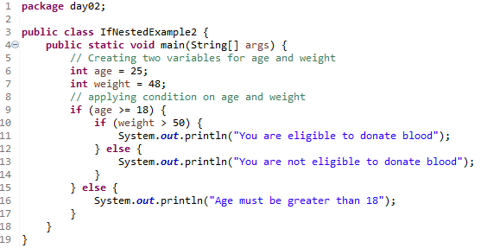

Java Nested if statement
Example 2 :
Output 2 :

Slide 13
Day 02
2
Switch

Slide 14
Java Switch Statement
The Java switch statement executes one statement from multiple conditions. It is like if-else-if ladder statement. The switch statement works with byte, short, int, long, enum types, String and some wrapper types like Byte, Short, Int, and Long. Since Java 7, you can use strings in the switch statement.
In other words, the switch statement tests the equality of a variable against multiple values.

Slide 15
Java Switch Statement
Points to Remember
There can be one or N number of case values for a switch expression.
The case value must be of switch expression type only. The case value must be literal or constant. It doesn't allow variables.
The case values must be unique. In case of duplicate value, it renders compile-time error.
The Java switch expression must be of byte, short, int, long (with its Wrapper type), enums and string.
Each case statement can have a break statement which is optional. When control reaches to the break statement, it jumps the control after the switch expression. If a break statement is not found, it executes the next case.
The case value can have a default label which is optional.

Slide 16
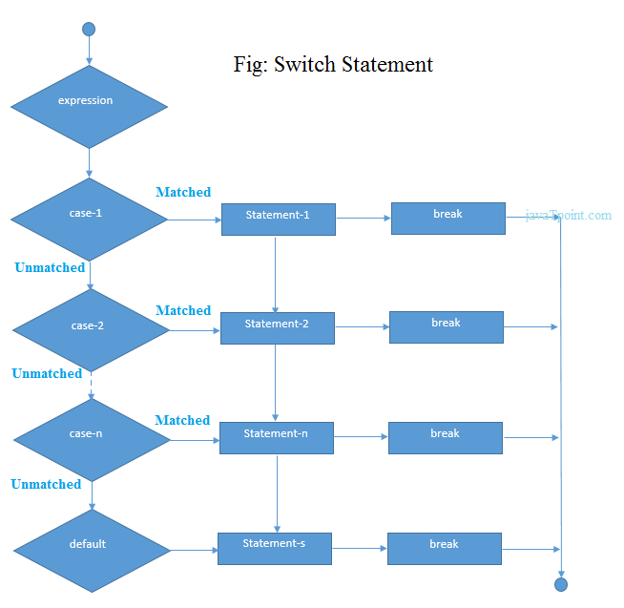
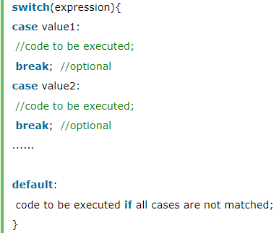
Java Switch Statement
Syntax :

Slide 17
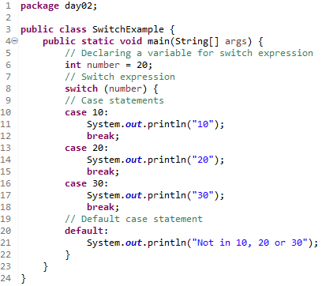

Java Switch Statement
Example 1 :
Output 1 :

Slide 18
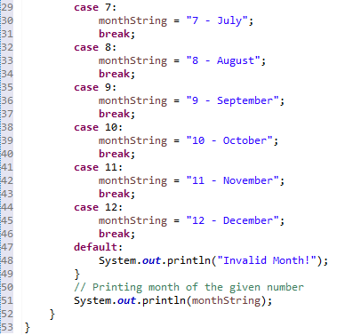
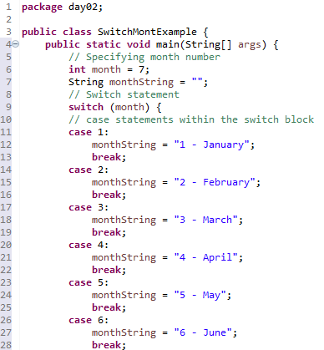

Java Switch Statement
Example 2 :
Output 2 :

Slide 19
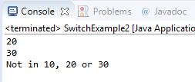
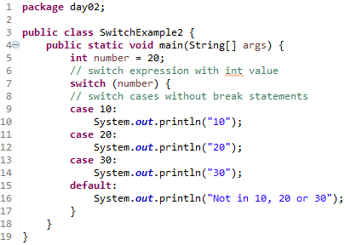
Java Switch Statement is fall-through
The Java switch statement is fall-through. It means it executes all statements after the first match if a break statement is not present.
Example :
Output :

Slide 20

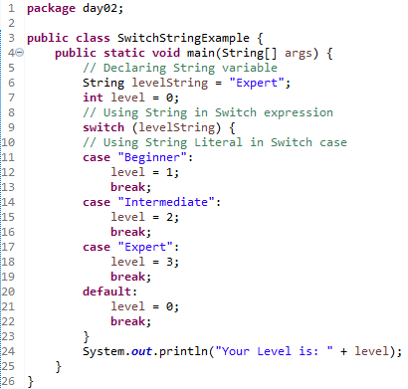
Java Switch Statement with String
Java allows us to use strings in switch expression since Java SE 7. The case statement should be string literal.
Example :
Output :

Slide 21
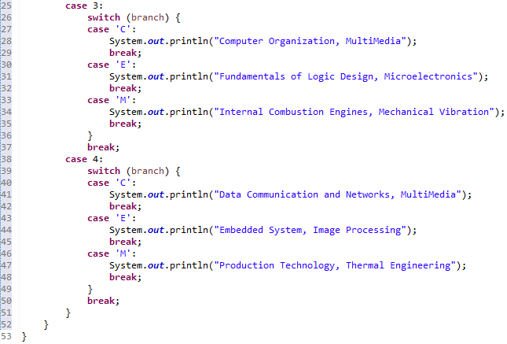
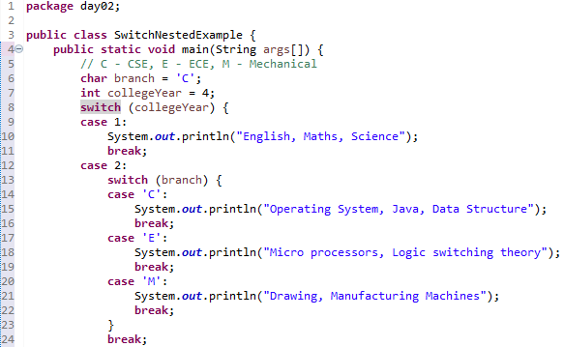
Java Nested Switch Statement
We can use switch statement inside other switch statement in Java. It is known as nested switch statement.
Example :
Output :

Slide 22
Day 02
1
Java Method

Slide 23
A method is basically a behavior. A class can contain many methods. It is in methods where the logics are written, data is manipulated and all the actions are executed.

Slide 24
Java – Kind of Method
Method with return value – using data type
Method non return value – using void

Slide 25
Java – Method Return Type
modifier returnType nameOfMethod (Parameter List) {
// method body
}
modifier − It defines the access type of the method and it is optional to use.
returnType − Method may return a value.
nameOfMethod − This is the method name. The method signature consists of the method name and the parameter list.

Slide 26
Java – Method Return Type
Parameter List − The list of parameters, it is the type, order, and number of parameters of a method. These are optional, method may contain zero parameters.
method body − The method body defines what the method does with the statements

Slide 27
Java – Method Return Type
public static int methodName(int a, int b) {
// body
}
public static − modifier
int − return type
methodName − name of the method
a, b − formal parameters
int a, int b − list of parameter

Slide 28
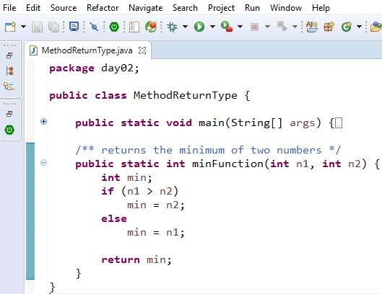
Java – Example Method Return Type

Slide 29
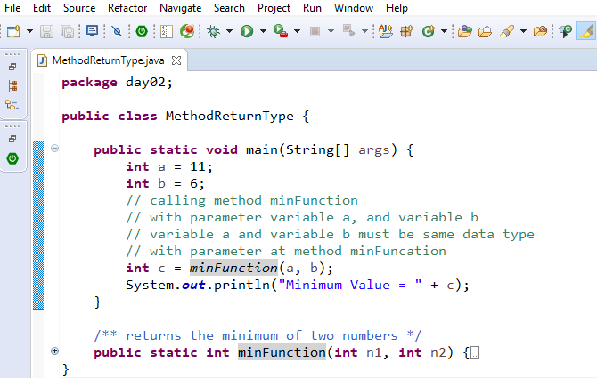
Java – Calling Method Return Type

Slide 30
Java – Method Non Return Type
modifier void nameOfMethod (Parameter List) {
// method body
}
modifier − It defines the access type of the method and it is optional to use.
void − non return type.
nameOfMethod − This is the method name. The method signature consists of the method name and the parameter list.

Slide 31
Java – Method Non Return Type
Parameter List − The list of parameters, it is the type, order, and number of parameters of a method. These are optional, method may contain zero parameters.
method body − The method body defines what the method does with the statements

Slide 32
Java – Method Non Return Type
public static void methodName(int a, int b) {
// body
}
public static − modifier
void − non return type
methodName − name of the method
a, b − formal parameters
int a, int b − list of parameter

Slide 33
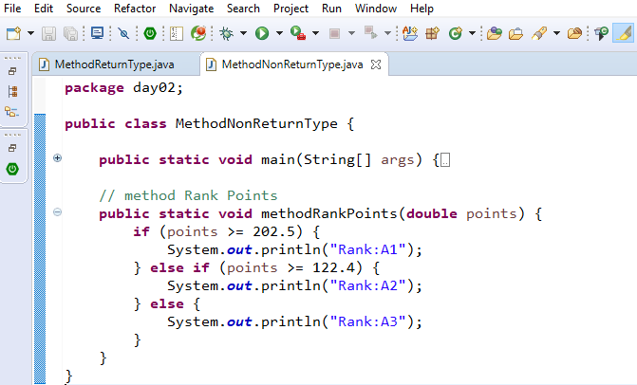
Java – Example Method Non Return Type

Slide 34
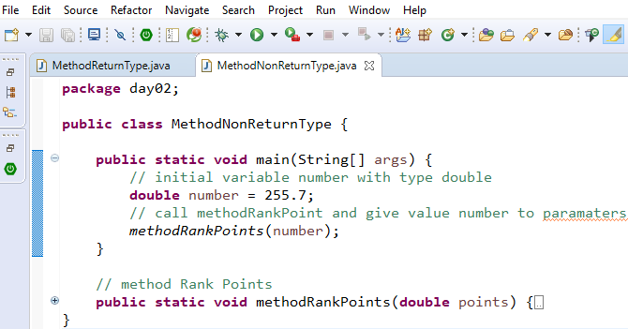
Java – Calling Method Non Return Type

Slide 35
Day 02
3
Nested If – Else

Slide 36
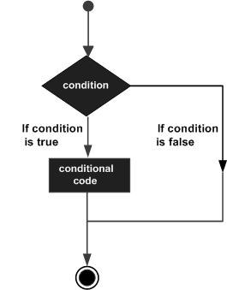
Java – Decision Making
Decision making structures have one or more conditions to be evaluated or tested by the program, along with a statement or statements that are to be executed if the condition is determined to be true, and optionally, other statements to be executed if the condition is determined to be false

Slide 37
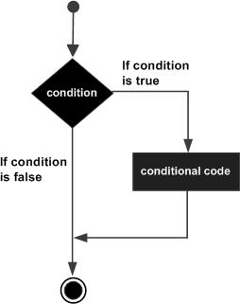
Java – If Statement
if(Boolean_expression) {
// Statements will execute if the
//Boolean expression is true
}
If the Boolean expression evaluates to true then the block of code inside the if statement will be executed. If not, the first set of code after the end of the if statement (after the closing curly brace) will be executed.

Slide 38
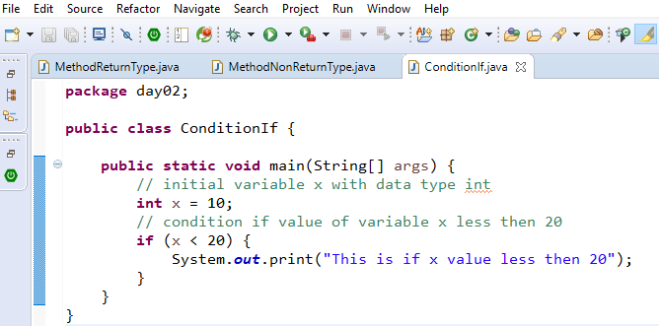
Java – If Statement Example

Slide 39
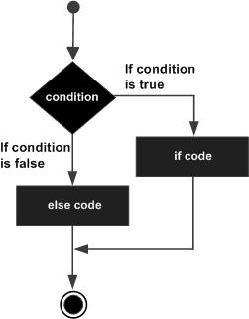
Java – If Else Statement
if(Boolean_expression) {
// Executes when the Boolean expression is true
}else {
// Executes when the Boolean expression is false
}
If the boolean expression evaluates to true, then the if block of code will be executed, otherwise else block of code will be executed..

Slide 40
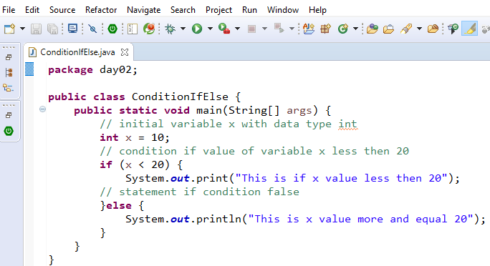
Java – If Else Statement Example

Slide 41
Java – Nested If Statement
if(Boolean_expression 1) {
// Executes when the Boolean expression 1 is true
if(Boolean_expression 2) {
// Executes when the Boolean expression 2 is true
}
}
You can nest else if...else in the similar way as we have nested if statement.

Slide 42
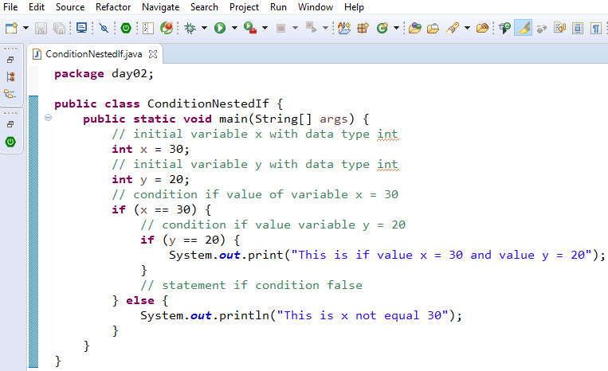
Java – Nested If Statement Example

Slide 43
Day 02
4
Switch – Case

Slide 44
Java – Switch Case Syntax
switch(expression) {
case value :
// Statements
break; // optional
case value :
// Statements
break; // optional
// You can have any number of case statements.
default : // Optional
// Statements
}

Slide 45
Java – Switch Case Rule
The variable used in a switch statement can only be integers, convertable integers (byte, short, char), strings and enums.
You can have any number of case statements within a switch. Each case is followed by the value to be compared to and a colon.
The value for a case must be the same data type as the variable in the switch and it must be a constant or a literal.
When the variable being switched on is equal to a case, the statements following that case will execute until a break statement is reached.
When a break statement is reached, the switch terminates, and the flow of control jumps to the next line following the switch statement.
Not every case needs to contain a break. If no break appears, the flow of control will fall through to subsequent cases until a break is reached.
A switch statement can have an optional default case, which must appear at the end of the switch. The default case can be used for performing a task when none of the cases is true. No break is needed in the default case.

Slide 46
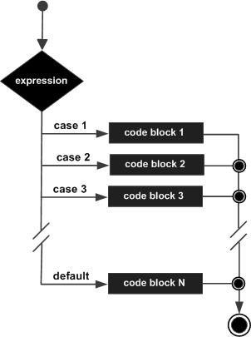
Java – Switch Case Diagram

Slide 47
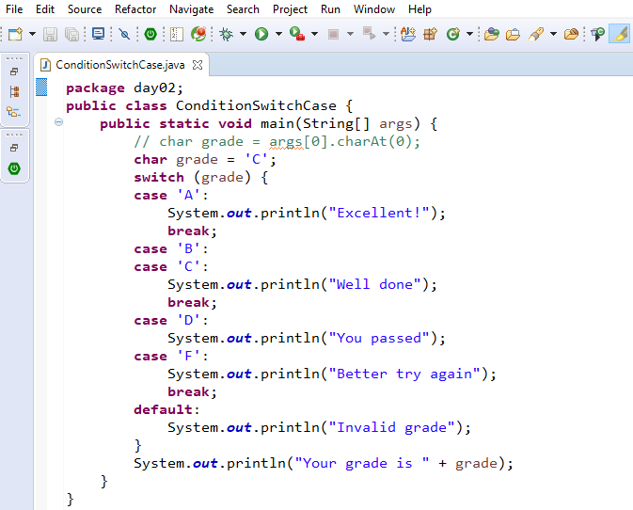
Java – Swith Case Example

Slide 48
Day 02
5
Study Case – Logic 02

Slide 49
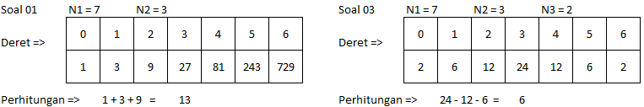
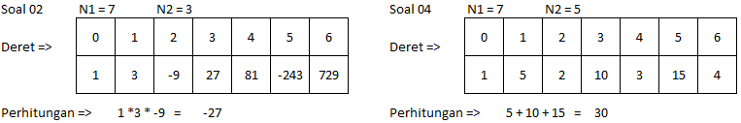
Study Case – Logic 02

Slide 50
Study Case – Logic 02

Slide 51
GOOD LUCK!

Slide 52
THANKS!
Any questions?
Contact Your Trainer

