Slide 1
Job shop scheduling algorithm optimization for generating efficient timetables
Student: Razi Alexis
Scientific supervisor: Lect. dr. Mircea Ioan Gabriel

Slide 2
Problem statement
Even though technology and computers are advancing at the fastest rate yet, it is still hard to solve problems situated in the NP category
The job shop scheduling problem (JSSP) poses the question that if n jobs and m machines are given and each job consists of various job operations, what is the best sequence that could solve all the job operations on the given machines while keeping the total time it takes for the jobs to finish at a minimum?
Flexible JSSP refers to the fact that a machine can only execute a set of job operations, not all of them

Slide 3
Motivation & relevance
The need for more research on NP-hard problems
Developing practical solutions for the flexible job shop scheduling problem (FJSSP) with uses in production environments
Adjusting the proposed approach for solving the FJSSP in order to generate timetables for students

Slide 4
Solving the job shop problem using AI (genetic algorithm ³ and ACO ⁴)
Starts with a random initial population, makes use of the disjunctive graph distance between schedules in order to create offspring and replace the worst members of the current population with the best children
Ant colony optimization (ACO) algorithm that aims to solve the flexible JSSP. ACO-based algorithms are influenced by the way ants, in real life, search for food. The whole colony’s survival is important, not just one individual’s.

Slide 5
Solving the flexible JSSP with a greedy insertion technique¹
At each step, the algorithm makes the choice that yields the best result at that particular step
It has the advantage of being easy to implement and expand
The approach follows an integrated approach: the jobs are started after they are placed in a sequence, not after the whole sequence is generated

Slide 6
Solving the FJSSP using a backtracking based approach²
Uses hyper-heuristics, which are different from meta-heuristics, which operate directly on the solution domain, while hyper-heuristics work with a set of low-level heuristics
The advantage of this approach is its diversity: it makes use of 5 low-level heuristics in order to generate a solution schedule
One of the main constraints of the problem is that the processing times of job operations are fuzzy and represented as (minimum_processing_time, median_processing_time, maximum_processing time)

Slide 7
Proposed idea for solving the FJSSP
Greedy-based technique
Job operations are each mapped to a machine number alongside how much it would take for that specific machine to run the operation
All the maps from each job are merged
The algorithm iterates through all job operations, identifying the best machine for the current one
Various heuristics are applied

Slide 8
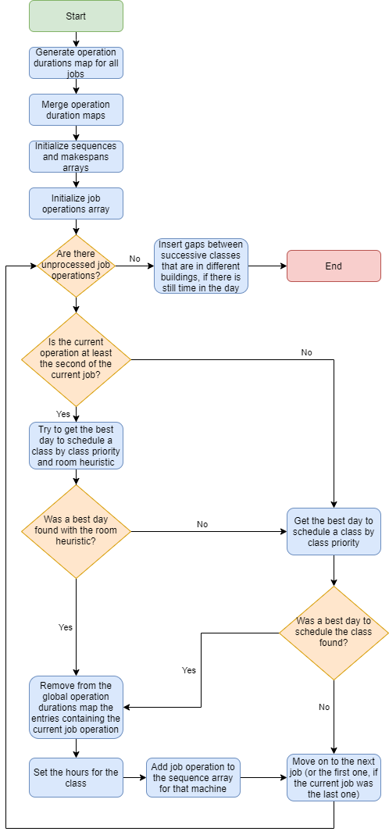
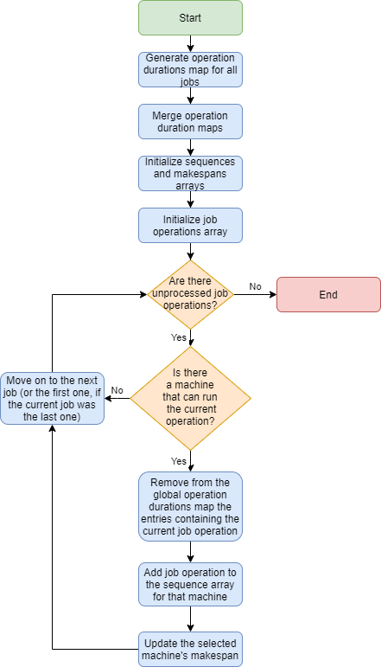
Flowcharts

Slide 9
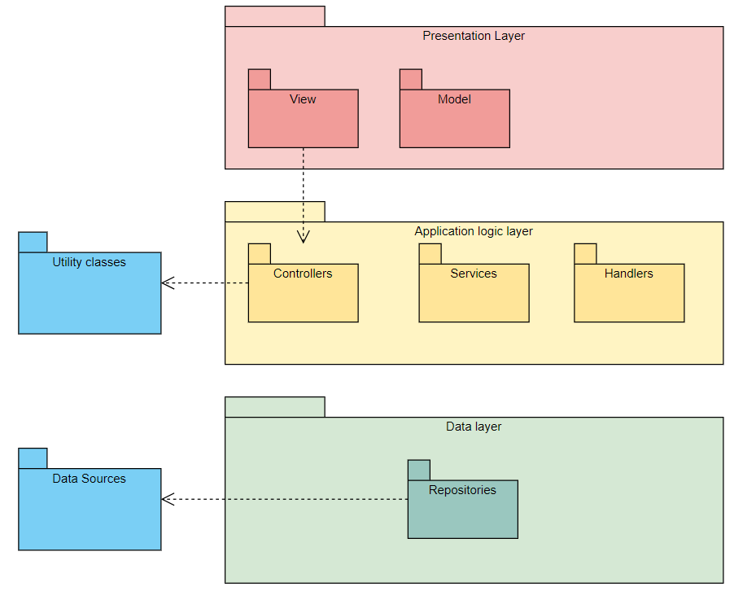
UBB Timetable
Web application written in Java and using Spring for the backend and HTML with Thymeleaf and Bootstrap for the frontend
Lets students and teachers interact easier
Provides a clean and intuitive user interface
Features a timetable generated by certain rules so that the student can easily progress through courses

Slide 10
Performance evaluation
The results shown by the proposed approach have been compared against an ant colony optimization (ACO) based approach with the same data set
The average makespan and elapsed time are calculated after 1000 runs of the proposed algorithm
Algorithm | Best makespan | Average makespan | Worst makespan | Average elapsed time
ACO | 25 | 25.2 | 26 | 5.825
Proposed approach | 35 | 53.193 | 80 | 0.385

Slide 11
Future improvements
Parallelize the algorithm such that at each step it checks the next operation that has to be completed for each job instead of processing one operation at a time
Even out the distribution of the classes so that each day contains at least a class
Support for class frequency: some classes can be held every 2 weeks, which could help generate a more efficient timetable

Slide 12
Questions & Answers

Slide 13
References
[1] - Azzedine Bekkar et al. “An Iterative Greedy Insertion Technique for Flexible Job Shop Scheduling Problem”. In: IFAC-PapersOnLine 49 (Dec. 2016), pp. 1956–1961. doi: 10.1016/j.ifacol.2016.07.917.
[2] - Jian Lin. “Backtracking search based hyper-heuristic for the flexible jobshop scheduling problem with fuzzy processing time”. In: Engineering Applications of Artificial Intelligence 77 (Jan. 2019), pp. 186–196. doi: 10.1016/j.engappai.2018.10.008
[3] - Mahanim Omar, Adam Baharum, and Yahya Hasan. “A JOB-SHOP SCHEDULING PROBLEM (JSSP) USING GENETIC ALGORITHM (GA)”. In: (Jan. 2006).
[4] - Lei Wang et al. “Flexible Job Shop Scheduling Problem Using an Improved Ant Colony Optimization”. In: Scientific Programming 2017 (Jan. 2017), pp. 1–11. doi: 10.1155/2017/9016303.

