Slide 1
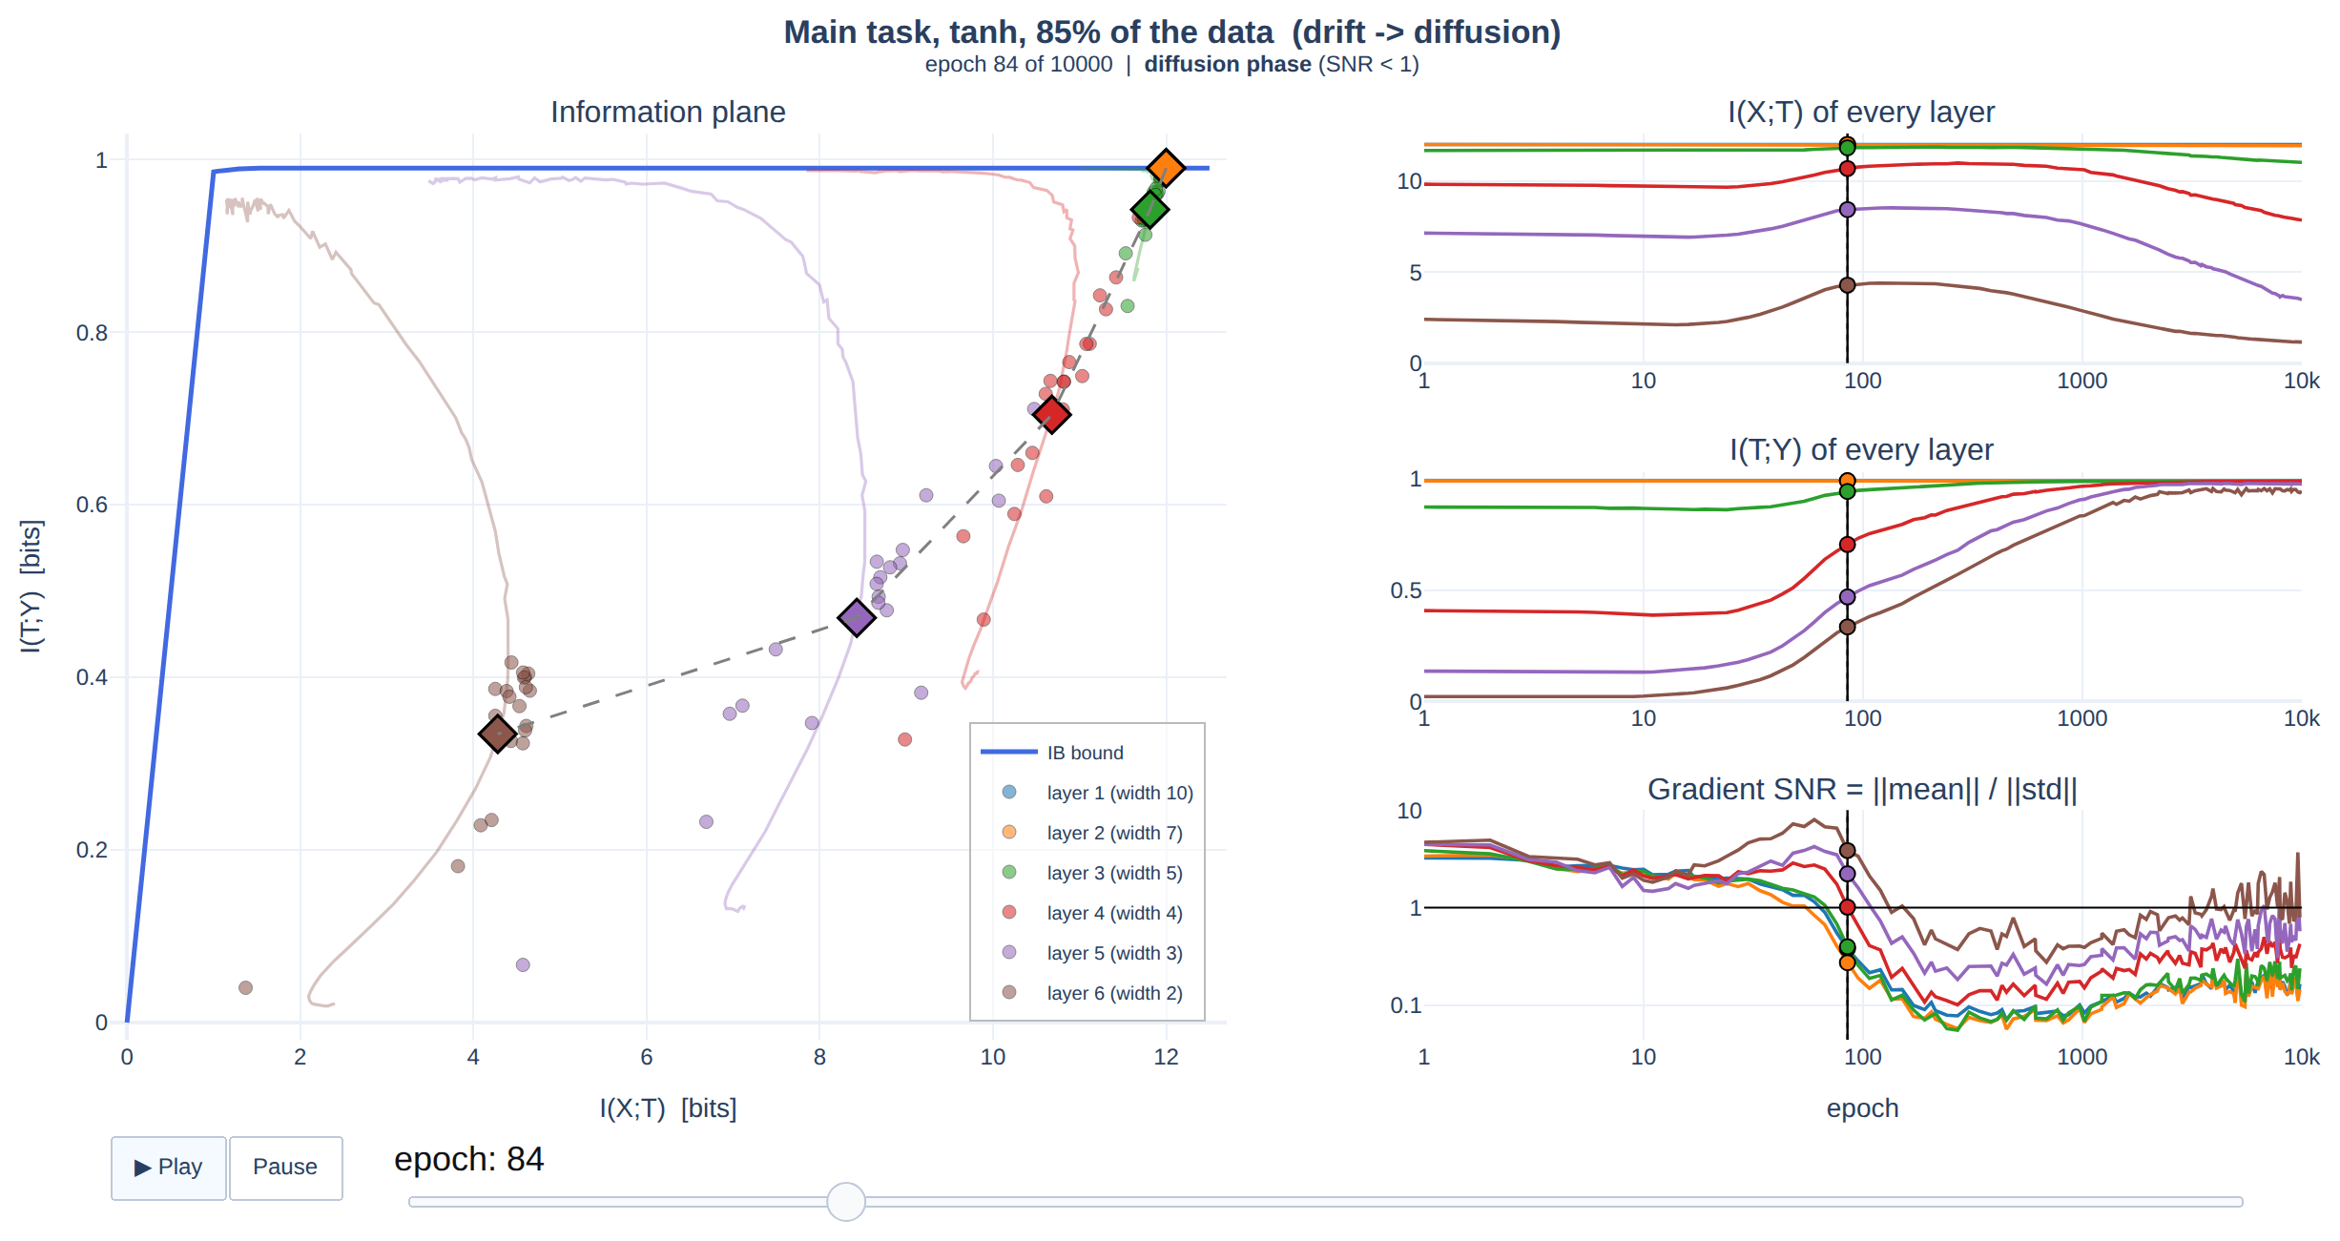
INFORMATION THEORY AND CODING TECHNIQUES · MIDTERM PROJECT
Opening the Black Box of
Deep Neural Networks
via Information
Midterm Project
Information Theory and Coding Techniques, Fall 2026
s
Naveed Ullah (D14949002) ; Apple Rose Buhisan Alce (D14949006)
ITCT · Fall 2026 · National Taiwan University
Notes:
Slide 1: Research evidence
Presenter script
Opening
This project investigates how a trained network transforms input information into predictive representations. We reproduce the original paper’s information-plane experiments rather than treating the plots as a black box.
Our work uses NumPy, manual backpropagation, ensemble training, explicit mutual-information estimation, two additional ablations, and an interactive explorer. We distinguish reproduction of a qualitative trend from proof of the underlying mechanism.
Explain the plotted variables, the fixed experimental settings, and the specific numerical evidence on this slide. State which conclusion follows directly from the notebook output and which interpretation depends on the estimator or model assumptions.
Evidence boundary
Treat notebook measurements and mathematically derived quantities as established for this implementation. Qualify causal mechanisms, continuous-information claims, global optimality, and generalization beyond the tested synthetic tasks.
Transition
The next slide turns to presentation roadmap, so I will carry forward the definitions and limitations established here.

Slide 2
PRESENTATION ROADMAP
From theory to reproducible evidence
01
Research questions & information-theoretic foundations
02
Synthetic data, neural network and NumPy implementation
03
Mutual-information estimation and SGD diagnostics
04
Reproduced figures and quantitative comparisons
05
Ablations, limitations, and conclusions
02
Notes:
Slide 2: PRESENTATION ROADMAP
Presenter script
The presentation begins with the paper's questions, then defines the information quantities before showing any result. It next explains the dataset, network, SGD implementation, and quantizer. The second half presents the measured results, the additional controls, and a claim-level assessment. This order lets each graph inherit a clear definition and experimental protocol.
Evidence boundary
Treat notebook measurements and mathematically derived quantities as established for this implementation. Qualify causal mechanisms, continuous-information claims, global optimality, and generalization beyond the tested synthetic tasks.
Transition
The next slide turns to research evidence, so I will carry forward the definitions and limitations established here.

Slide 3
MOTIVATION
Research question: what changes inside a network?
Accuracy alone describes the final prediction, not the internal representation.
Can we measure how much a hidden layer remembers about X, and how much it retains about Y?
Can SGD dynamics explain changes in these quantities?
Input X
12 binary bits
→
Layer T₁
10 neurons
→
Layer T₄
4 neurons
→
Prediction Ŷ
2 outputs
ITCT • Naveed Ullah | Apple Rose Buhisan Alce • Fall 2026
3
Notes:
Slide 3: Research evidence
Presenter script
Motivation
A deep network contains intermediate transformations. A layer may preserve distinctions among many input patterns that are irrelevant to the output. Information theory supplies two coordinates: input information and label information.
The objective is not to assert that hidden layers literally discard physical bits. The experiment measures an induced discrete representation after binning activations.
Explain the plotted variables, the fixed experimental settings, and the specific numerical evidence on this slide. State which conclusion follows directly from the notebook output and which interpretation depends on the estimator or model assumptions.
Evidence boundary
Treat notebook measurements and mathematically derived quantities as established for this implementation. Qualify causal mechanisms, continuous-information claims, global optimality, and generalization beyond the tested synthetic tasks.
Transition
The next slide turns to research evidence, so I will carry forward the definitions and limitations established here.

Slide 4
RESEARCH QUESTIONS
Four claims tested against the original paper
(i) Fitting precedes compression in SGD.
(ii) Noise-dominated training occupies most epochs.
(iii) Converged layers approach the IB frontier; β* declines with depth.
(iv) Additional hidden layers accelerate training.
ITCT • Naveed Ullah | Apple Rose Buhisan Alce • Fall 2026
4
Notes:
Slide 4: Research evidence
Presenter script
Claims
The original study associates early SGD with a drift phase and late SGD with diffusion. Its strongest interpretation is that training organizes hidden representations near Information Bottleneck solutions.
Our evaluation asks whether each claim survives a concrete reproduction with independently implemented data, training, and estimation, and whether the evidence is sufficient for the strongest interpretation.
Explain the plotted variables, the fixed experimental settings, and the specific numerical evidence on this slide. State which conclusion follows directly from the notebook output and which interpretation depends on the estimator or model assumptions.
Evidence boundary
Treat notebook measurements and mathematically derived quantities as established for this implementation. Qualify causal mechanisms, continuous-information claims, global optimality, and generalization beyond the tested synthetic tasks.
Transition
The next slide turns to research evidence, so I will carry forward the definitions and limitations established here.

Slide 5
THEORY
Variables and the information-processing chain
X: 12-bit input pattern
Y: stochastic binary target label
Tₗ: activation vector of layer ℓ
Ŷ: network prediction
For a fixed deterministic trained network: X → T₁ → … → T₆.
The task obeys Y → X → Tₗ.
Y
label
→
X
input
→
Tₗ
representation
→
Ŷ
prediction
Data processing: I(Tₗ;Y) ≤ I(X;Y); deeper layers cannot gain information about X.
ITCT • Naveed Ullah | Apple Rose Buhisan Alce • Fall 2026
5
Notes:
Slide 5: Research evidence
Presenter script
Markov structure
Because the label and layer activation are conditionally independent given X, Y–X–T forms a Markov chain. The Data Processing Inequality restricts the amount of label information any representation can retain.
For a deterministic forward pass, a deeper layer is a function of its predecessor. Exact mutual information cannot increase with depth; small numerical violations are estimator effects.
Explain the plotted variables, the fixed experimental settings, and the specific numerical evidence on this slide. State which conclusion follows directly from the notebook output and which interpretation depends on the estimator or model assumptions.
Evidence boundary
Treat notebook measurements and mathematically derived quantities as established for this implementation. Qualify causal mechanisms, continuous-information claims, global optimality, and generalization beyond the tested synthetic tasks.
Transition
The next slide turns to research evidence, so I will carry forward the definitions and limitations established here.

Slide 6
THEORY
Entropy and mutual information in bits
Entropy measures uncertainty in a discrete random variable.
Mutual information is the uncertainty reduction from observing another variable.
The information plane plots two different questions: input retention and label relevance.
H(Z)=−Σz p(z) log₂ p(z) I(A;B)=H(B)−H(B|A)
ITCT • Naveed Ullah | Apple Rose Buhisan Alce • Fall 2026
6
Notes:
Slide 6: Research evidence
Presenter script
Information definitions
Entropy is defined from a probability mass function and uses base-two logarithms, so the units are bits. Mutual information is a symmetric quantity measuring statistical dependence, not correlation alone.
In this experiment, H(X)=12 bits because all 4096 binary patterns are equally likely. The target is almost balanced and nearly deterministic given X, so I(X;Y) is 0.990 bits.
Explain the plotted variables, the fixed experimental settings, and the specific numerical evidence on this slide. State which conclusion follows directly from the notebook output and which interpretation depends on the estimator or model assumptions.
Evidence boundary
Treat notebook measurements and mathematically derived quantities as established for this implementation. Qualify causal mechanisms, continuous-information claims, global optimality, and generalization beyond the tested synthetic tasks.
Transition
The next slide turns to research evidence, so I will carry forward the definitions and limitations established here.

Slide 7
THEORY
The Information Bottleneck optimization
Find a representation T that is predictive of Y but discards input details unnecessary for Y.
Compression term: I(X;T) (minimize)
Prediction term: I(T;Y) (maximize)
β controls the relative priority of prediction.
min p(t|x) L_IB = I(X;T) − β I(T;Y)
ITCT • Naveed Ullah | Apple Rose Buhisan Alce • Fall 2026
7
Notes:
Slide 7: Research evidence
Presenter script
IB objective
The Information Bottleneck is a constrained representation problem: retain relevant information while limiting dependence on the raw input. The Lagrangian formulation subtracts β times label information from input information.
Large β rewards retaining label information more strongly. The computed IB curve is a reference frontier for the known joint distribution p(x,y), not an automatically achieved objective of ordinary cross-entropy SGD.
Explain the plotted variables, the fixed experimental settings, and the specific numerical evidence on this slide. State which conclusion follows directly from the notebook output and which interpretation depends on the estimator or model assumptions.
Evidence boundary
Treat notebook measurements and mathematically derived quantities as established for this implementation. Qualify causal mechanisms, continuous-information claims, global optimality, and generalization beyond the tested synthetic tasks.
Transition
The next slide turns to research evidence, so I will carry forward the definitions and limitations established here.

Slide 8
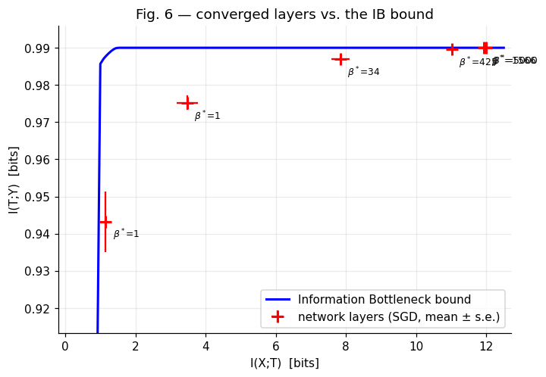
THEORY
How to read the information plane
Horizontal axis: I(X;T), retained input information.
Vertical axis: I(T;Y), retained label information.
Upward motion → greater predictive relevance.
Leftward motion → reduced measured input information.
Upper-left is attractive only when label information remains high.
ITCT • Naveed Ullah | Apple Rose Buhisan Alce • Fall 2026
8
Notes:
Slide 8: Research evidence
Presenter script
Information plane
Every point corresponds to a layer at one training epoch. Moving upward means the representation distinguishes labels better. Moving left means the discretized representation separates fewer input patterns.
The plane is a diagnostic visualization, not a proof that a layer optimizes the IB Lagrangian. In particular, when the frontier is horizontal, a point can be vertically close but unnecessarily far right.
Explain the plotted variables, the fixed experimental settings, and the specific numerical evidence on this slide. State which conclusion follows directly from the notebook output and which interpretation depends on the estimator or model assumptions.
Evidence boundary
Treat notebook measurements and mathematically derived quantities as established for this implementation. Qualify causal mechanisms, continuous-information claims, global optimality, and generalization beyond the tested synthetic tasks.
Transition
The next slide turns to research evidence, so I will carry forward the definitions and limitations established here.

Slide 9
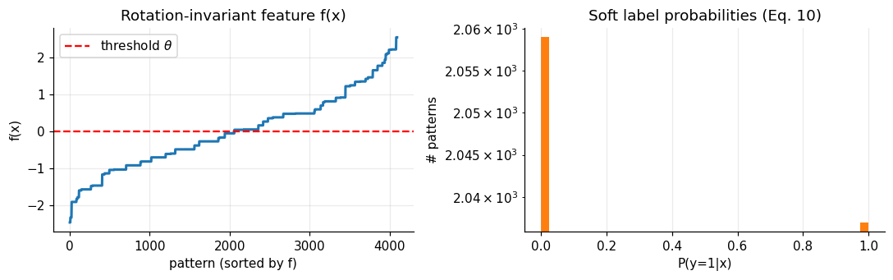
DATA GENERATION
Synthetic task: all 2¹² binary patterns
12 vertices of an icosahedron define the binary input coordinates.
Enumerate all 4,096 possible input patterns.
Construct a rotation-invariant feature f(x) from a spherical-harmonic power spectrum.
64 distinct feature/orbit classes.
ITCT • Naveed Ullah | Apple Rose Buhisan Alce • Fall 2026
9
Notes:
Slide 9: Research evidence
Presenter script
Dataset
The data-generating distribution is fully known, which makes the experiment unusually suitable for information theory. Every possible 12-bit pattern can be evaluated rather than estimating generalization solely on a held-out sample.
The feature is invariant under the 120 rotational symmetries of the icosahedron. The report records a numerical invariance deviation of 7×10⁻¹⁵ and 64 distinct feature values.
Explain the plotted variables, the fixed experimental settings, and the specific numerical evidence on this slide. State which conclusion follows directly from the notebook output and which interpretation depends on the estimator or model assumptions.
Evidence boundary
Treat notebook measurements and mathematically derived quantities as established for this implementation. Qualify causal mechanisms, continuous-information claims, global optimality, and generalization beyond the tested synthetic tasks.
Transition
The next slide turns to research evidence, so I will carry forward the definitions and limitations established here.

Slide 10
DATA GENERATION
Label generation: a nearly deterministic soft rule
Compute f(x), subtract a threshold θ, then apply a logistic link with gain γ=85.3.
Choose θ for P(Y=1)=0.497.
Calibrate the rule so I(X;Y)=0.990 bits.
Training labels are sampled from p(y|x), not simply thresholded.
p(Y=1|x)=σ[γ(f(x)−θ)] σ(u)=1/(1+e⁻ᵘ)
ITCT • Naveed Ullah | Apple Rose Buhisan Alce • Fall 2026
10
Notes:
Slide 10: Research evidence
Presenter script
Label model
The target is stochastic but close to deterministic: most conditional label probabilities lie near zero or one. The stochastic labels distinguish the latent label rule from individual sampled training labels.
Information evaluation uses the known conditional probability p(y|x) over all inputs, which prevents the reported label information from being merely the fit to sampled training labels.
Explain the plotted variables, the fixed experimental settings, and the specific numerical evidence on this slide. State which conclusion follows directly from the notebook output and which interpretation depends on the estimator or model assumptions.
Evidence boundary
Treat notebook measurements and mathematically derived quantities as established for this implementation. Qualify causal mechanisms, continuous-information claims, global optimality, and generalization beyond the tested synthetic tasks.
Transition
The next slide turns to research evidence, so I will carry forward the definitions and limitations established here.

Slide 11
IMPLEMENTATION
Implemented neural network: 12–10–7–5–4–3–2
Fully connected feed-forward network.
Five tanh hidden layers; 2-unit softmax output.
Weights: truncated normal, scale 1/√fan-in; zero biases.
Cross-entropy training; no additional regularizer.
12
input
→
10
tanh
→
7
tanh
→
5
tanh
→
4
tanh
→
3
tanh
→
2
softmax
ITCT • Naveed Ullah | Apple Rose Buhisan Alce • Fall 2026
11
Notes:
Slide 11: Research evidence
Presenter script
Architecture
The widths describe six measured representation layers after the 12-dimensional input. Each layer applies an affine map and a nonlinearity; the final layer produces two class probabilities.
The narrow downstream layers impose a structural bottleneck, but layer width alone is not equivalent to mutual information. A continuous vector with few coordinates may still distinguish many discrete inputs.
Explain the plotted variables, the fixed experimental settings, and the specific numerical evidence on this slide. State which conclusion follows directly from the notebook output and which interpretation depends on the estimator or model assumptions.
Evidence boundary
Treat notebook measurements and mathematically derived quantities as established for this implementation. Qualify causal mechanisms, continuous-information claims, global optimality, and generalization beyond the tested synthetic tasks.
Transition
The next slide turns to research evidence, so I will carry forward the definitions and limitations established here.

Slide 12
IMPLEMENTATION
Forward pass, loss and manual backpropagation
Forward: zₗ=Wₗaₗ₋₁+bₗ; aₗ=tanh(zₗ).
Output: softmax logits into two class probabilities.
Loss: sampled-label cross-entropy.
Backward: chain-rule gradients propagated layer by layer.
SGD updates weights from mini-batch gradients.
Wₗ ← Wₗ − η ∂L/∂Wₗ η=0.05
ITCT • Naveed Ullah | Apple Rose Buhisan Alce • Fall 2026
12
Notes:
Slide 12: Research evidence
Presenter script
Training mathematics
For each mini-batch, the network computes activations and the categorical cross-entropy loss. Gradients are propagated backward through the affine transformations and tanh derivatives, then the SGD step updates weights.
The report uses plain SGD with a tuned learning rate of 0.05 and a batch-size rule min(1024,max(32,n_train/4)). The 85% setting uses a batch size of 870. These hyperparameters were not specified by the original paper and affect the phase transition.
Explain the plotted variables, the fixed experimental settings, and the specific numerical evidence on this slide. State which conclusion follows directly from the notebook output and which interpretation depends on the estimator or model assumptions.
Evidence boundary
Treat notebook measurements and mathematically derived quantities as established for this implementation. Qualify causal mechanisms, continuous-information claims, global optimality, and generalization beyond the tested synthetic tasks.
Transition
The next slide turns to research evidence, so I will carry forward the definitions and limitations established here.

Slide 13
PIPELINE
Reproduction workflow: from data to evidence
Separate training, information estimation, and figure generation.
Every setting uses 20 random networks trained as a batched NumPy tensor.
Snapshots preserve layer activations and gradient statistics.
4096
patterns
→
Sample
train split
→
20 SGD
networks
→
Bin all
activations
→
Compute
MI + SNR
ITCT • Naveed Ullah | Apple Rose Buhisan Alce • Fall 2026
13
Notes:
Slide 13: Research evidence
Presenter script
Pipeline
First, enumerate the full task distribution and sample training subsets. Second, train 20 networks independently in their initialization and sampled data, while processing the ensemble efficiently in NumPy.
Third, evaluate all 4096 inputs at selected epochs, bin every layer’s activations, and compute information quantities using the known label distribution. Fourth, aggregate across the ensemble and compare trajectories, gradient statistics, and the IB frontier.
Explain the plotted variables, the fixed experimental settings, and the specific numerical evidence on this slide. State which conclusion follows directly from the notebook output and which interpretation depends on the estimator or model assumptions.
Evidence boundary
Treat notebook measurements and mathematically derived quantities as established for this implementation. Qualify causal mechanisms, continuous-information claims, global optimality, and generalization beyond the tested synthetic tasks.
Transition
The next slide turns to research evidence, so I will carry forward the definitions and limitations established here.

Slide 14
METHOD
Experimental controls and reproducibility
Training fractions: 3, 5, 10, 20, 30, 45, 60, 85%.
20 networks per condition (original paper: 50).
10,000 epochs; seed 0.
Main information estimator: 30 equal-width bins.
Full-distribution evaluation on all 4096 inputs.
ITCT • Naveed Ullah | Apple Rose Buhisan Alce • Fall 2026
14
Notes:
Slide 14: Research evidence
Presenter script
Experimental controls
Different random initializations and training subsets are used across the ensemble, so plotted points represent network-to-network variability. The ensemble size differs from the paper: 20 instead of 50.
The report explicitly notes that learning rate and batch size were tuned to recover a drift phase. The experiments therefore demonstrate reproducibility under a particular implementation and tuning, not exact parameter matching with the original work.
Explain the plotted variables, the fixed experimental settings, and the specific numerical evidence on this slide. State which conclusion follows directly from the notebook output and which interpretation depends on the estimator or model assumptions.
Evidence boundary
Treat notebook measurements and mathematically derived quantities as established for this implementation. Qualify causal mechanisms, continuous-information claims, global optimality, and generalization beyond the tested synthetic tasks.
Transition
The next slide turns to research evidence, so I will carry forward the definitions and limitations established here.

Slide 15
INFORMATION ESTIMATION
How continuous activations become discrete codes
At an epoch, pass every input through a fixed network.
For each neuron, map its activation to an equal-width bin.
Concatenate neuron bin indices into one discrete layer code t.
Count how many of the 4096 inputs share each code.
Input x
12 bits
→
Activation
aₗ(x)
→
Neuron-wise
binning
→
Joint code
t(x)
→
Counts
p(t)
ITCT • Naveed Ullah | Apple Rose Buhisan Alce • Fall 2026
15
Notes:
Slide 15: Research evidence
Presenter script
Binning procedure
Each complete activation vector is treated as one random variable, not each neuron independently. For example, a four-neuron layer yields a four-component bin-index code.
Because the network is deterministic after training, each input maps to exactly one binned code. Distinct inputs may collide in the same code, reducing the entropy of the induced representation. The bin count is therefore part of the measurement definition.
Explain the plotted variables, the fixed experimental settings, and the specific numerical evidence on this slide. State which conclusion follows directly from the notebook output and which interpretation depends on the estimator or model assumptions.
Evidence boundary
Treat notebook measurements and mathematically derived quantities as established for this implementation. Qualify causal mechanisms, continuous-information claims, global optimality, and generalization beyond the tested synthetic tasks.
Transition
The next slide turns to research evidence, so I will carry forward the definitions and limitations established here.

Slide 16
INFORMATION ESTIMATION
Deriving I(X;T) from the binned representation
For a fixed trained network, the binned T is a deterministic function of X.
Therefore H(T|X)=0.
The input mutual information equals the entropy of the discrete code distribution.
The maximum is H(X)=12 bits.
I(X;T)=H(T)−H(T|X)=H(T)=−Σt p(t) log₂ p(t)
ITCT • Naveed Ullah | Apple Rose Buhisan Alce • Fall 2026
16
Notes:
Slide 16: Research evidence
Presenter script
Input information
The equality I(X;T)=H(T) follows from determinism of the binned mapping. It is not generally valid for a stochastic encoder.
If every input has a unique code, p(t)=1/4096 and H(T)=12 bits. If many inputs collapse into the same code, H(T) decreases. This is precisely why binning can create an apparent compression effect even when the original continuous activations remain distinct.
Explain the plotted variables, the fixed experimental settings, and the specific numerical evidence on this slide. State which conclusion follows directly from the notebook output and which interpretation depends on the estimator or model assumptions.
Evidence boundary
Treat notebook measurements and mathematically derived quantities as established for this implementation. Qualify causal mechanisms, continuous-information claims, global optimality, and generalization beyond the tested synthetic tasks.
Transition
The next slide turns to research evidence, so I will carry forward the definitions and limitations established here.

Slide 17
INFORMATION ESTIMATION
Deriving I(T;Y) using the known label rule
Group all inputs that share a binned code t.
Average their known p(Y=1|x) to obtain p(Y=1|t).
Compute conditional binary-label entropy for each code.
Subtract from H(Y).
p(1|t)=mean{x:t(x)=t} p(1|x) I(T;Y)=H(Y)−Σt p(t)H(Y|t)
ITCT • Naveed Ullah | Apple Rose Buhisan Alce • Fall 2026
17
Notes:
Slide 17: Research evidence
Presenter script
Label information
The conditional label distribution for each code is obtained from the exact task rule, not from the finite set of sampled training labels. Because inputs are equiprobable, a simple mean across the members of a code is appropriate.
This makes I(T;Y) a measure of how informative the representation is about the population label rule. The theoretical ceiling is I(X;Y)=0.990 bits by the Data Processing Inequality.
Explain the plotted variables, the fixed experimental settings, and the specific numerical evidence on this slide. State which conclusion follows directly from the notebook output and which interpretation depends on the estimator or model assumptions.
Evidence boundary
Treat notebook measurements and mathematically derived quantities as established for this implementation. Qualify causal mechanisms, continuous-information claims, global optimality, and generalization beyond the tested synthetic tasks.
Transition
The next slide turns to research evidence, so I will carry forward the definitions and limitations established here.

Slide 18
TRAINING DYNAMICS
SGD drift and diffusion: operational measurement
Collect mini-batch gradients at snapshots.
Compare the norm of the mean gradient with the norm of its fluctuations, layer by layer.
Aggregate layer ratios by geometric mean.
Operational transition: first SNR < 1 after its peak.
SNRₗ = ||mean(gₗ)||₂ / ||std(gₗ)||₂
ITCT • Naveed Ullah | Apple Rose Buhisan Alce • Fall 2026
18
Notes:
Slide 18: Research evidence
Presenter script
Gradient SNR
The numerator represents coherent gradient direction across batches and the denominator represents fluctuations. High SNR is consistent with systematic gradient-driven motion; low SNR means fluctuations dominate this norm ratio.
The report normalizes mean and standard deviation by layer weight norms for plotting; their ratio is unchanged by a common normalization. This SNR-based transition is an operational criterion, not a mathematical proof of diffusion or of causal compression.
Explain the plotted variables, the fixed experimental settings, and the specific numerical evidence on this slide. State which conclusion follows directly from the notebook output and which interpretation depends on the estimator or model assumptions.
Evidence boundary
Treat notebook measurements and mathematically derived quantities as established for this implementation. Qualify causal mechanisms, continuous-information claims, global optimality, and generalization beyond the tested synthetic tasks.
Transition
The next slide turns to research evidence, so I will carry forward the definitions and limitations established here.

Slide 19
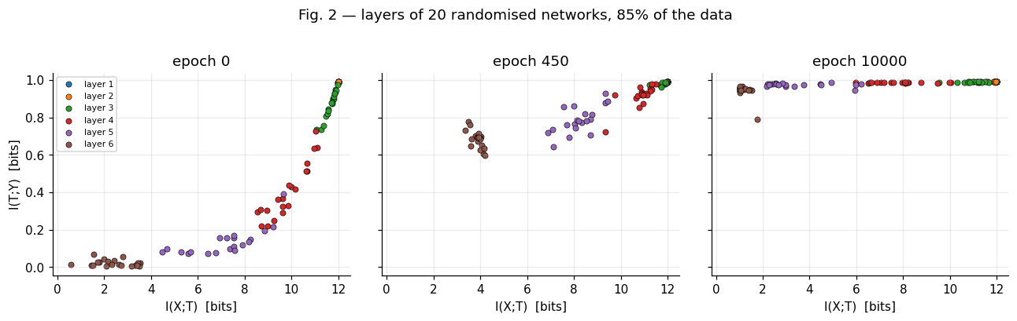
RESULTS
Figure 2: layer positions at three training stages
Epoch 0: deep layers initially retain little label information.
Epoch 450: deeper layers have gained I(T;Y).
Epoch 10,000: most layers approach the top of the plane, while narrow layers move left.
ITCT • Naveed Ullah | Apple Rose Buhisan Alce • Fall 2026
19
Notes:
Slide 19: Research evidence
Presenter script
Figure 2
Each point represents one layer of one of 20 networks. Color identifies the layer. The three panels reveal how training changes the ensemble distribution rather than just a single averaged path.
The key distinction is between upward movement, which indicates increased label information, and leftward movement, which indicates lower binned input information. This supports a qualitative fitting-then-compression description.
Explain the plotted variables, the fixed experimental settings, and the specific numerical evidence on this slide. State which conclusion follows directly from the notebook output and which interpretation depends on the estimator or model assumptions.
Evidence boundary
Treat notebook measurements and mathematically derived quantities as established for this implementation. Qualify causal mechanisms, continuous-information claims, global optimality, and generalization beyond the tested synthetic tasks.
Transition
The next slide turns to research evidence, so I will carry forward the definitions and limitations established here.

Slide 20
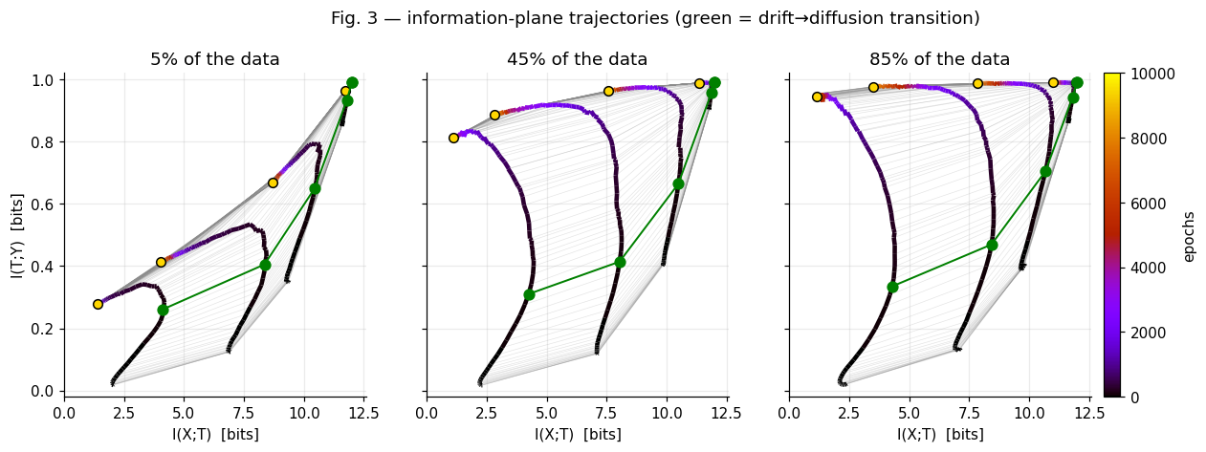
RESULTS
Figure 3: trajectories across training-set sizes
Compare 5%, 45% and 85% of training patterns.
Paths first gain label information, then bend left.
Larger training sets yield higher final output-layer I(T;Y).
The green markers denote the SNR-defined transition.
ITCT • Naveed Ullah | Apple Rose Buhisan Alce • Fall 2026
20
Notes:
Slide 20: Research evidence
Presenter script
Figure 3
These paths show the ensemble-mean layer position across snapshots. The gradient transition is marked at epoch 84 for the main setting.
The training-set dependence is important: the output representation retains more population label information with more training examples, even though the same full 4096-pattern distribution is used for evaluation.
Explain the plotted variables, the fixed experimental settings, and the specific numerical evidence on this slide. State which conclusion follows directly from the notebook output and which interpretation depends on the estimator or model assumptions.
Evidence boundary
Treat notebook measurements and mathematically derived quantities as established for this implementation. Qualify causal mechanisms, continuous-information claims, global optimality, and generalization beyond the tested synthetic tasks.
Transition
The next slide turns to research evidence, so I will carry forward the definitions and limitations established here.

Slide 21
RESULTS
Quantifying layer-wise compression
From epoch 84 to epoch 10,000:
Layer 1: 0.00 bit; Layer 2: −0.06 bit
Layer 3: −0.80 bit; Layer 4: −2.83 bits
Layer 5: −4.95 bits; Layer 6: −3.13 bits
Four of six layers pass the report’s practical threshold.
ITCT • Naveed Ullah | Apple Rose Buhisan Alce • Fall 2026
21
Notes:
Slide 21: Research evidence
Presenter script
Compression table
The wide layers preserve nearly all 12 input bits under 30-bin discretization. Layer 5 loses the most binned input information after the transition, whereas the output layer ends at I(X;T)=1.15 and I(T;Y)=0.943 bits.
The threshold used in the report requires a reduction of at least 0.5 bit and more than two standard errors. These are changes in a specific estimator, not direct measurement of entropy in the original continuous activation vectors.
Explain the plotted variables, the fixed experimental settings, and the specific numerical evidence on this slide. State which conclusion follows directly from the notebook output and which interpretation depends on the estimator or model assumptions.
Evidence boundary
Treat notebook measurements and mathematically derived quantities as established for this implementation. Qualify causal mechanisms, continuous-information claims, global optimality, and generalization beyond the tested synthetic tasks.
Transition
The next slide turns to research evidence, so I will carry forward the definitions and limitations established here.

Slide 22
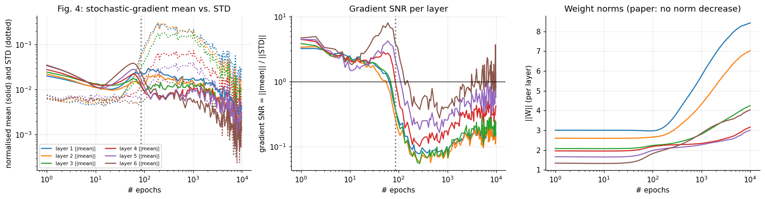
RESULTS
Figure 4: gradient SNR and weight norms
Initial gradient SNR = 3.97.
SNR falls below 1 at epoch 84 (paper ≈350).
About 99% of epochs occur after this transition.
Weight norms increase; compression is not explained by shrinking weights.
ITCT • Naveed Ullah | Apple Rose Buhisan Alce • Fall 2026
22
Notes:
Slide 22: Research evidence
Presenter script
Drift diffusion results
The left plot compares gradient mean and standard deviation, the middle plots SNR, and the right shows weight norms. The dotted vertical line marks the SNR transition.
Cross-entropy to the true rule decreases from 0.710 bits at transition to 0.077 bits at the end, compared with a 0.010-bit noise floor. The different transition epoch relative to the paper is consistent with sensitivity to learning rate and batch size.
Explain the plotted variables, the fixed experimental settings, and the specific numerical evidence on this slide. State which conclusion follows directly from the notebook output and which interpretation depends on the estimator or model assumptions.
Evidence boundary
Treat notebook measurements and mathematically derived quantities as established for this implementation. Qualify causal mechanisms, continuous-information claims, global optimality, and generalization beyond the tested synthetic tasks.
Transition
The next slide turns to research evidence, so I will carry forward the definitions and limitations established here.

Slide 23
RESULTS
The IB frontier: vertical gap versus excess input bits
Mean vertical gap to IB curve: 0.010 bit.
But layers 1–3 retain 9.66–10.55 excess input bits relative to the frontier at equal label information.
Output layer: only 0.20 excess input bit.
Vertical proximity alone is weak evidence of optimal compression.
ITCT • Naveed Ullah | Apple Rose Buhisan Alce • Fall 2026
23
Notes:
Slide 23: Research evidence
Presenter script
IB bound
The IB frontier is calculated from the known p(x,y) by iterating the self-consistent IB equations while sweeping β. The wide layers lie near the flat top of the curve, where a zero vertical gap does not imply minimal I(X;T).
The report therefore considers the deeper layers relatively close to optimal in both coordinates, but does not interpret the wide layers as efficient representations. The fitted β* values decrease with depth, though the first layer hits the search-grid boundary at 5000.
Explain the plotted variables, the fixed experimental settings, and the specific numerical evidence on this slide. State which conclusion follows directly from the notebook output and which interpretation depends on the estimator or model assumptions.
Evidence boundary
Treat notebook measurements and mathematically derived quantities as established for this implementation. Qualify causal mechanisms, continuous-information claims, global optimality, and generalization beyond the tested synthetic tasks.
Transition
The next slide turns to research evidence, so I will carry forward the definitions and limitations established here.

Slide 24
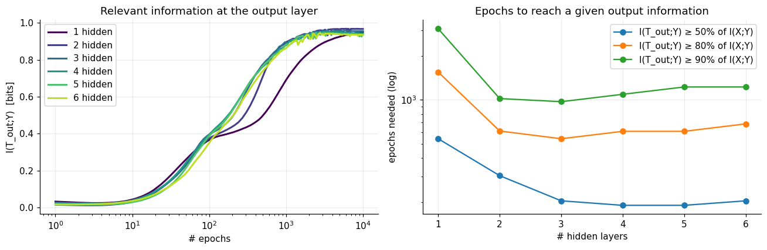
RESULTS
Does increasing depth reduce training time?
At 80% of available label information:
1 hidden layer: 1,548 epochs
2 hidden layers: 612 epochs
3 hidden layers: 542 epochs
4–6 hidden layers: 609, 609, 685 epochs
Speed-up ≈2.9× to three layers, then non-monotone.
ITCT • Naveed Ullah | Apple Rose Buhisan Alce • Fall 2026
24
Notes:
Slide 24: Research evidence
Presenter script
Depth ablation
The experiment changes the number of hidden layers from one to six and measures when output I(T;Y) reaches 50%, 80%, or 90% of the available information.
Depth helps substantially between one and three hidden layers. Beyond that, the threshold epoch does not keep decreasing. Thus the experiment partly supports the original claim but does not reproduce an ever-increasing super-linear speed-up.
Explain the plotted variables, the fixed experimental settings, and the specific numerical evidence on this slide. State which conclusion follows directly from the notebook output and which interpretation depends on the estimator or model assumptions.
Evidence boundary
Treat notebook measurements and mathematically derived quantities as established for this implementation. Qualify causal mechanisms, continuous-information claims, global optimality, and generalization beyond the tested synthetic tasks.
Transition
The next slide turns to research evidence, so I will carry forward the definitions and limitations established here.

Slide 25
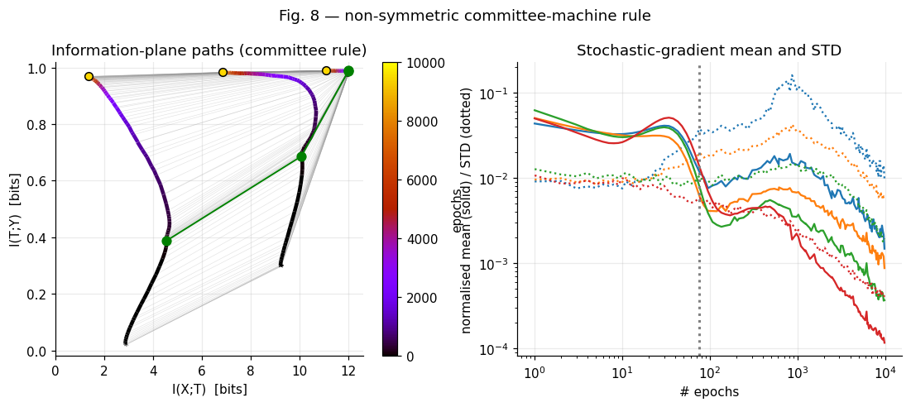
RESULTS
Generality test: non-symmetric committee machine
Teacher: majority vote of K=5 random perceptrons.
Soft stochastic label rule with I(X;Y)=0.990 bits.
Student: 12–8–5–3–2 network, 85% data.
SNR transition at epoch 75; fitting-then-leftward movement persists.
ITCT • Naveed Ullah | Apple Rose Buhisan Alce • Fall 2026
25
Notes:
Slide 25: Research evidence
Presenter script
Committee task
The committee-machine experiment removes the rotation-invariant structure of the original task and uses a different student architecture.
Its SNR threshold at epoch 75 and information-plane trajectories resemble the main task, supporting qualitative generality across these two synthetic tasks. This is not a claim about arbitrary architectures or real-world datasets.
Explain the plotted variables, the fixed experimental settings, and the specific numerical evidence on this slide. State which conclusion follows directly from the notebook output and which interpretation depends on the estimator or model assumptions.
Evidence boundary
Treat notebook measurements and mathematically derived quantities as established for this implementation. Qualify causal mechanisms, continuous-information claims, global optimality, and generalization beyond the tested synthetic tasks.
Transition
The next slide turns to research evidence, so I will carry forward the definitions and limitations established here.

Slide 26
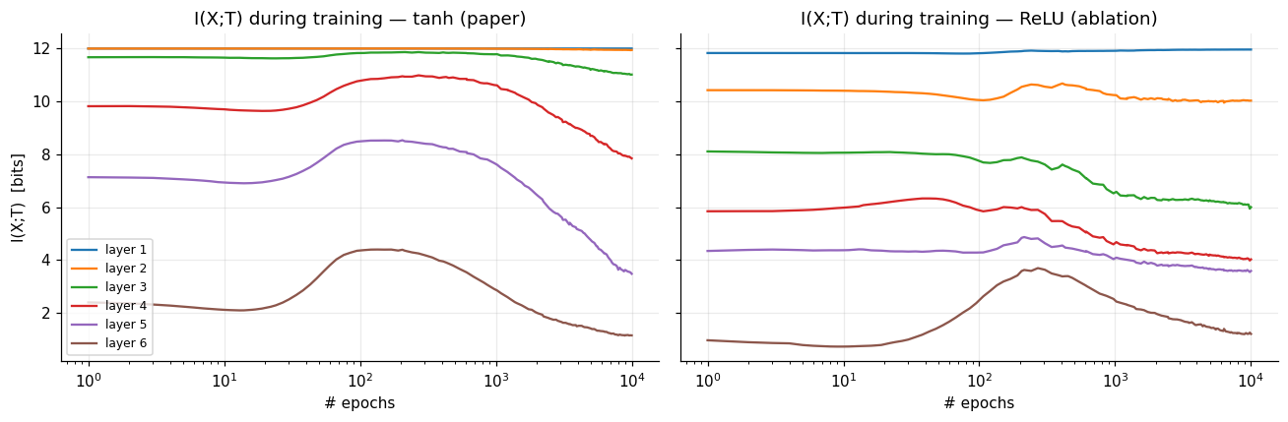
ABLATION
Extension 1: ReLU versus tanh
Measured peak-to-final drops occur under both activation functions.
Tanh: 4/6 layers meet the compression criterion.
ReLU: 5/6 layers meet the criterion.
But ReLU bins are rescaled to [0,max] at each snapshot.
ITCT • Naveed Ullah | Apple Rose Buhisan Alce • Fall 2026
26
Notes:
Slide 26: Research evidence
Presenter script
Activation ablation
The experiment tests whether the observed reduction in binned information is specific to saturating tanh units. ReLU also shows reductions under the implemented estimator.
However, ReLU activations are unbounded and the bin range is recomputed from each snapshot’s maximum. Growing outliers can coarsen effective resolution for most observations and reduce measured entropy without true representational compression. No fixed-range control was run; the mechanistic conclusion is inconclusive.
Explain the plotted variables, the fixed experimental settings, and the specific numerical evidence on this slide. State which conclusion follows directly from the notebook output and which interpretation depends on the estimator or model assumptions.
Evidence boundary
Treat notebook measurements and mathematically derived quantities as established for this implementation. Qualify causal mechanisms, continuous-information claims, global optimality, and generalization beyond the tested synthetic tasks.
Transition
The next slide turns to research evidence, so I will carry forward the definitions and limitations established here.

Slide 27
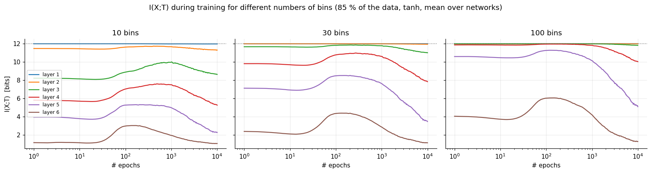
ABLATION
Extension 2: bin-count sensitivity
Evaluate the same type of representation with 10, 30, and 100 bins.
Layers 4–6 lose 1.9–6.4 bits across settings.
Layer 3 drop changes from 1.60 to 0.17 bit.
At 100 bins, layers 1 and 2 reach the 12-bit ceiling.
ITCT • Naveed Ullah | Apple Rose Buhisan Alce • Fall 2026
27
Notes:
Slide 27: Research evidence
Presenter script
Bin sensitivity
The 30-bin curve reproduces the main run exactly. Finer bins separate more activation vectors, raising H(T) until the finite input entropy ceiling is reached.
The deepest layers show a consistent direction of change across bin counts, but absolute information values are not comparable without accounting for the estimator. The count of compressing layers changes from five to four to three as bins increase.
Explain the plotted variables, the fixed experimental settings, and the specific numerical evidence on this slide. State which conclusion follows directly from the notebook output and which interpretation depends on the estimator or model assumptions.
Evidence boundary
Treat notebook measurements and mathematically derived quantities as established for this implementation. Qualify causal mechanisms, continuous-information claims, global optimality, and generalization beyond the tested synthetic tasks.
Transition
The next slide turns to research evidence, so I will carry forward the definitions and limitations established here.

Slide 28
DEMONSTRATION
Interactive explorer: evidence through time
Experiment selector: 17 runs.
Epoch slider + Play/Pause controls.
Information-plane points: 20 networks, layer means, IB curve.
Time series: I(X;T), I(T;Y), and SNR or cross-entropy.
Standalone HTML exports run offline.
ITCT • Naveed Ullah | Apple Rose Buhisan Alce • Fall 2026
28
Notes:
Slide 28: Research evidence
Presenter script
Explorer
The explorer uses cached results, so moving the slider does not retrain the network. It allows direct comparison of the early drift state and the final low-SNR state, as well as the eight training fractions and additional experiments.
In a live presentation, move from an early epoch to epoch 84 and then to 10000, pointing out the change in vertical versus horizontal motion. If the live notebook is unavailable, use the exported static screenshots and describe the controls.
Explain the plotted variables, the fixed experimental settings, and the specific numerical evidence on this slide. State which conclusion follows directly from the notebook output and which interpretation depends on the estimator or model assumptions.
Evidence boundary
Treat notebook measurements and mathematically derived quantities as established for this implementation. Qualify causal mechanisms, continuous-information claims, global optimality, and generalization beyond the tested synthetic tasks.
Transition
The next slide turns to more examples improve retained label information, so I will carry forward the definitions and limitations established here.

Slide 29
RESULTS · TRAINING DATA
More examples improve retained label information
Final output-layer I(T;Y) evaluated on the full 4,096-pattern distribution
3% training
0.234 bits
5% training
0.277 bits
10% training
0.401 bits
20% training
0.581 bits
30% training
0.685 bits
45% training
0.811 bits
60% training
0.876 bits
85% training
0.943 bits
Interpretation: the final output representation approaches I(X;Y) = 0.990 bits as coverage increases.
This is full-distribution information, not merely training accuracy.
Notes:
Slide 29: More examples improve retained label information
Presenter script
The final output-layer I(T;Y) rises from about 0.234 bit at 3 percent training coverage to 0.943 bit at 85 percent. Every value is evaluated on all 4096 patterns, so the chart measures population-level retained label information rather than training accuracy. The monotone direction is strong, while the exact values remain specific to the task, architecture, seed, and estimator.
Evidence boundary
Treat notebook measurements and mathematically derived quantities as established for this implementation. Qualify causal mechanisms, continuous-information claims, global optimality, and generalization beyond the tested synthetic tasks.
Transition
The next slide turns to research evidence, so I will carry forward the definitions and limitations established here.

Slide 30
SYNTHESIS
Evidence scorecard: reproduced versus limited
(i) Two SGD phases: qualitative agreement.
(ii) Late phase dominates: yes by SNR criterion; compression strongest in layers 3–6.
(iii) IB bound: deep layers closer; wide layers inefficient despite tiny vertical gaps.
(iv) Depth benefit: partial, no super-linear gain.
ITCT • Naveed Ullah | Apple Rose Buhisan Alce • Fall 2026
30
Notes:
Slide 30: Research evidence
Presenter script
Scorecard
The strongest replicated pattern is the evolution from label fitting toward reduced binned input information in narrow layers. The SNR transition is operational and differs quantitatively from the paper.
The IB claim needs a two-coordinate test, and the depth claim is only partly reproduced. The presentation should avoid treating a plotted trajectory as evidence of a universal optimization principle.
Explain the plotted variables, the fixed experimental settings, and the specific numerical evidence on this slide. State which conclusion follows directly from the notebook output and which interpretation depends on the estimator or model assumptions.
Evidence boundary
Treat notebook measurements and mathematically derived quantities as established for this implementation. Qualify causal mechanisms, continuous-information claims, global optimality, and generalization beyond the tested synthetic tasks.
Transition
The next slide turns to research evidence, so I will carry forward the definitions and limitations established here.

Slide 31
LIMITATIONS
What the experiment cannot establish
Binned MI is sensitive to quantization and activation range.
A low gradient SNR does not prove Brownian diffusion.
20 networks versus 50 in the original paper.
SGD hyperparameters were tuned; exact replication is not established.
Residual output gap likely reflects generalization limits.
ITCT • Naveed Ullah | Apple Rose Buhisan Alce • Fall 2026
31
Notes:
Slide 31: Research evidence
Presenter script
Limitations
Because the input is discrete and the network deterministic, exact unbinned I(X;T) can remain at 12 bits if all 4096 activation vectors are distinct. A lower binned estimate can reflect quantization collisions instead.
The output ends at 0.943 bits of the 0.990 available and cross-entropy 0.077 bits versus a 0.010 noise floor. The report suggests this remaining gap is most likely due to generalization, but this is an interpretation rather than a demonstrated causal diagnosis.
Explain the plotted variables, the fixed experimental settings, and the specific numerical evidence on this slide. State which conclusion follows directly from the notebook output and which interpretation depends on the estimator or model assumptions.
Evidence boundary
Treat notebook measurements and mathematically derived quantities as established for this implementation. Qualify causal mechanisms, continuous-information claims, global optimality, and generalization beyond the tested synthetic tasks.
Transition
The next slide turns to research evidence, so I will carry forward the definitions and limitations established here.

Slide 32
FUTURE WORK
Recommended controls for a stronger follow-up
1. Fixed-range ReLU binning and multiple quantizers.
2. Track exact activation collisions on all 4096 inputs.
3. Repeat across SGD learning rates, batch sizes, and seeds.
4. Compare IB vertical gaps and horizontal excess jointly.
5. Evaluate additional tasks and architectures.
ITCT • Naveed Ullah | Apple Rose Buhisan Alce • Fall 2026
32
Notes:
Slide 32: Research evidence
Presenter script
Future controls
A fixed-range ReLU control would isolate changes in activation distribution from changes in quantizer scale. Exact collisions would distinguish genuine many-to-one deterministic mappings from finite-bin merging.
Repeating hyperparameter grids would test the stability of the transition epoch and the two-phase interpretation. A broader set of tasks would assess generality. These are proposed experiments, not completed results.
Explain the plotted variables, the fixed experimental settings, and the specific numerical evidence on this slide. State which conclusion follows directly from the notebook output and which interpretation depends on the estimator or model assumptions.
Evidence boundary
Treat notebook measurements and mathematically derived quantities as established for this implementation. Qualify causal mechanisms, continuous-information claims, global optimality, and generalization beyond the tested synthetic tasks.
Transition
The next slide turns to research evidence, so I will carry forward the definitions and limitations established here.

Slide 33
TAKEAWAYS
Conclusion: what was actually reproduced?
We reconstructed the task, SGD training, information estimator, IB comparison, and original figures in NumPy.
The fitting-to-binned-compression pattern is clear in deeper layers.
IB proximity and depth acceleration are more qualified than a simple success/failure label.
Measurement choices are central to the scientific interpretation.
ITCT • Naveed Ullah | Apple Rose Buhisan Alce • Fall 2026
33
Notes:
Slide 33: Research evidence
Presenter script
Closing
The main contribution is a transparent reproduction pipeline and a critical evaluation of the claims, rather than a claim that information theory fully explains deep learning.
Our extensions expose a crucial methodological point: measured information depends on how continuous representations are discretized. The findings support a useful descriptive information-plane view while leaving causal mechanisms and universality open.
Explain the plotted variables, the fixed experimental settings, and the specific numerical evidence on this slide. State which conclusion follows directly from the notebook output and which interpretation depends on the estimator or model assumptions.
Evidence boundary
Treat notebook measurements and mathematically derived quantities as established for this implementation. Qualify causal mechanisms, continuous-information claims, global optimality, and generalization beyond the tested synthetic tasks.
Transition
The next slide turns to research evidence, so I will carry forward the definitions and limitations established here.

Slide 34
References
Schwartz-Ziv & Tishby (2017), Opening the Black Box of Deep Neural Networks via Information.
Information Bottleneck foundations: Tishby and collaborators.
Saxe et al.: critical analysis of compression and nonlinearities.
Source of reported numbers: supplied ITCT midterm report and notebook.
ITCT • Naveed Ullah | Apple Rose Buhisan Alce • Fall 2026
34
Notes:
Slide 34: Research evidence
Presenter script
Questions
Be prepared to explain why I(X;T)=H(T) for deterministic binned mappings, why H(X)=12 bits, and why the label information ceiling is 0.990 bits.
Also be prepared to distinguish the theoretical IB curve from the ordinary cross-entropy training objective, and explain why bin-count sensitivity limits claims about actual compression.
Explain the plotted variables, the fixed experimental settings, and the specific numerical evidence on this slide. State which conclusion follows directly from the notebook output and which interpretation depends on the estimator or model assumptions.
Evidence boundary
Treat notebook measurements and mathematically derived quantities as established for this implementation. Qualify causal mechanisms, continuous-information claims, global optimality, and generalization beyond the tested synthetic tasks.
Transition
I will stop here and invite questions about the estimator, implementation, or evidence boundaries.

