Slide 1
CODES OF ETHICS & CONDUCT IN PSYCHOLOGY
THE British Psychological Society (August, 2009)

Slide 2
Purpose
Highest standards of professionalism
To promote ethical behaviour, attitudes and judgments
Being mindful of the need for protection of the public
Developing and implementing methods to help
psychologists monitor their professional behaviour and attitudes
Assisting psychologists with ethical decision making
Providing opportunities for discourse on these issues

Slide 3
BENEFITS
Evaluate the rights, responsibilities and welfare of all clients and stakeholders.
Establish a cost/risk benefit analysis
Generating Alternatives
Make the decision after checking that the reasoning behind it is logical, lucid and consistent. Document the process of decision Making.
Assume responsibility
Apologise for any negative outcomes that result. Many formal complaints are often a client’s only way of obtaining an acknowledgement of distress. Saying ‘sorry’ does not
automatically admit liability.
Make every effort to correct any negative outcomes and remain engaged in the process
Learn from the process for yourself, for others and for the Society
Ethical decisions needs to be clear, especially where time is short and/or where
high levels of emotion and risk are involved

Slide 4
The areas of concern include:
Multiple relationships –
Personal relationships – where the psychologist
violates the trust of a client or clients
Unclear or inadequate standards of practice – where the psychologist is unaware of or disregards the current systems
Breaches of confidentiality – where rules and constraints were broken
Competence – where excessive or misleading claims are made
Informed Consent
Health problems affecting performance or conduct
Bringing the profession or the Society into disrepute
AREAS of CONCERN

Slide 5

Respect
General Respect
Privacy and Confidentiality
Informed Consent
Self Determination

Slide 6
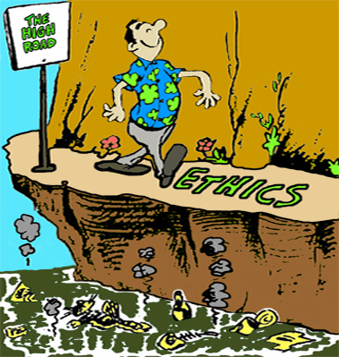
COMPETENCE
Awareness of Professional Ethics
Ethical Decision Making
Recognizing Limits of Competence
Recognizing Impairment

Slide 7

Responsibility
General
Termination & Continuity of care
Protection of Research Participants
Debriefing of Research Participants

Slide 8

Integrity
Honesty and Accuracy
Avoiding Exploitation and Conflicts of Interest
Maintaining Personal Boundaries
Addressing Ethical Misconduct

Slide 9

American Psychological Association
FIVE PRINCIPLES

Slide 10

Beneficence and Nonmaleficence

Slide 11

Fidelity and Responsibility

Slide 12

Integrity

Slide 13

Justice

Slide 14

Respect for people’s Rights and Dignity

