Slide 1

Hacking

Slide 2

Contents
◆ History of Hacking
◆ What is Hacking?
◆ Who is Hacker?
◆ Famous hackers in history
◆ Why do Hackers hack?
◆ Types of Hacking
◆ How to give a password to account
◆ What should do after hacked
◆ How to secure our data
◆ Advantages of Hacking
◆ Disadvantages of Hacking
◆ Conclusion
◆ References

Slide 3

History of Hacking
Hacking has been a part of computing
The first computer hacker emerged at
Hacking is began in the 1960s at MIT ,
for 40 MIT.
origin
years.
of the term
“hacker”.
The truth
hacker
amongst
our societies
have
thirst
for the
knowledge .
Boredom
is never
an object
of challenge
for the hacker

Slide 4
What is Hacking ?
The Process of attempting to gain or successfully gaining, unauthorized access to computer resources
is called Hacking.

Slide 5
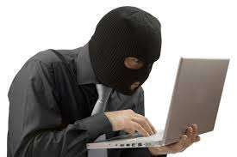

Slide 6
Who is a hacker?
◆ In the seeks and
computer security context, a hacker is someone who
exploits weaknesses in a computer system or network.
hacker is reclaimed by computer programmers who
computer
◆ The term
argue
that someone breaking into computers is better called
a cracker.

Slide 7




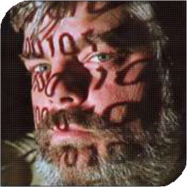
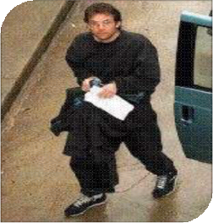





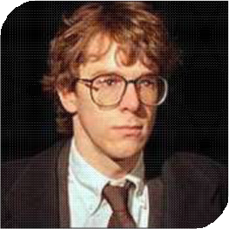
Famous Hackers in History
Kevin Mitnick
Johan Helsinguis
LinusTorvalds
Ian Murphy
Mark Abene
Robert Morris

Slide 8

Why do hackers hack ?
Just for fun.
Show off.
Hack other systems secretly.
Notify many people their thought.
Steal important information.
Destroy enemy’s computer network during the war.

Slide 9

Types of Hacking
◆ Website Hacking
◆ Network Hacking
◆ Ethical Hacking
◆ Email Hacking
◆ Password Hacking
◆ Online Banking Hacking
◆ Computer Hacking

Slide 10


Slide 11

Website Hacking
Hacking a website means taking control from the website owner to a person who hacks the website.

Slide 12
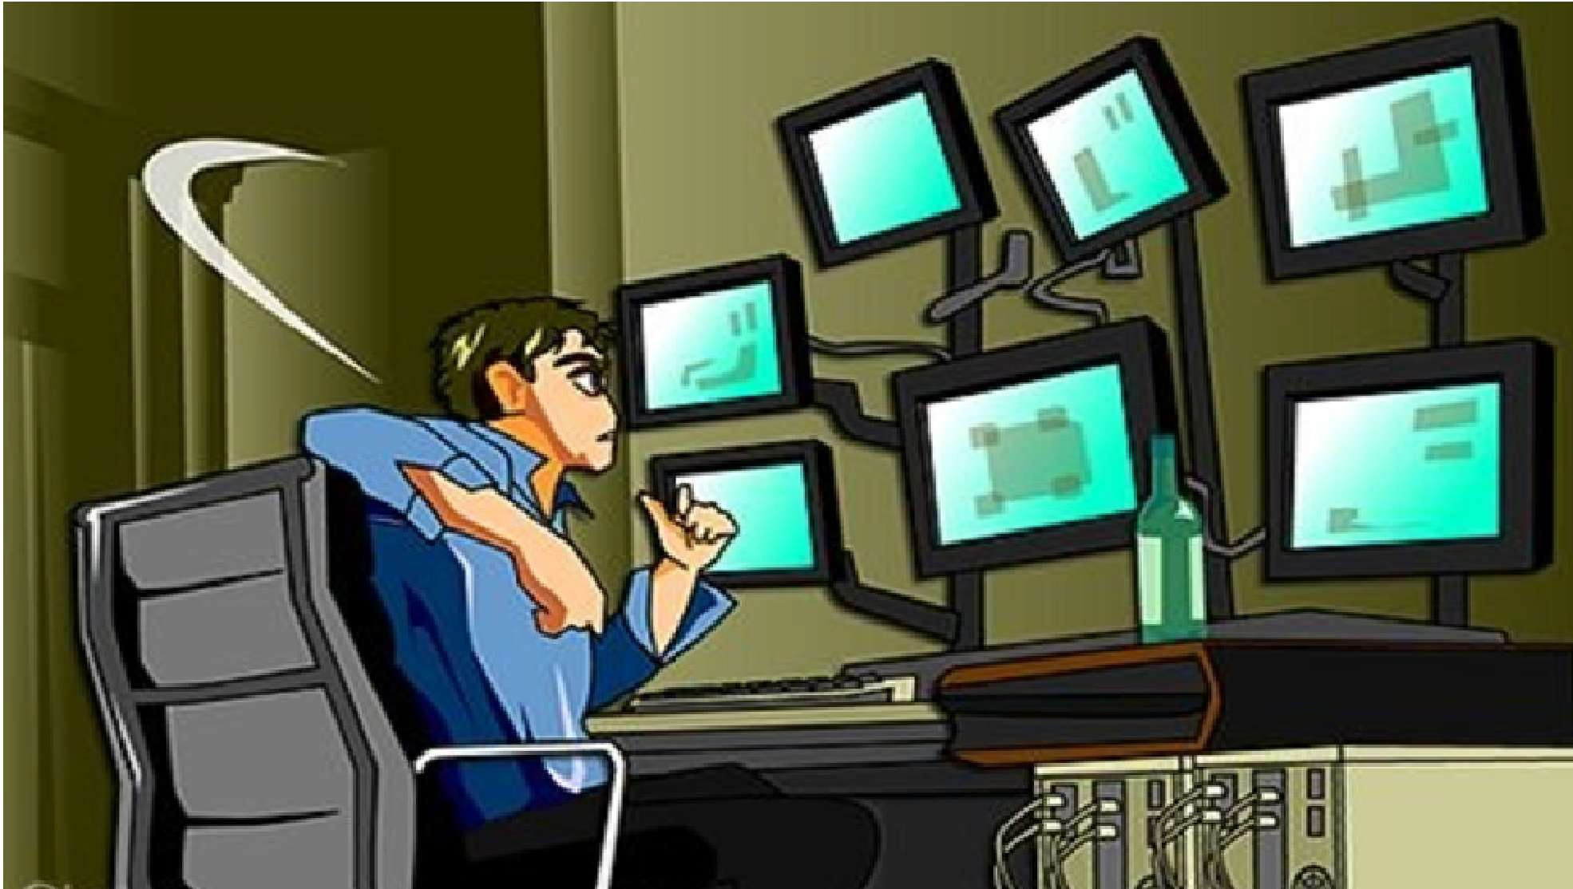

Slide 13

Network Hacking
◆ Network Hacking is generally means gathering information about domain by using tools like Telnet, Ns look UP, Ping, Tracert, Netstat, etc… over the network.

Slide 14
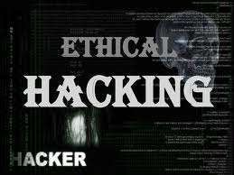

Slide 15

Ethical Hacking
◆ Ethical hacking is where a person hacks to find
weaknesses in a system and then usually patches them.

Slide 16


Slide 17

Email Hacking
Email hacking is illicit access to an email account
or email correspondence.

Slide 18
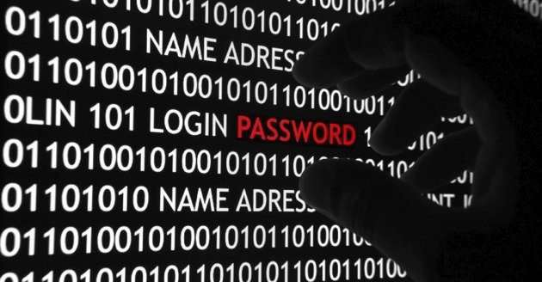

Slide 19


Password Hacking
Password Hacking Password cracking is the process of recovering secret passwords from data that has been stored in or transmitted by a computer system.

Slide 20
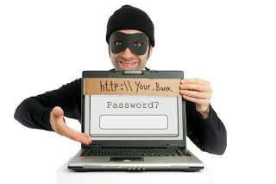

Slide 21



Online Banking Hacking
Online banking Hacking Unauthorized accessing bank accounts without knowing the password or without permission of account holder is known as Online banking hacking.

Slide 22
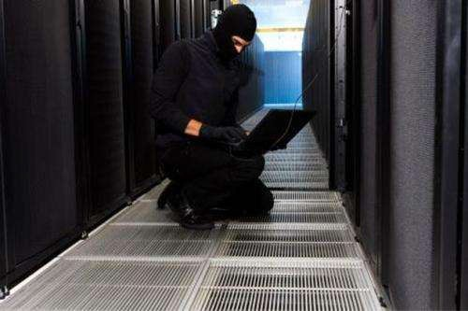

Slide 23


Computer Hacking
Computer Hacking is when files on your computer are viewed, created, or edited without your authorization.

Slide 24

What should do after hacked?
Shutdown the system
– Or turn off the system
Separate the system from network
Restore the system with the backup
– Or reinstall all programs
Connect the system to the network
It can be good to call the police

Slide 25
How to give a password to account
◆ Use unique passwords for your accounts.
◆ Choose a combination of letters, numbers, or symbols to
create a unique password.

Slide 26
How to secure our data
1 -> i or l
3 -> e
4 -> a
+ -> t
9 -> g
0 -> o
$ -> s
| -> i or l
|\| -> n
|\/| -> m s -> z
c -> [
f -> ph ph -> f x -> ck ck -> x

Slide 27

How to secure our data
◆ Ex.
◆ 1 +r4|\|$ph3rr3d R$ iooooo +0 y0ur 4[[0u|\|+ , 4$ 0ur pi4|\|.
$0 90 4h43d
◆ I transferred plan.
Rs.100000 to your account, So go ahead
as our

Slide 28



Advantages of hacking
◆ Can be used to recover lost information where the computer password has been lost.
◆ Teaches you that no technology is 100% secure.
◆ To test how good security is on your own network.
◆ They call it white hat computer hacking.

Slide 29

Disadvantages of Hacking
◆ Criminals can use it to their advantage.
◆ It can harm someone's privacy
◆ It's Illegal

Slide 30


Conclusion
Keep your password protected. Write
your password should be with
combination of characters, digits, special symbols.
Do not respond to
transection always
feck on fishing email. when you are doing any online
keep watch on site whether the protocol of site is https & whether there is a lock symbol .

Slide 31

References
www.wikipedia.org/wiki/Hacker
www.wikipedia.org/wiki/Hacking

Slide 32

Thank You

