Slide 1

Personality

Slide 2
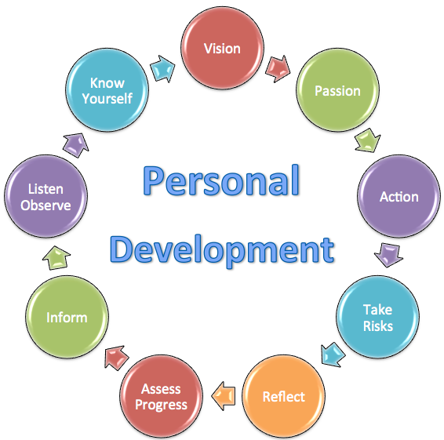

Slide 3
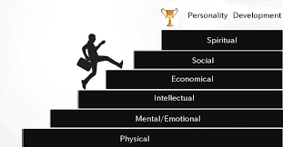
Personality refers to individual differences in characteristic patterns of thinking, feeling and behaving. Personality is a dynamic and organized set of characteristics possessed by a person that uniquely influences their environment, cognitions, emotions, motivations, and behaviors in various situations. The word "personality" originates from the Latin persona, which means Mask.

Slide 4
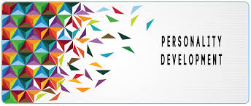

Slide 5
Personality development is the relatively enduring pattern of thoughts, feelings, and behaviors that distinguish individuals from one another
Personality development basically occurs in different phases: Infancy Toddlerhood Preschool School Age Adolescence

Slide 6
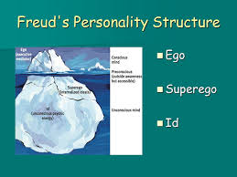

Slide 7
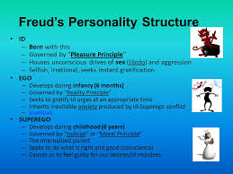
According to the ego theory of Sigmund Freud the personality structure is based on the basic id, or our primal, most instinctive primitive behaviors, on the Ego, or our actual selves, and the Superego, or the critical and moralizing (judgmental) part of our personality

Slide 8
Theories of Personality
Biological Theory of Personality.
Tripartite Theory of Personality.

Slide 9
Biological Theory of Personality
Eysenck proposed a theory of personality based on biological factors, arguing that individuals inherit a type of nervous system that affects their ability to learn and adapt to the environment.

Slide 10
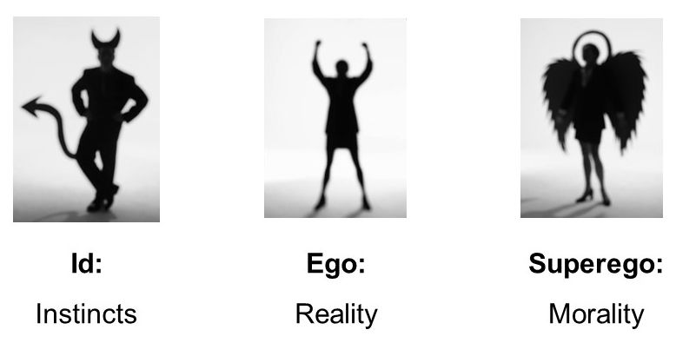
Tripartite Theory of Personality

Slide 11
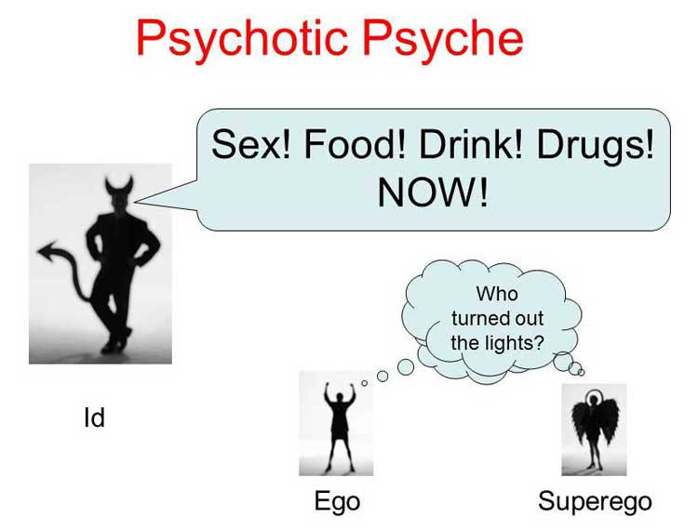
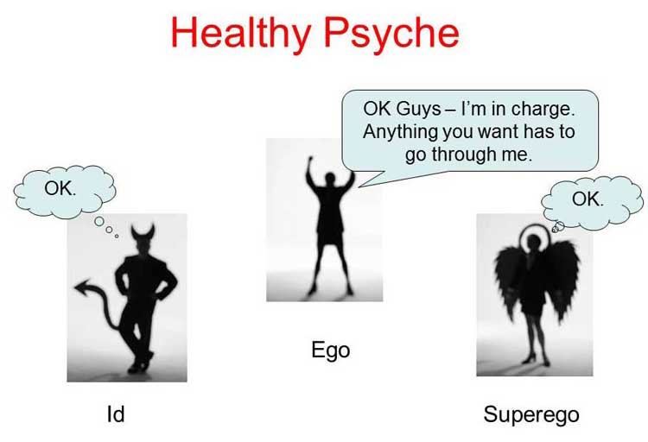

Slide 12
Biological Influences
The biological perspective on personality emphasizes the internal physiological and genetic factors that influence personality. It focuses on why or how personality traits manifest through biology and investigates the links between personality, DNA, and processes in the brain.

Slide 13
Biological Influences(cont)
Examples:
Psychosocial and Behavioral Mechanisms
Biological Influences on the Development of Challenging Behavior
Genetics, personality, psychopathy and intelligence

Slide 14
Environment Influences
Although there is definite evidence for the fact that our personalities are, at least in part, determined by genetics, there's more to it than that. In fact, our environment may shape or alter our personalities as well - not just the social environment but the natural environment around us too. Lastly, the factors in our environment that shape our personalities.

Slide 15
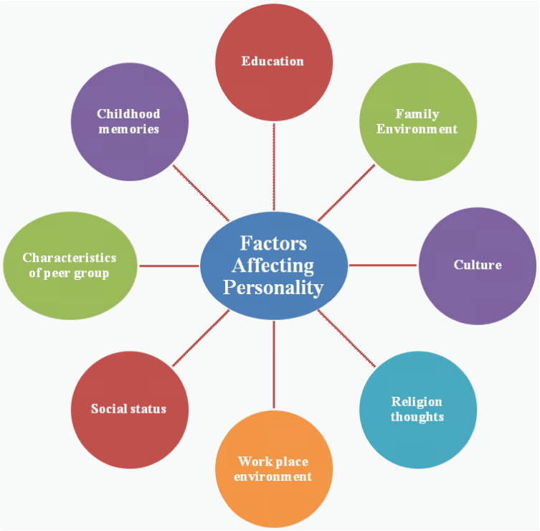

Slide 16
Environment Influences(cont)
Types of Environmental Factors:
Physical Environment
Social Environment
Family Environment
Cultural Environment

Slide 17


