Slide 1
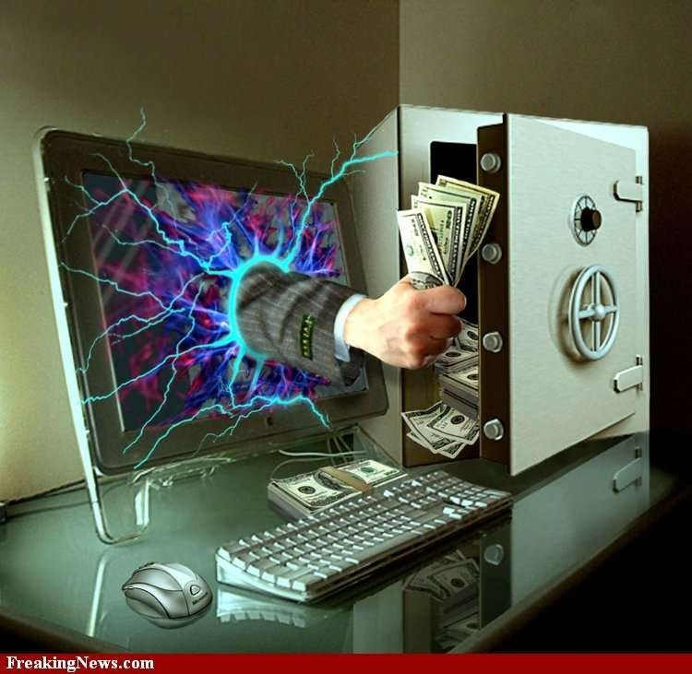


Slide 2

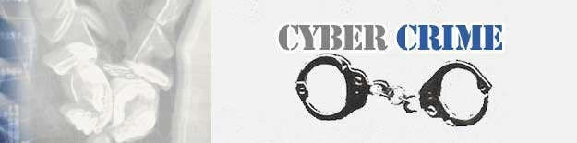
Crime committed using a computer and the internet to steal a person’s identity or illegal imports or malicious programs cybercrime is nothing but where the computer used as an object or subject of crime

Slide 3


The first recorded cyber crime took place in the year 1820 That is not surprising considering the fact that the abacus, which is thought to be the earliest form of a computer, has been around since 3500 B.C.

Slide 4


 The Computer as a Target : using a computer to attack other computers.
 The computer as a weapon : using a computer to commit real world crimes.

Slide 5

Types of Cyber attacks, by percentage (source- FBI)
Financial fraud: 11%
Sabotage of data/networks: 17%
Theft of proprietary information: 20%
System penetration from the outside: 25%
Denial of service: 27%
Unauthorized access by insiders: 71%
Employee abuse of internet privileges 79%
Viruses: 85%

Slide 6


 “ If you experienced computer system intrusions by someone from outside your organization, indicate the type of activity performed by the intruder.”
 Manipulate data integrity | 6.8%
 Installed a sniffer | 6.6%
 Stole password files | 5.6%
 Proving/scanning systems | 14.6%
 Trojan logons | 5.8%
 IP spoofing | 4.8%
 Introduced virus | 10.6%
 Denied use of services | 6.3%

Slide 7


HACKING
CHILD PORNOGRAPHY
DENIAL OF SERVICE ATTACK
VIRUS DISSEMINITION
COMPUTER VANDALISM
CYBER TERRORISM
SOFTWARE PIRACY

Slide 8



Slide 9


Hacking in simple terms means an illegal intrusion into a computer system and/or network. It is also known as CRACKING. Government websites are the hot targets of the hackers due to the press coverage, it receives.
Hackers enjoy the media coverage.

Slide 10


The Internet is being highly used by its abusers to reach and abuse children sexually, worldwide. As more homes have access to internet, more children would be using the internet and more are the chances of falling victim to the aggression of pedophiles.

Slide 11

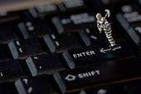
 This is an act by the criminal, who floods the bandwidth of the victims network or fills his e-mail box with spam mail depriving him of the services he is entitled to access or provide

Slide 12

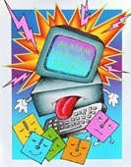
Malicious software that attaches itself to other software. (virus, worms, Trojan Horse, web jacking, e-mail bombing etc)

Slide 13
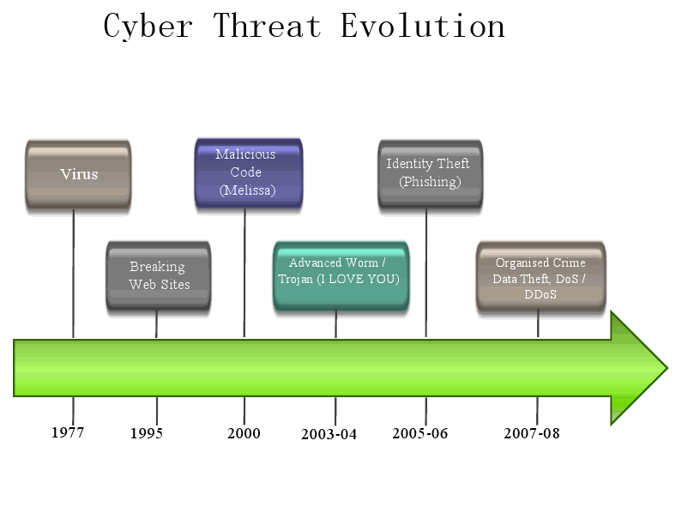

Slide 14


Damaging or destroying data rather than stealing or misusing them is called cyber vandalism. Transmitting virus: These are programs that attach themselves to a file and then circulate .

Slide 15


Terrorist attacks on the Internet is by distributed denial of service attacks, hate websites and hate emails, attacks on sensitive computer networks, etc. Technology savvy terrorists are using 512-bit encryption, which is impossible to decrypt.

Slide 16


Theft of software through the illegal copying of genuine programs or the counterfeiting and distribution of products intended to pass for the original.

Slide 17

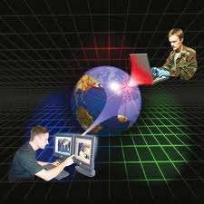
Internet security is a branch
of computer security specifically related to the Internet.
It's objective is to establish rules and measure to use against attacks over the Internet.

Slide 18



Slide 19


Use antivirus software’s
insert firewalls
uninstall unnecessary software
maintain backup
check security settings
Stay anonymous - choose a genderless screen name
Never give your full name or address to strangers

Slide 20


Learn ‘inetiquette' - follow it and expect it from others
Don't respond to harassing or negative messages (flames)
Get out of uncomfortable or hostile situations quickly
Save offending messages
Learn more about Internet privacy

Slide 21



Slide 22

 The cyber security will defend us from critical attacks.

It helps us to browse the safe website.
 Internet security process all the incoming and outgoing data on our computer.

Slide 23


 security will defend from hacks and virus.
The application of cyber security used in our PC needs update every week.
 The security developers will update their database every week once. Hence the new virus also deleted


Slide 24
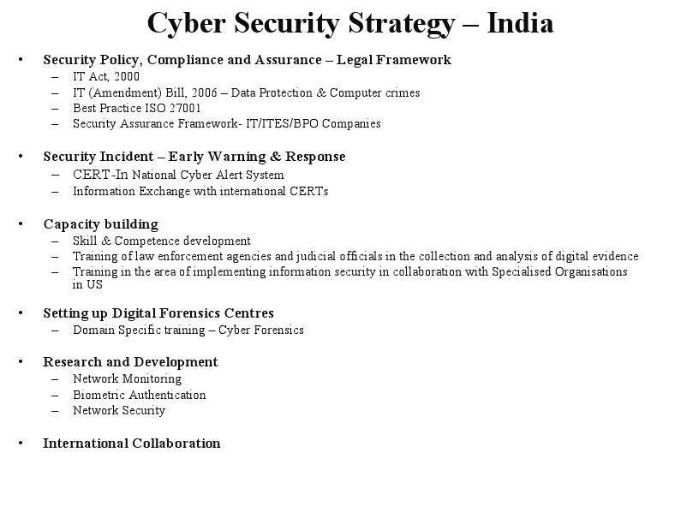

Slide 25

Technology is destructive only in the hands of people who do not realize that they are one and the same process as the universe.
Alan Watts
“Technology is like a fish. The longer it stays on the shelf, the less desirable it becomes.”

Slide 26


